Slide 1
Welcome!
Nagios World Conference 2012

Slide 2
What Is Nagios?

Slide 3
Technology is Ubiquitous
It makes our lives easier
It makes systems work
It makes business run

Slide 4
Technology is great!
Except when it breaks
At the worst time
When you don’t expect it
And you weren’t the first to know
And can’t fix it fast enough
And need to find a new job

Slide 5
What Nagios Does
Monitors entire IT infrastructure
Identifies problems
Alerts appropriate staff

Slide 6
What Nagios Provides
Increased uptime
Faster problem resolution
Peace of mind

Slide 7
Nagios Monitoring Solutions

Slide 8
Nagios Core
Monitoring engine
Alerts and notifications
Extendable
Nagios Core
Plugins
Addons

Slide 9
Nagios XI
Dashboards
Web configuration
Auto-discovery
Advanced reports
Easy-to-use
Nagios XI
Wizards, Components
Nagios Core
Plugins
Addons

Slide 10
Nagios Fusion
Central dashboard
Multiple servers
Authentication
Reports
Nagios Fusion
Nagios XI
Nagios Core
Nagios XI
Nagios Core
Nagios XI

Slide 11
Recent Developments

Slide 12
Project Development
700 new projects
3500 projects
exchange.nagios.org

Slide 13
Nagios Core 4
Worker Processes
Internal Structure
Performance
Scalability
Nagios Core
Worker
Worker
Worker
Worker

Slide 14
Nagios XI 2012
Bulk management
Capacity planning
Scheduled reporting
Audit logging
Advanced reporting
More wizards

Slide 15
Nagios Fusion 2012
Centralized reports
New visualizations
Fused graphs

Slide 16
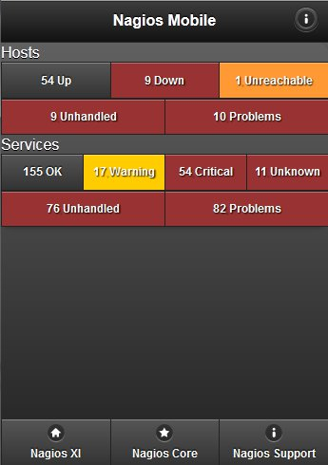
Nagios Mobile
Remote access for XI, Core
Acknowledge problems
Schedule downtime
Disable notifications

Slide 17
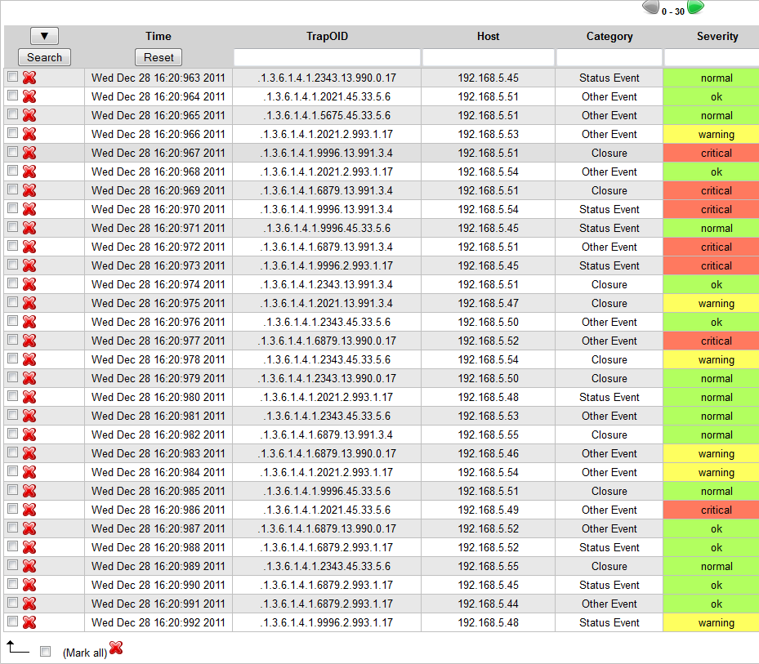
NSTI
Manage SNMP traps
See unhandled traps
Integrates with XI, Core

Slide 18
NRDS
The Problem:
How to monitor remote devices?
How to monitor roaming devices?
How to update remote configs?
How to install remote plugins?
Nagios
Win/Lin/Mac

Slide 19
NRDS
Passive monitoring agent
Built on NRDP
Centralized configuration
Automatic plugin deployment
Nagios server is public
Nagios
Win/Lin

Slide 20
NRDS In Nagios XI
Web-based wizard
Easy client installation
Plugins deployed from server
Monitoring data sent passively

Slide 21
Upcoming Solutions

Slide 22
Nagios Reflector
The Problem:
How to monitor remote devices?
How to monitor roaming devices?
Two Firewalls + NAT
Nagios server is private
Nagios
Win/Lin/Mac

Slide 23
Nagios Reflector
Hosted service
Monitor remote machines
Public reflector
Punch through firewalls
Supports NRDP + NSCA
Nagios
Reflector
Win/Lin/Mac

Slide 24
Nagios Reflector In Nagios XI
Register online
Configure client
Run wizard in XI
Select items to monitor

Slide 25
NPush
The Problem:
How to simplify agent installation?
How to modify remote config?

Slide 26
NPush
Automatically deploy agents
Customized deployments
Deploy, configure, go!
Install, uninstall, reconfigure
Nagios
Windows

Slide 27
New Products Under Development

Slide 28
Nagios Incident Manager
Incident/Issue Management

Slide 29
Nagios Incident Manager
Lightweight ticketing system
Teams and users
Attach notes, files
Integration with XI and Core
Callback API

Slide 30
Nagios Network Analyzer
NetFlow and sFlow Monitoring

Slide 31
Nagios Network Analyzer
Who’s using what?
NetFlow and sFlow
Usage graphs
Custom queries
Integration with XI and Core

Slide 32
Nagios Reactor
Event Handler and Workflow Management

Slide 33
Nagios Reactor - Goals
Make event handlers easier
Web-based configuration
User-definable event chains
Include common tests and actions
Allow for custom tests and actions

Slide 34
Nagios Reactor - Event Chains

Slide 35
Nagios Reactor - Event Chains

Slide 36
Nagios Reactor - Event Chains

Slide 37
Nagios Reactor - Event Chains

Slide 38
Nagios Reactor - Event Chains

Slide 39
Nagios Reactor - Event Chains

Slide 40
Nagios Reactor - Event Chains

Slide 41
Nagios Reactor - Event Chains

Slide 42
Nagios Reactor - Event Chains

Slide 43
Nagios Reactor - Event Chains

Slide 44
Nagios Reactor - Event Chains

Slide 45
Nagios Reactor - Event Chains

Slide 46
Nagios Reactor
Event chains
Workflows
Steps
Conditions
True/False actions

Slide 47
One More Thing

Slide 48
For Attendees
Your choice of free product license
go.nagios.com/attendees

Slide 49
Thank You
-
Enjoy The Conference!

