Slide 1
Title
Monitoring the User Experience
for Availability and Performance
Nathan Vonnahme
Nathan.vonnahme@bannerhealth.com

Slide 2
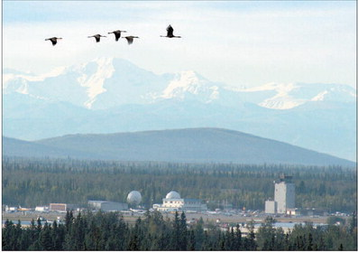
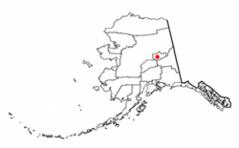
Hi from Fairbanks
~100,000 people
Notes:
Photos: http://www.newsminer.com/pages/features_our_town/

Slide 3
Not very big
Fairbanks Memorial Hospital
~150 beds
~1500 employees; ~40 IT dept.
around 300 production servers (~75% Vmware)... roughly 400 "apps“
24x7x365.25 as only healthcare can be
Nagios monitors 113 hosts (includes some devices like switches and UPSes), but 442 services.
Nagios in the gaps
Notes:
Photo: http://www.uaf.edu/files/news/featured/03/tvc/index.html

Slide 4
Context
Last year: “Monitoring and Test Driven Development”

Slide 5
Last year – central idea
Monitoring tools are to the sysadmin what testing tools are to the developer.

Slide 6
Last year

Slide 7
Last year: “Not a CI [Continuous Integration] tool”
Not as coupled to build processes
We don’t build most of our software!
Strengths in flexibility, alerting, production monitoring
Potentially weak in being IT-focused instead of customer-focused.

Slide 8
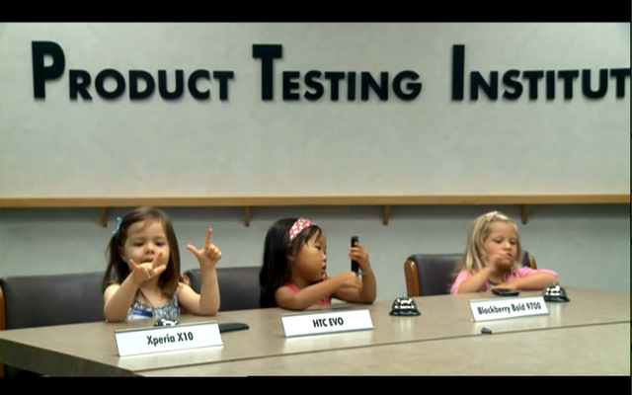
QA and the Manufacturing Metaphor
Testing the end product

Slide 9
The main idea
Can users actually use it?
Does it suck?

Slide 10
Availability: Can users actually use it?
If the database server won’t ping, that’s obviously important.
If the network is down, duh.
But is your monitoring coverage good enough to prove that your end product is delivering?
Notes:
Image: http://availabilityadvisor.com/2012/01/10/how-much-availability-is-enough/

Slide 11
Performance: Does it suck?
Let’s be objective.
The user doesn’t care why.
Notes:
Les Claypool: Primus performance sucks! Image http://www.thehazardreport.com/2012/09/primus-sucks-at-club-nokia-part-ii-2010.html

Slide 12
It matters
THIS IS NOT AN IPHONE 5!
“I started to learn that the days when I was happiest were the days with lots of small successes and few small frustrations.” –Joel Spolsky
Notes:
Quote from “Controlling Your Environment Makes You Happy” http://www.joelonsoftware.com/uibook/chapters/fog0000000057.html
----- Meeting Notes (9/24/12 15:05) -----
THIS IS NOT AN IPHONE 5!

Slide 13
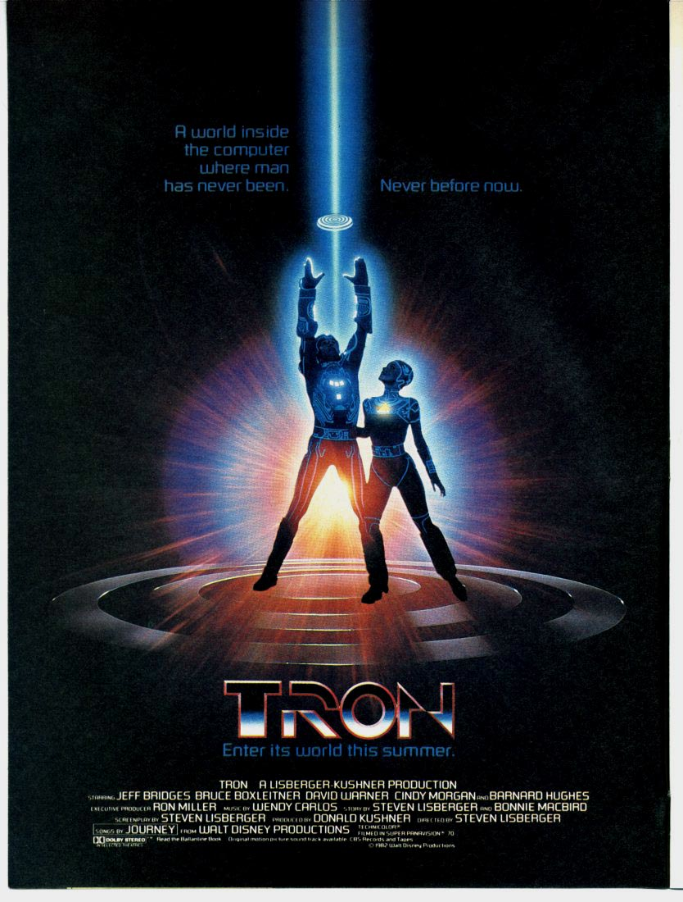
Two examples
A mission-critical legacy Windows app with a complicated architecture
A cooler modern web app

Slide 14
Legacy windows app

Slide 15
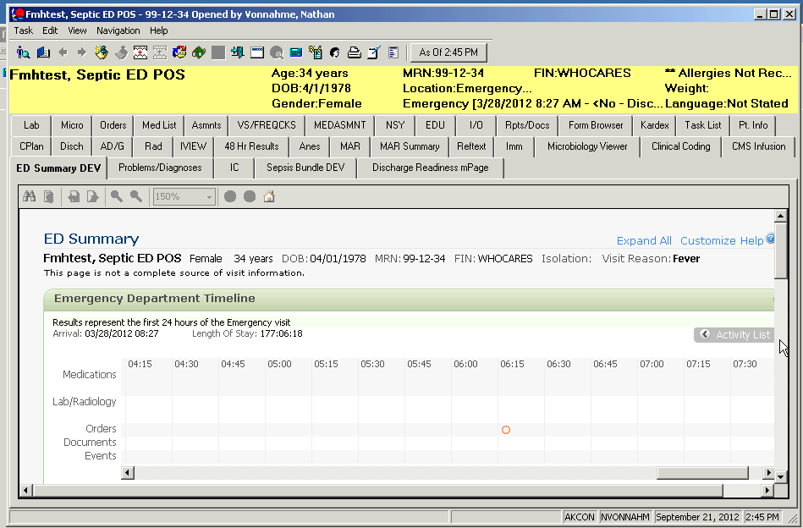
Cerner Electronic Medical Record
Note: Only fake patients in this presentation.

Slide 16
Complex architecture
SAN
AIX
Oracle
Middle-ware
Another SAN
VMWare
Windows
Citrix
Network
Desktop
Every-thing x 2 for High Avail-ability

Slide 17
A quick definition of Citrix
The users are remote-controlling the application running on the Citrix server.
The “client” runs on the Citrix server. The user’s actual workstation runs a “thin client”.
90% or more of Cerner customers use Citrix.
For comparison: old school “fat client”

Slide 18
Complex support team
Notes:
Image: http://www.couriermail.com.au/spike/columnists/blame-game-in-full-swing-amid-election-2010-fallout/story-e6frerex-1225911543729

Slide 19
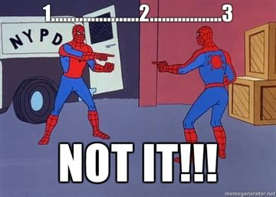
Complex monitoring
Not just Nagios for monitoring.
Most things are well-monitored by Somebody
Certain things are “lost and found” and Nobody wants to touch them.
Notes:
Img http://axtonlennox111.deviantart.com/art/1-2-3-NOT-IT-dam-242775890

Slide 20
Can the users actually use it?
AutoIt lets us drive it like a user.
Log in
Search for a (fake) patient
Open the patient’s chart.

Slide 21
Do it live.

Slide 22
The Live Demo
Interactive demo with a test patient in production.

Slide 23
Runify
"c:\program files\nsclient++\scripts\check_powerchart.exe" fat –w5,1,1 -c40,5,5
Compiled .exe
Use fat or citrix client
WARNING if more than 5,1,1 seconds for login, search, chart
CRITICAL over 40,5,5

Slide 24
The AutoIt Script
Open in SciTE and glance through.
Note, Nagios.com has a couple of good articles by Sam Lansing about using AutoIt.
Also see the presentation he did just before this one!

Slide 25
NSCP config
[/settings/external scripts/scripts]
check_ctx = scripts\check_powerchart.exe citrix -w20,5,5 -c40,5,5
check_fat = scripts\check_powerchart.exe fat -w20,5,5 -c40,5,5

Slide 26
Gotchas: too many running at once
Runs a KillHungProcesses() routine at beginning and end to clean them up.
Also set max_check_commands=1 in config for this host.

Slide 27
Gotchas: Occasional popups
AdlibRegister("HandleRelationship")
Func HandleRelationship()
If WinActive("Assign a Relationship") Then
Send("cc{ENTER}")
EndIf
EndFunc
...
AdlibUnRegister("HandleRelationship")
Notes:
AdlibRegister basically runs every quarter second until unregistered.

Slide 28
Gotchas: Stupid typer
I repeatedly mistakenly added lines to the wrong section of the nsclient.ini file.
Notes:
Img http://livelovelaugh-lace1013.blogspot.com/2008_10_01_archive.html

Slide 29
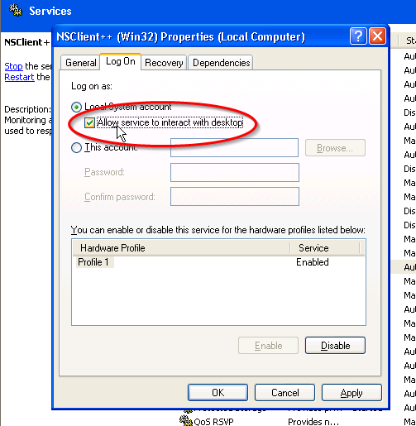
Gotchas: Service vs. Interactive GUI

Slide 30
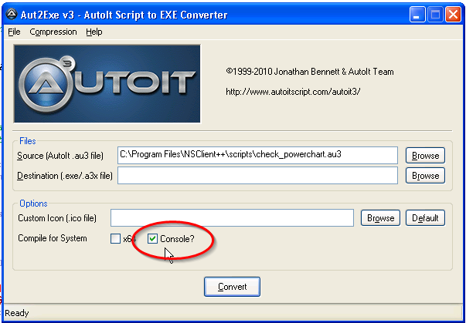
Gotchas: AutoIt output to STDOUT
You have to compile to .exe with
“Console” checkbox or
/console switch on commandline aut2exe compiler
"%programfiles%\Autoit3\aut2exe\aut2exe.exe" /in check_powerchart.au3 /console /nopack
Notes:
This is why the nagios.com article uses notepad to write output to a file… I guess it works!

Slide 31
Gotchas: Annoying phantom icons in the tray
Slow too!
Solution: LP#TrayIconBuster

Slide 32
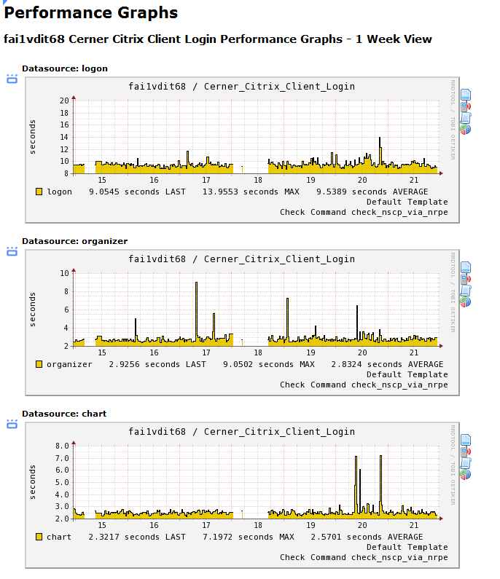
The results: Citrix
1 week of 15 minute samples

Slide 33
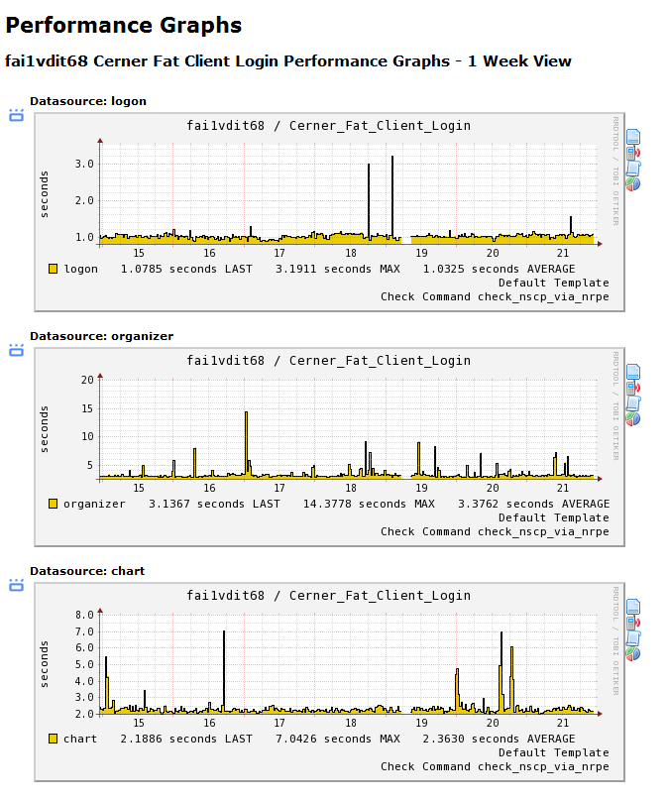
The results: Fat client
Note the much different Y axis scale

Slide 34
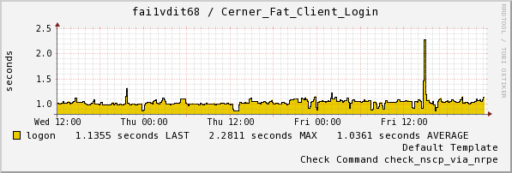
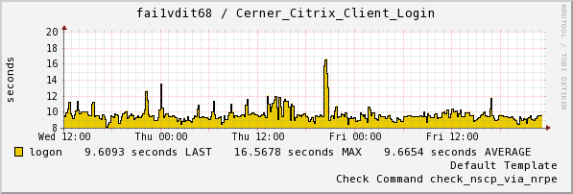
Citrix vs Fat: icon to login (zoomed to 1.5 days)
PATHETIC
Notes:
This Citrix performance is what we actually deliver to our users. Note how much more erratic it is too.

Slide 35
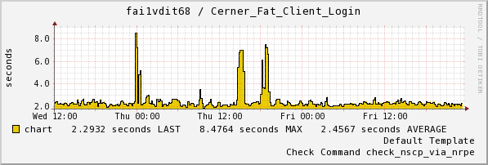
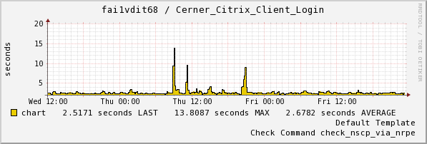
Citrix vs Fat: open one patient’s chart
Notes:
Much more similar Y scale– the performance doesn’t change that much.
This makes the spikes much more interesting. What was going on with the backend on Thursday?

Slide 36
The advantages
Continuous monitoring of the end product
Nagios alerting, escalating, whatever.
Control/experiment
Just the two (Citrix vs fat) tell us a lot
We have a historical benchmark to compare anomalies with
We’ve already identified a symptomatic Citrix problem we can treat with a Nagios event handler.

Slide 37
Still TODO:
Thresholds don’t yet affect OK/WARNING/CRITICAL
Thresholds in perfdata
Make it less noisy for less ignorable notifications
Make it run more often with tighter thresholds now that we have a benchmark.
Move it to a dedicated VM/user accounts
More experiment groups
No antivirus
No Citrix printers
No VMWare (fat, no Citrix)

Slide 38
Questions/comments about this example?

Slide 39
Modern web app

Slide 40
Demo
fairbanks.bannerhealth.com/ cpoe_ordersets
It’s not a fair comparison, just an example.

Slide 41
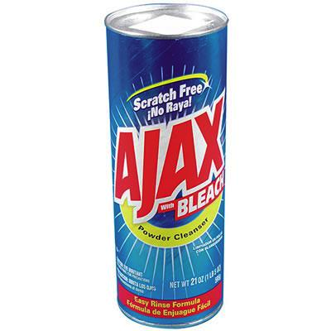
Modern == Ajax
Notice there’s not a full page load.
How do we tell if users can actually use this?
How can we tell if it sucks?

Slide 42
Options: Perl/PHP
I’ve done this… Symfony functional scripts, for example.
They’ll never do JavaScript or AJAX.
I worry it won’t match the top level, what the user sees.

Slide 43
Options: Selenium
Runs a real browser or browsers, kind of like AutoIt
Other people are using it quite successfully (e.g. Nathan Broderick 2011; Sam Lansing 2012)
I have not gotten into it… images of too many browser windows?
Not very mobile-like

Slide 44
PhantomJS
Headless webkit
As of July 2012 [webkit] has the most market share of any layout engine at over 40% of the browser market share according to StatCounter.
-- http://en.wikipedia.org/wiki/WebKit

Slide 45
PhantomJS
Allows you to write client scripts in JavaScript, executed by its own fast V8 engine
“Always bet on JS” – Brendan Eich, original author of JavaScript
JavaScript is funny in that most people don’t actually learn it before they start using it. – Douglas Crockford (paraphrase), author of JavaScript: The Good Parts

Slide 46
CasperJS
Nicer JS API on top of PhantomJS
Notes:
----- Meeting Notes (9/24/12 15:05) -----
need darker background

Slide 47
SHOW ME THE CODEZ
Quick Walkthrough in Aquamacs or Gist
Demo failure + screenshot

Slide 48
Works on Nagios XI host
A little bit heavy (it is firing up a WebKit)
Zombiejs looks promising as a lighter (pure JS in Node) JS-capable headless browser
Quick CasperJS install instructions on my blog, n8v.enteuxis.org

Slide 49
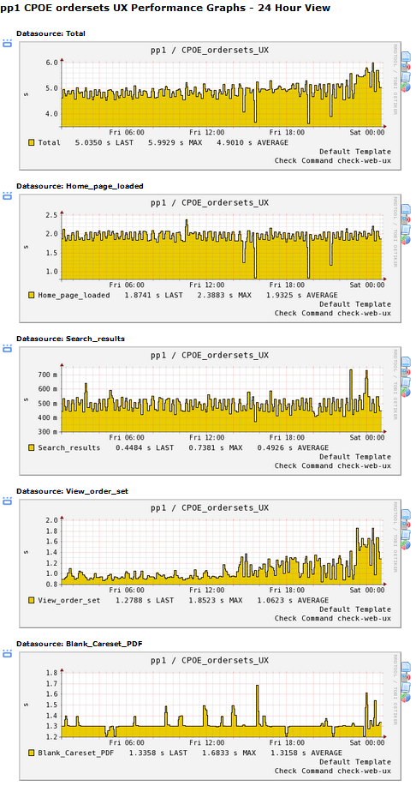
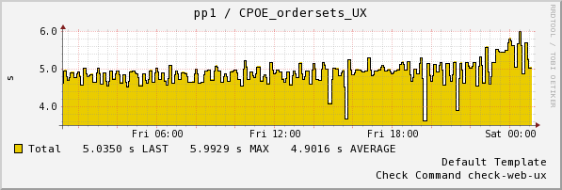
The results – 10 minute interval
Boring… note total amplitude.

Slide 50
The benefits
Ongoing assurance that it is basically usable
If it’s usable, all its layers must be working.
Benchmarked performance so we can evaluate the end result of changes

Slide 51
Still TODO
Check timestamp at bottom of page
Run the same checks on an internal development version
Upgrade jQuery UI and see if performance changes
Check from an Internet host

Slide 52
Main idea again
Can the users actually use it?
Does it suck?

Slide 53
Concluding Questions/comments
JS Sample Code at gist.github.com/n8v
Email me if you want the AutoIt code.

Slide 54
Sneak peek
./check_facebook_friends.js -u nathan.vonnahme -w @202 -c @203
Come to my other talk, “Writing Custom Nagios Plugins” Friday morning to see how it works.

