Slide 1
Proactive Alerting & Intelligent Communication
Abbas Haider Ali
October 16, 2014

Slide 2
Notes:
Canadian (out of Toronto)
IBM – field services for IBM Global Services all across Ontario (big region!)
OPNET – network simulation, network design, application performance. Basically super network nerd.
Managed Objects – Business Service Management to translate infrastructure into real services. How does a drive failure translate into ability to execute trades? What’s the impact to a hospital of a campus network outage.
xMatters – Intelligent communication to allow people to receive & take action on info from wherever they are. For IT that means that when a critical bllinking red light needs someone’s attention. xMatters is on hand to deliver it. Involves lots of decision making to get it to the right person, at the right time, with the right content, right responses so that you can move things forward. Specific scenarios coming later.

Slide 3
Notes:
Let’s talk about a specific persona – Network Engineer – Could be a Unix admin, DBA, Middleware experts, App dev, project manager, IT exec, etc.
We all serve different roles. Network person could be working an escalated ticket, deploying a new site, upgrading the DC, assigned to a major app project, testing changes to be rolled on the weekend, and be part of a buying decision for new tech. All at the same time.
http://techcafeteria.com/blog/wp-content/uploads/2014/05/wpid-wp-1400673294349.jpeg

Slide 4
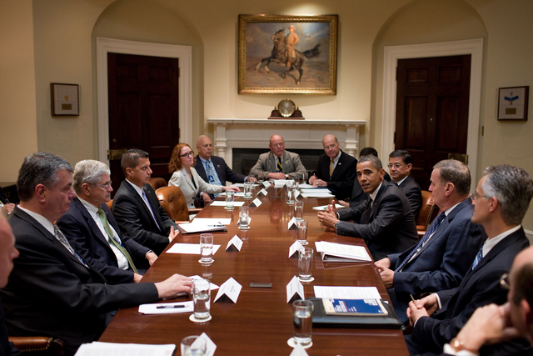
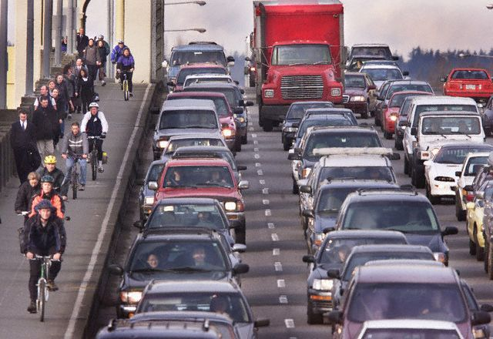
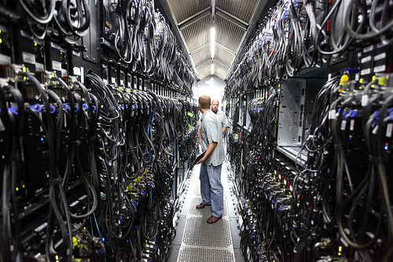
Top 5 places you’re likely to be when needed
Notes:
Because it’s so many roles, people run 24/7 which means that you have to be able to connect with them when that person is specifically needed but leave them alone when it’s not necessary.
http://bitsandpieces.us/2012/02/27/uh-oh-2/

Slide 5
Incident Management
Accept tickets
Reject tickets
Update tickets
Close tickets
Chase tickets
Escalate / Hand off tickets
FYI execs
FYI / feedback users
FYI stakeholders
Change Management
Approvals
Scheduling
Alert impacted parties
Successful completion
Rollbacks / Failures
Emergency changes
Operations
Verify impact
Quick fix
Avoid “red” consoles
Create ticket
Initiate Major Incident
Know who to call
Major Incident Mgmt
Initiate conference calls
Pull people onto bridges
Add people to bridges
Update responders
Update service owners
Update execs
Update LOB stakeholders
Update users
Automation
Detail on failures
What else is impacted
Run diagnostic steps
Attempt to resolve
People Requirements
Don’t forget about me
Don’t disturb me
Don’t spam me
Reduce volume
Reduce noise
Call me if it’s urgent
Text me if it’s important
Sample wishlist for an IT alerting platform
Notes:
Ask any org about what they want an IT communication hub to give them and you’ll get a wide range of answers. Process stuff. Features. Integrations. People stuff. All kinds. And this is just poking at some basic areas. And it’s largely from the IT team’s perspective. Don’t forget execs, stakeholders, partners, customers. They all have a hand in pulling off an effective communication strategy.

Slide 6
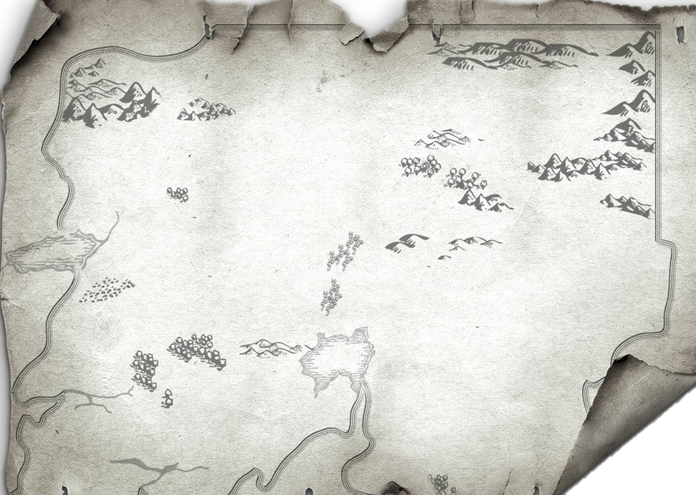
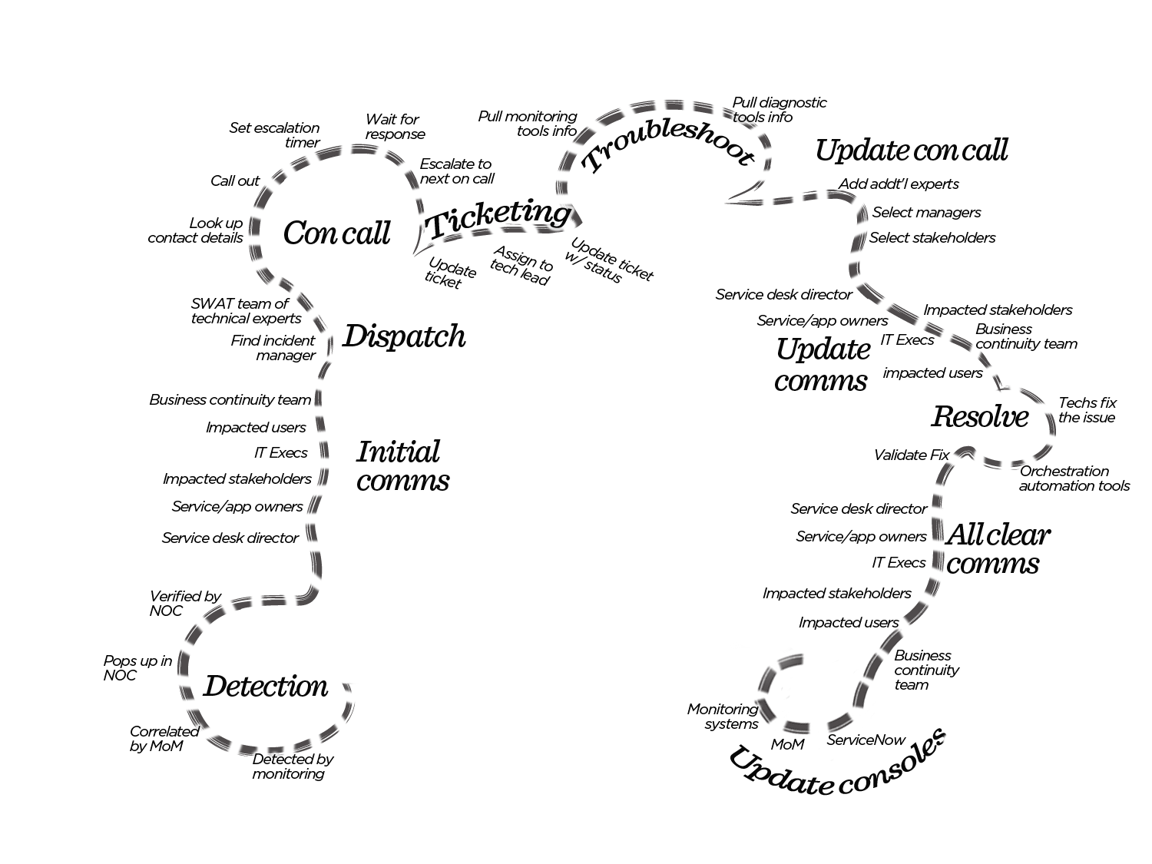
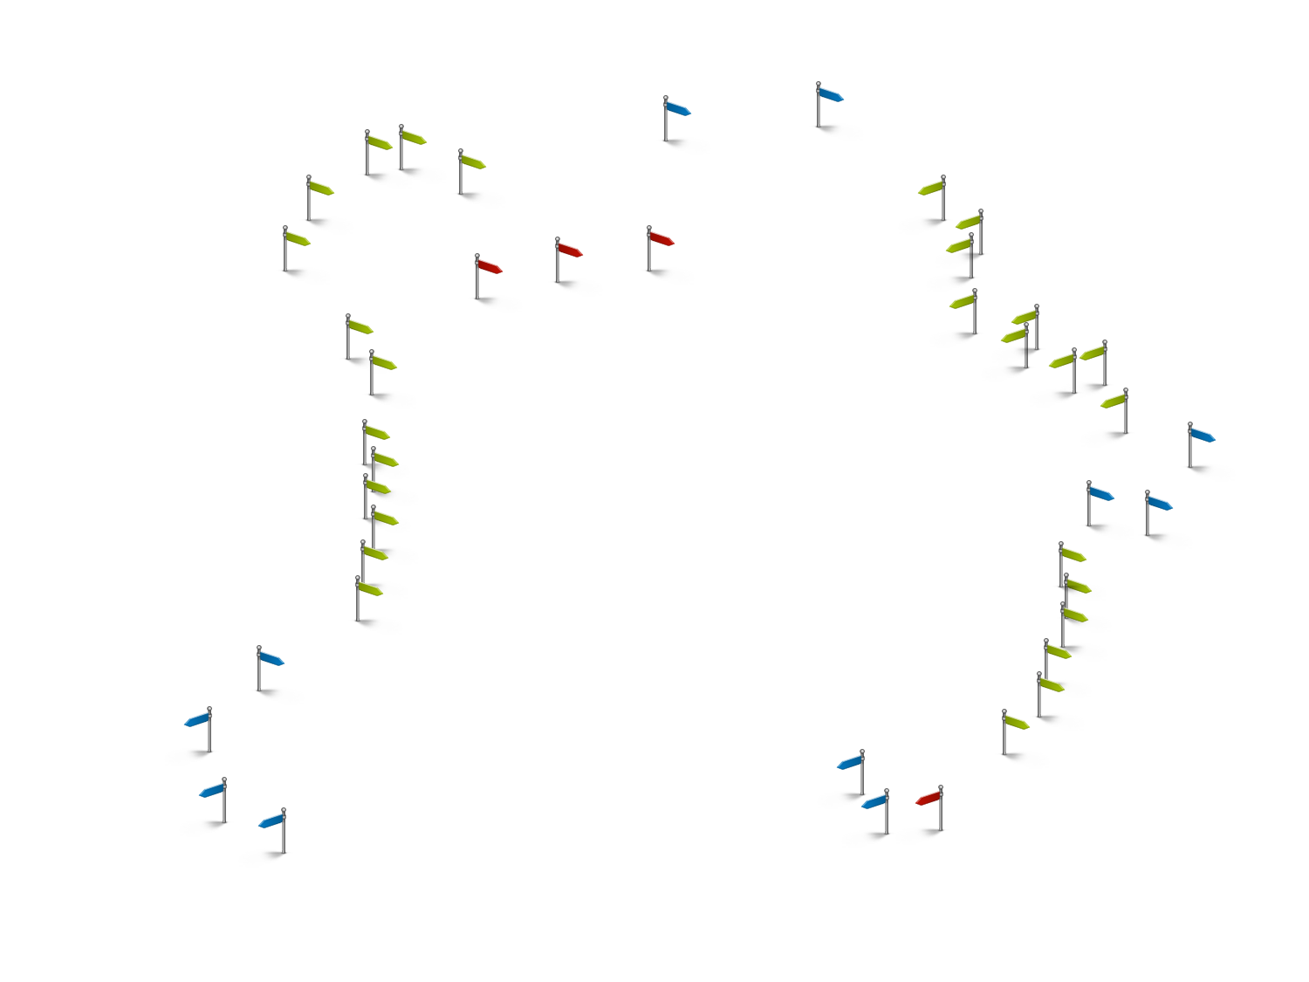
Notes:
Let’s pick something that should be easy. Incident. Something goes wrong that people are noticing, and we’re going to fix it.
When you look at the actual steps that take place from point detection to resolution to closing and updating all of our systems, it’s like navigating Middle Earth.

Slide 7
With major incidents, all bets are off
Notes:
And just when you think you’ve got the process understood with all it’s twists and turns, you get into major incidents when the rules are different and things are even more visible and time sensitive.

Slide 8
SaaS
Integrations
Audit trail
Synchronized
Notes:
http://www.xmatters.com/resources/category/resources/case-study/
Centrica is a leading gas supplier and integrated energy company, based out of the UK
xMatters clients for a number of years, but using our legacy on premises tech. Migrated to SaaS for velocity, elasticity, lower operating costs, and more capabilitiies.

Slide 9
Transparency & Accountability
E2E automation
Reporting & Analytics
Notes:
http://www.xmatters.com/resources/category/resources/case-study/
E2e integration and automation, monitoring – ticketing – alerting – all the way back. 2.5m response time.
Integration for data synch. Integration for onboarding/offboarding. Integrate for documentation.

Slide 10
Mobility
Eliminate alert fatigue
Delivery channel diversity
Accurate IT consoles
Notes:
http://www.xmatters.com/resources/category/resources/case-study/
Largest pawn load and payday loan provider in the world
Thousands of stores all counting on IT to run the business
Mobility is key

Slide 11
Eliminate people runbooks
On-call schedules
Escalations
Dynamic groups
Geotagged groups
Notes:
http://www.xmatters.com/resources/category/resources/case-study/
Dynamic teams, Geo-tagged groups, Escalations, scheduling, subscriptions all in the name of auto-routing and intelligent communications

Slide 12
Collaboration
Reduce over-engagement
Team analytics
Elasticity
Notes:
http://www.xmatters.com/resources/category/resources/case-study/
Collaboration – con calls.

Slide 13
Communication hub
Process specific messaging & responses
Fine tune integrated systems with feedback loops
Notes:
http://www.xmatters.com/resources/category/resources/case-study/
2M people need to get paid
Batch jobs make it happen

Slide 14
Integrations – end to end
Reduce noise, improve targeting
Collaboration
Tailor inputs, messages, and responses by process & audience
Mobile
Security & compliance
Reporting & Analytics
7 key things to make it work
Notes:
When you look across all of our clients and the things that lead to actual success (measured after deployment, not theoretical), 7 common themes emerge that make it happen.

Slide 15
OR
A lot of you are thinking it, so let’s get it out in the open…
Notes:
39. Ray or Kumar?
- People always ask after sessions, so I'll beat you to it :)

Slide 16
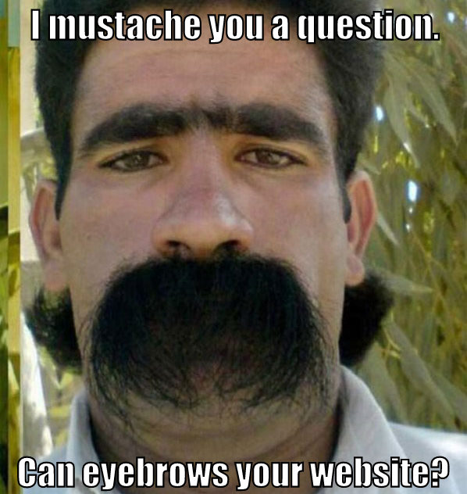
Q&A
Notes:
Q&A – More info on website of course!

Slide 17
Proactive Alerting & Intelligent Communication
Abbas Haider Ali
October 16, 2014

