Slide 1
The experience of inheriting a Nagios monitored environment
Anna-Sofia Lejman
anna-sofia.lejman@vixtechnology.com
Notes:
I will talk about the experience of inheriting a Nagios monitored environment

Slide 2



About me
From Sweden
Been into IT since 1999
Works at
VIX Technology
Supporter of
Nordic Garrison
CRazy cat lady
Notes:
Works at VIX. International company ed with servicedesk, secondline support, user administration
and now I am ITIL event manager and Nagios administrator at our office.
Work at VIX – international company, our region provides a validation system for public transport
Nordic Garrison - part of 501st legion , uses their biggest interest to help others
Anyone familiar? Creates exact replicas of the costumes from villains in starwars movies
Attends events like
A sucker for kitties, aiming for crazy cat lady title. Only have 1 though,
may have to get a starter kit

Slide 3
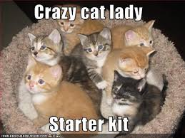
Starter Kit

Slide 4
Agenda

Slide 5
Agenda
  Implementing Nagios
  Conclusions
  Tips and tricks
  Questions

Slide 6
Implementing Nagios
-The background

Slide 7
Vix Technology
Notes:
Rembember ticket validation for public transports?
= purchase ticket, validate it when starting journey – not thrown off

Slide 8

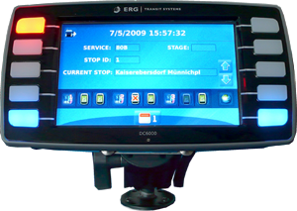
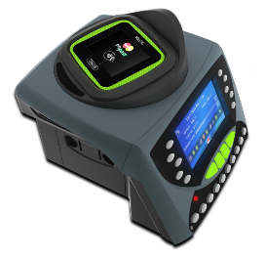
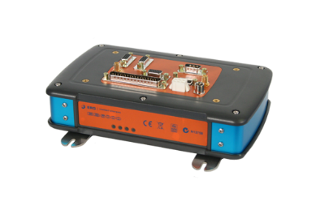





Ticket validation
Current Range of iValTM Devices
Processor Boards
  Viper Processor Board
Bus Computers
  DC Range (Driver Console)
  TP Range (Ticket Processor)
  EB Range (Bus Computer)
Patron Devices
  CP Range (Card Processor)
  CR Range (Card Reader)
  V Range (Combination Validator)
  ST Range (Platform Validator)
  PCP Range (Platform Validator)
Notes:
Means a bunch of FO devices connected to a BO system
Has to work or people will notice

Slide 9

Why Nagios?
Automation
of manual checks
Measuring service uptime
Monitoring 24/7
Automatic incident Creation
Notes:
To make sure our system was up and running, we had daily health checks
some automatic checks but had to get away from the manual ones -too much time.
A way to automate those manual checks
Another office in Australia already used Nagios – could set us up on their server.
Sounded great, as we would get a better measuring of service uptime + around the clock monitoring.
Also connect the Nagios alarms to incident handling system - automatic incidents from the alarms.
Sounded pretty good!

Slide 10
Implementing Nagios
-The Project
Notes:
So we started up a project for it

Slide 11
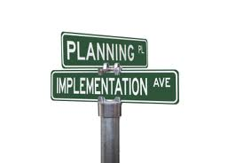
Implementation
Developing
testing
Implementing
Into
production
Oops!
Notes:
Our australian colleagues developed the checks - gave them the checklist for our manual checks.
I was on the projectteam as a technical resource – had performed the manual checks
After a while we had something ready for testing
Wanted to do this by the book, tested in test environment + acceptance
Small problem – the resources collided, other projects more business critical
Environments busy + testers busy.
The only solution - do the testing at nights.
Guess who?
So after testing – implementation. Roll out in production!
What do you think happened next?

Slide 12

What happened next?

Slide 13

Ok, not that bad
errors in Checks
Errors in
Specs
Thresholds
too low
Incidents!
Notes:
Ok not that bad – most checks worked as they should. 10 checks on 50 hosts= lot of alarms
Errors in checks –
Some checks could not be tested. The other projects testers did not want crappy data flowing through the system, that could affect their results.
So some of the checks had errors that didnt show up until they hit production
Errors in specs – based on the manual checklist
For example a file generation taking place a specific time of day.
Manual checks were run some time after this.
Check file generation NOT STILL RUNNING, hanged.
= Nagioscheck reported critical each time file generation ran.
Thresholds too low –a batch job would hog all the memory for a few hours during night time
Wasnt in the spec, no checking during that batch job
All this lead to a lot of incidents! Servicedesk was not happy with me the first weeks.

Slide 14

What to do?
Troubleshoot
Call the developer
Request help
from developer teams
Manager
Notes:
Did troubleshoot as best I could. Didnt know the system well, but could
change thresholds,, very simple changes in scripts
Called developer – helped out with some of the errors. Got another position and moved to Thailand shortly after
Nice guy – tried to help out as much as he could but simply did not have the time
Could his boss assign someone else? Sent list of things we needed help with.
Busy! All SW changes & 3d line troubleshooting done by this office.
Had a lot of more business critical stuff to do at the moment & just lost a resource.
Knew we could fall back in manual checks = important to us but could not give us priority in this

Slide 15



OK NOW What?
Servicedesk hero
Incident
levels Down
Access To
A developer
Notes:
Yep – that was how I felt. Wasnt the easy checks left, scripts and database queries
A little bit of luck. Servicedesk part time programmer – incidents down.
Cannot praise him enough but we also needed an experienced developer for some of the advanced checks, and there was one. He had been tied up as a specialist in a bunch of projects earlier.
But as his projects were finishing, he would now have time to take a look at those scripts.

Slide 16
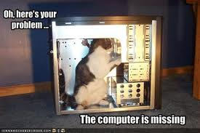
Fixed it - all good nao
GOT IT
Working!
happily
ever
after!
Set &
Forget
Or…???
Notes:
Great, we got it working,
checks should just be running in the background.
A simple set & forget thing, right?

Slide 17

maintenance
Notes:
A monitoring system is a living thing
Of course depending on what is monitored, but
there will always be something to tweak or add another check.
”we need to monitor this too”
As your IT environment changes you will need to adapt the monitoring
And as you learn more about Nagios, you find more stuff to implement.
It needs maintenance

Slide 18
Conclusions

Slide 19
What did we Learn?
START with firewall ports / VPN connections.
access to a test environment
experienced tester.
Test thoroughly.
Notes:
Security requests can take a long time
Access to a test environment and an experienced tester:
Need to test all the checks to see how they respond
Need to send crappy data through the system and watch those alarms fire off

Slide 20

Think the checks through
very clear specifications
Remember:
Every 5 minutes
Notes:
Feel very stupid when a check sends off false alarms and turns out to be according to spec,
As in that file generation
checks will run every 5, 24/7. even at night when a batch jobs hogs all the memory

Slide 21
More lessions learned
A good programmer
Plan for THE aftermath,
log book &
Script Repository
Plan for improvements
Notes:
Programming skills are vital if you dont have them yourself, the team needs a good developer
Plan: it is normal to have some tweaking to do, so you need to make sure you have access to the resources for a while after,
maybe our case was a little bit extreme , it is not usual that they take off because of a new job
but can be good to make sure for example your resources dont go on vacation shortly after rollout
First changes can be remembered but after a while you need to keep track of it.
Set up a log book and log changes and version control on scripts
Improvements: is not a set & forget thing,
will always be something -modification of an existing check, or add a new check.
You will want to add for example
dependencies
Failover system
test server for Nagios – not test new stuff live and risk messing up the system
if you have scripted checks – ensure future access to developer

Slide 22
But most important of all

Slide 23

No 1
Notes:
Makes all the difference in the world.
You go from from having a clue to knowing
so many ways of setting things up in Nagios,
Need training in Nagios and knowledge of the different solutions to see what is best for you.

Slide 24
Tips & tricks

Slide 25
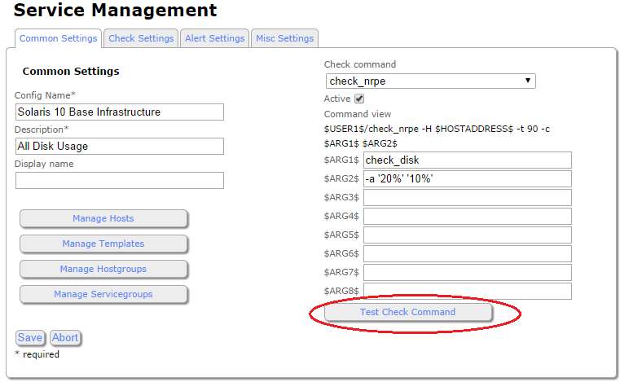
Basic troubleshooting
/etc/nagios/nrpe.cfg
/etc/nagios/nrpe.cfg
Run check locally on host
( In solaris : as nagios USER + root )
RUN “Test check command”
in console
Check HOST config files
Solaris: /etc/nagios/nrpe.cfg
Windows: C:\Program Files\NSClient++\NSC.ini
Check HOST logs
Solaris: /var/adm/nrpe
Windows: C:\Program Files\NSClient++\nsclient.log
Notes:
Run check locally to see that it works.
On Solaris, run as nagios user and root, to make sure it is not permission related.
Run test check command from console to see response.
Had set the wrong ip adress once.
Config files – if you cant get answers from the checks and you know FW ports are open, check that the nagios server is listed in the allowed hosts section of the config files
Also, if you have added scripted checks, make sure the command definition is correct.
Check your host logs, they give a pretty good idea of what is going on

Slide 26

Heeelp!!!
where to find info as a beginner:
  FAQs
  Nagios Library
  NSClient++
Notes:
Thes

Slide 27

FAQ
  Nagios FAQs
  http://support.nagios.com/knowledgebase/faqs/

Slide 28

The Library
  Nagios XI Library http://library.nagios.com/library/products/nagiosxi
Nagios support forum
Nagios Documentation
User and Administrator
manuals
Notes:
The library has links to the support forum, to the documentation and to the manuals. This is a good place to start
Read the manuals, they will give you an general understanding of how the system works

Slide 29

Nsclient++
  NSClient++
  http://www.nsclient.org/
Notes:
If you are using NSClient, this website has a bunch of stuff for your windowsclient.
If you cant find what you need there, it Also has a direct chat with the developer

Slide 30
The internetz
Google is your friend
  ( just doublecheck the Nagios version )
Notes:
Make sure the answer you get is for the same version you were searching for. Getting advice about nagios core if you were looking for xi can be a bit confusing.

Slide 31

Questions?
All typo:s are attributed to lolcat lingo!

Slide 32
Thank you!
Anna-Sofia Lejman
anna-sofia.lejman@vixtechnology.com

