Slide 1
Bryan Heden
Lead Solutions Provider
bheden@agilenetworks.com

Slide 2
Introduction & Agenda
What we do and what we needed
Customized and configured
IO issues...
Offload all the things!
What did we learn?
What’s next?

Slide 3
Agile Networks: Who We Are
Telecom Provider
We Engineer and Operate The Agile Network, a general purpose backhaul network with Last-Mile AgilityTM
Who We Serve
Public Sector … particularly Public Safety
Oil/Gas
Underserved Communities
Enterprise

Slide 4
Customer Examples

Slide 5
What We Needed
General insight into network health
Ability to maintain SLAs with customers
To react to network downtime as fast as possible
The Government doesn’t like to wait
To monitor traffic across the network

Slide 6
What We Did
We chose Nagios XI
Easy to use and understand interface
No more text based configurations to manage
(Haha, just kidding!)
Built on top of something we were already comfortable with

Slide 7
How'd That Go?
It worked, but not exactly how we wanted it to
“WHAT DO YOU MEAN IT DOESN'T AUTOMATICALLY TRANSLATE OIDS INTO HUMAN UNDERSTANDABLE ENGLISH?”
“YOU MEAN TO TELL ME THAT OUR EQUIPMENT DOESN'T COME STANDARD WITH NAGIOS PLUGINS OR THAT NAGIOS DOESN'T PRODUCE ONE FOR EACH TYPE OF DEVICE WE USE?!”
Etc.
Ping worked just fine

Slide 8
If You Build It..
..The Network Engineers will use it
We wrote our own configuration wizards for each different type of device (PTP, PTMP, Routers, Power, GPS) We made some maps
Executives love maps!
One map tracked health of devices/links between sites along with radar
Another map tracked the operating frequencies of active devices

Slide 9
Finally, Some Pictures!
The NOC Overview MAP provides our teams insight into the health of every node and their connections on our network.

Slide 10
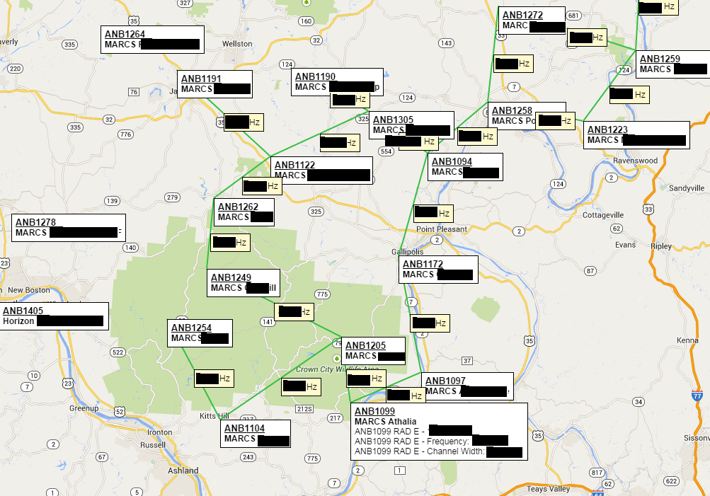
More Pictures
Our Network Engineers can see from a central source what the health and operating frequencies are of our equipment.

Slide 11
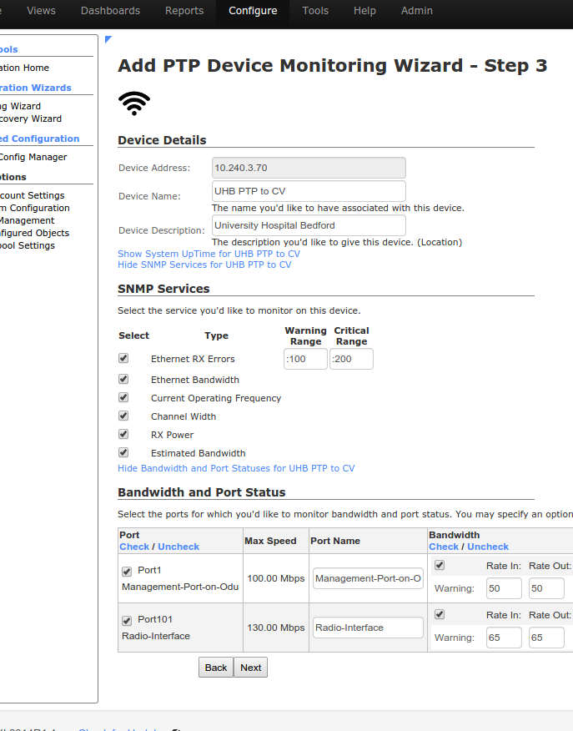
And More Pictures
My custom built configuration wizards keep our teams working on what they need to work on and allow me to be hands off with system additions.

Slide 12
Stress Testing in Production
We reached maximum occupancy
Our existing server setup wasn't meant for active checks for this many hosts and services
We introduced ModGearman
We offloaded MySQL
Things got better, but we still had some problems...

Slide 13
IO is a Major Factor
Lots of writes, not enough throughput
There were suddenly more host and service checks than we could handle with our setup
Running on a VM on an ESX Host with 2x10K drives in a RAID1
Bandwidth was only graphing once every 10 to 20 minutes
Upgraded the ESX Host drives to 6x15K RAID10
Okay, okay! We upgraded some other stuff on the ESX Host, too
This was the single most important decision we had made

Slide 14
But We Didn't Stop There!
We offloaded MRTG
Set up NFS Share for /var/lib/mrtg so that Nagios could read from it
Set up NFS Share for /etc/mrtg so that Nagios could write to it, in order to add host configuraiton files
Put both Virtual Machines on the same Host (17 Gb/sec network throughput)

Slide 15
MRTG
MRTG had some issues of its own…
We had to split the cron job into separate processes
This stops MRTG from taking too long to complete its checks, preventing the next process from starting
(Remember the 5 to 20 minute graphing issue a few slides back?)

Slide 16
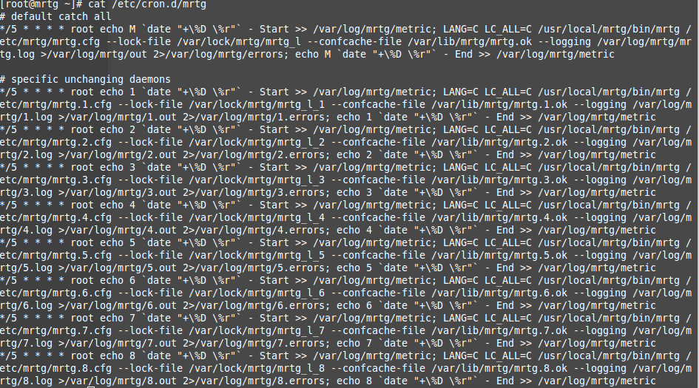
Pictures of Text
Here is what MRTG’s cron file looks like after we’ve made our changes:

Slide 17
MRTG Process Splitting
How we did it
Split the configuration files into logical chunks by size and created separate cron entries for each
/etc/mrtg/conf.d/ has multiple subdirectories (1/, 2/, 3/, etc.)
Each corresponding process in cron loads the configuration files present in those directories (Include: /etc/mrtg/conf.d/X/*.cfg)
We measure each process separately (run time, errors, standard output, logs)

Slide 18
What Else?
We did some other things, too…
We installed and offloaded SmokePing
We created a SmokePing Nagios XI component to increase visibility of our graphs in our NOC
We built a portal to SmokePing for a particular client to login and check device health
We created a ModGearman Nagios XI component to manage our servers from a central location

Slide 19
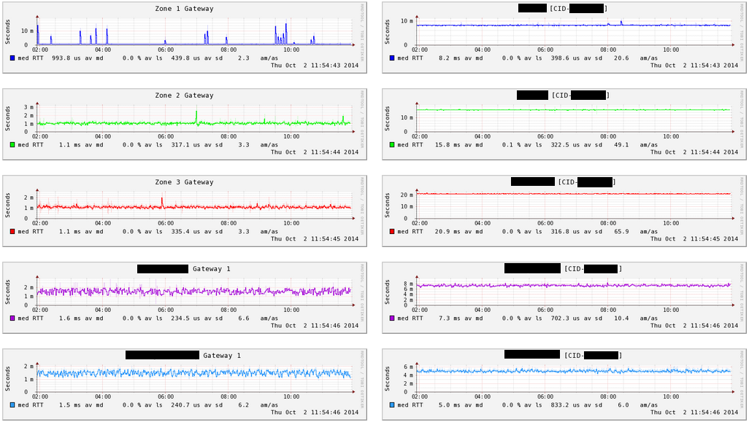
SmokePing Component
This component keeps our gateway graphs up at all times so we can keep an eye on them, and then rotates graphs from other hosts in each zone so we can (hopefully) notice inconsistencies when they arise.

Slide 20
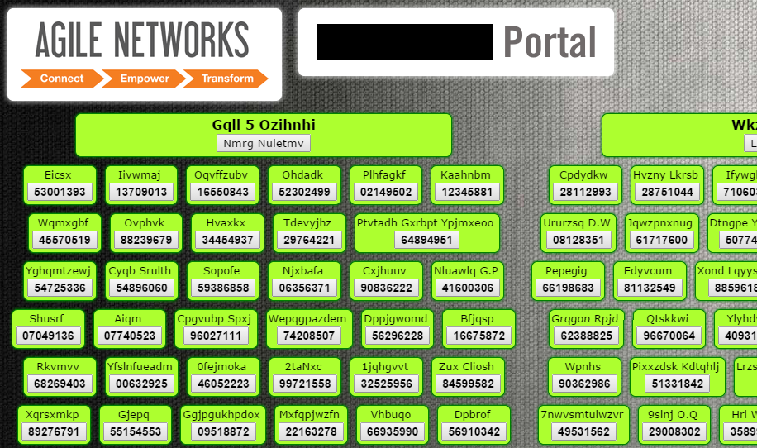
SmokePing Portal
We use a portal that parses the config file for SmokePing hosts, pings them, and shows current status. It also allows the portal user to ping those hosts.

Slide 21
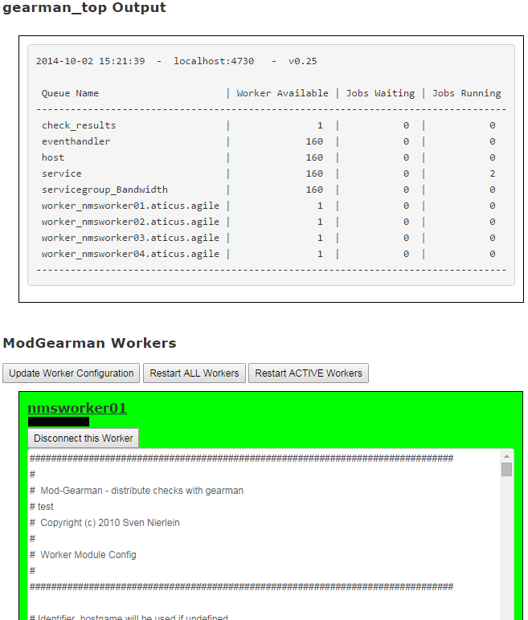
ModGearman Component
I was tired of having to repeatedly log in to each ModGearman instance to tweak something when we were still getting everything set! So I wrote this to make my life a little bit easier.

Slide 22
Conclusion
What did we learn?
Nagios XI can be extended far beyond the default behavior
Custom Configuration Wizards, Plugins and Components
Custom MRTG installations and scans used in the Config Wizards
IO will become an issue, and should be planned for
How to build a process for creating customizations
Offload what you can!

Slide 23
What’s Next?
Big Plans!
Automating the MRTG Process Splitting
Releasing a generic and well documented Configuration Wizard Template
Continuing to grow and expand our current installation
Questions
Do you have any?

