Slide 1
“If you think technology can solve your security problems, then you don't understand the problems and you don't understand the technology” Bruce Schneier

Slide 2
Customizing Nagios
Dorancé Martínez Cortés
dorancemc@gmail.com
@dorancemc

Slide 3
Agenda
About me
Good practices
Monitoring tools
Why nagios?
Work with IT
Nagios for >300 host >2500 services
Strategy
Capacity planning
Conclusion
Questions

Slide 4
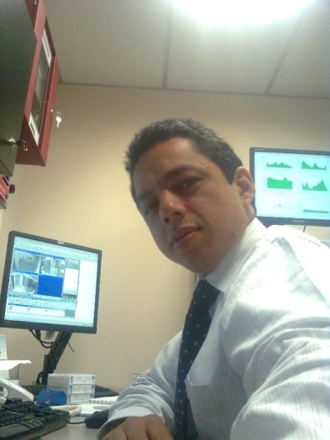
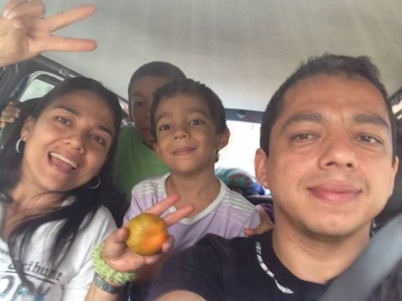
About me
>10 Years: Linux, Windows, HPUX, AIX, Mac.
Tecnoquímicas
Alert Logic
In free time: camping
And full-time: husband and father

Slide 5
Tecnoquímicas
Tecnoquímicas
Health
Personal care and household cleaning
Processed foods
Agricultural and veterinary products

Slide 6
Best practices
If you can't be measured, you can't control it
If you can't control, you can't manage
If you can't manage, you can't improve it

Slide 7
Lowest incident

Slide 8
More information

Slide 9
bigger incident?

Slide 10
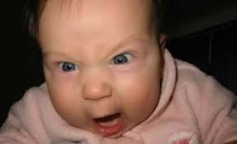
users

Slide 11
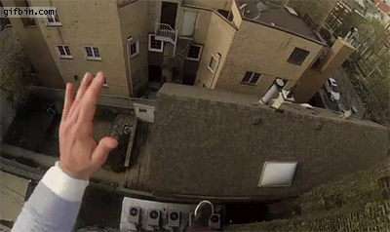
Feeling the incident

Slide 12
Best practices
If you can't be measured, you can't control it
If you can't control, you can't manage
If you can't manage, you can't improve it

Slide 13
Monitoring Tool

Slide 14
Monitoring Tool
Views
Alerts
Prevention
Compatibility
Visibility network and infrastructure not controlled.
Flexibility
Reports
ROI

Slide 15
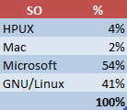
Decision
CPU
MEM
DISK SPACE DISK I/O
TCP/UDP
NIC

Slide 16
Decision

Slide 17
Decision

Slide 18
Decision

Slide 19
Decision

Slide 20
IT
Infrastructure and development
Infrastructure, network and communications
Development
Financials
Sales
Manufacturing
Services
IT
Help Desk

Slide 21
Responsabilities
Application Administration
Database Administration
Script development
User support (level2)
Training
New projects
Contact with suppliers
Internet Support
Software updates
AntiVirus updates
Network speed
Backups
SLA compliance
Best practices
Infrastructure improvement

Slide 22
Incidents
Slowness problems
Failures in the database
Users with little training
Urgent projects
Failures in Internet
Virus in the system
Recovery of Backups
Incidents
Breach of SLA

Slide 23
Hardware
HP
IBM
DELL

Slide 24
Operative System
HP
IBM
DELL
XEN
MS HyperV
ORACLEVM
GNU/Linux
HPUX
Microsoft
GNU/Linux

Slide 25
Software
HP
IBM
DELL
XEN
Oracle VM
MS HyperV
GNU/Linux
HPUX
GNU/Linux
Microsoft
Oracle
Oracle
Apache
MySQL
Oracle
Apache
MSExchange
MSSQL
Active Directory
+
+
MySQL
+
+

Slide 26
Network & Storage
HP
IBM
DELL
XEN
Oracle VM
MS HyperV
GNU/Linux
HPUX
GNU/Linux
Microsoft
Oracle
Oracle
Apache
MySQL
Oracle
Apache
MSExchange
MSSQL
Active Directory
+
+
MySQL
+
+
Network
Storage

Slide 27
Hardware

Slide 28
Hardware

Slide 29
Software

Slide 31
Network & Storage
HP
IBM
DELL
XEN
Oracle VM
MS HyperV
GNU/Linux
HPUX
GNU/Linux
Microsoft
Oracle
Oracle
Apache
MySQL
Oracle
Apache
MSExchange
MSSQL
Active Directory
+
+
MySQL
+
+
Network
Storage

Slide 32
Strategy
Minimum Requirements
Solutions
Software
Hardware
Critical
Warning
Normal -> Statistics
Make connections
Network
Storage
Virtual
Physical

Slide 33
Software

Slide 34
Strategy
Minimum Requirements
Make connections
Solutions
Software
Hardware
Physical
Virtual
Storage
Network
Critical
Warning
Normal -> Statistics

Slide 35
Software

Slide 36
Software

Slide 37
Software

Slide 38
Strategy
Minimum Requirements
Make connections
Solutions
Software
Hardware
Physical
Virtual
Storage
Network
Critical
Warning
Normal -> Statistics

Slide 39
Software

Slide 40
Software

Slide 41
Running…

Slide 42
Software

Slide 43
Services groups

Slide 44
Services groups

Slide 45
Host groups

Slide 46
infrastructure

Slide 47
performance

Slide 48
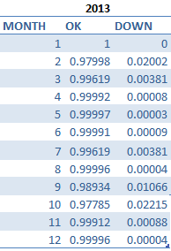
Statistics
2013
2014

Slide 49
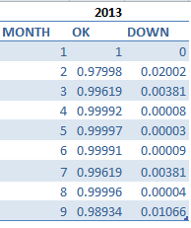
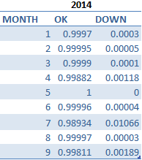
Statistics

Slide 50
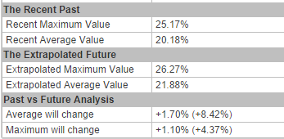
Capacity planning

Slide 51
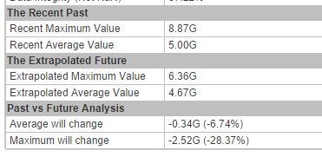
Capacity planning

Slide 52
Capacity planning

Slide 53
Software

Slide 54
Monitoring Tool
Views
Alerts
Prevention
Compatibility
Visibility network and infrastructure not controlled.
Flexibility
Reports
ROI

Slide 55
Conclusion
There is no tool or universal solution
Monitoring tools should point to the prediction and prevention
Monitoring tools are not used at 100%: unknowledge of the tool and methods of analysis
The company should have a monitoring strategy

Slide 56
Conclusion
People
Strategy
Tools

Slide 57
Conclusion
Monitoring strategy
Good teamwork
Great tools
If you think technology can solve your security problems, then you don't understand the problems and you don't understand the technology. “Bruce Schneier”

Slide 58
Questions?

Slide 59
THANKS!
Dorancé Martínez Cortés
dorancemc@gmail.com
@dorancemc

