Slide 1
Monitoring Netezza database with Nagios
Frank Pantaleo
fpantaleo@brightlightconsulting.com

Slide 2
Introduction & Agenda
A couple of W’s
State of monitoring Netezza
Monitoring Netezza with Nagios
Future direction

Slide 3
A couple of W’s - Why
Why are we monitoring Netezza ?
  How much $ does your business lose when IT is down ?
    7 million each year from IT downtime
    Gartner (2005) pegs the hourly cost of downtime for computer networks at $42,000
    A data center outage by itself can cost an average of $5,600 per minute
    Outages damage their reputation
    Now take this and bring it to a Cloud level - For every hour it is not up and running, Amazon.com takes a hit of almost $5 million
  Allows you to be more proactive
  Allow upper management to plan for DB growth (includes secondary effects e.g. DR, tape, disk for backup)

Slide 4
A Couple of W’s - What
What are we looking for in a monitor ?
  Universal monitoring
  Efficient Alert Notifications (also allows your IT staff to tell each other when something is being worked on)
  Web Dashboard (one stop shopping!)
  Issue Escalation (separate lists for warning, high)
  Distributed Monitoring and Scalability (high availability)

Slide 5
A couple of W’s - What
  What are we looking for in a monitor ? (cont)
  Reporting (how many times was this service down ?)
  External Application Integration (Can I enable my current applications to allow for early issue notification)
  Open source solution

Slide 6

State of Netezza monitoring
  Monitoring systems available for Netezza
Netezza event monitor – comes stock with tool
Netezza portal – comes stock with tool
Commercial offerings – Brightlight Consulting Observation Deck

Slide 7
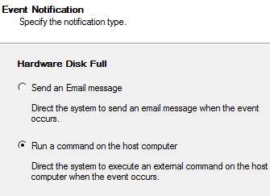
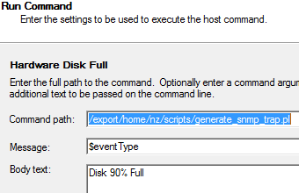
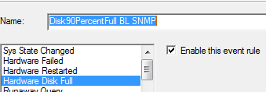
State of Netezza monitoring
Netezza comes with 34 alerts
Alerts actions have limited responses
  Email
  Script execution
  In Version 7.1 can auto create support ticket
  Configuration can be done through NPS client or command line interface on Netezza server

Slide 8

State of Netezza monitoring
Examples of Netezza 7.1 stock sample alerts
  Disk Full
  SPU Full
  Hardware Failed
  Hardware needs attention
  Hardware restarted
  Hardware service requested
  Heat threshold exceeded
  History capture event
  History load event
  HwvoltageFaultAuto
  NPSNoLongerOnline
  RegenFault
  RunAwayQuery
  No custom events allowed

Slide 9
State of Netezza monitoring
Netezza Portal
  Face on glass monitoring
  Custom queries can be added to the monitor
  All queries can be seen as numeric or graphic
  No alerting
  Tool can also be used for maintaining database objects, users, events, and sessions
  If you are using LDAP, portal can’t take advantage of it. Once you login to portal though you will be using your DB username/password

Slide 10
Netezza monitoring using Nagios
What are we monitoring in Netezza ?
  Table Locks by non-EDW statements during EDW batch cycle
  User queries exceeding 1 hour (90% time poorly formed queries)
  User queries during EDW batch cycle (depends on SLA)
  Age of backup older than SLA
  LDAP server available for SSO

Slide 11
Netezza monitoring using Nagios
  What are we monitoring in Netezza ? (cont)
  SPU space unbalanced (generally a side effect of poor distribution)
  State of EDW e.g. loading files, file processing complete
  Late arrival of files preventing the EDW from meeting SLA’s

Slide 12
Netezza monitoring using Nagios
Architecture options with Nagios
  Sensors live on Nagios monitoring server
  Sensors live on Database server and are controlled by NRPE. This is what we went with based on customer security rules.
  Scripting language is Perl. Really could be any language that allows ability to query the database and deal with responses. There are other options such as Bash, Java, Python, and C.

Slide 13
Netezza monitoring using Nagios
  Architecture options with Nagios (cont)
  Active – NRPE is a intermediary for running scripts and bringing results back to Nagios.
  Passive – SNMP is an option but current provided alerts need to be tied into a SNMP agent that reports status. Netezza doesn’t raise SNMP alerts OOB.

Slide 14
Netezza monitoring using Nagios
Passive alerts require snmp trap software
  Nagios server must be enabled to receive alerts
      http://hyper-choi.blogspot.com/2012/12/nagios-snmp-trap-part-1-snmptt.html
      http://hyper-choi.blogspot.com/2013/01/nagios-snmp-trap-part-2-configuration.html
  Once Nagios is enabled Netezza events must be changed to make Nagios aware there is a issue
      http://netezzaadmin.wordpress.com/2011/10/07/using-netezzas-event-manager-to-generate-snmp-traps

Slide 15
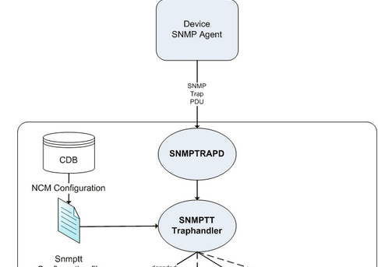
Netezza monitoring using Nagios
Passive alerts architecture

Slide 16

Netezza monitoring using Nagios
Active alerts require NRPE to be installed
Checking is done using shell script and Perl
  Perl DBI ODBC
    Downside is you have to have a exposed user/password. In this case it was against IT policy so I stopped using this option.
    If we use this though all agents could live on Nagios server
  Perl supplied package from Netezza
    Downside is this is equivalent of admin so you can do anything
    Upside is no username/password configuration
    Agents must live on Database server

Slide 17
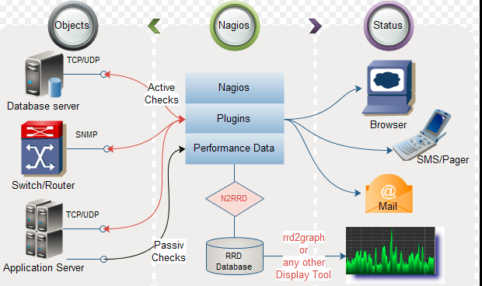
Netezza monitoring using Nagios
Active Alert architecture

Slide 18

Netezza monitoring using Nagios
Active Alert agent writing (interface requirements)
  MUST set a return code e.g.
    # 0 OK
    # 1 WARNING
    # 2 CRITICAL
    # 3 UNKNOWN
  Nagios dashboard displays associated text
    if (some logic here )
        print "Ok\n";
      else
        print "Error please look at tablexyz\n";

Slide 19

Netezza monitoring using Nagios
Active alerts - NRPE configuration on Netezza server
If using the Perl package commands must run as nz user so /etc/nagios/nrpe.cfg must use the following
  nrpe_user=nz
  nrpe_group=nz
Once a sensor (perl script) is written and tested it must be added to nrpe.cfg file.
command[check_nz_longqry]=/export/home/nz/scripts/check_nz_longqry.pl
Best practice - Request /etc/nagios/nrpe.cfg be open to read/write from nz user

Slide 20
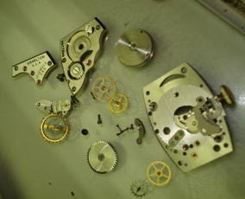
Netezza monitoring using Nagios
Active alerts - How does NRPE work on Nagios server ?
define command{
command_name check_nrpe
command_line $USER1$/check_nrpe -H $HOSTADDRESS$ -c $ARG1$ -t 300
}
define service{
use generic-service
host_name proddb
service_description NZSQL Long query
check_command check_nrpe!check_nz_longqry!
notifications_enabled 0
}

Slide 21
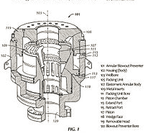
Netezza monitoring using Nagios
Active Alerts - Perl programming using SQL.pm package
Invocation
  use lib "/nz/kit/share/perl";
  use nz::SQL;
Package can only be used by the nz owner
NO username & password
  my ($KITDIR, $DATADIR);
  $DATADIR = "/nz/data.1.0";
  $KITDIR = "/nz/kit";
  nz::SQL::config(KITDIR => $KITDIR, DATADIR => $DATADIR);
Best practice - use alarm timers around SQL statements
Handy variables after each SQL execution $qresp->{nrows}, ncols, colid, qtype;

Slide 22

Netezza monitoring using Nagios
Perl programming using SQL.pm package (continued)
Interface example … nz::SQL::query($dbname, $sql). Unlike DBI the database must be called out every time you query.
Resultsets are not active in database (unlike DBI) they are in perl memory
Resultset traversal is done using perl foreach e.g.
  foreach my $row (@{$qresp->{data}}) {
    ($blocker_username,$blocker_sql,$blockee_username,$blockee_sql) = @$row;
Best practice: If you can avoid dealing with resultset and deal only with counts
  e.g (nrows). Most efficient use especially when dealing with a Nagios alert check that is going to occur several times a day.

Slide 23
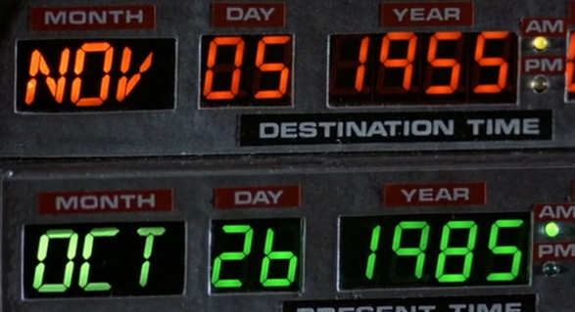
Future direction
Data graphing
Expand areas that we are monitoring for in Netezza
Integrate into a product offering (Observation Deck) from Brightlight that collects NZHIST for customer
Predict when we are going to outgrow our current processing and database needs

Slide 24
Conclusion
Key takeaways are
  Using Nagios can help your company have an extensible event monitor. Understanding Nagios architecture is important to a stable and working monitoring setup. Once you understand architecture setup writing an agent is trivial. If you can write SQL to detect an event then you can write an agent.
Other Reading materials or learning devices on this subject that you would like to share
  URL’s provided in document have the recipe for how to setup Nagios, SNMP traps, and Netezza. Please visit those sites to get that info.

Slide 25

Questions?
Any questions?
Thanks!

Slide 26
Reference
http://www.thegeekstuff.com/2010/08/monitoring-software-criteria/
  http://exchange.nagios.org/directory/Tutorials/Install-and-Configure-NRPE-in-CentOS-and-Red-Hat/details
  http://www-01.ibm.com/support/knowledgecenter/SSULQD_7.1.0/com.ibm.nz.portal.doc/c_portal_welcome.html
  http://www.networkworld.com/article/2329877/infrastructure-management/how-to-quantify-downtime.html

Slide 27
The End
Frank Pantaleo
fpantaleo@brightlightconsulting.com

