Slide 1
A Trillion Truths
Gerald Combs
gerald@wireshark.org
@geraldcombs

Slide 2
Why Am I Here?
Dunno. Ask Ethan.
Notes:
Unlike the other speakers here, I am in no way a Nagios expert.
I have much love and knowledge to share.
Protocol analysis is its own billion dollar industry with its own conferences and everything.
Going to try to distill that down to 50 minutes.

Slide 3
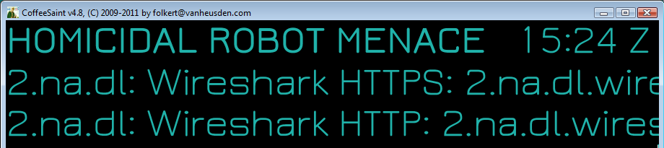
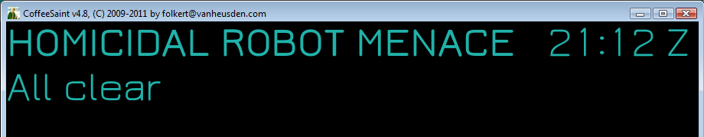
Nagios @ wireshark.org

Slide 4
What's happening on your network?
Notes:
Nagios and Wireshark approach this question differently.

Slide 5

Nagios Is Paging Me
Is this the cause?
Notes:
Check out Sysdig for system-level information.

Slide 6
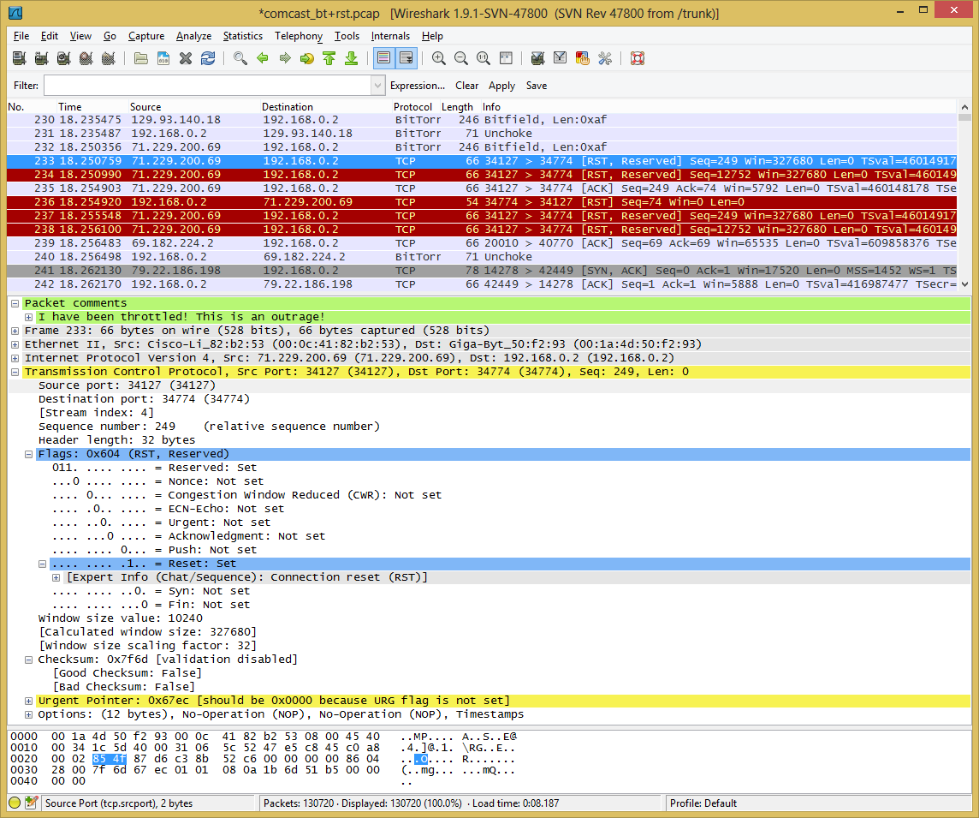
Packet Analysis
Notes:
Wireshark's job is to turn packets into fields. From there we can arrange them in a tree, add filters, coloring rules, taps, and a lot of other features.
These fields drive most of Wireshark's features.

Slide 7
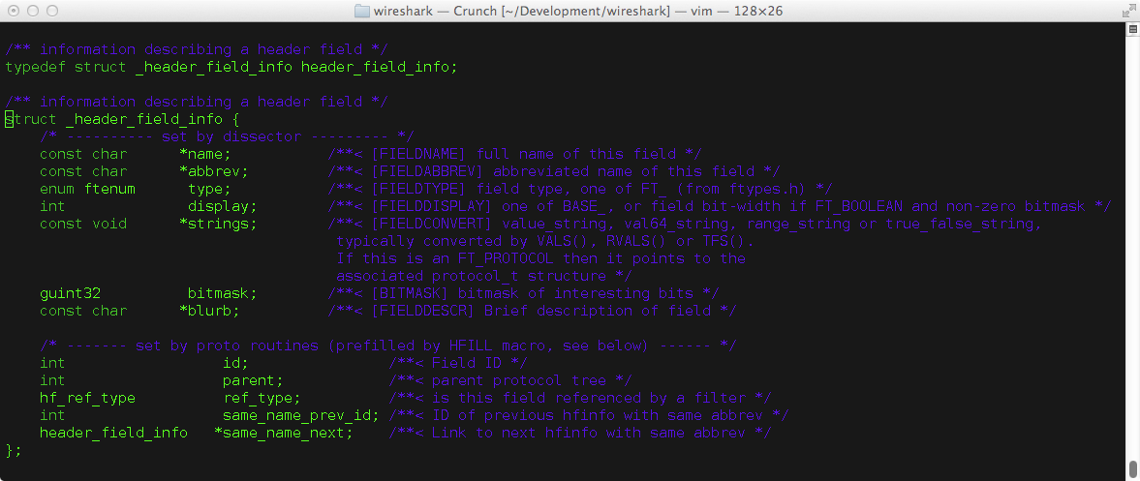
Wireshark is a Dissection Engine
Notes:
My job is to make that dissection engine as useful as possible to as many people as possible.
Wireshark spends a great deal of time filling in this data structure.

Slide 8
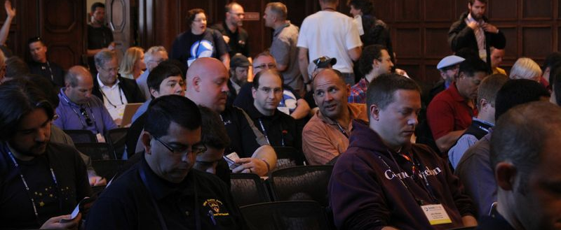
Wireshark is a Community
Notes:
My job is to make sure the community has the tools they need.

Slide 9
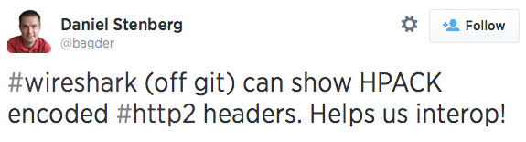
Who uses it?
Network engineer: Troubleshooting tool
Security engineer: Forensics tool
Developer: Debugging tool
Educator: Teaching tool
Protocol designer: Validation tool

Slide 10
Open Source Business Models
Small? Use GitHub
Large? Get Google or IBM to give you piles of money
Medium? Uhhhh…
Notes:
What are the three steps to starting a project on GitHub?
1. Create GitHub account.
2. Check in your source code.
3. Trick question. There is no step 3.

Slide 11
Complementary Products
2006: CACE Technologies
2010:

Slide 12
Finding Network Truths
Notes:
----- Meeting Notes (10/15/14 18:36) -----
How do you find out what's happening on your network? How do you answer that question?

Slide 13
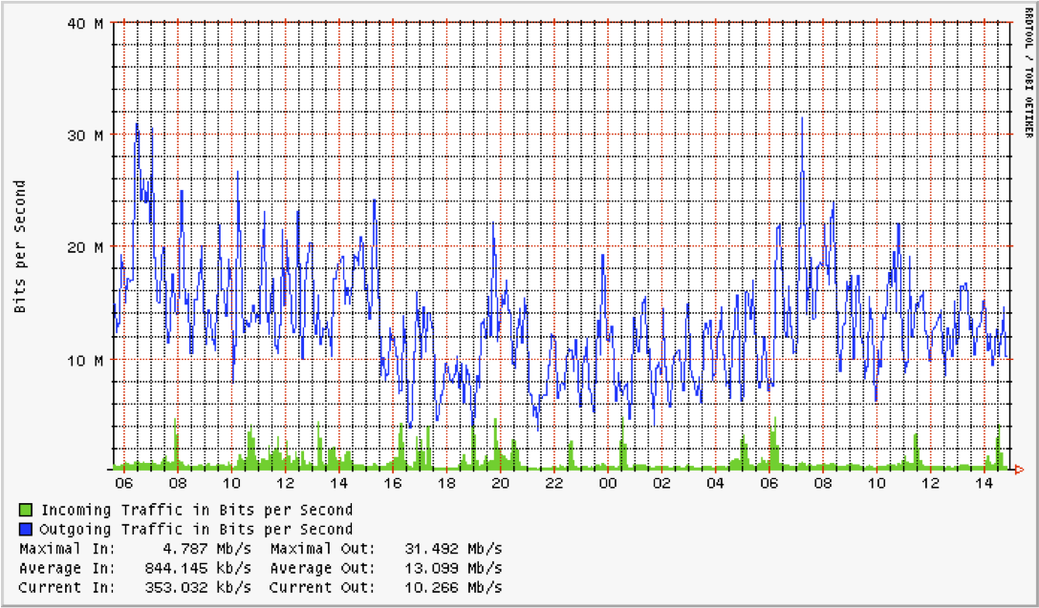
Your 5 Minute Average Is Full Of Lies
Notes:
Up front: not here to complain about RRDTool.
Got DDoSed during Sharkfest.
Contacted provider. They sent a graph that looked like this. Sent "sh int" output too.
How do we get this graph?
Read a counter via SNMP.
Wait 1 or 5 minutes…
…
Read the same counter.
That's your data point.
This is literally the least number of calculations on the least amount of data that you can do and still get usable output.
Again, don't get me wrong – not putting down Tobi Oetiker or MRTG or RRDTool.
Peeved that my provider was misusing it as a diagnostic tool.
This is your starting place, not your stopping place.

Slide 14
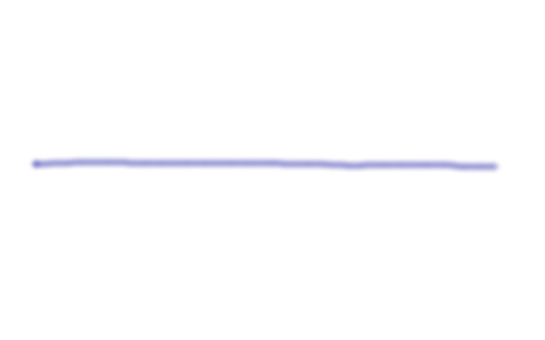
Did the interval look like this…

Slide 15

…or this…

Slide 16
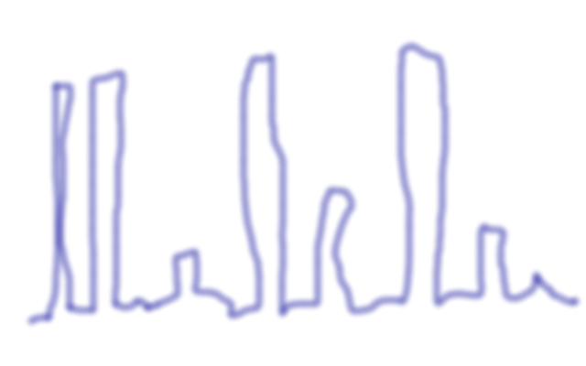
…or this?
Notes:
Financials really care about this stuff. Microbursts can affect trading protocols.

Slide 17
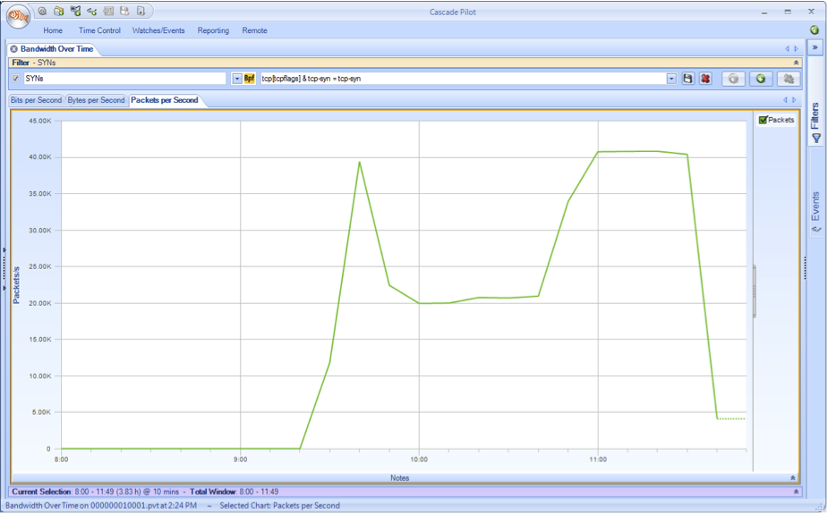
Maybe this…
Notes:
If your monitoring ends at 5 minute averages then you don't really know what is going on on your network.

Slide 18
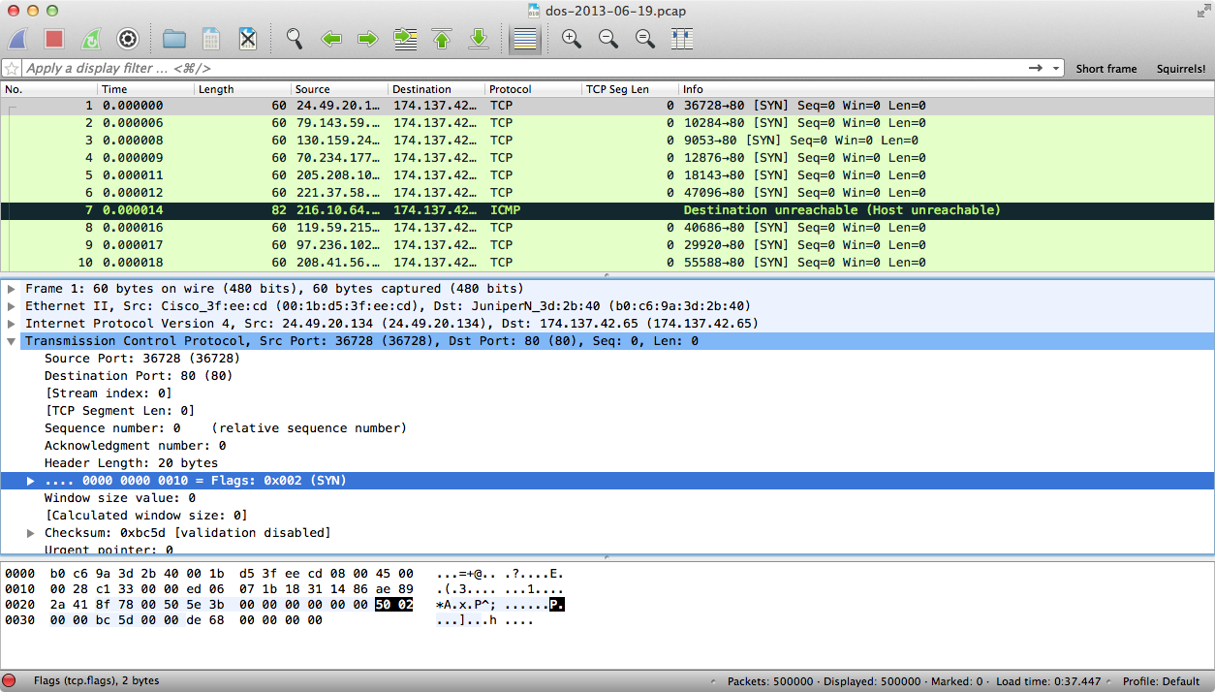
…or this
Notes:
If your monitoring ends at 5 minute averages then you don't really know what is going on on your network.

Slide 19
The Packets Never Lie
  Different truths at different layers
  What do you do with a trillion truths?
Notes:
As the creator of Wireshark I want you looking at interesting packets.

Slide 20
Capturing At Zero Scale
Start tcpdump.
Say "Try it now."
Stop tcpudmp. scp the capture & analyze.

Slide 21
Visibility You Want
Flows
Bits
Dawn of Time
Now
You'll have to make your own surveillance jokes. I have to go through a TSA checkpoint tomorrow.
Notes:
This was an easy diagram to make!
Not going to talk about flow. It would be rude.

Slide 22
Visibility You Get
Flows
Bits
Dawn of Time
Now

Slide 23
Retrospective Analysis
Cheap: Laptop or server running dumpcap or tcpdump
Fancy: Dedicated boxes
Time equals money. And disks. Time equals disks.
Notes:
Capture infrastructure gives you continuous capture.
Fancy appliances give you things like better performance monitoring, remote analysis, time-based filesystems, automation, and other things.

Slide 24
Port Mirroring
Pros
Any¹ switch does this…
Just a config change…
Cons
…often poorly
…requiring change control
1. Any switch you'd want to use in production.
Notes:
Mirroring is usually far down on the feature list.
I bought $89 switches a few years ago that support mirroring.
SPAN ports can be really convenient but they can cause problems.
Cisco has a really nice document that describes how SPAN limitations on their different switches.
Problems include drops, time massaging, switch performance.

Slide 25
Taps
Pros
Passive
Time accuracy
Filtering
Duplication
Cons
Cost
Extra hardware
Sometimes a switch
Notes:
Taps are awesome.
When I say passive I mean passive. Optical taps are prisms. Electrical taps fail "on".

Slide 26
VM Capture
Where do you want to kill performance today?
Jasper Bongertz:
http://blog.packet-foo.com/2013/04/capturing-packets-of-vmware-machines/
http://blog.packet-foo.com/2013/04/capturing-packets-of-vmware-machines-part-2/

Slide 27
Cloud Capture
Like VM but with less control.
Back to tcpdump. Seriously?

Slide 28
SDN, or Why Cloud Capture Annoys Me
Microsoft (Rich Groves): DEMon
Big Switch: Big Tap
Distributed tap built on SDN
Scales to thousands of ports
Notes:
This annoys me because this capability hasn't filtered down to customers.

Slide 29
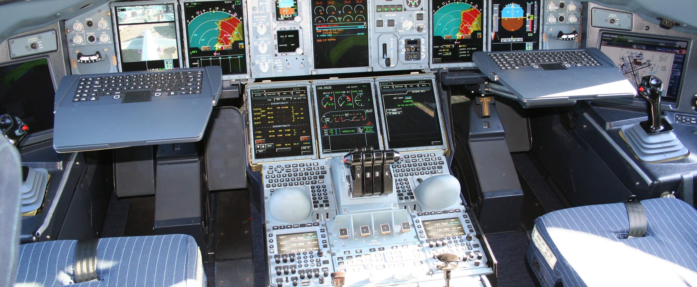
Using Wireshark For The First Time
http://en.wikipedia.org/wiki/File:Airbus_A380_cockpit.jpg
Notes:
Wireshark can tell you what's happening on your network. It can't tell you what anything means.
Ultimately you have to learn how all of the pieces work and fit together in order to use Wireshark effectively.
Why go to all of that trouble?

Slide 30
Educational Resources
Wireshark Q&A · https://ask.wireshark.org/
Laura Chappell · http://www.wiresharkbook.com/
Mailing lists · https://www.wireshark.org/lists/
Sharkfest · http://sharkfest.wireshark.org/
Bibliography · https://www.wireshark.org/bibliography.html
Notes:
If you're the kind of person that takes pictures of slides now is the time to do so.

Slide 31
More Educational Resources
Hansang Bae · http://www.riverbed.com/blogs/authors/Hansang-Bae.html
More Hansang · https://blog.wireshark.org/
Tim O'Neill · http://www.lovemytool.com/
Jasper Bongertz · http://blog.packet-foo.com/

Slide 32
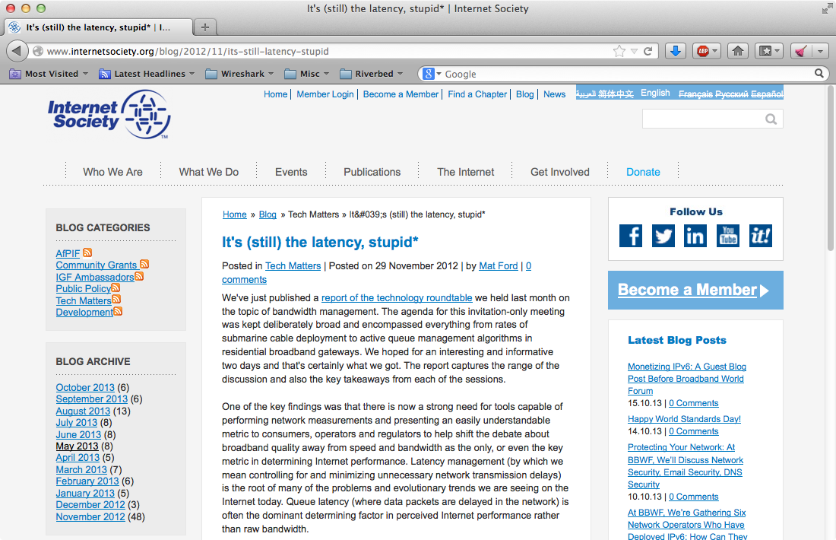
Latency – 2012

Slide 33
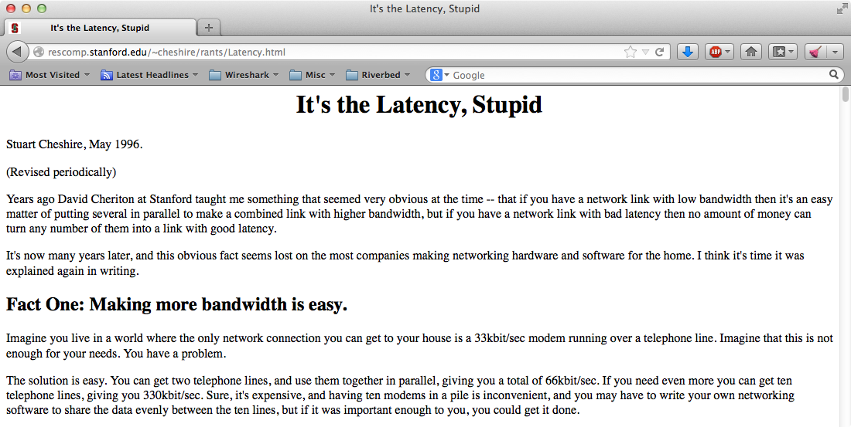
Latency – 1996

Slide 34
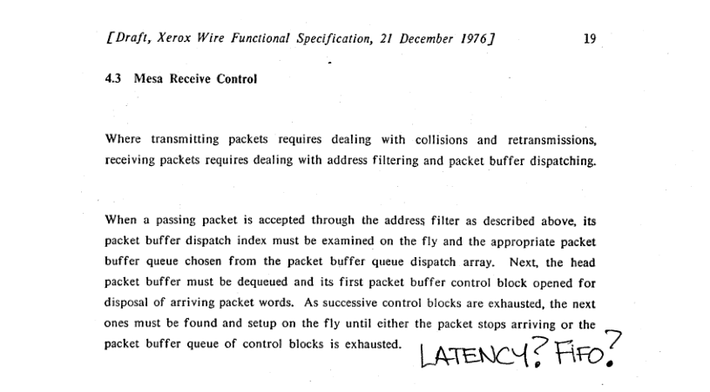
Latency – 1976
http://bitsavers.informatik.uni-stuttgart.de/pdf/xerox/ethernet/XeroxWireDraft_Dec1976.pdf
Notes:
Xerox Wire Functional Specification
http://bitsavers.informatik.uni-stuttgart.de/pdf/xerox/ethernet/XeroxWireDraft_Dec1976.pdf

Slide 35
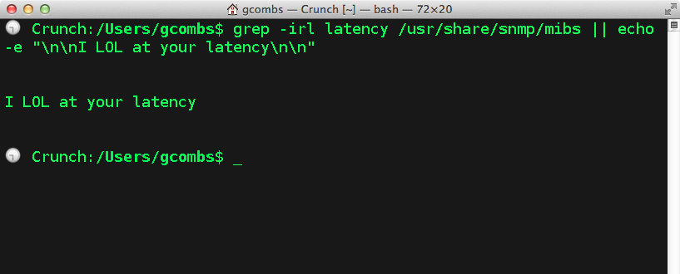
…and yet…

Slide 36
Wireshark Today
Large, vibrant ecosystem
Hundreds of authors
Statistics:
  1500 protocols
  117k filter fields
  500k 1M downloads / month
  2M lines of code
  Rich web presence
Your network is not a black box
http://www.hanselman.com/blog/TheInternetIsNotABlackBoxLookInside.aspx

Slide 37
What's Next?

Slide 38
Challenges
To install on OS X you need a bucket and a screwdriver
Packet analysis + tablet = sadness
"The cloud" is not in the interface list
400GBASE-OUCH-THAT-HURTS
You want process information? Too bad

Slide 39
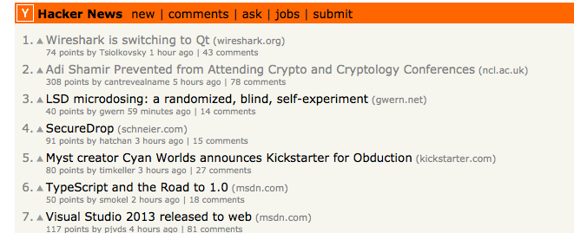
We made the news

Slide 40
Demo Time

Slide 41
