Slide 1
Nagios – Cool Tips and Tricks
Jim Clark
jclark@itconvergence.com

Slide 2
Introduction & Agenda
About Me
Cool Tips and Tricks
Released Scripts
Questions and Answers

Slide 3


About Me
About Me
Have been in the IT industry since
1988
Have been using Nagios since
~2003
Switched to XI ~2010
Work for IT Convergence as
Global Manager – Monitoring
Personal web page is
http://www.bandits-home-on-the-web.com

Slide 4
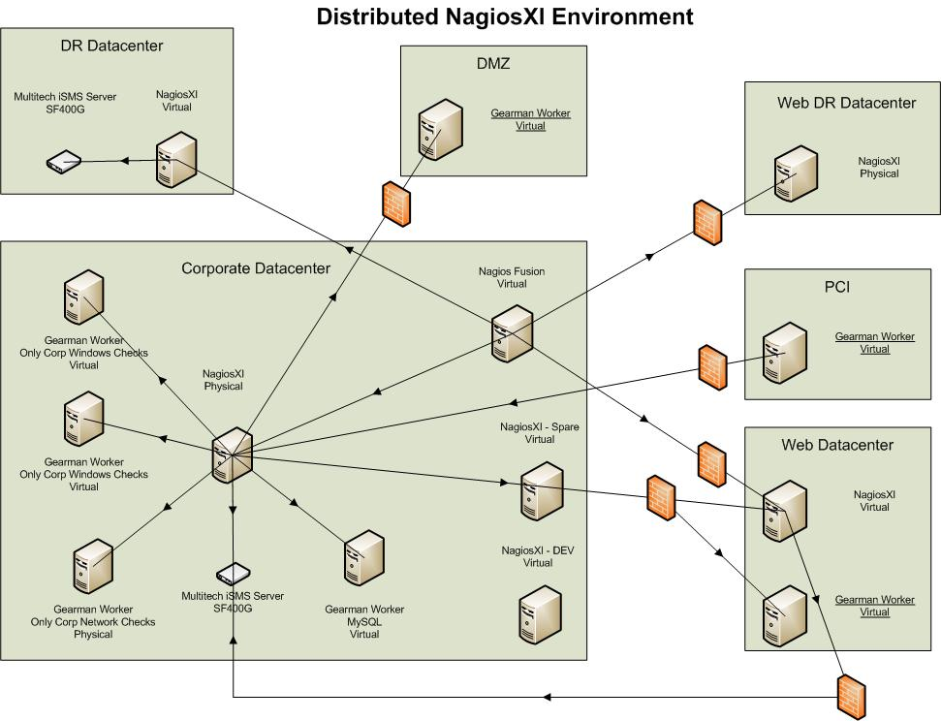
Nagios Environment

Slide 5
Add new NRPE check without restarting
Reason for implementing
  100+ AIX servers
  Understaffed AIX admin group
  Needed a way to add a new plugin without needing to restart the NRPE service

Slide 6
Add new NRPE check without restarting
Add this check command
  command[check_whatever]=/usr/opt/nagios/libexec/open_scripts/$ARG1$ $ARG2$ $ARG3$
Restart NRPE one last time
Security Concerns
  As long as you nest it down one folder as I did, use SSL, have NRPE locked to only_from the proper IP, the security issues should be relatively small

Slide 7
Check by ssh with password
I know, I know…bad! bad! BAD!
Sometimes though, you just can’t do things the proper method. Plus, it is only on my personal network ☺
Install ‘sshpass’ on your Nagios server
Create a bash script
    #!/bin/sh
    sshpass -p $1 ssh $2@$4 $3

Slide 8
Check by ssh with password
Use this command definition in Nagios
  $USER1$/check_freenas $ARG1$ $ARG2$ $ARG3$ $HOSTADDRESS$
  ARG1=Password, ARG2=User, ARG3=command to run

Slide 9
Check by ssh with local script
Reason for implementation
  Only have to modify the scripts in one location, the Nagios server
How to implement
  For a bash script use
    ssh nagios@$HOSTADDRESS$ 'bash -s' -- < $USER1$/$ARG1$ $ARG2$
  For a perl script use
    ssh nagios@$HOSTADDRESS$ 'perl - $ARG3$' -- < $USER1$/$ARG1$ $ARG2$

Slide 10
Check by ssh with local script
Known issues
  Must be a script, it can not be a binary. At least I haven’t found the proper command yet.
  Nagios Core 4 / NagiosXI 2014 and newer versions require a wrapper around the command instead of just using the command directly

Slide 11
Alert Different Groups Based on Day of Week
Reason for implementation
  The group works 4 day and 3 day shifts. One group covers Monday – Thursday and the other Friday – Sunday.
Method used
  Escalations
  Special time periods
  Contact groups

Slide 12
Alert Different Groups Based on Day of Week
define serviceescalation{
host_name ASPIT01P
service_description *
contact_groups pkms_01p-mon-thu
first_notification 1
escalation_period mon-thu
last_notification 0
notification_interval 15
}
define serviceescalation{
host_name ASPIT01P
service_description *
contact_groups pkms_01p-fri-sun
first_notification 1
escalation_period fri-sun
last_notification 0
notification_interval 15
}
define serviceescalation{
host_name ASPIT01P
service_description *
contact_groups pkms_01p-managers
first_notification 3
last_notification 0
notification_interval 15
}

Slide 13
Check for new *nix mount point
Reason for implementing
  We monitor all mount point separate as each one may have a different contact group
  If Unix admins add a new mount point they may forget to inform monitoring to start monitoring it
Nagios Command
  $USER1$/check_new_disk $USER1$/check_nrpe -n -H $HOSTADDRESS$ -t 30 -c check_disk -a ‘$ARG1$’

Slide 14
Check for new *nix mount point
Bash script
#!/bin/bash
if [[ $("$@") == "DISK UNKNOWN - free space:|" ]]
then
echo “OK: No new drives!”;
exit 0;
else
echo “CRITICAL: New drives!”;
exit 2;
fi;

Slide 15
Check for new *nix mount point
Example usage from cli
  /usr/local/nagios/libexec/check_new_disk /usr/local/nagios/libexec/check_nrpe -n -H 10.97.235.15 -t 30 -c check_disk -a ‘-w 1000 -c 500 -A -x / -x /usr -x /home -x /tmp -x /u01 -x /proc -x /opt -x /tomaxbin -i ‘/var*$’ -i ‘^/notes*$”

Slide 16
Custom SNMP Trap Handling
Reason for implementing
  I use sitescan to monitor building health at the data center and send traps to Nagios.
  Unfortunately those traps are not very good and the data requires manipulation before writing the trap to Nagios.
What I did
  Make a copy of snmptraphandling.py to snmptraphandlingss.py.

Slide 17
Custom SNMP Trap Handling
What I did
  Modify snmptt.conf and changed the line calling the script to the new filename and send over all important data.
  Modify snmptraphandlingss.py to do what I need.
Changed line in snmptt.conf
  EXEC /usr/local/bin/snmptraphandlingss.py “$r” “SNMP Traps” “$s” “$@” “$-*” “$*”

Slide 18
Newer On-Call Handling
Reason for implementing
  Last year I gave a presentation on how we had previously incorporated on-call. That method had one flaw, it required daily restarts of Nagios.
  Wanted a way for Nagios to display who is on-call
Script details
  Only works with NagiosXI
  Comes with a component to add a link on the main menu to display who is on-call

Slide 19
Newer On-Call Handling
Script details
  Does not create the on-call data files. These need supplied manually or by some other method (We use SharePoint to schedule and it automatically writes out data files).
  Works with escalations as well
  Adds new notification handlers that maintain following user’s notification preferences in their XI account

Slide 20
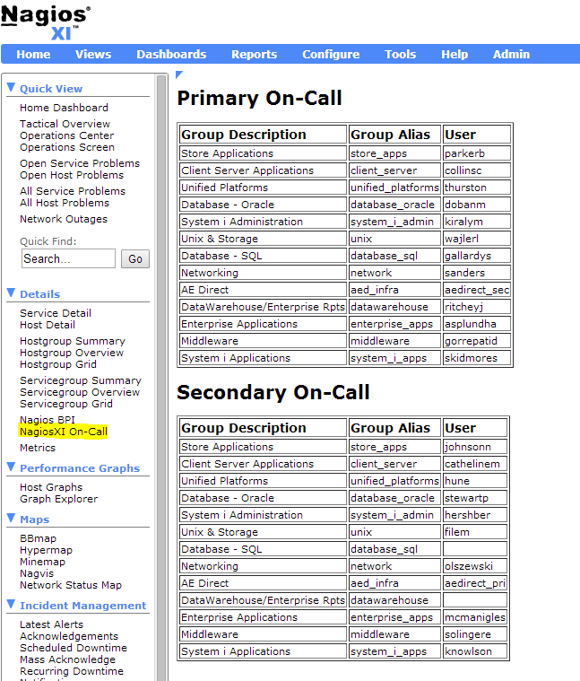
Newer On-Call Handling

Slide 21
Script: Check E-Mail Subject
Reason for implementing
  We send an email with a virus every 30 minutes to an outside address
  Our checker should catch it and send an alert email
  We check the account every 30 minutes for the presence of that email
Script details
  Can be found on the Exchange
  Uses NTLM for auth

Slide 22
Script: Acknowledge by Email
Reason for implementing
  Multiple Nagios servers
  Some servers behind special firewalls so can not use Nagios Mobile or other solutions
  No need for on call individuals to carry around tablets or laptops if they can use their phones to easily acknowledge alerts

Slide 23
Script: Acknowledge by Email
Details
  Script is located on the Exchange
  It is an NTLM fork of the script NagMailAck but uses NTLM auth
  Every Nagios server has it’s own identity string that gets added to the email subject when replying
  All Nagios servers can monitor the same email account for replies and just search for subjects with their identity

Slide 24
Script: Check E-Mail Delivery
Reason for implementing
  Need to verify email is flowing
Script details
  Uses NTLM for authentication
  Sends an email with a specific subject and then reconnects and verifies that email is in the inbox.
  Uses my check_email_subject script
  Uses phpmailer to send the email

Slide 25
Script: Check E-Mail Delivery
Script
command="php /usr/local/nagios/bin/email_delivery.phps \"*** Check for E-Mail Working\"“
eval $command
command2="/usr/local/nagios/libexec/check_email_subject.rb \"*** Check for E-Mail Working\"“
eval $command2

Slide 26
Conclusion
There are other scripts of mine located on the exchange under the owner ‘banditbbs’
I am always browsing the Nagios forums and offering help when I can
There are a few other nagios scripts and hints on my personal web page linked earlier in this presentation

Slide 27

Questions?
Any questions?
Thanks!

Slide 28
The End
Jim Clark
jclark@itconvergence.com

