Slide 1
How Revenue Increased After Implementing Nagios XI and Nagios Network Analyzer
Jose Marroquin
josem.marroquin@outlook.com
josem_marroquin@bantrab.net.gt

Slide 2
Introduction & Agenda
About The Bank
Before Nagios
Business case
Nagios Implementation
Revenue increase
Nagios Today
Nagios in the future

Slide 3
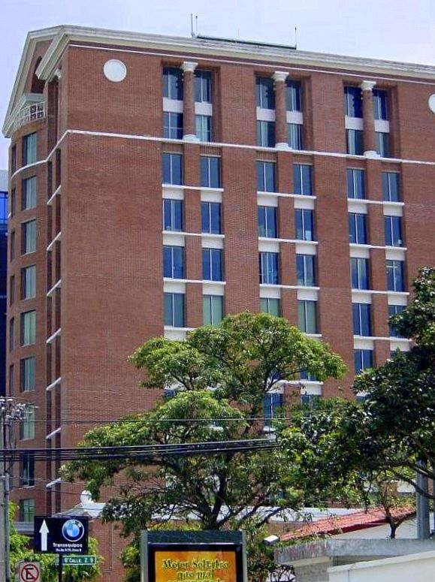
About The Bank
Located in Guatemala, Central America
3,500 employees
140 Branches
Risk Qualification “A” By Fitch Ratings

Slide 4
BEFORE NAGIOS
Lost
Unquantifiable losses
Architectural purchase decisions.

Slide 5
project approval process
BUSINESS CASE

Slide 6
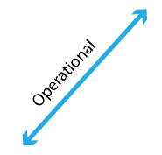
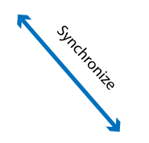
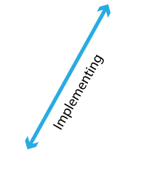
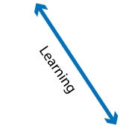
Diamond Organizational Excellence
2. Tree Ms - Measures, Goals, Means
1. Strategy Focus
3. Strategic Alignment
5. Organizational Agility
6. Improvement, Enhancement
4. Execution Culture

Slide 7
Why Service Excellence is part of our strategy?
“There is only one boss, the customer, and he can fire everybody in the company from the chairman down, simply by spending his money somewhere else.”
Sam Walton

Slide 8
Strategic
objectives
Measures
(KPIS)
Mission Vision
Budgets and resources
Levels (data and information)
Selection plans (planning of Project implementation)
Goals (short, médium, and long term)
Strategic Project portfolio (priotization and selection)
Medium (potential initiatives)
Align
Direction and operationalization
Execution
Aligning the direction to the operationalization and execution

Slide 9
Strategic Objectives Map
Strategic Objectives Map
Linked measures to the four perspectives
Strategic theme: SERVICE EXCELLENCE
(Growing up in the local market with current products
FINANCIAL
Increase profitability
Growing market
CUSTOMER
Customer satisfaction
Increase productivity
INTERNAL BUSINESS PROCESS
Enhacement of all services
Fulfill the requirements of business operations
Increase staff trainning
LEARNING AND GROWTH
Improve staff productivity

Slide 10
Strategy Operacionalization: service excellence
Direction
MEASURE
GOALS
MEANS
OBJECTIVE | KPI´s | KPI Dictionary | GOALS | DECISION MAKING | Project | Action Plan | Resources
Customer Satisfaction | % UP TIME SERVICE | Responsible Definition Frequency Source Level = 100% | > 99 % to 2014: Long, medium, short term | Red light < 95 Yellow light 97-98 Green light > 99 | NAGIOS | What How Who When Whar for | -Money, people, time
Enhacement of all services |  |  |  |  | ISO 2000
Which is my objective?
How I make myself sure to achieve to it?
Which would be the expected impact?
How do I achieve that impact?

Slide 11
How can we achieve our Strategic Goals of Service Excellence?

Slide 12
Priorización de iniciativas-proyectos
STRATEGY THEME: PROJECTS TO ACHIEVE SERVICE EXCELLENCE OBJECTIVES
Projects portfolio
high
NAGIOS
ITIL, ISO 20000
SERVICE CULTURE
Disney standards
STRATEGY CRITERIA
Low
Low
Return of investment, ROI
high
ECONOMIC CRITERIA

Slide 13
Analysis of Project Investment
 | Detail | Year 0 | Year 1 | Year 2 | Year 3 | Year 4 | Year 5
Income
 | Business revenue, (previously lost by system downtime) |  | 50,000 | 53,500 | 57,245 | 61,252 | 65,540
 | Revenue from new business, (Trusting Systems and Strong IT Arquitecture) |  | 104,400 | 111,708 | 119,528 | 127,894 | 136,847
 | Savings for Hardware Acquisition |  | 45,000 | 48,150 | 51,521 | 55,127 | 58,986
 | Total Income |  | 199,400 | 213,358 | 228,293 | 244,274 | 261,373
Expenses
 | Nagios XI Maintenance & Support |  | (4,750) | (4,750) | (4,750) | (4,750) | (4,750)
 | Nagios Network analyzer Maintenance & Support |  | (4,750) | (4,750) | (4,750) | (4,750) | (4,750)
 | Services Support |  | (5,000) | (5,000) | (5,000) | (5,000) | (5,000)
 | Total Expenses |  | (14,500) | (14,500) | (14,500) | (14,500) | (14,500)
 | Net Profits(Incomes-Expenses) |  | 184,900 | 198,858 | 213,793 | 229,774 | 246,873
 | Investments
 | Nagios Products | (10,000)
 | Implementation services | (10,000)
 | Hardware | (40,000)
 | Cash Flow | (60,000) | 184,900 | 198,858 | 213,793 | 229,774 | 246,873
 | NPV (Net Present Value) | 645,833 |  | Investment Rate = 10%
 | IRR (Internal Rate of Return) | 315.3%
 | Recovery period | 9 | months

Slide 14
Nagios: Project approval process
Strategy focus
Project Implementation
Strategic objectives
Projects Portfolio
Analysis Investment

Slide 15
SUCCESSFUL NAGIOS PROJECT IMPLEMENTATION
Have all needed resources
Staff Training
Focus: Services generating 80% of income (Pareto)
Phase Down plan development
Results delivery
Policies & Procedures

Slide 16
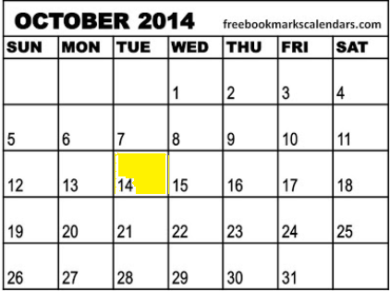
Nagios today
BUSINESS CASE

Slide 17
NAGIOS TODAY
Monitoring
> 1000 Host.
> 3000 Services
Created more than 30 diagrams

Slide 18
important achievements with Nagios xi AND NETWORK ANALIZER

Slide 19
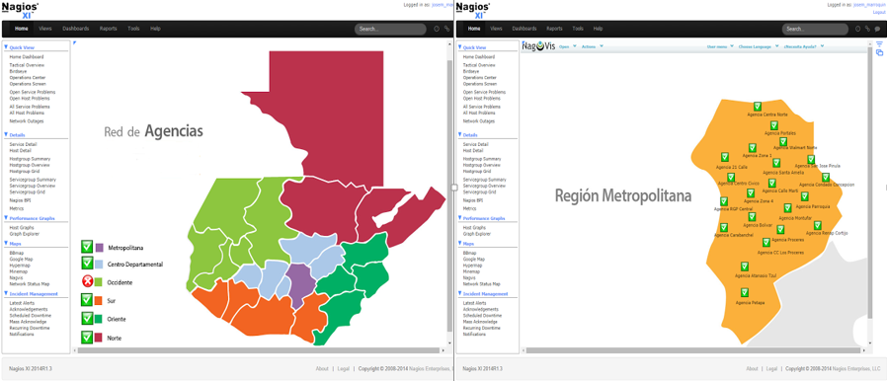
REAL TIME MONITORING

Slide 20
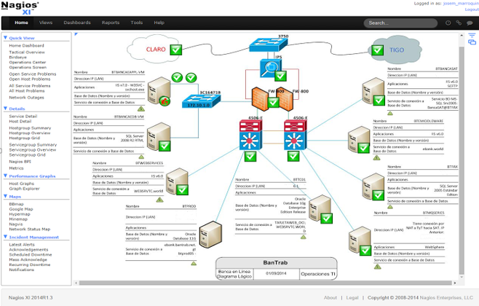
SERVICES TRACEABILITY

Slide 21
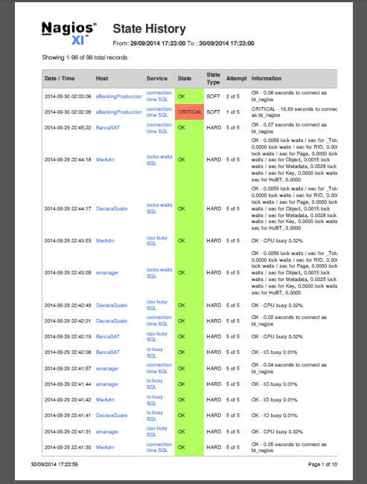
SERVICES ACCOUNTABILITY

Slide 22
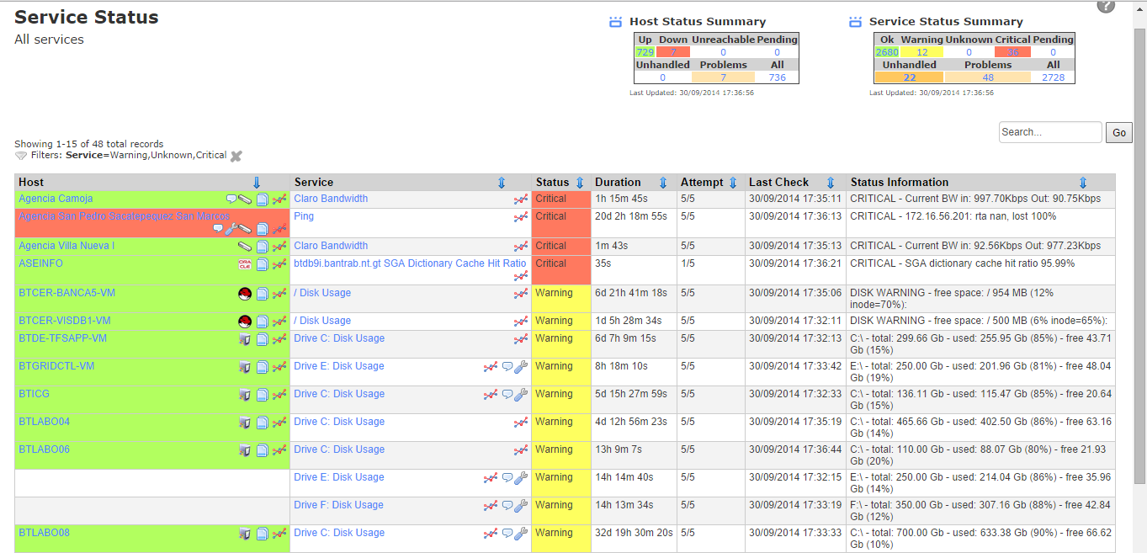
PREVENTIVE ACTIONS

Slide 23
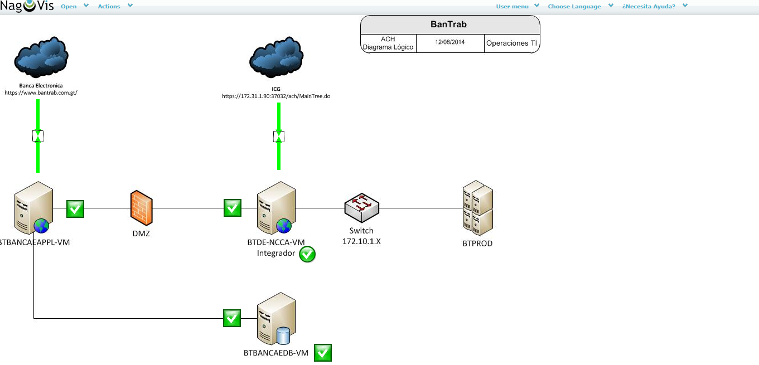
SAME SERVICE ORIENTED
INTEGRATION OF DIFFERENT COMPONENTS, VARIOUS TECHNOLOGIES.

Slide 24
NAGIOS NETWORK ANALIZER

Slide 25
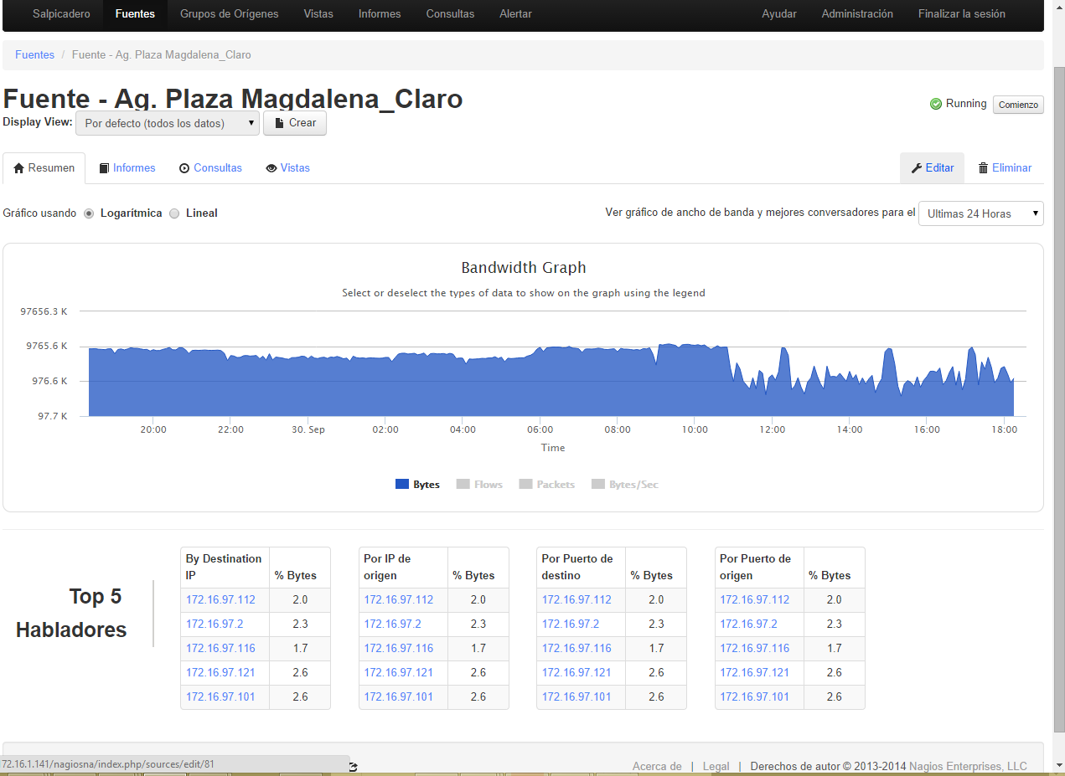
CHECK, BANDWITH IN REAL TIME.
Network Analizer

Slide 26
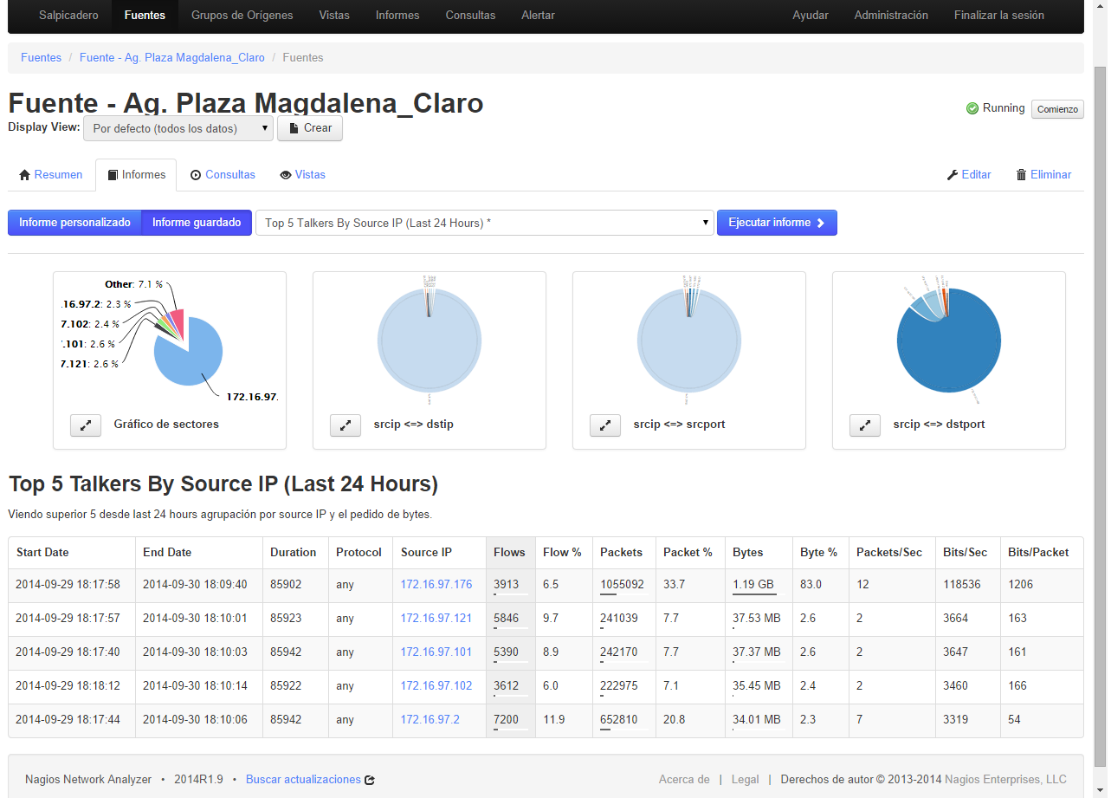
BANDWITH BY IP
Network Analizer

Slide 27
THE FUTURE ON NAGIOS
BUSINESS CASE
It depends on the new trends, that I find during this conference.

Slide 28
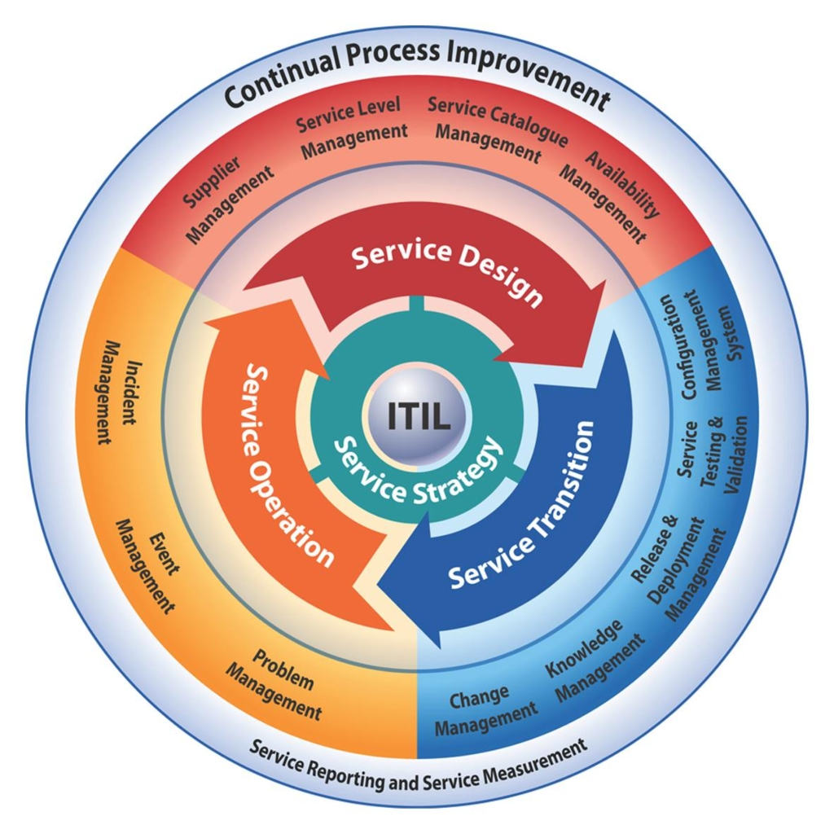
How I Visualize Nagios in the Future
Nagios Integrating ITIL platform

Slide 29
KPI’S Delivery Performance Communication: Periodic daily reports from the business
Business Service: Internet Banking
Goals | Metrics | Dimensions
Average Fulfillment Time (#) | System Problems | Systems
Fulfillment on Target (%) | Avg. Time to Service Response | Aplication
System Downtime (#) | System Dowtime Events (#) | System
 |  | System Problems
 |  | Problem Severity
 |  | System Problem
 |  | System Downtime
 |  | Downtime Time of Day
 |  | Custumer Transaction Acounts
 |  | Customer
 |  | System Transaction Account
 |  | Day
 |  | Year
 |  | Quarter
 |  | Month
 |  | Day

Slide 30
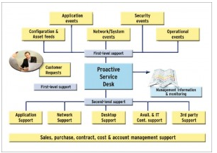
Service Operation: Function service Desk Integrated By Nagios

Slide 31
Incident management kpi
 |  | Quantity |  |  | Percentage
Kpi |  | Acceptable | Inaceptable |  | Acceptable | Inaceptable
amount of repeated incidents |  | 0-20 | >20
Incident Resolution Time |  | <2 | >2 | hrs
First call resolution rate |  |  |  |  | >80 | <80
Resolution within SLA |  |  |  |  | >95 | <5

Slide 32
Conclusion
How Revenue Increased After Implementing Nagios XI and Nagios Network Analyzer
Includes Nagios in your Strategic Project Portfolio.
Focus on services that will generate 80% of your income (Pareto)
Service quality versus service costs
Some Incomes
Savings for Hardware Acquisition
99.9 % UP Time Services: Customer Satisfaction.
Business Areas believes in IT Department and Create more products and services.
thanks

Slide 33
“Whatever you do, do it well. Do it so well that when people see you do it they will want to come back and see you do it again and they will want to bring others to show them how well you do what you do.”
Walt Disney

Slide 34
Questions?
Any questions?
Thanks!

Slide 35
Thanks!
Jose Marroquin
Josem.Marroquin@outlook.com
Josem_Marroquin@bantrab.net.gt

