Slide 1
Monitoring SAP System with Nagios Core
Luis Contreras
lcontreras@nagios.com

Slide 2
Introduction & Agenda
Who am I ?
SAP Stuff
SAP Concepts
Let’s rock with Nagios Core

Slide 3
Who am I ?
Me ;-)
Nagios Independent Contractor
Nagios Community Leader
Nagios Speaker
SAP Basis & SAP Hana DB Administrator
Python Dev
New Stuff Tester
Bike Rider ;-)

Slide 4
SAP Stuff
SAP
One of the biggest ERP in the Market
Many modules on it FR, HR, etc.
Multi-platform / diversity of databases
Windows / Linux / Unix
While bigger more complex
BI / Portal

Slide 5
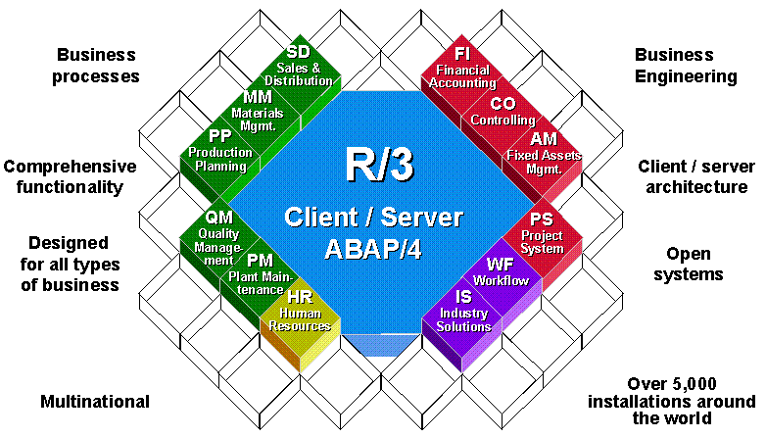
SAP Stuff

Slide 6
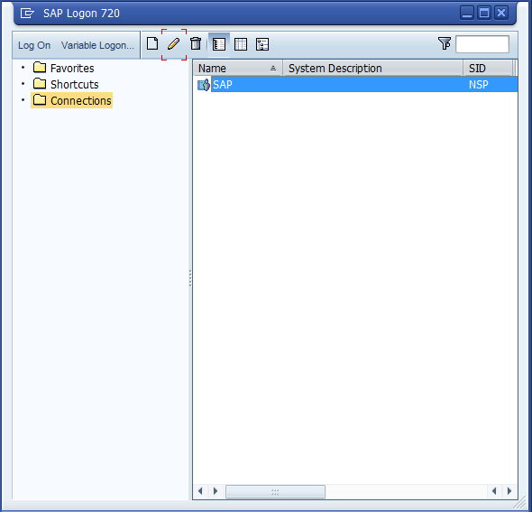
SAP Concepts
SAP GUI
Windows Java
HTML

Slide 7
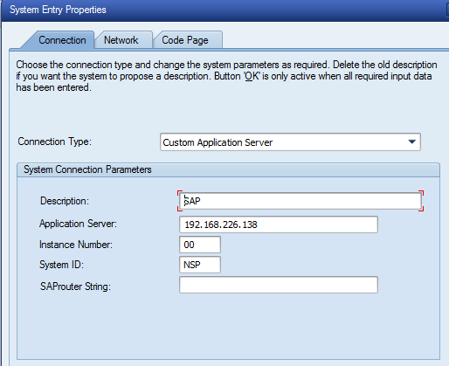
SAP Concepts
SAP GUI
SAP Server Definition

Slide 8
SAP Concepts
Dispatcher
Work Process
Dialog Work Process
Update Work Process
Background Work Process
Spool Work Process
Enqueue Work Process
Message Server
Gateway
Transactions

Slide 9
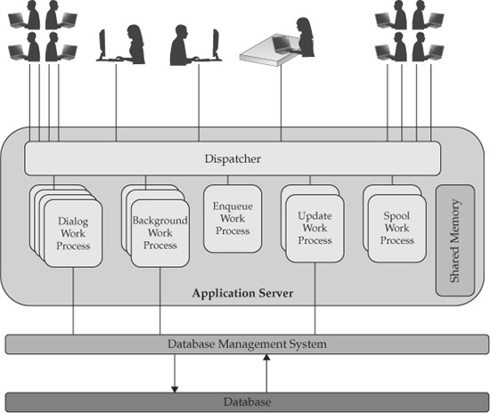
SAP Concepts
1
2
8
5
7
3
4
6
9
10

Slide 10
Let’s rock with Nagios Core
SAP Enviroment
SAP Netweaver 7.0 ABAP
MaxDB Database 7.x / Oracle DB 10g Ent
Windows 2003 Server Enterprise

Slide 11
Let’s rock with Nagios Core
Situation:
A SAP Basis wants to monitor Message Server, Application Server (Processes and Services), SAP Ports, others services, but he/she doesn’t want to install any SAP plugin on a SAP System.

Slide 12
Let’s rock with Nagios Core
Define SAP Server on windows.cfg

Slide 13
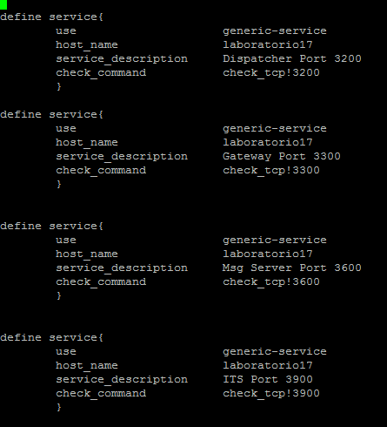
Let’s rock with Nagios Core
Define Ports to monitor on file windows.cfg
Dispatcher
Gateway
Msg Server
Internet Transaction Services

Slide 14
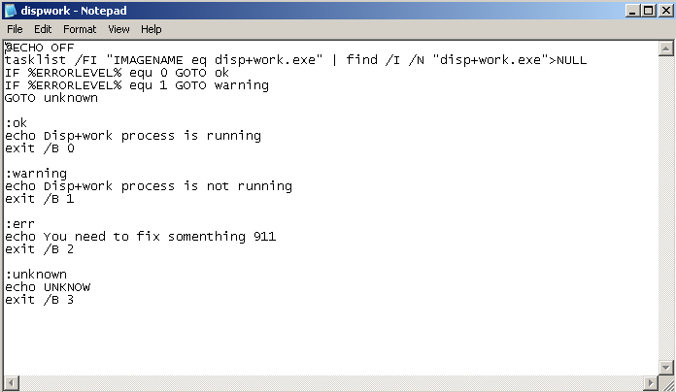
Let’s rock with Nagios Core
dispwork.bat script for checking disp+work.exe process

Slide 15
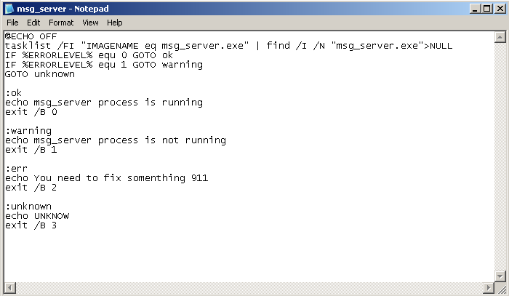
Let’s rock with Nagios Core
msg_server.bat script for checking disp+work.exe process

Slide 16
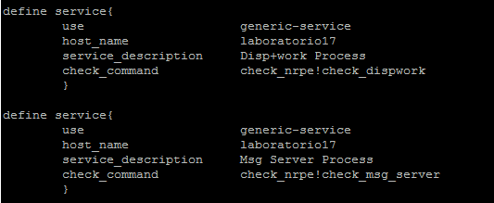
Let’s rock with Nagios Core
Define processes to monitor on file windows.cfg

Slide 17
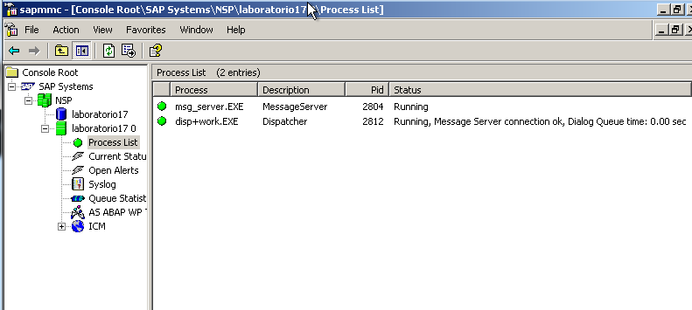
Let’s rock with Nagios Core
SAP Management Control

Slide 18
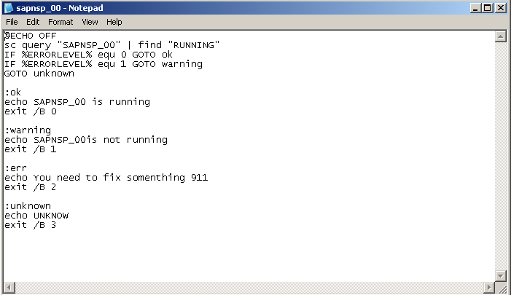
Let’s rock with Nagios Core
sapnsp_00.bat script for checking SAPNSP_00 Service

Slide 19
Let’s rock with Nagios Core
Define services to monitor SAP Instance on file windows.cfg

Slide 20
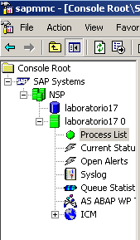
Let’s rock with Nagios Core
SAP Management Control

Slide 21
Let’s rock with Nagios Core
NSC.ini file
…….
[External Scripts]
check_dispwork=scripts\dispwork.bat check_msg_server=scripts\msg_server.bat
check_sapnsp_00=scripts\sapnsp_00.bat
……..

Slide 22
Let’s rock with Nagios Core
Nagios Web Interface

Slide 23
Conclusion
We’ve seen:
How SAP works
How Nagios could help you monitoring your SAP environment
These steps could be accomplish on Nagios XI too, with some minimum changes.

Slide 24
Questions?
Any questions?
Thanks!

Slide 25
The End
Luis Contreras
lcontreras@nagios.com

