Slide 1
SLA - Marriage of an effective tool with a well planned architecture
Nate Broderick
Dan Johnson
nate@aivector.com
Notes:
I’m your typical management.
Been in high tech for over 40 years
Educational background Accounting & Finance
Consider myself a fast learned and I understand the concepts – but I depend on my expert staff to “know” what’s going on
Nate came to me and said there as a conference in St Paul in October and I think having you give a presentation from the Management point of view would be interesting
I lived in the mid-west for a number of years and even though I’m a tea-tottaler I enjoyed the food, dancing and I said it will be fun
**********

Slide 2
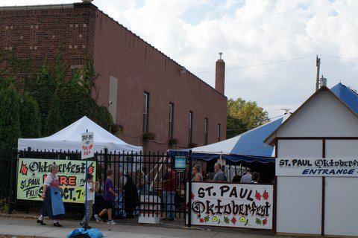
September 20 - 21
Notes:
Then I did a little investigation
**********
And I found out that St Paul Oktoberfest wasn’t quite what I expected
**********
In fact –
********
It was held in September
*********

Slide 3
SLA
Notes:
AI Vector is a small company based about an hour south of Salt Lake City. We have been in the monitoring field for about 15 year.
**********
Today we’re going to talk about SLA
**********

Slide 4
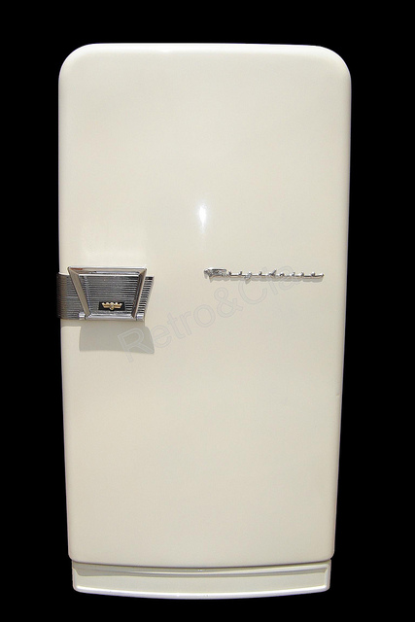
Get me a drink out of the Frigidaire
Service Level Agreement
Availability
Probability of being “UP”
Historical reliability
Notes:
I’m going to refer to managers and techies; let me give you the definition. The half of you that are thinking – “What in the world does a refrigerator have to do with SLA?”; you’re a manager
The other half that are thinking – “What’s its IP? If I can ping it I can monitor it.” you’re a techie.
Now let me explain:
***********
My dad would say – Get me a drink out of the Frigidaire
I was 11 years old before I knew you could buy appliances from other places rather than Sear & Roebuck – We never owned a Frigidaire in my dad’s lifetime but I knew what he meant
*************
When we say SLA we are using it in a broad generic way – don’t get hung up
Another deviation - - If I use an IT example to introduce my presentation I’d have the same problem I had in an Econ class when I was in college, back in the stone age.
College in the Intermountain West
New teacher – thought he’d make it relevant by asking this question “why do they sell more #1 potatoes per capita than #2 potatoes in NY than they do in Idaho, the difference is quite substantial… Yeah but, yeah but
We’re going to talk about a non-computer related Critical Application
**********

Slide 5
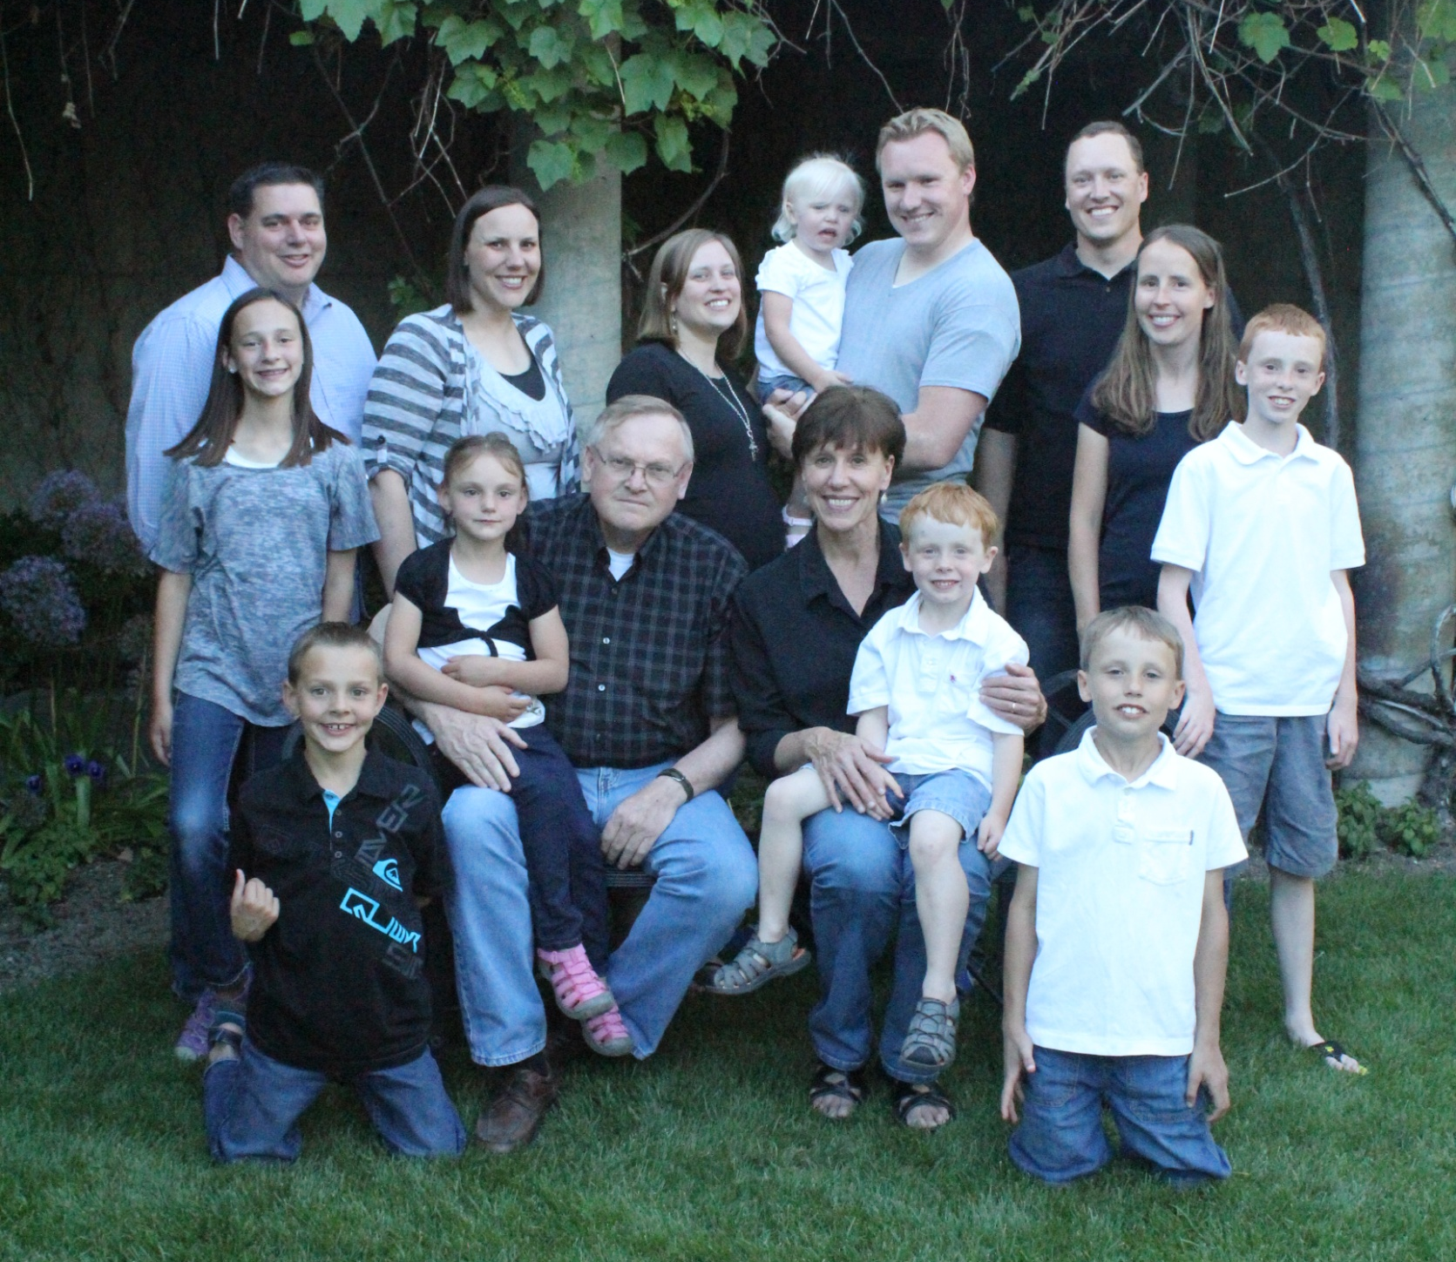
62.500%
Notes:
Beware – I’m a great salesman. That’s the only logic I can come up with why the beautiful woman on my left has stayed married to me for 42 years last August. And I was 50 pounds heavier up to about 2 years ago.
Our oldest son [point to Chris] his wife and 3 sons live in Louisville, KY area – he’s an attorney out there and well established – he aint come back to Utah. Standing next to him is our youngest son. He is in an 8 year graduate program and lives in a small town named Middlesboro, KY with his wife and 2 daughters.
**************
For you number crunchers, this represents 62.500% of my wife’s grandkids.
I know there are some of you in this group that are responsible for e-commerce websites that represent 1000’s 10’s of thousands, even 100’s of thousands of dollars per hour in revenues. The pressure you have to maintain and be proactive with these systems is great. I understand that.
But when my wife decides to go see her grandkids – your issues compared to my critical application is minor.
**************

Slide 6
CRITICAL APPLICATION: Get Grandma to the Airport
2005 Honda Accord 115,268.738 miles
Total miles driven per year:
Freeway 6,812.951 @ 57.654 mph 118.170 hrs
City 5,978.225 @ 28.991 mph 206.780 hrs
Total hrs/year 324.950 hrs
Total minutes /year 19,496.994 mins
Average minutes per day 53.416 mins
Car must be available 24/7 – 1,440.000 minutes per day
Notes:
Our main car is in the shop - - it crashed
************
Here are the information about my car . . . I can see some of you are chuckling over the 3 (three) decimal places
An SLA is asking someone to be accurate to 5 decimal places - - They want it both ways I want 5 – 9’s and my down time is about . . .
************

Slide 7
CRITICAL APPLICATION: Get Grandma to the Airport
2005 Honda Accord 115,268.738 miles
Total miles driven per year:
Freeway 6,812.951 @ 57.654 mph 118.170 hrs
City 5,978.225 @ 28.991 mph 206.780 hrs
Total hrs/year 324.950 hrs
Total minutes /year 19,496.994 mins
Average minutes per day 53.416 mins
Car must be available 24/7 – 1,440.000 minutes per day
Statistics for the Last 24 Hours
Up
Unscheduled
Down
Scheduled
Down
Warning
Light
Oil change, lube job & 100,000 mile maint
122.594
Tire blowout and roadside change
10.821
Check engine light on
15.173
Mechanic found loose plug wire & fixed
4.653
1,286.659
15.474
122.694
15.173
89.351%
1.075%
8.520%
1.054%
Notes:
Let’s look at the 24 hour statistics on my car
************
Review the data
I made a big mistake. While I was preparing for this presentation I printed a number of articles about SLA’s and I left them laying around. My wife read a few of them. Now my boss has an opinion about the reliability of my car. Unfortunately, she has come to the conclusion that if we done have 5 – 9’s
************

Slide 8
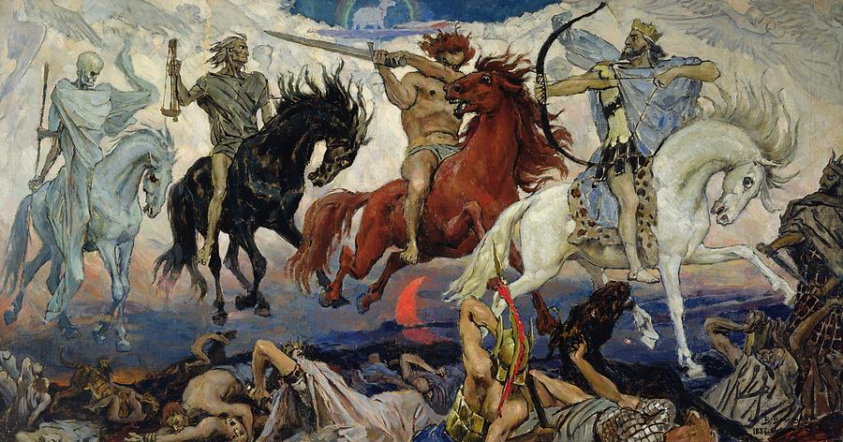
The consequence of not having 5 -9’s
would be biblical in nature…
…we’ll run into the Four Horsemen of the Apocalypse on the way to the airport!
Notes:
***********

Slide 9
Up
Unscheduled
Down
Scheduled
Down
Warning
Light
Oil change, lube job & 100,000 mile maint
122.594
Tire blowout and roadside change
10.821
Check engine light on
15.173
Mechanic found loose plug wire & fixed
4.653
1,286.659
15.474
122.694
15.173
89.351%
1.075%
8.520%
1.054%
7 day time period (10,080 minutes)
9,926.659
15.474
122.694
15.173
98.479%
0.154%
1.217%
0.151%
Warning is not technically down
9,941.832
15.474
122.694
98.629%
0.154%
1.217%
Scheduled down time is planned
10,064.526
15.474
99.847%
0.154%
Notes:
So what am I going to do if I want to make it to 43 years
*************
Dear – 24 hr an anomaly let’s look at 7 days. I can’t go back further than that because I had serious problems
************
Warnings are not down
*************
Scheduled shouldn’t count against my SLA
Still not there
************

Slide 10
Current SLA
10,064.526
15.474
99.847%
0.154%
Restoring a 1967 Ford Mustang
1,440.000
14.286%
If I spend $995 for a rebuilt engine I can achieve the same reliability as my Honda
Fail Over Scenario
99.999%
I need your help!
Is there anyone aware of literature suggesting more than 5 – 9’s
I need to rebuild my transmission
12 – 9’s to justify the cost to my wife!
Notes:
*************
Describe Mustang
Put it together and ran 2.489 minutes – but it could have run the entire time so that’s the 1,440 minutes.
I tore it down the next day
If I include this in the mix it would pull everything down.
*************
Now some of you are saying – Yeah Right 995 won’t cut it. The engine I want is $2,800
I’m introducing the concept – When it gets closer to the time to order it I’ll put in a Change Order and get the one I want
*************
In a Fail Over Architecture the SLA would be 5 – 9’s
************ Help
************ Literature
************ Transmission
************ 12 – 9’s
*********************

Slide 11
We’re at 5 – 9’s!
Great:
Over what period of time?
What’s your Check Interval (5-1-5, 3-1-3, 10-1-10…?)
Do you include “Soft”, “Hard” or both alerts?
What’s on your exclusion list?
Do you use the Average or Probability method to calculate SLA?
What’s the REAL purpose of an “SLA” anyway?
Notes:
************* Great
************* Period – Like my car – are you selecting advantageous time periods
************* Check Intervals *********** Soft – go over 10-1-10 example
************* Exclusion AT&T Example
************* Method
*************
Purpose
*************

Slide 12
SLA is a tool
A tool is an instrument that you use to help accomplish some task.
Notes:
Like the tools I use to rebuild my car I can waste a lot of time using the wrong tool
*************

Slide 13
Less about JUSTIFICATION
More about INFORMATION
Opportunity for EDUCATION
All about COMMUNICATION
Notes:
************ Justification – my wife/my boss without sufficient understanding has in her mind a STANDARD from which she is formulating opinions. Sometimes management gets into the mode of “I don’t understand but here’s my opinion.” Often techie reaction to this is depicted in my Critical Application scenario - - what do I need to do to Justify this data?
************
Information – If management understands not only the what’s but also the why’s they can form better opinions. Managers must approach the data from a neutral position with an attitude of “explain this to me”. Techies must be completely upfront with the information so the whole situation can be evaluated. That leads to ***********
Education – If applicable to your system, does everyone in the decision cycle know what a “Soft Alert” is? How about Fluttering? Swap Memory? Load and what acceptable levels for our system would be? BECAREFUL, I used to tell professionals “I need to understand my insurance coverage, but if I wanted to become an insurance expert I’d have a license on my wall” Managers - - you need to become familiar with the real world challenges of running a very complex and some times very delicate system.
*************
This is the ultimate goal of an SLA. Issues can be handled quickly. Proactive maintenance and long-term planning can help prevent problems. Capital needs can be identified and assessed early. But it can’t work without Communication and Trust.
************

Slide 14
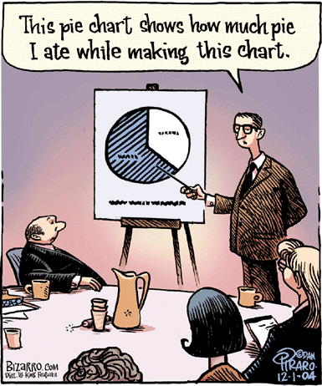
Notes:
Sometimes I feel like this is the type of information I get about SLA – Interesting but not that helpful.
************

Slide 15
We’re at 5 – 9’s!
Over what period of time?
I want the ability to view and analyze different time periods in just seconds.
What’s your Check Interval (5-1-5, 3-1-3, 10-1-10…?)
Do you include “Soft”, “Hard” or both alerts?
Let’s not kid ourselves; precision is determined by the quaity of the input.
What’s on your exclusion list?
I’m a big boy and I can handle the truth; together we’ll come up with a solution.
Do you use the Average or Probability method to calculate SLA?
Why can’t I see both?
Notes:
Let me give you the management view
************* *********** I want to see trends
************* *********** *********** Precision
************* *********** Big Boy
************* *********** Both

Slide 16
SLA - Marriage of an effective tool
with a well planned architecture
Notes:
The other half of the story is the Architecture
*************

Slide 17
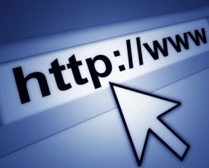
www.buymystuffpleez.com
Uptime 100%
Was there ever a time
when people couldn’t get to my site?
There’s nothing more to worry about
RIGHT?
Notes:
Let’s look at one example
*************
I’m responsible for a website
************* buymystuff.com
************* What’s my primary concern about this site? *********
I’m want to know if it’s been up 100% of the time
************* I need to communicate with the system and get the pertinent data

Slide 18
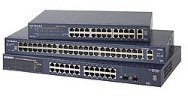
BUSINESS PROCESS
APPLICATION
HARDWARE
Related Host
& Services
Server_shopping
HOSTGROUP [Cluster]
Related Host
Spares
3
Related Host
& Services
Server_email
Related Host
Related Host
Related Host
Related Host
Related Host:
Server_bmsp
Related Host
& Service
Server_vicci_dialer
NETWORK
Related Host
& Service
Router_R15
Related Host
& Service
Switch_R15
Related Host
& Service
Other Services_R15

Slide 20
BUSINESS PROCESS
How do technical people view reports?
Technical people view their systems as systems they are responsible for.
Technical people are generally focused in their assigned areas
How does management view reports?
Management views entire systems from a top level view and don’t focus so much on the details.
Friction can be caused by tech people and management due to misunderstandings.
Often management doesn’t understand why things are broken when they are or where potential problems are.
Notes:
Talk a little about differences between management and technical

Slide 21
SLA Search
DEMO

Slide 22
BUSINESS PROCESS SLA
Nagios needs to be configured to monitor the structure properly
From a technical side, it is important to setup the monitoring in a way that helps the engineer determine problems in the quickest way
From the business side it is important to determine which components are contained in each business process
To understand the business processes, you need to understand all components associated with it
Made up of Network, Application, Hardware monitors
SLA Reports DEMO
Notes:
Talk about how Dan mentioned application, network,

Slide 23
Predictive SLA
HARDWARE
How do I know as a technical person and a manager what I can do to fix problems?
First we need to know what the real problem is. Our SLA page shows you what the problems are.
The predictive SLA page allows management and technical staff to make changes for the future
DEMO

Slide 24
Conclusion
HARDWARE
What will tool do for you?
Predict fixes
Helps in meaningful numbers and allows you to determine which resources should be spent
Meaningful reports for the technical side and management
Opportunity for the technical to educate management
Facilitates communication by viewing the reports by both technical and management
Communication allows the business to put resources in the items it needs to and enhances business processes

Slide 25
Questions

