Slide 1
Nagios – Corporate Finance World
Paloma Giraudo
pgalan@nagios.com

Slide 2
Introduction & Agenda
About me
Bank World
CIB World
Fix Protocol Monitoring
Calypso - Nagios
SWIFT
Conclusion
Questions

Slide 3
About me
I am an IT Professional with more than 12 years of experience.
Over the course of these years I have taken leadership and responsibilities in diverse Technological Domains:
IT Security, Data Center Architecture & Design
Operations Management and Software Engineering
Project and Service Management
My last experience is Capital Markets, my passion.

Slide 4
Bank World
RETAIL
CORPORATE

Slide 5
CIB World

Slide 6
Question
What does or says the competition ?

Slide 7
Calypso-Nagios
Calypso is a global application software provider that sells an integrated suite of trading and risk applications to the capital markets function within banks and other companies participating in the world’s financial markets.

Slide 8
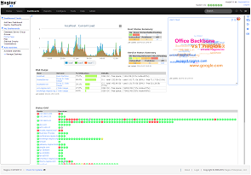
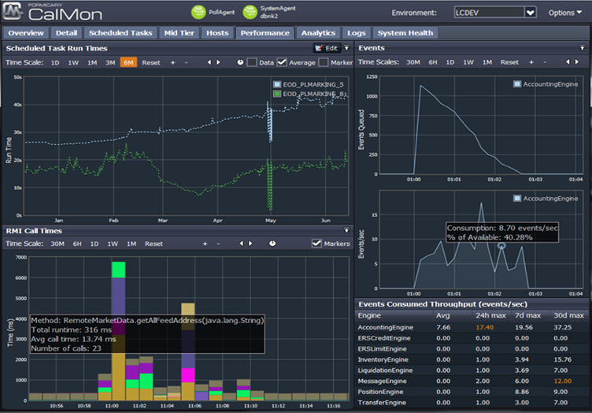
Calypso - Nagios
Calypso Monitoring - Events, log errors, scheduled tasks, thread dumps, engine memory/CPU statistics, RMI call and SQL query times.
Nagios Monitoring - Nagios can do it.

Slide 9
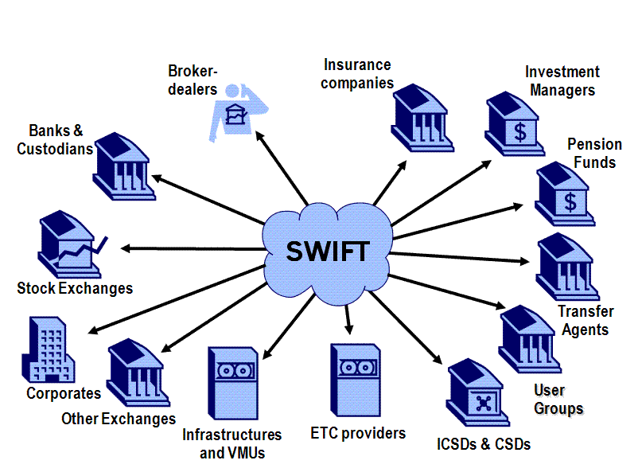
SWIFT
The global provider of secure financial messaging services.
By customer:
Banks
Corporate
Custodians
Brokers/Dealers
Banking Market Infrastructures

Slide 10
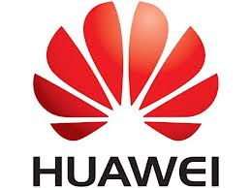
SWIFT: Clients
Notes:
Different Clients Swift , use Swift Alliance

Slide 11
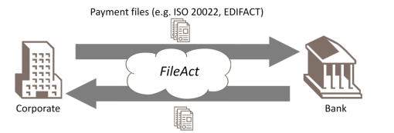
SWIFT: Different typology
Notes:
1.Standard situation
2.Low value/non urgent payments and reporting
3.High Value

Slide 12
SWIFT: Introduction SWIFT Environment
A typical SWIFT customer environment consists of a combination of individual components that interact with each other to provide messaging services.
DMZ - No problem to Nagios ☺
HSM - Check_HSM
HTTPS - Check_https
MQ - Check_mq ; Check_MK
PKI - Check_ssl ; Check_ipsec
VPN box - Check_openvpn

Slide 13
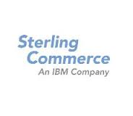
SWIFT: Inside Bank Enviroment
Perimeter Server
IMG
GMM
GMM
Notes:
Perfecta integración de las transacciones de business partners
Permite el intercambio de datos, independientemente de los protocolos de comunicación o de los formatos de datos
Mejora la habilidad y el control de la cadena de suministro con inteligencia empresarial en tiempo real

Slide 14
OUR SOLUTION-Sterling-Buzón
Notes:
This plugin help me to know like to measure the time that the files have been slow to be sent or received.
This monitor was designed to see how fast could receive files from SWIFT, taking detailed time in milliseconds,

Slide 15
FIX-Protocol
The FIX Protocol, as a cooperative effort of principal asset management and brokerage firms in the US and Europe, has evolved to an effective standard for real-time electronic communication. Shortened settlement dates, straight through processing, and increased interest in electronic connectivity has positioned FIX to be major component of real-time

Slide 16
Example

Slide 17
Example
Notes:
example of information we receive in real time via Nagios Monitoring Operations (in this case a rejection of a request by a client) .

Slide 18
Example –Fix Protocol
Notes:
Revision mornign before meeting,
Also

Slide 19
Conclusions
There isn’t special monitoring tool for Corporate finance Investment world.
It’s true principal bank application has monitoring tool like Bloomberg.
If you are Test Manager in a bank, you prefer a monitoring tool what allows to have a global vision of the banking environment.
Nagios is the tool
Let´s work
Notes:
No hay una herramienta de monitorización especial para el mundo del Corporate finance Investment..
Cierto que hay aplicaciones que tiene herramientas de monitorización como Bloomberg
Si tu eres el TestManager en un banco tu prefieres una herramienta que te permita tener una visión global de todo el entorno…

Slide 20
Questions?
Thanks

Slide 21
The End
Paloma Giraudo
pgalan@nagios.com @Nagios_esp

