Slide 1
How To Maintain Over 20 Monitoring Appliances
Rob Hassing
rob.hassing@deltics.com
Notes:
Welcome everybody, my name is Rob Hassing I’m an consultant at Deltics.
Deltics is a system integrator based in the Netherlands who also has over 20 customers where we do maintenance and support. This is for either the entire environment or just parts of their infrastructure. In this presentation I will tell about the way we maintain over 20 monitoring appliances.

Slide 2
Introduction & Agenda
History
Installation
Look and Feel
Administration
Alerting
Maintenance
Checks
Conclusion
Questions

Slide 3
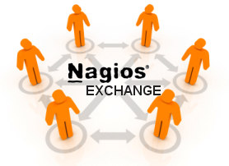
Deltics Nagios Appliance

Slide 4
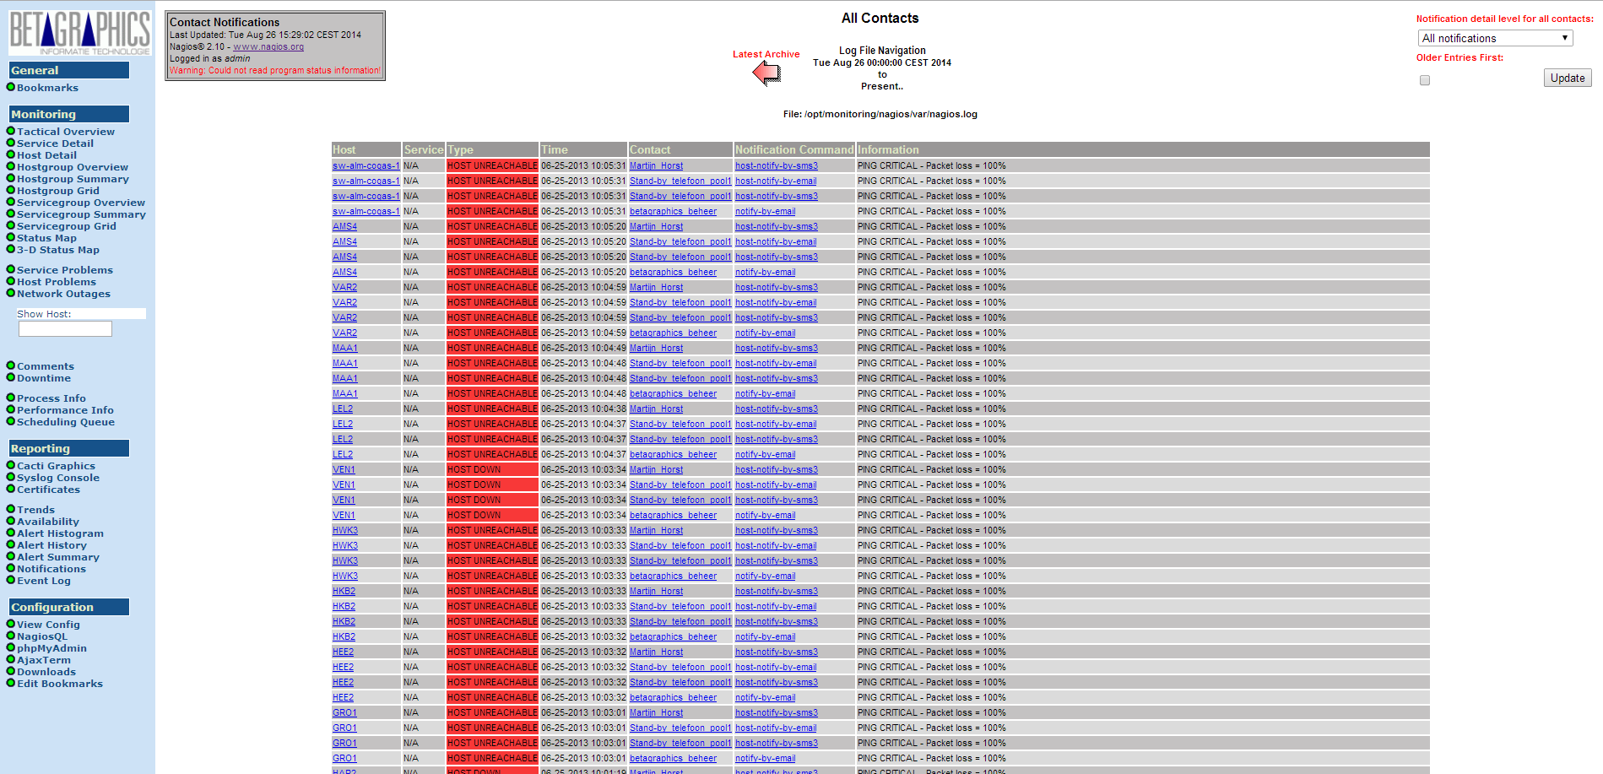
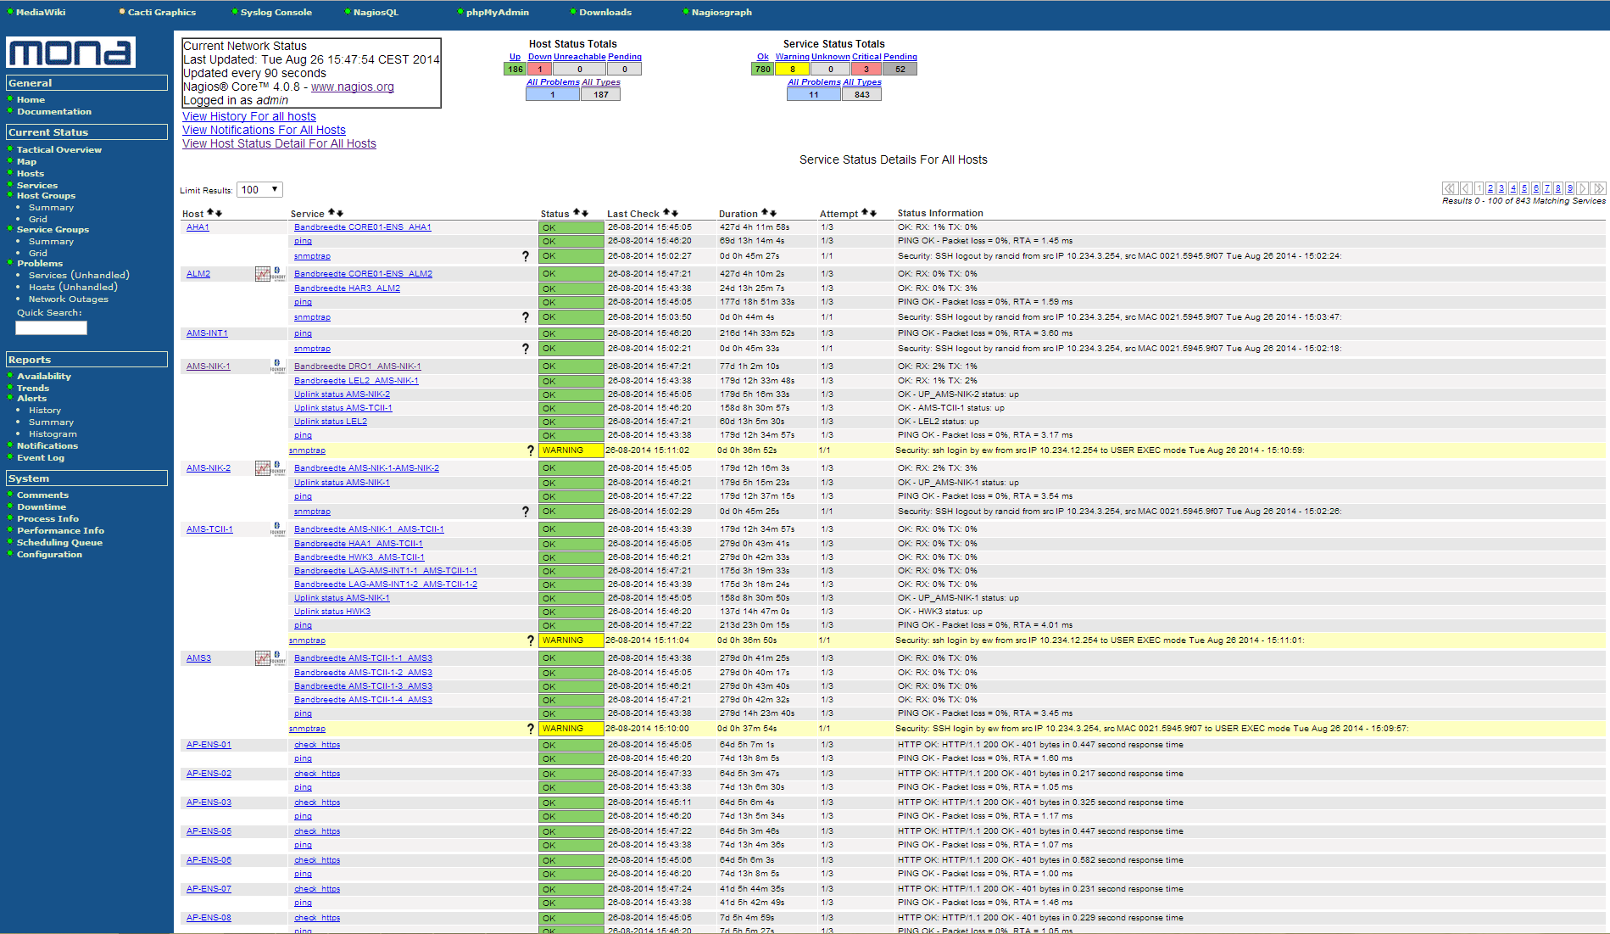
History
Version 1
Installed in /opt/monitoring
Using compiled sources
Hardly upgradable
Version 2
Installed in the “usual” paths
Using pre-compiled RPM packages
Upgradable using yum
Introduced SNMP monitoring
Using SNMPTT for snmptraps
SMS text alerting

Slide 5
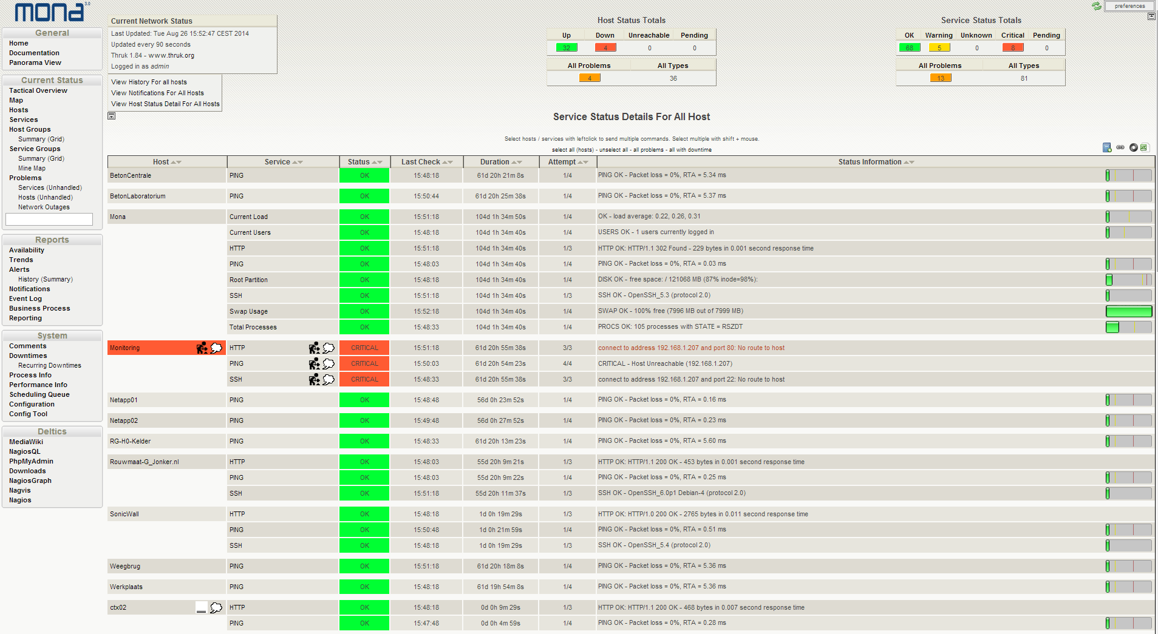
History
Version 3
Based on Nagios 4.X
Latest NagiosQL for configuration
New frontend / webinterface (Thruk)
Saltstack (salt-ssh) for global configuration
Useraccounts for all engineers
Sflow
RRDTool

Slide 6
Installation
Based on CentOS 6.5
Extra repositories (EPEL + Deltics)
Standard packages for Thruk / RRDTool / phpMyAdmin / MediaWiki enz.
Adjusted or own RPM files for Nagios / NagVis / thirdparty / NagiosQL / Mona_BG / nagios_plugins_BG / nagios_plugins / smstools3

Slide 7
Installation
Using PXE boot for initial installation
Kickstart file for default configuration
Using RPM dependencies in mona_BG to install all packages needed
Default CentOS and EPEL for most packages
Using the Deltics repository for self created packages

Slide 8
Installation

Slide 9
Look and Feel

Slide 10
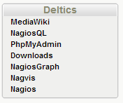
Look and Feel
Extra added menu for additional tools
Mediawiki for customer information
NagiosQL for web based configuration
PhpMyAdmin for MySQL management
Downloads for custom download map (for firmware or other software)
NagiosGraph for performance output graphics
Nagvis for a graphical overview of the customer environment
Nagios for the default Nagios (Mona v2) webinterface

Slide 11
Deltics Nagios network

Slide 12
Deltics - Administration

Slide 13
Deltics - Administration
That’s a total of:
2447 Hosts
&
7903 Service checks
in
24 Nagios installations

Slide 14
Multiple useraccounts
In Nagios it is possible to use as many useraccounts you like.
25 useraccounts are currently used, for engineers and customerview accounts.
Password recovery (setting a new password) can be done via a webpage.

Slide 15
(Re)set the passwords
#!/bin/bash
name=$1;
passwd=$2;
mailaddress=$3;
echo "<h1> The new password for:<font color=red> $name </font> is now: <font color=red>$passwd</font></h1><br><br>“
echo "<br><br><br>"
sudo /usr/bin/salt-ssh "*" -r "sudo htpasswd -D /etc/nagios/htpasswd.users $name"
sudo /usr/bin/salt-ssh "*" -r "sudo htpasswd -mb /etc/nagios/htpasswd.users $name $passwd"
echo "<br><br><br>"
echo "<h1>An email message is sent to: <font color=red>$mailaddress </font>, did you not get the message please contact: <a href=mailto:rob.hassing@deltics.nl>Rob Hassing</a><br><br><br></h1>"
# Email text/message
EMAILMESSAGE=“The password for $name is changed to: $passwd"
# send an email using /bin/mail
echo $EMAILMESSAGE | /bin/mail -s “The new password for the Nagios Monitoring systems" "$mailaddress"

Slide 16
Notifications using Nagios
In Nagios you are able to create any event to notify the engineer/customer.
SMS text alerting is used to notify the on call engineer.
For backup an email is send to a corporate Google apps account.

Slide 17
SMS text alerting

Slide 18
SMS Acknowledgement
An incoming SMS text message is received by the SMSD daemon
The configuration says it has to start a script called ‘sms_incoming.pl’
This perl script updates the database an writes a file
A cronjob looks in the directory for new files
The MySQL database is altered and the file is processed and deleted

Slide 19
Change the on call engineer
Normally every week the on call engineer changes to the next person.
The “contacts.cfg” needs to be adjusted to send the notifications to the correct engineer.
On the central server a webpage is available to change who is on call.
All servers for this pool have to be changed.
Ssh scripts are used to change the settings everywhere.

Slide 20
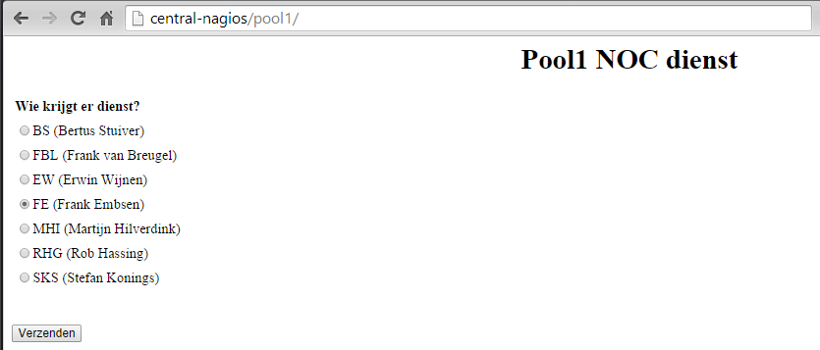
Change the on call engineer
The webinterface indicating who is on call now, and the possibility to change that.

Slide 21
Change the on call engineer
#!/bin/bash
newnumber=$1;
name=$2;
oldnumber=`grep -A1 pool1 /etc/nagios/contacts.cfg | grep pager | awk '{print $2}'`;
echo “The old number is: $oldnumber <br>";
/usr/bin/mysql -unagiosqlusr -ppassword -e "UPDATE db_nagiosql_v2.tbl_contact SET pager='$newnumber' WHERE contact_name LIKE '%pool1%';";
/usr/local/bin/change_pool_tel.pl pool1 $newnumber /etc/nagios/contacts.cfg >> /etc/nagios/contacts.cfg.new || ( echo "fout [$newnumber]" ; exit 1 )
mv -f /etc/nagios/contacts.cfg /etc/nagios/contacts.cfg.org;
mv -f /etc/nagios/contacts.cfg.new /etc/nagios/contacts.cfg;
chown apache /etc/nagios/contacts.cfg;
now=`date +%s`
commandfile='/var/nagios/rw/nagios.cmd'
echo "Restart nagios <br>"
printf "[%lu] RESTART_PROGRAM" $now > $commandfile
ennu=$newnumber;
echo “The new number is: $ennu <br>";
smstext=“You are on call...for $HOSTNAME"
/usr/local/bin/sms_nagios.pl $ennu "$smstext"
echo “CustomerA";
ssh root@10.234.7.3 "/usr/local/bin/changes.sh $ennu";
echo "<br>";
echo "mail";
/usr/local/bin/python2.7 /usr/local/bin/gam/gam.py user pool1@deltics.info forward on $name keep
# Email text/message
EMAILMESSAGE=“Now $newname will receive the mail for pool1@deltics.info"
# send an email using /bin/mail
echo $EMAILMESSAGE | /bin/mail -s “Mail for pool1 is being sent to you…" "pool1@deltics.info"

Slide 22
Change the on call engineer
Central server
Remote servers
Changing contacts.cfg
Changing contacts.cfg
Altering MySQL database
Altering MySQL database
Restart Nagios
Restart Nagios
Start scripts on remote Nagios servers
A text message and email is send to the new on call engineer

Slide 23
Maintenance
Updates are installed via a yum repository
Global updates are installed using salt-ssh to update all systems simultaneous
salt-ssh “*” -r “sudo yum -y update”
salt-ssh "*" -r "cd /etc/nagios && \
sudo mv cgi.cfg cgi.cfg.org && \
sudo wget http://betagraphics.blankurl.com/cgi.cfg && \
sudo chown -R nagios.apache cgi.cfg && sudo chmod g+w cgi.cfg"
New checks are installed by RPM package
And are manually configured in NagiosQL

Slide 24
Maintenance
Backup via webdav to the repository server
#! /bin/bash
day=`date '+%A'`
cd /opt/backup/mysqldump/
tar zcvf nagios-log.tgz /var/log/nagios/
tar zcvf nagiosgraph-rrd.tgz /var/spool/nagiosgraph/
cadaver <<EOF
mkdir $HOSTNAME
cd $HOSTNAME
mput mysql$day.txt
mput wikidb$day.txt
mput db_nagiosql_v2$day.txt
mput nagios-log.tgz
mput nagiosgraph-rrd.tgz
quit
EOF

Slide 25
Checks
Some possible host and service checks:
Standard
Ping, Cpu, Memory, Disk (via snmp)
Microsoft windows services checks
Check Citrix, MSSQL and Exchange (snmp and WMI)
Protocol checks
TCP check
Imap, smtp, http check
NetApp checks
Health check
Volume en LUN checks
Snapmirror lagtime
HP MSM wireless checks

Slide 26
Conclusion
We continue to develop on our Nagios monitoring appliance
Always the latest releases of Nagios will be used
New features can easily be build in
Customer requests are build in (extra checks)
Next steps:
Easier way of deploying new checks in MySQL backend
Make collections of Nagios installations for each pool using Thruk.

Slide 27
Questions?
Any questions?
Thanks!
Notes:
Thank you all for taking the time to see my presentation, that is highly appreciated. Are there any questions?

Slide 28
The End
Rob Hassing
rob.hassing@deltics.nl

