Slide 1
Visualization and alerting with RRD, Nagios XI, and PNP
Rob Seiwert
rob@vcaglobal.com

Slide 2
Introduction
IT Director for Video Corporation of America for the last 18 years.
Used Big Brother since Beta until 2011.
Used MRTG pre RRD and RRD from Beta.
Moved to Nagios Core in 2011.
Moved to Nagios XI in 2012.

Slide 3
Introduction & Agenda
A Real World Problem
Trending and Prediction using RRD
Creating Cool PNP Templates
The problem with Cool Visualizations
LSL and what does it all mean
A Proactive Solution

Slide 4
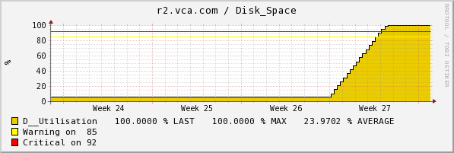
Real World Problem
Run away processes consuming SAN storage
Virtual Storage complicated and masked the issue
Wanted earlier notice of pending issues
Needed to work with my history

Slide 5
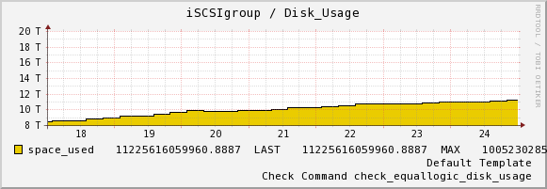
Looking for Something Better
This doesn’t look so bad does it?

Slide 6
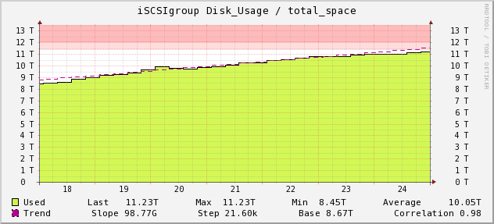
A little better

Slide 7
Trending Options in RRD
Holt-Winters Forecasting (RRA)
Trend
Predict
Least Squares Line

Slide 8
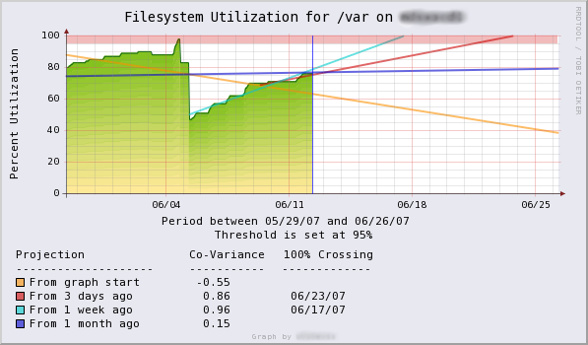
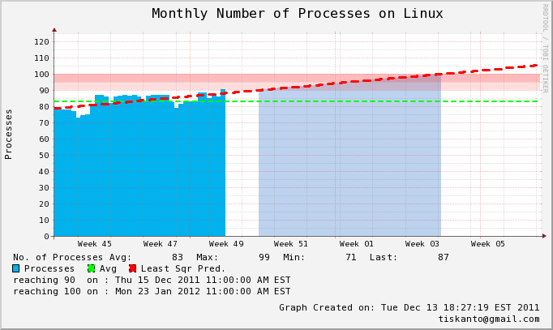
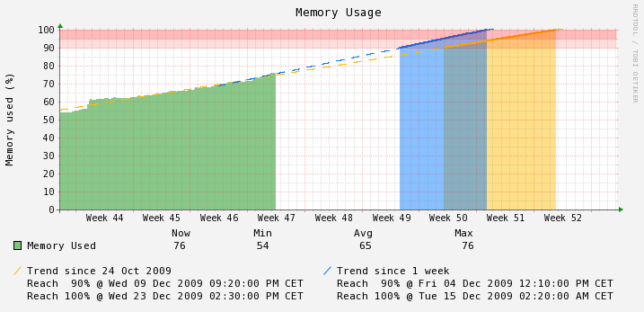
LSL Trending using RRDTool
http://tiskanto.blogspot.com/2011/12/trend-predictions-with-rrd-tool-not-so.html
http://blog.hermione.de/?p=67
http://hints.jeb.be/2009/12/04/trend-prediction-with-rrdtool/

Slide 9
Getting it into Nagios / PNP
Custom Templates are stored at two places in the file system.
share/templates.dist - for templates included in the PNP package
share/templates - for custom made templates which are not changed during updates
If the graph for the service “http” on host “localhost” should be shown, PNP will look for the XML file perfdata/localhost/http.xml and read its contents. The XML files are created automatically by PNP and contain information about the particular host and service. The header contains information about the plugin and the performance data. The XML tag <TEMPLATE> identifies which PNP template will be used for this graph.

Slide 10
Finding the Template
PNP will append .php to the template value found in the xml and look for a template with the name check_http.php in the following sequence:
templates/check_http.php
templates.dist/check_http.php
templates/default.php
templates.dist/default.php
The template default.php takes an exceptional position as it is used every time no other applicable template is found.

Slide 11
XML Contents
Useful information from the PNP XML files is available within your template.
<NAGIOS>
<DATASOURCE>
<TEMPLATE>check_http</TEMPLATE>
<DS>1</DS>
<NAME>time</NAME>
<UNIT>s</UNIT>
<ACT>0.006721</ACT>
<WARN>1.000000</WARN>
<CRIT>2.000000</CRIT>
<MIN>0.000000</MIN>
<MAX></MAX>
</DATASOURCE>
Notes:
http://docs.pnp4nagios.org/pnp-0.6/tpl

Slide 12
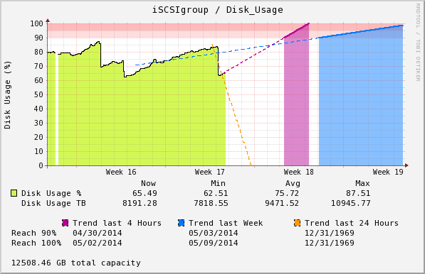
PNP Templates
Building the RRD options
$opt[1] = "--vertical-label \"Disk Usage (%)\" --height 200 -l 0 -u 100 --upper-limit 100 --title \" $hostname / $servicedesc\" ";
$opt[1] .= " --start now-7d --end now+7d --right-axis 1:0 ";

Slide 13
Building Graph Definition
Define the RRD data to test
$def[1] .= "DEF:used1=$rrdfile:$DS[1]:AVERAGE ";
# used2 = data used to calc 1 day trend
$def[1] .= "DEF:used2=$rrdfile:$DS[1]:AVERAGE:start=now-1d ";
# used2 = data used to calc 2 day trend
$def[1] .= "DEF:used3=$rrdfile:$DS[1]:AVERAGE:start=now-2d ";
# used3 = data used to calc 1 week trend
$def[1] .= "DEF:used4=$rrdfile:$DS[1]:AVERAGE:start=now-7d ";

Slide 14
Whats a DEF?
DEF
DEF:<vname>=<rrdfile>:<ds-name>:<CF>[:step=<step>][:start=<time>][:end=<time>]
This command fetches data from an RRD file
CDEF
CDEF:vname=RPN expression
This command creates a new set of data points (in memory only, not in the RRD file) out of one or more other data series.
VDEF
VDEF:vname=RPN expression
This command returns a value and/or a time according to the RPN statements used.

Slide 15
What’s a RPN Expression
RPN = Reverse Polish Notation
In reverse Polish notation the operators follow their operands; for instance, to add 3 and 4, one would write "3 4 +" rather than "3 + 4". If there are multiple operations, the operator is given immediately after its second operand; so the expression written "3 − 4 + 5" in conventional notation would be written "3 4 − 5 +" in RPN: 4 is first subtracted from 3, then 5 added to it. An advantage of RPN is that it obviates the need for parentheses that are required by infix.
http://en.wikipedia.org/wiki/Reverse_Polish_notation

Slide 16
Working in Percent
I decided to visualize this as a percentage. Could just as well been Bytes.
The plugin author in this case had decided to put the max space in as a second data source probably due to the virtual and dynamic nature of the Storage Pool.
$def[1] .= "DEF:cap=$rrdfile:$DS[2]:MAX ";
$def[1] .= "CDEF:pused1=used1,100,*,cap,/ ";
$def[1] .= "CDEF:pused2=used2,100,*,cap,/ ";
$def[1] .= "CDEF:pused3=used3,100,*,cap,/ ";
$def[1] .= "CDEF:pused4=used4,100,*,cap,/ ";
This uses gets the max capacity from the second data source in the Perf data then creates calculated datasets as a percent for each range using reverse polish notation.

Slide 17
Getting the LSL Trend
$def[1] .= "VDEF:D2=pused2,LSLSLOPE "; # this is the slope (m)
$def[1] .= "VDEF:H2=pused2,LSLINT "; # this is the y intercept
$def[1] .= "VDEF:C2=pused2,LSLCORREL "; # this is the Correlation Coeffient
$def[1] .= "CDEF:trend2=pused2,POP,D2,COUNT,*,H2,+ "; # new cdef with trend
$def[1] .= "CDEF:trend2limit=trend2,0,100,LIMIT "; # trim the trend to run from 0 to 100
$def[1] .= "CDEF:danger2=trend2,90,100,LIMIT "; # find the danger zone
$def[1] .= "VDEF:min2=danger2,FIRST "; # datapoint that crosses 90%
$def[1] .= "VDEF:max2=danger2,LAST "; # returns the datapoint that crosses 100%
The forth line creates the trend line. Each cdef must have a time reference so we push a dataset into the equation and pop it off. This just gives us a valid cdef. Next push the slope and and count (aka x) and multiply them. Next we add in the y intercept.
Basically line 4 builds a data set using the equation: y = mx + b
Repeat for all other data sets you want to trend. At this point we have all we need. Time to make the chart

Slide 18
Adding the Lines
$def[1] .= "AREA:pused1#BDF400AA:\"Disk Usage % \" ";
$def[1] .= "LINE1:pused1#000000 ";
$def[1] .= "LINE1:trend4limit#B70094:\"Trend last Week \":dashes ";
$def[1] .= "LINE1:trend3limit#0077FF:\"Trend last 2 Days \":dashes ";
$def[1] .= "LINE1:trend2limit#FF9900:\"Trend last 24 Hours\\n\":dashes ";

Slide 19
Adding the Danger Zone
$def[1] .= "AREA:danger4#B7009477 ";
$def[1] .= "AREA:danger3#0077FF77 ";
$def[1] .= "AREA:danger2#FF990077 ";
$def[1] .= "LINE2:danger4#B70094 ";
$def[1] .= "LINE2:danger3#0077FF ";
$def[1] .= "LINE2:danger2#FF9900 ";

Slide 20
Adding the Danger Zone Markers
Cool alternate to warning and critical lines.
This creates the two pink bars from 90% to 100%
$def[1] .="LINE1:90 AREA:5#FF000022::STACK AREA:5#FF000044::STACK ";

Slide 21
Adding the Danger Dates
$def[1] .= "COMMENT:\"Reach 90% \" ";
$def[1] .= "GPRINT:min4:\"%x\":strftime ";
$def[1] .= "GPRINT:min3:\"%21x\":strftime ";
$def[1] .= "GPRINT:min2:\"%21x\\n\":strftime ";
$def[1] .= "COMMENT:\"Reach 100%\" ";
$def[1] .= "GPRINT:max4:\"%x\":strftime ";
$def[1] .= "GPRINT:max3:\"%21x\":strftime ";
$def[1] .= "GPRINT:max2:\"%21x\\n\":strftime ";

Slide 22
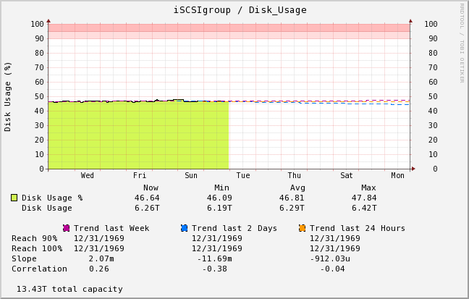
End Result

Slide 23
Second Chart
This second chart is simpler but follows the same layout. The difference is that it takes the PNP time range and extends the chart by the same amount giving you a dynamic trend. In this example, it’s the standard 24 hour period and the template adds another 24 hours into the future.

Slide 24
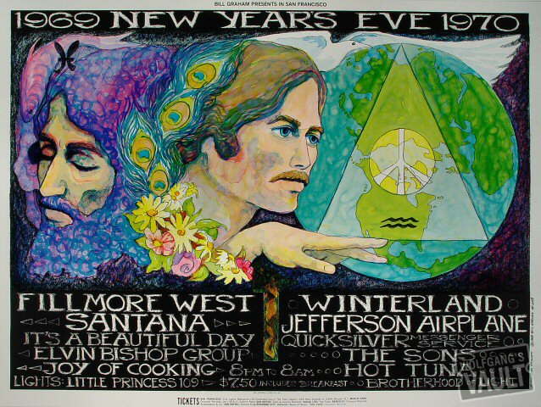
Strftime and Unknown Dates
http://www.wolfgangsvault.com/santana/poster-art/poster/BG209.html

Slide 25
The Problem with Pretty Charts
Had my chart that predicted when my SAN would hit 100%. As disk usage increased and decreased you could see the trending lines jump.
The problem with cool visualizations is that they have to be watched.
It seemed to me that it should be possible to build an alert using the data available in RRD.

Slide 26
LSL – Least Squares Line
LSLSLOPE, LSLINT, LSLCORREL
Return the parameters for a Least Squares Line (y = mx +b)
which approximate the provided dataset.
LSLSLOPE is the slope (m) of the line related to the COUNT position of the data.
LSLINT is the y-intercept (b), which happens also to be the first data point on the graph.
LSLCORREL is the Correlation Coefficient
(also know as Pearson's Product Moment Correlation Coefficient).
It will range from 0 to +/-1 and represents the quality of fit for the approximation.
$def[1] .= "VDEF:D2=pused2,LSLSLOPE "; # this is the slope (m)
$def[1] .= "VDEF:H2=pused2,LSLINT "; # this is the y intercept
$def[1] .= "VDEF:C2=pused2,LSLCORREL "; # this is the Correlation Coeffient
Notes:
http://en.wikipedia.org/wiki/Least_squares

Slide 27
What is the Slope
Rise over Run
Rate of Change
describes both the direction and the steepness of the line.
denoted by the letter m in y=mx+b
For RRD is the rate of change for each step in the dataset

Slide 28
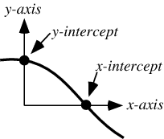
What is the Y-Intercept
The point at which a curve or function crosses the y-axis
Basically the Starting point for Y when X=0
Notes:
http://mathworld.wolfram.com/y-Intercept.html

Slide 29
What is the Correlation Coefficient
The linear correlation between the data set and the resultant slope.
represents the quality of fit for the approximation
Returns a value between +1 and −1 inclusive
1 is total positive correlation
0 is no correlation
−1 is total negative correlation.
Notes:
http://en.wikipedia.org/wiki/Pearson_product-moment_correlation_coefficient

Slide 30
What is the Correlation Coefficient
Notes:
http://en.wikipedia.org/wiki/Pearson_product-moment_correlation_coefficient

Slide 31
What is the Correlation Coefficient
Notes:
http://en.wikipedia.org/wiki/Pearson_product-moment_correlation_coefficient

Slide 32
Solving for X
Knowing the maximum capacity for y (100%) and y=mx+b after calculating the LSLSlope(m) and the LSLINT(b) we can solve for x.
x=(y-b)/m
Question is what is X really?

Slide 33
What is X Really?
X is the number of steps to reach the upper limit
Knowing the step size is critical. Be aware setting step on the DEF or the options doesn’t guarantee that is the step used.
X * stepsize = number of seconds to reach 100% from the beginning of the trend

Slide 34
Building the check
result=$(rrdtool graph --width 4000 --step $step \
DEF:used1=/usr/local/nagios/share/perfdata/iSCSIgroup/Disk_Usage.rrd:1:AVERAGE:start=now-48h:step=$step \
DEF:used2=/usr/local/nagios/share/perfdata/iSCSIgroup/Disk_Usage.rrd:1:AVERAGE:start=now-48h:step=$step \
DEF:cap=/usr/local/nagios/share/perfdata/iSCSIgroup/Disk_Usage.rrd:2:MAX \
VDEF:SLOPE2=used2,LSLSLOPE \
VDEF:H2=used2,LSLINT \
VDEF:C2=used2,LSLCORREL \
CDEF:c=used2,COUNT,EXC,POP \
CDEF:t=used2,TIME,EXC,POP \
VDEF:tmin=t,MINIMUM \
VDEF:tmax=t,MAXIMUM \
VDEF:cmax=c,MAXIMUM \
CDEF:s=used2,POP,tmax,tmin,-,cmax,1,-,/ \
PRINT:SLOPE2:'%lf' \
PRINT:H2:'%lf' \
PRINT:C2:'%4.2lf' \
PRINT:SLOPE2:'%4.2lf%s' \
PRINT:cap:MAX:'%lf' \
PRINT:s:MAX:'%16.0lf' \
PRINT:tmin:'%16.0lf' \
PRINT:tmax:'%16.0lf')

Slide 35
Building the Check
if [ "X$result" != "X" ] ; then
# split results to $1 $2 etc
set $result
else
# no results must be error
exit
fi
timerange="Data Analyized Starting $(date -d @$8) - Ending $(date -d @$9)"
# $2 = Slope = m
# $3 = y-intercept = b
# $4 = Corralation Coefficient
# $5 = Slope, SI Scaled
# $6 = Max Capacity
# $7 = Step
# $8 = Start Time (sec since epoch)
# $9 = End Time (secs since epoch)

Slide 36
Building the Check
status=0
buf="Reach 100% on $(date -d @$reach100in) Slope $5 per $7 seconds Correlation Coefficient $4"
timetill=$(($reach100in-$now))
if [ $timetill -lt $(($day*30)) ] ; then
status=1
buf="WARNING: $buf"
fi
if [ $timetill -lt $(($day*2)) ] ; then
status=2
buf="CRITICAL: $buf"
fi
echo $buf
echo $timerange
echo "|'Rate of Change per Min'=$2"
exit $status

Slide 37
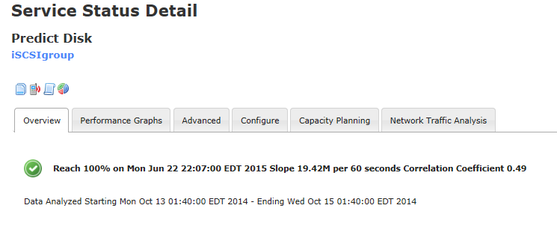
Resulting Check

Slide 38
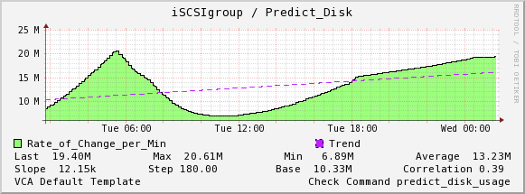
“Performance Data”

Slide 39
Other Lessons Learned
RRD Step Size is not always what you think
Data Resolution will affect your results
Follow the Perf Data API
Use Bytes without UOM and let RRD Scale
Default Template differs between PNP and XI
Use Check_pnp_rrd.pl

Slide 40
Follow the PerfData API
Nagios PerfData API
https://nagios-plugins.org/doc/guidelines.html#AEN200
'label'=value[UOM];[warn];[crit];[min];[max]
Recommend setting all fields available
In my real world example the plugin author had decided to list volume and snapshot reserves in the warn and crit fields and put the max value into a second dataset. Follow the standard!

Slide 41
SI: Le Système International d'Unités
The International System of Units
the modern form of the metric system and is the world's most widely used system of measurement. It comprises a coherent system of units of measurement built around seven base units,
http://en.wikipedia.org/wiki/Second

Slide 42
SI Scaling
Metric prefixes in everyday use
Text | Symbol | Factor
tera | T | 1000000000000
giga | G | 1000000000
mega | M | 1000000
kilo | k | 1000
hecto | h | 100
deca | da | 10
(none) | (none) | 1
deci | d | 0.1
centi | c | 0.01
milli | m | 0.001
micro | μ | 0.000001
nano | n | 0.000000001
pico | p | 0.000000000001
http://en.wikipedia.org/wiki/Metric_prefix

Slide 43
Questions?
Any questions?
Thanks!

Slide 44
The End
Robert C. Seiwert
rob@vcaglobal.com

