Slide 1
Developing Your Own Plugin With Your Imagination
Rodrigo Faria
Email: rmfaria@ma.nagios.com

Slide 2
Introduction
Developing your own plugin
Not much knowledge needed
Using models
Understanding output
Implementation examples
Conclusion
Notes:
Today we´re going to talk about how to develop your own plug-ins for Nagios,
The initial idea is to use the most simple way to develop plugins without much programming knowedge. And of course, we can use ready made models to understand better.
After that we´ll have a look at output and a couple of real world examples.

Slide 3
Three Ways
Developing your own plugin
  First step: declare / get information
  Second step: core plugin / decision
  Third step: output / graphs & gauges
Notes:
We have three steps, the first is where our data will come from,
The Second is the deciding factor ( OK, Warning or Critical )
And the third step, is the generation of messages and graphs.

Slide 4
Required Information Before First Step
Numeric Value | Service Status | Status Description
0 | OK | The plugin was able to check the service and it appeared to be functioning properly
1 | Warning | The plugin was able to check the service, but it appeared to be above some "warning" threshold or did not appear to be working properly
2 | Critical | The plugin detected that either the service was not running or it was above some "critical" threshold
3 | Unknown | Invalid command line arguments were supplied to the plugin or low-level failures internal to the plugin (such as unable to fork, or open a tcp socket) that prevent it from performing the specified operation. Higher-level errors (such as name resolution errors, socket timeouts, etc) are outside of the control of plugins and should generally NOT be reported as UNKNOWN states.
Notes:
It´s important to understand that Nagios plugins work like connectors between Nagios Core and the Monitored System,
Each check that Nagios Core is performing, and will give an output of 0, 1, 2 or 3 - like the table.
The code is then returned to the plugin.

Slide 5
Code Flow Example
RUN COMMAND
RUN SCRIPT
RETURN 0 1 2 3
NAGIOS PROCESS
PLUGINS
RETURN SCRIPT
MONITORED
SYSTEM
Notes:
This is an example:
Here we will see The Nagios Process running commands that have associated scripts in commands.cfg to perform ( run ). with all commands associated with the plug-ins.
The code flows like here in the image –
1 – Nagios runs the command
2 – calls the plugin
3 – the plugin runs the script 4 – to the monitored system
5 – the monitored system returns the result of the script back to the plugin
6 – lastly, the plugin returns 0,1,2 OR 3 back to Nagios Process
This is a simple way to explain the flow.

Slide 6
First example: Real Estate Agency
Notes:
In this example we can see a Real Estate Agency who want to change from paper to online, for their monthly reports
The Real Estate Agency needs to show goals in their sales screen statistics – On this screen they would like to view completed sales, reservations and cancelations.
They have a system that can get the data through url or files but they do not have a realtime information dashboard.
Now we will be able to see the steps running in the nagios process.

Slide 7
  First Step: Declare / Get Information
Notes:
First, you need to decide what you need monitored.
Then, you can get information from the file, wget via url, snmpget or query DB.
There are also other methods that use NSclient and others.

Slide 8
Simple PHP: Declare and Get Info
########################### HEADER PHP SCRIPT
#!/usr/bin/env php
<?php
########################### GET INFORMATION
$file=file_get_contents('/tmp/basimovelescriturado', true);
########################### DECLARE VARIABLE AND VALUES TO USE
$goal=100000000;
$division = $file / $goal;
$percentage = $division * 100;
Notes:
In this case, well we will use php.
Here, you can see variable receive file contentes and you can use this to get information via the other ways we saw in the last slide.
The idea here is to show a simple way to finish your own plugin
Variable $goal Receives the value that the sales manager wanted.
For the next two, you divide the file by the goal and multiply by one hundred to get the percEntage

Slide 9
  Second Step: Core Plugin / Decision
if ($percentage >= 60)
{
$output_msg = "GOAL REACHED = $percentage%, REACHED = $file Dollars";
$exit_code = 0;
display_output($exit_code, $output_msg);
}
else
if ($percentage >= 30)
{
$output_msg = "GOAL FINISHED IN $percentage for 60%, REACHED = $file Dollars";
$exit_code = 1;
display_output($exit_code, $output_msg);
}
else
{
$output_msg = "GOAL NOT YET REACHED, REACHED = $file Dollars";
$exit_code = 2;
display_output($exit_code, $output_msg);
}
function display_output($exit_code, $output_msg) {
print $output_msg;
exit($exit_code);
}
?>
Notes:
Explain script:
All right, here is the core plugin.
Now, the plugin will make a decision based on the information it received. If the value returned is 0 it returns Ok, 1 returns Warning and 2 returns Critical.
If the percentage of the goal is more than 60%, that is OK and will return 0
If it is between 30 and 60, that is a warning and will return 1
If it is less than 30%, the Goal has not been reached.
The most importante alert is when the sensor returns an OK and the sales manager receives the message that the goal was reached.

Slide 10
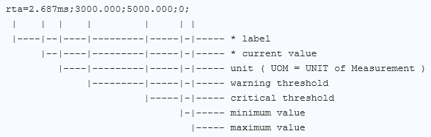
Third Step: Rules of Performance
Here is a breakdown of the performance data
The asterix (*) fields are required fields, everything else is optional.
In this instance, rta in our case is percentage of goal
Notes:
For use output performance, We need to follow the rules in this slide.
First is label and the second is current value, here – the warning and critical value are the last two in the scale ( In our case/ percentage 0 to 100 )

Slide 11
  Third step: Output
if ($percentage >= 60)
{
$output_msg = "GOAL REACHED = $percentage%, REACHED = $file Dollars";
$exit_code = 0;
display_output($exit_code, $output_msg);
}
else
if ($percentage >= 30)
{
$output_msg = "GOAL FINISHED IN $percentage for 60%, REACHED = $file Dollars";
$exit_code = 1;
display_output($exit_code, $output_msg);
}
else
{
$output_msg = "GOAL NOT YET REACHED, REACHED = $file Dollars";
$exit_code = 2;
display_output($exit_code, $output_msg);
}
function display_output($exit_code, $output_msg) {
print $output_msg;
exit($exit_code);
}
?>
Notes:
Now we can compare this with the next slide and our output parametrs.

Slide 12
  Third step: Output Performance
if ($percentage >= 60)
{
$output_msg = "GOAL REACHED = $percentage%, REACHED = $file Dollars | Goal-Monthly=$percentage%;30;60;0;100";
$exit_code = 0;
display_output($exit_code, $output_msg);
}
else
if ($percentage >= 30)
{
$output_msg = "GOAL FINISHED IN $percentage for 60%, REACHED = $file Dollars | Goal-Monthly=$percentage%;30;60;0;100";
$exit_code = 1;
display_output($exit_code, $output_msg);
}
else
{
$output_msg = "GOAL NOT YET REACHED, REACHED = $file Dollars | Goal-Monthly=$percentage%;30;60;0;100";
$exit_code = 2;
display_output($exit_code, $output_msg);
}
function display_output($exit_code, $output_msg) {
print $output_msg;
exit($exit_code);
}
?>
Notes:
In my opinion, this is the better step, here you can print the result in nagios XI if you follow the rules to generate output

Slide 13
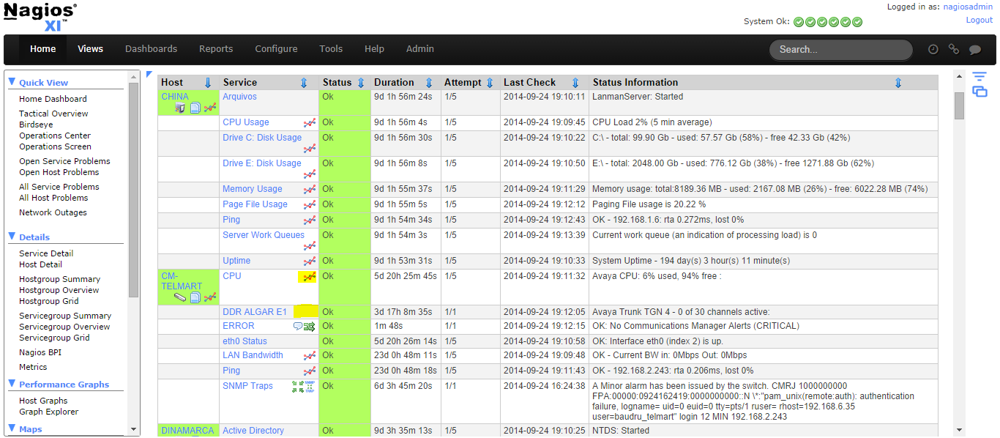
Third Step: Output on Service View
Notes:
Here we can see output without performance.
For everything that has output performance, you can see the icon in nagios XI.

Slide 14
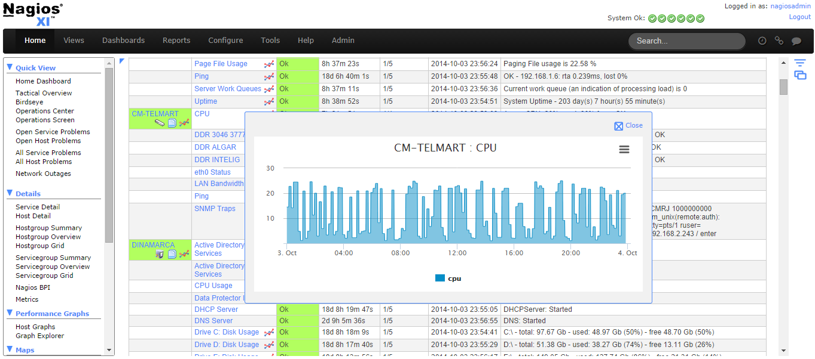
Third Step: What Can I Do ?
Notes:
When you put the output rules, nagios XI automatically generates graphs, SO - What can we do with this?

Slide 15
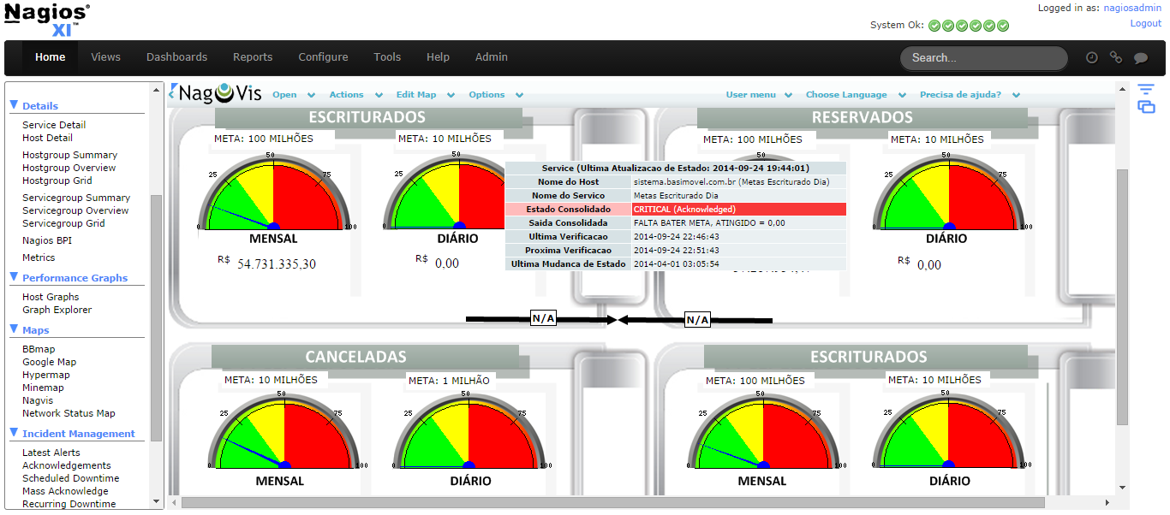
RESULT with Nagvis
Notes:
The first version was made in Nagvis,
if you have an output, you can use native GAYJIZ (gauges), but it is a little difficult to look at
These were made in Nagios XI 2012,
But in Nagios XI 2014 it looks like .......

Slide 16
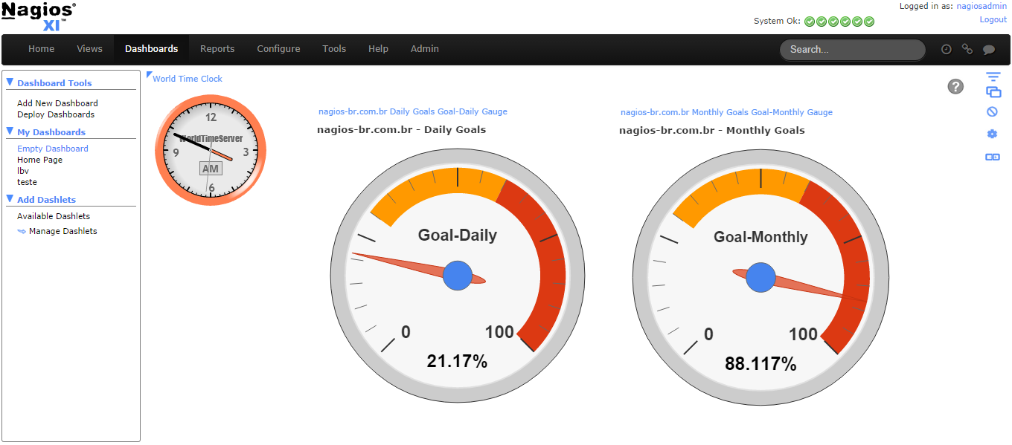
RESULT with Nagios XI 2014
Notes:
...This
With nagios XI 2014, the gauges appears automaticaly when you use the output performance rules,
in this case, the Real Estate Agency now have a good panel to use on Screens to show the goal percentage in real time, using the nagios process.

Slide 17
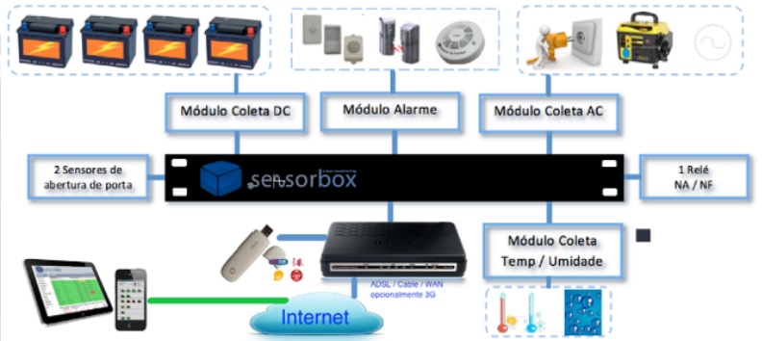
Second Example: Tempture Sensor
Notes:
I will talk about a second example. The company provide service that monitor a few sensors. The main business for the company is monitoring voltage variance and tempeture in ISP hotspots LTE.
The Problem for my partner is, that they don’t have snmp in their MSSQL Windows platform and need to provide information via snmp because they have many customers that need to integrate with nagios and others monitoring solutions.
My first challenge in this Project is to convert data to snmp world.
I will use an existing phyton script to run query and get the information about the tempture.
To find the sensor information in the database, they need to associate the MAC address appliance in Query. It is Primary Key in database.

Slide 18
Before needs put Sensor Information in File
Runs modified plugin check_mssql with print only
############# EXECUTE MANUAL
[root@nagiosxi libexec]# python check_mssql9090 -H sensorbox.db -d sbx -u SNMP -p snmpx
############# PRINT
[(10, '0', 134), (10, '1', 528), (10, '2', 240), (10, '3', 125), (10, 'T0', 0), (10, 'T1', 0), (11, '2097', 240)]
For generate information, run command on cronjob to generate local file with information.
############# FOR CRON
*/5 * * * * nagios /usr/bin/python /scripts/check_mssqlOutput -H sensorbox.db -d sbx -u SNMP -p snmpx > /tmp/sensorwkve
############# WHERE FILE sensorwkve RECEIVE THE SAME VALUE ABOVE
Notes:
I created a cronjob to run a phyton script and write the output in file.
I can talk about modified plugin after but I need explain next step.

Slide 19
Generate OID in SNMP-EXTEND in snmp.conf
OUTPUT -> [(10, '0', 134), (10, '1', 528), (10, '2', 240), (10, '3', 125), (10, 'T0', 0), (10, 'T1', 0), (11, '2097', 240)]
##### CUSTOMER ABCD
######################### INTERNAL BATTERY
#
extend wkve.0050C24C0200.1 '/bin/cut -c12,13,14 /tmp/sensorwkve‘ ###### RESULT 134
#
########################## EXTERNAL BATTERY
#
extend wkve.0050C24C0200.2 '/bin/cut -c28,29,30 /tmp/sensorwkve‘ ###### RESULT 528
#
########################## POWER
#
extend wkve.0050C24C0200.3 '/bin/cut -c44,45,46 /tmp/sensorwkve‘ ###### RESULT 240
#
########################## EXTERNAL ENERGY
#
extend wkve.0050C24C0200.4 '/bin/cut -c60,61,62 /tmp/sensorwkve‘
#
########################## TEMPTURE
#
extend wkve.0050C24C0200.7 '/bin/cut -c109,110,111 /tmp/sensorwkve'
#
###############################################################################
Notes:
So, We configure snmp.conf to read information on file
Logical is use customer name point MAC Address point sensor ID
Here, I have used this method to generate SNMP-Extend OID to generate an output value to integrate with Nagios XI.
We use cat commAnd with cut to get specific information in file that contains information about sensor.
You can see....

Slide 20
Check snmp answer
root@nagiosxi tmp]# /usr/bin/snmpwalk -v 2c –c public 65.18.25.24 1.3.6.1.4.1.8072
NET-SNMP-EXTEND-MIB::nsExtendOutputFull."wkve.0050C24C0200.1" = STRING: 134
NET-SNMP-EXTEND-MIB::nsExtendOutputFull."wkve.0050C24C0200.2" = STRING: 528
NET-SNMP-EXTEND-MIB::nsExtendOutputFull."wkve.0050C24C0200.3" = STRING: 240
NET-SNMP-EXTEND-MIB::nsExtendOutputFull."wkve.0050C24C0200.4" = STRING: 125
NET-SNMP-EXTEND-MIB::nsExtendOutputFull."wkve.0050C24C0200.5" = STRING: 0
NET-SNMP-EXTEND-MIB::nsExtendOutputFull."wkve.0050C24C0200.6" = STRING: 0
NET-SNMP-EXTEND-MIB::nsExtendOutputFull."wkve.0050C24C0200.7" = STRING: 240
Notes:
Before continue, I needed check snmp answer.

Slide 21
Discovery OID number with -On
[root@nagiosxi tmp]# /usr/bin/snmpwalk -On -v 2c -c L@s@S3ns0r 65.181.125.24 1.3.6.1.4.1.8072
.1.3.6.1.4.1.8072.1.3.2.3.1.2.19.119.107.118.101.46.48.48.53.48.67.50.52.67.48.50.48.48.46.49 = STRING: 134
.1.3.6.1.4.1.8072.1.3.2.3.1.2.19.119.107.118.101.46.48.48.53.48.67.50.52.67.48.50.48.48.46.50 = STRING: 528
.1.3.6.1.4.1.8072.1.3.2.3.1.2.19.119.107.118.101.46.48.48.53.48.67.50.52.67.48.50.48.48.46.51 = STRING: 240
.1.3.6.1.4.1.8072.1.3.2.3.1.2.19.119.107.118.101.46.48.48.53.48.67.50.52.67.48.50.48.48.46.52 = STRING: 125
.1.3.6.1.4.1.8072.1.3.2.3.1.2.19.119.107.118.101.46.48.48.53.48.67.50.52.67.48.50.48.48.46.53 = STRING: 0
.1.3.6.1.4.1.8072.1.3.2.3.1.2.19.119.107.118.101.46.48.48.53.48.67.50.52.67.48.50.48.48.46.54 = STRING: 0
.1.3.6.1.4.1.8072.1.3.2.3.1.2.19.119.107.118.101.46.48.48.53.48.67.50.52.67.48.50.48.48.46.55 = STRING: 240
Notes:
For get OID number information, I can run snmpwalk with parametrs –On.
Now, you can get full OID for next step

Slide 22
  Create shellscript with snmpwalk command
Create shell script to run snmpwalk:
cat /tmp/script.sh
/usr/bin/snmpwalk -On -v 2c -c L@s@S3ns0r .1.3.6.1.4.1.8072.1.3.2.3.1.2.19.119.107.118.101.46.48.48.53.48.67.50.52.67.48.50.48.48.46.55
Notes:
In this case, I created a simple shell script with snmpwalk to get extend snmp OID to get tempture value.

Slide 23
  First Step: Declare / Get Information
#!/usr/bin/env php
<?php
$file = $output = shell_exec("/tmp/script.sh"); ###### TEMPTURE VALUE
Notes:
Quando estiver neste ponto, provavelmente você já decidiu o que quer monitorar mas talvez ainda não saiba como fazer, a primeira decisão é como vou coletar as informações, existem diversas formas de se conectar ao sistema externo, com agentes nsclient, nrpe, nsclient++.
Utilizando snmp, pois qualquer informação pode ser carregada via get snmp.
Via URL, este método é muito interessante e no qual vamos prosseguir.
Via query em banco de dados.
First, you need to decide what you need monitored.
Then, you can get information from the file, wget via url, snmpget or query DB.
There are also other methods that use NSclient and others.

Slide 24
Second Step: Core Plugin / Decision
if ($file <= 025)
{
$output_msg = "OK: Tempture $file";
$exit_code = 0;
display_output($exit_code, $output_msg);
}
else
{
$output_msg = "CRITICAL: Tempture High $file\n";
$exit_code = 2;
display_output($exit_code, $output_msg);
}
function display_output($exit_code, $output_msg) {
print $output_msg;
exit($exit_code);
}
?>
Notes:
In the second step you can see the decision that if the temperature is more than 80 F, nagios will send an alert

Slide 25

Third Step: Output
if ($file <= 050)
{
$output_msg = "OK: Tempture $file | Tempture=$fileDegree;30;50;0;100";
$exit_code = 0;
display_output($exit_code, $output_msg);
}
else
{
$output_msg = "CRITICAL: Tempture High $file | Tempture=$fileDegree;30;50;0;100 \n";
$exit_code = 2;
display_output($exit_code, $output_msg);
}
function display_output($exit_code, $output_msg) {
print $output_msg;
exit($exit_code);
}
?>
Notes:
Lastly, you can see the output in nagios XI with the tempture

Slide 26
Conclusion
You can developer your own plugin
Follow three steps
Will be creative
Use Nagios XI to the best visualization

Slide 27

Questions?
Any questions?
Thanks!

Slide 28
The End
Rodrigo Faria
rmfaria@ma.nagios.com

