Slide 1
Utilizing Data Visualizations in Systems Management
Sam Lansing
- slansing@nagios.com -

Slide 2
About Myself
Support Tech at Nagios Enterprises
- Forums, Tickets, Phone Support
- “Good Cop”
A smidge of development
- Bug fixes, small features, random things that nobody sees
2 ½ Years

Slide 3
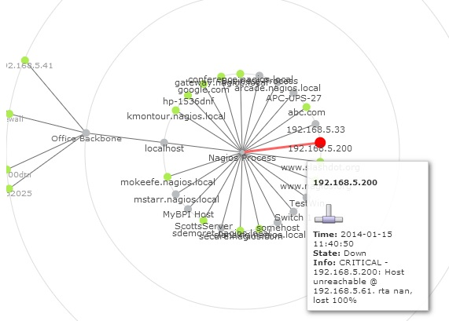
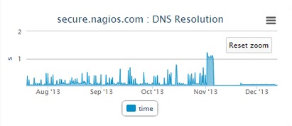
Introduction & Agenda
This presentation will cover how to use data visualizations to help manage your monitoring systems.
Sculpt your XI server to make use of mostly vanilla based visualizations
How to integrate visualizations with custom dashboards, what's new and what's coming for visualizations.
What visualization techniques are used for other products such as Nagios Network Analyzer.

Slide 4
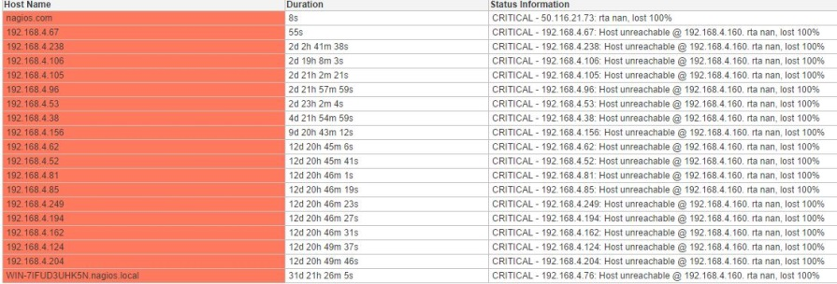
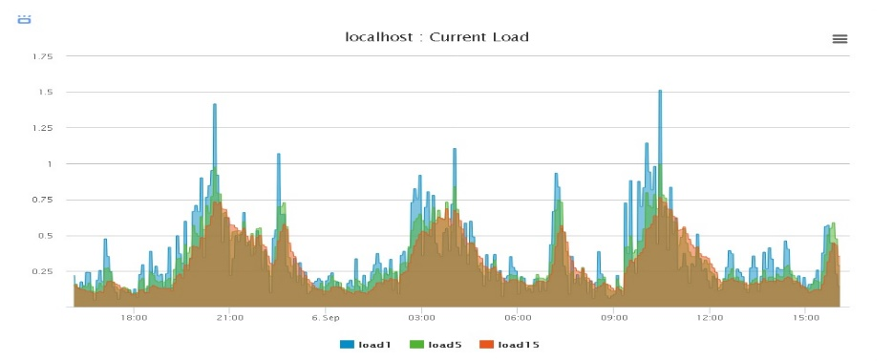
What do data visualizations bring to the table?
A great accompaniment for standard data that would otherwise only be in plain English or integers.
You don't have to spend additional time trying to draw graphs in your brain to be able to understand how the information presented to you would relate to the same set of information from a different source.
You can easily compare (visually) two otherwise identical metrics (such as disk space) from two separate hosts in Nagios.
A quick way to identify when action should be taken to resolve an issue before Nagios alerts you of it.

Slide 5
Why should I make better use of Data Vis?
Scripts handler large sets of data better than the average human
They offer you many quick and accurate ways of displaying what is happening in your environments
The same information that would otherwise be displayed in a large, obtrusive table can be shared in an easier to read and more natural fashion.
Can be much easier to spot trends in the past, or recurring issues in your environment. They can allow for a much broader and easier to attain overview of your infrastructure.
Mainly due to the Primary Visual Cortex, which is the earliest cortical visual area. Basically... it allows you to spot and recognize patterns easier.

Slide 6
The Main Goals of our Visualizations
Several points we try to hit while developing graphs, charts, and other visualizations
What will the end-user do with the data? How will it be used?
Talk to the end-users, figure out what they want displayed, and in what visual form.
Pictures are often worth a thousand numbers or phrases, the human eye can summarize what numbers really mean when they are presented in a more uniform, and visually pleasing way.
Communicate results at a glance, such as turning the comparison of 10.4GB and 13.7888GB versus 11.29GB and 2GB into points drawn side by side in different colors.

Slide 7
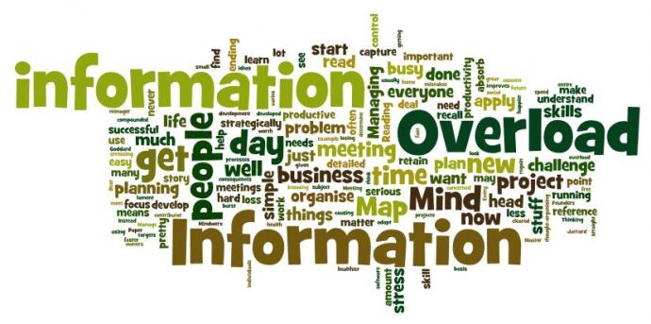
Building the visual to display the numerical
Multiple aesthetic qualities can be used
Color / Gradient
Size / Shape (Width, depth, length)
Position and distance from different data sets
Movement and shifting of information around the movement
Some examples to follow (don't be frightened)

Slide 8
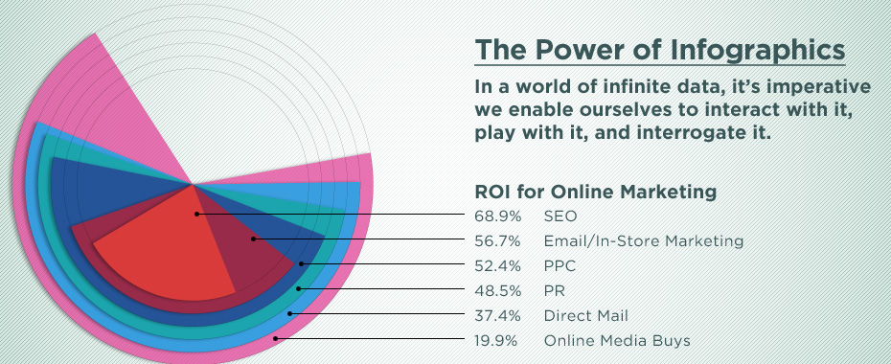
Ouch!

Slide 9
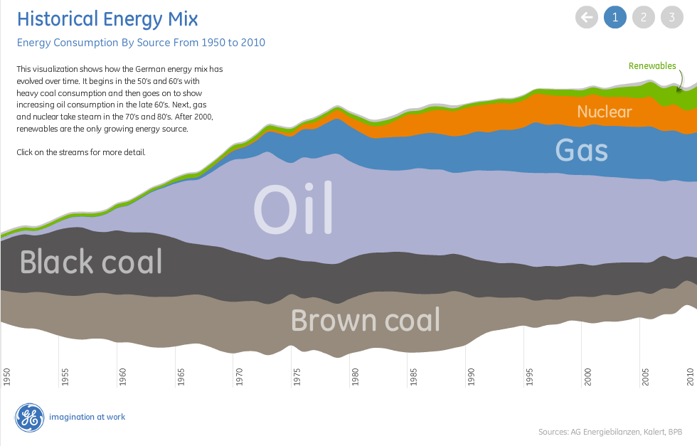
Much better!

Slide 10
So how do we handle this in XI?
Performance data chain
Nagios runs a check against a plugin which outputs performance data
Check/plugin output returns to Nagios, perf data is packaged with it and is denoted by all information after a pipe symbol
Output: “OK: Used percent was 33% | ‘used_percent_0’=33%;70;90
Nagios strips the performance data off the end and initiates the perfdata processing chain which eventually pushes the perfdata through RRDTool and dumps it in an RRD file
The RRD files are actively read by your graphing tool, such as PNP4Nagios, or in the case of XI 2014, almost exclusively displayed via Highcharts graphing libraries

Slide 11
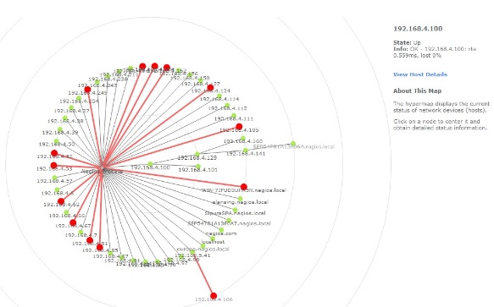
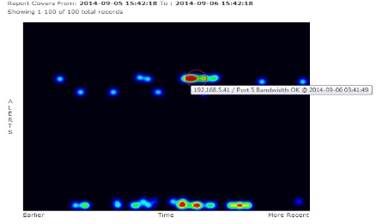
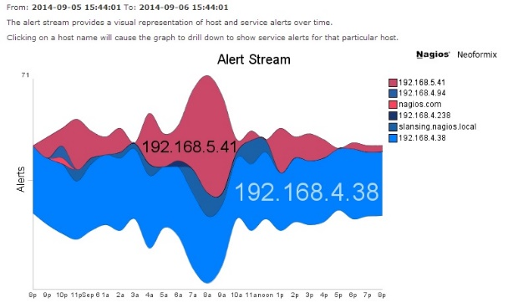
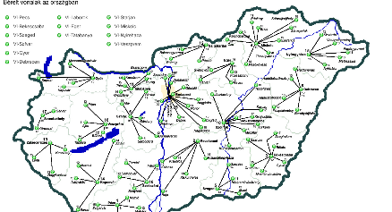
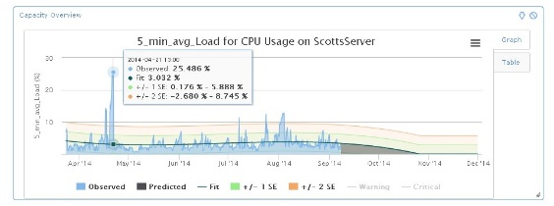
So how do we handle this in XI? Cont.
Non “performance data” related visualizations
Hypermap
Minemap
Nagvis
Metrics Component
Availability Summary / Executive Summary Reports
Alert Heatmap
Alert Stream

Slide 12
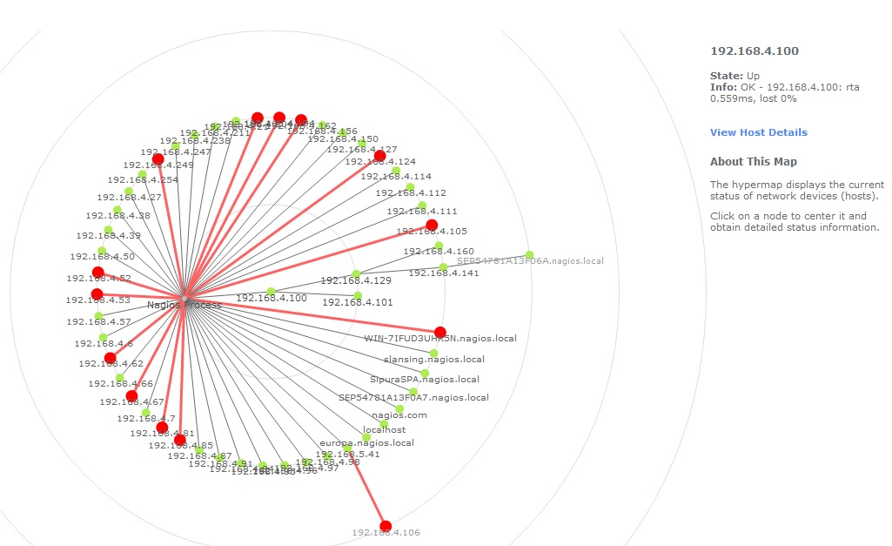
Hypermap
Display Parent-Child relationships
Visualize the effects of outages
Interactive
Ability to drill down to details pages

Slide 13
Alert Stream
A “self guiding” visualization
Quick problem acquisition
Shows top alert producing hosts
Java (bleh!) driven, must have proper access rules
Great pairing with the Executive Summary report (flashy for management)
Unable to dashify at this time =(

Slide 14
Alert Stream
“Jelly” visualization, free form, directs your eyes to the top values

Slide 15
Heatmap
The “Predator” visualization, less to read, more about at-a-glance detection. (Quick
Problem acquisition, mouse over to see host/service name and time of alert, unable
To dashify at this time ☹)

Slide 16
Nagvis
3rd party component which harnesses the active Nagios Configuration
Host/Service Mapping on JPEG/PNG/etc.
Ability to place Hostgroups/Servicegroups under one icon
Summarize state information, as well as vital statistics
Gives you the ability to visualize your entire infrastructure, given enough time, even how it is actually laid out in your environment
Web Configuration UI, as well as multi-lingual support

Slide 17
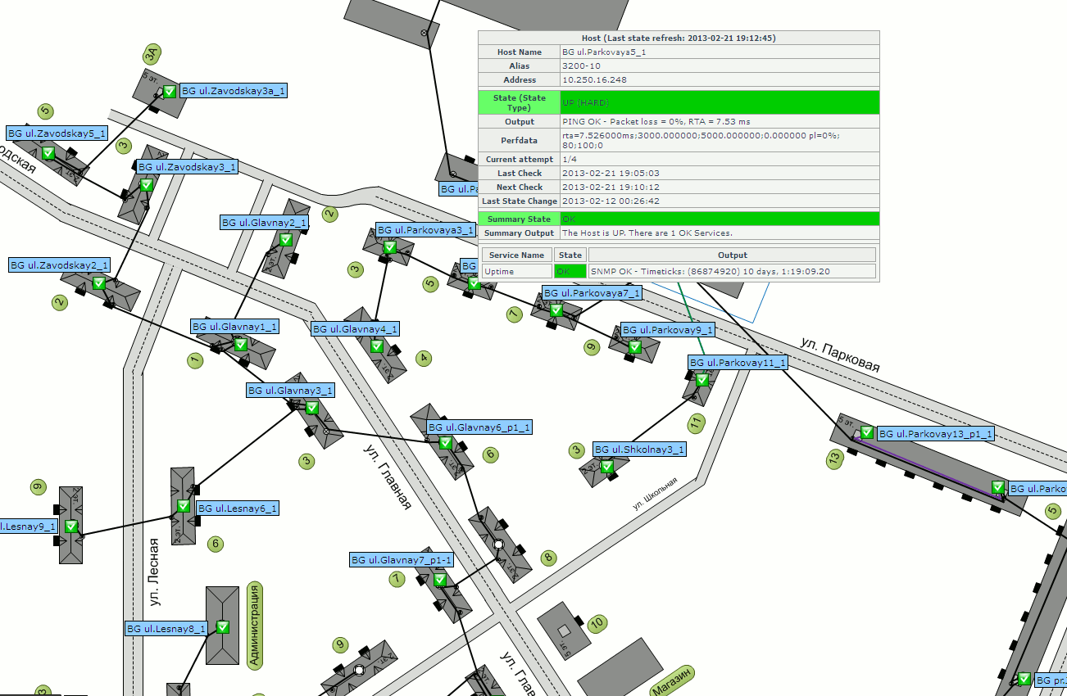
Nagvis
Map the network’s infrastructure, top down.

Slide 18
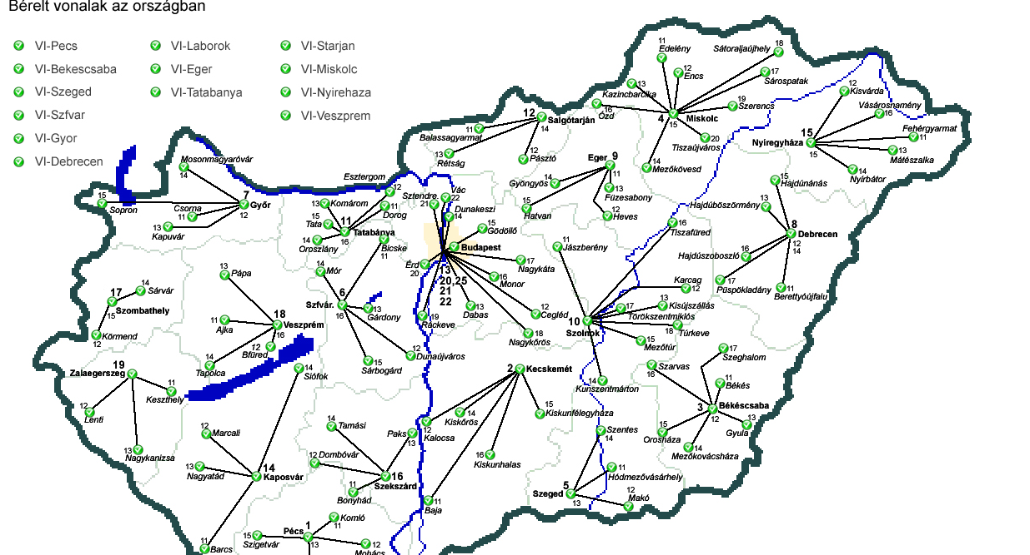
Nagvis
Display interconnectivity, and cartography.

Slide 19
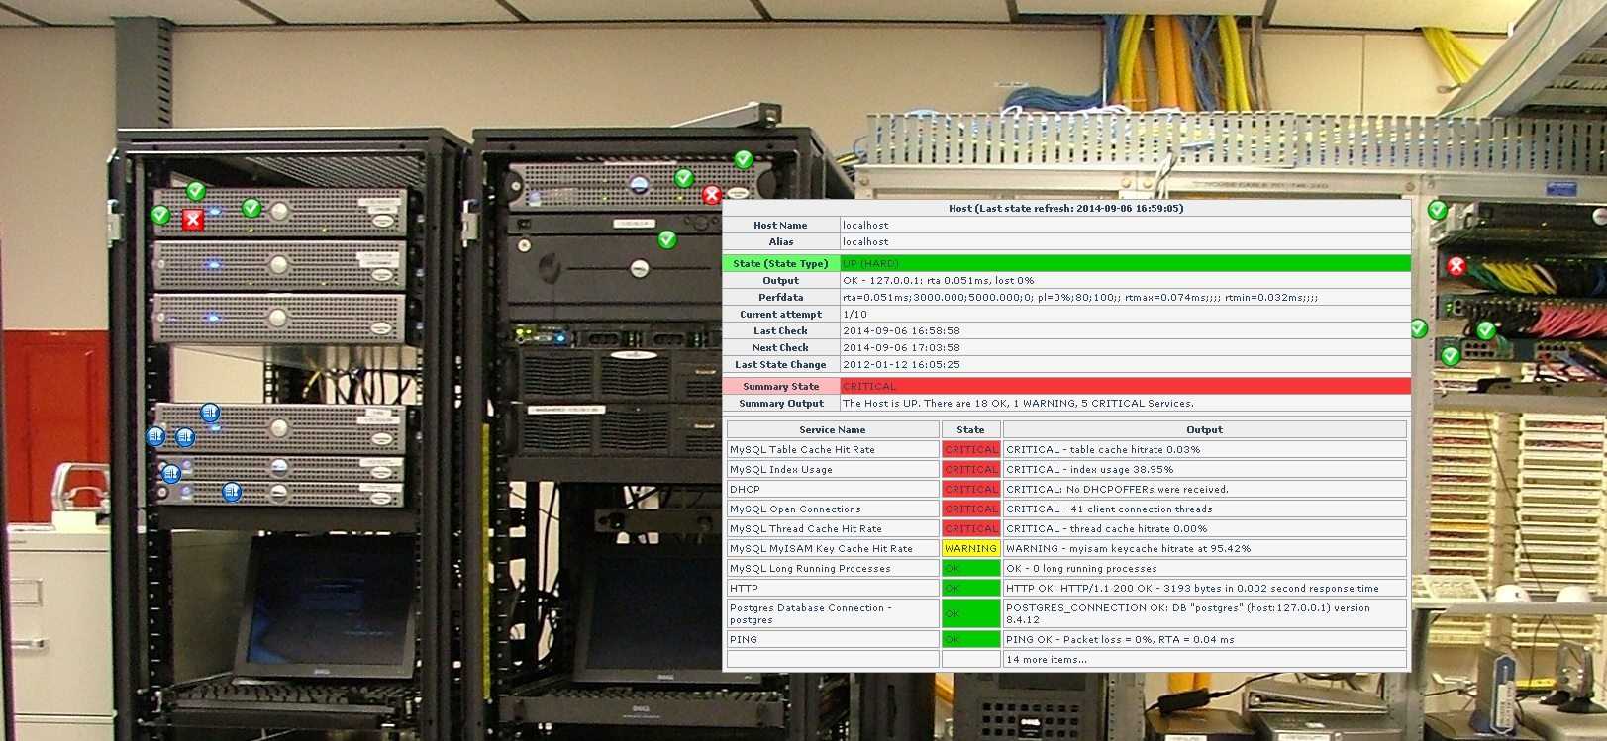
Nagvis
“And now for something completely different.” – Monty Python

Slide 20
So how do we handle this in XI? Cont.
“Performance data” related visualizations
Host/Service Performance Graphs
Capacity Planning
Graph Explorer
Performance Gauges
Custom Tools
Graph Display Dashboards
MRTG “special case”

Slide 21
Capacity Planning
- Interactive
- Common Extrapolation Algorithms
Holt-Winters
Linear-Fit
Quadratic-Fit
Predictive performance data modeling
Based on past trends
Data Integrity Calculations (nNAN)
Percent Deviation
Predict the future with relative accuracy

Slide 22
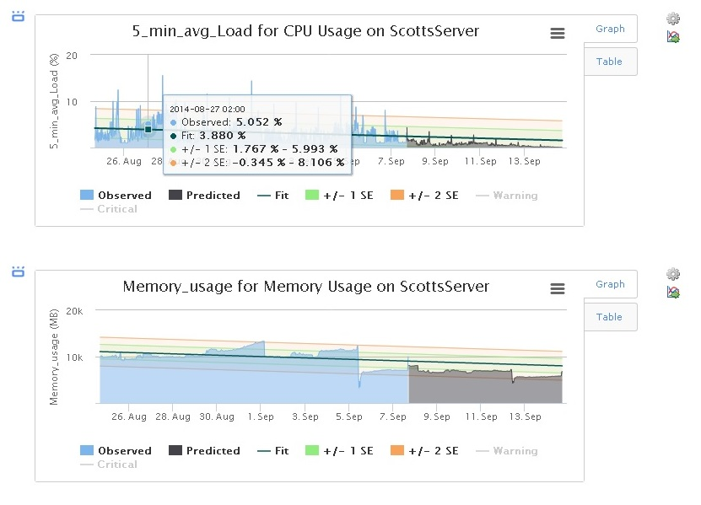
Capacity Planning

Slide 23
Capacity Planning
Monitor your data integrity, view recent values, sculpt your dashlet.

Slide 24
Host/Service Performance Graphs
Interactive Host/Service graphs
Reads in RRD data
Can be found on Details pages as well as in the Graph Explorer
Offers a view of all metrics returned by the check
Drill down to the data that matters
Export as images
Dashifyable

Slide 25
Host/Service Performance Graphs
Contains all metrics being returned in performance data, is able to be interacted with.

Slide 26
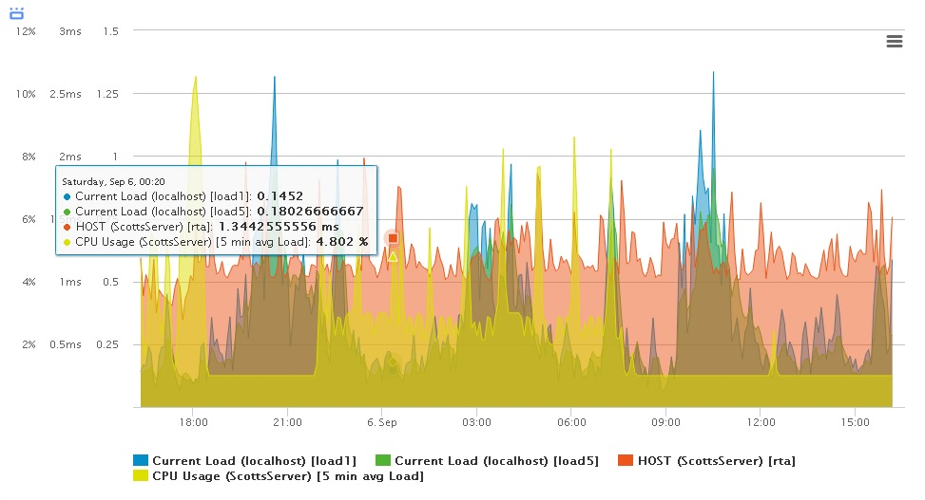
Multistacked Performance Graphs
View all of the individual metrics at once or filter them down, comparing them to one another. (ISP Bandwidth metering, color coded, dashifyable, yay!)

Slide 27
Tying It All Together
Dashboards
Compare multiple data sets from hosts/services
Build supplemental graphs for other dashlets such as hostgroups or service groups
Prepare and deploy centralized dashboards for Net/Sys admins, and management
Ability to build a report based on visualizations and statistics, paired together

Slide 28
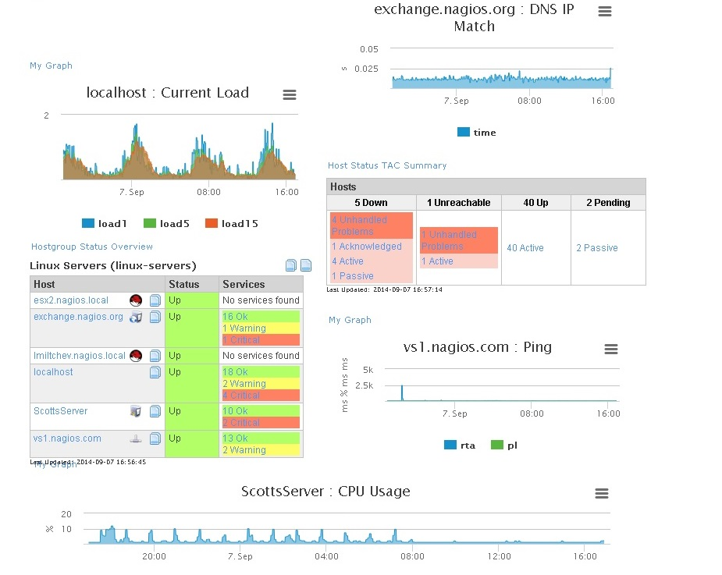
Multiple Metrics, One Dashboard

Slide 29
Datavis Component
The future of visualizations in XI, and other Nagios tools.
Pull together performance data from RRD files, Highcharts Templates/Libraries, D3 streaming, modular.

Slide 30
What is used in Nagios Network Analyzer?
Standard and Circular charts, data tables
(Linear Graph, standard type)
(Logarithmic Graph, large data sets)

Slide 31
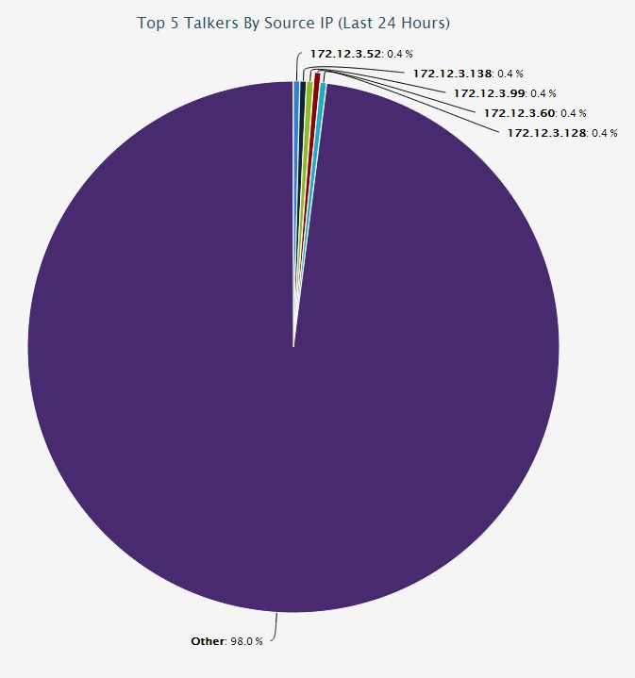
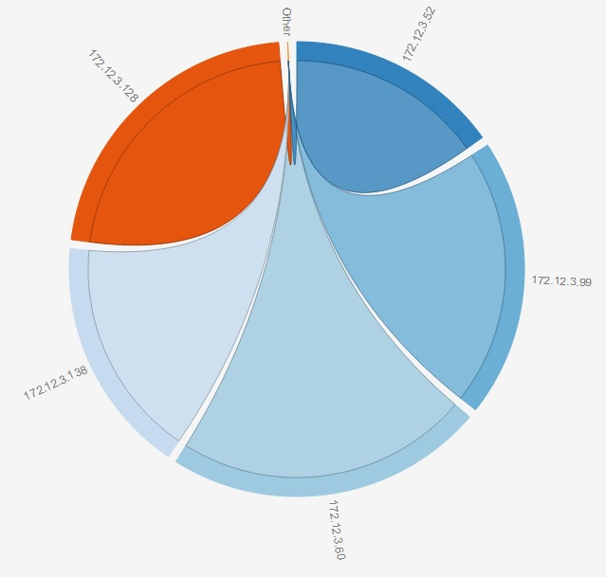
What is used in Nagios Network Analyzer?
Top Talkers -

Slide 32
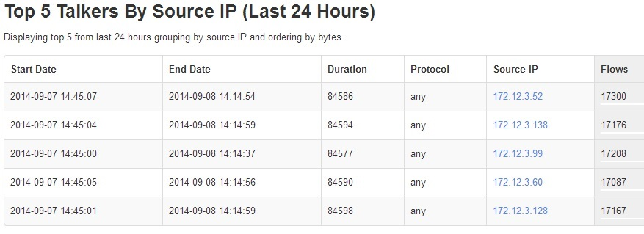
What is used in Nagios Network Analyzer?
Top Talkers – The Data

Slide 33
Where does that leave Core?
Options for Core:
Nagiosgraph “older”
PNP4Nagios
Nagvis
Cacti
Highcharts “For Nagios Core”
Custom solutions
Harness RRD files
Strip performance data out of incoming checks directly

Slide 34
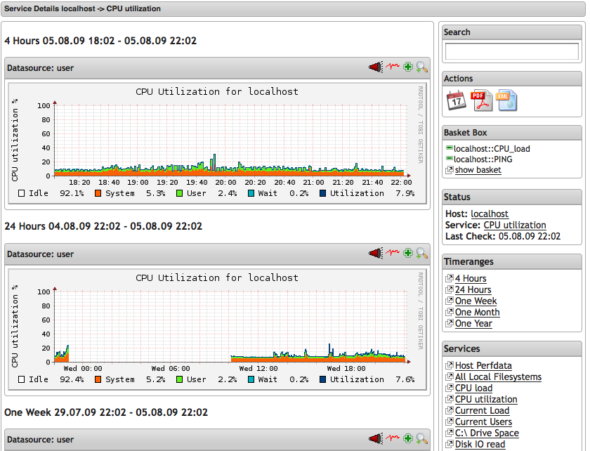
PNP4Nagios
RRD’s and templates
Perfdata stripping, Web frontend, export (XML, CSV, JSON), not so interactive

Slide 35
Cacti
Options for Core:
Datasources maintained at 5 minute intervals
Stores data/templates in a MySql database
Hooks in with MRTG via SNMP polling (GET requests)
Uses RRDTool graphs, you can use just about any you wish
Ability to create a “tree” for graph organization and hierarchy
Baked in user management
Templating “like PNP,” allowing you to manage a large volume of graphs much like templating objects in Nagios

Slide 36
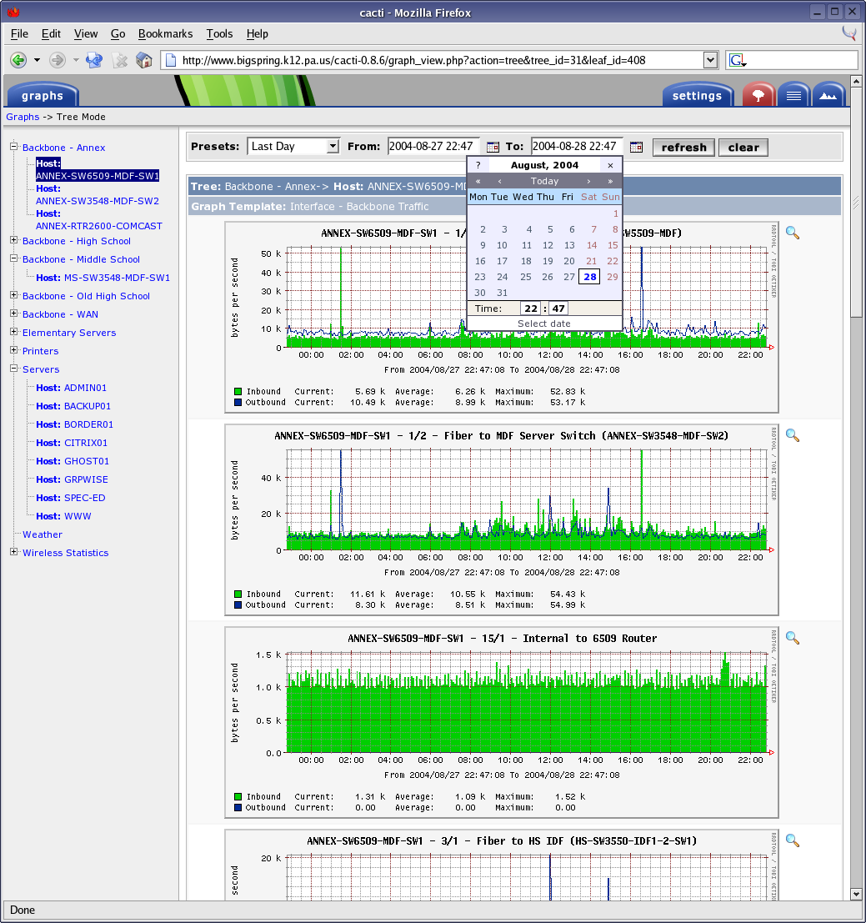
Cacti

Slide 37
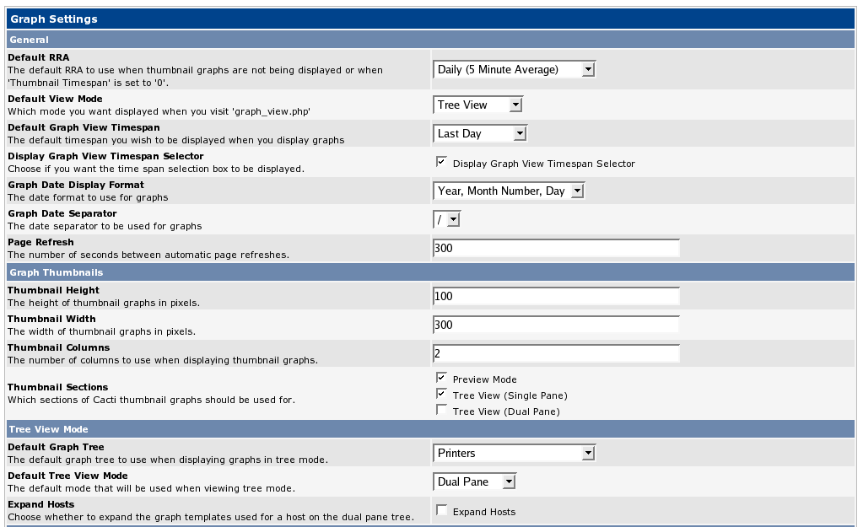
Cacti

Slide 38
Looking Forward
The future of visualizations in XI, and other Nagios tools.
Ability to build a report based on visualizations and statistics, paired together
Possibility of ticking/moving near real-time D3 like graphs (NCPA)
Adding enhanced visualizations to NSTI, and NCPA

Slide 39
Thank you! …Questions?

