Slide 1
Log Monitoring, Management and Analysis with Nagios
Introducing:
Nagios Log Server
Scott Wilkerson
swilkerson@nagios.com

Slide 2
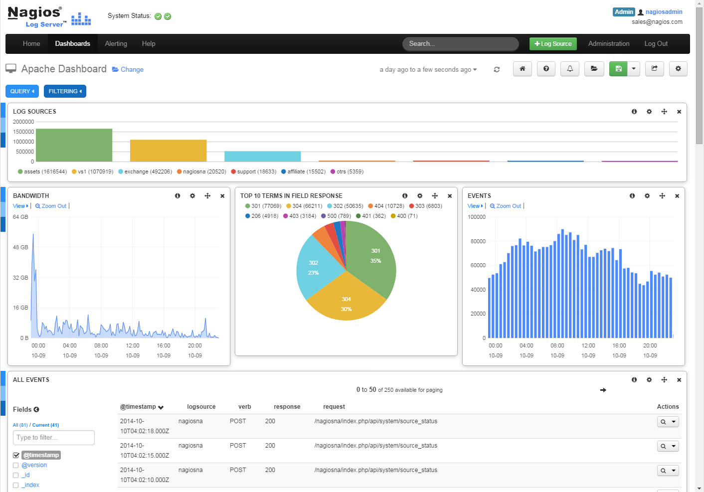
Agenda
Introduction
Nagios Log Server
What is it?
Key Features and Benefits
Demonstrations
Searching & Alerting
5 Minute Dashboard
Administration
How To Win License!
Questions?

Slide 3
Who Is This Guy?
Scott Wilkerson swilkerson@nagios.com
Almost 4 Year at Nagios
3rd Nagios World Conference
New Title At Each Conference
Product Development Manager

Slide 4
What is Nagios Log Server?
Inspired by 2013 Conference Ask Nagios!

Slide 5
What is Nagios Log Server?
Inspired by 2013 Conference Ask Nagios!
Central Log Collection Platform

Slide 6
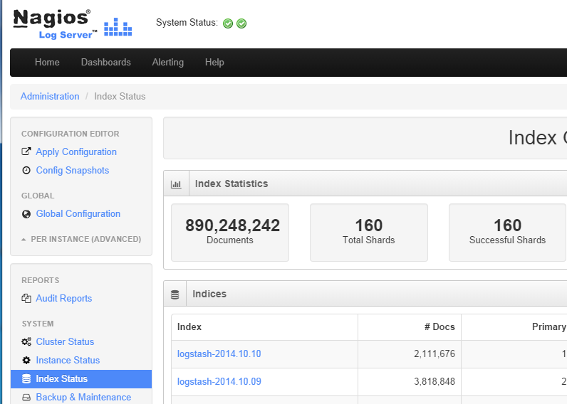
What is Nagios Log Server?
Inspired by 2013 Conference Ask Nagios!
Central Log Collection Platform
It's Making Big Data Useful

Slide 7
What is Nagios Log Server?
Inspired by 2013 Conference Ask Nagios!
Central Log Collection Platform
It's Making Big Data Useful
Commercial Product - Open Source Roots

Slide 8
What is Nagios Log Server?
Inspired by 2013 Conference Ask Nagios!
Central Log Collection Platform
It's Making Big Data Useful
Commercial Product - Open Source Roots
Elasticsearch

Slide 9
What is Nagios Log Server?
Inspired by 2013 Conference Ask Nagios!
Central Log Collection Platform
It's Making Big Data Useful
Commercial Product - Open Source Roots
Elasticsearch
Logstash

Slide 10
What is Nagios Log Server?
Inspired by 2013 Conference Ask Nagios!
Central Log Collection Platform
It's Making Big Data Useful
Commercial Product - Open Source Roots
Elasticsearch
Logstash
Kibana

Slide 11
What is Nagios Log Server?
Inspired by 2013 Conference Ask Nagios!
Central Log Collection Platform
It's Making Big Data Useful
Commercial Product - Open Source Roots
Elasticsearch
Logstash
Kibana
Nagios Enterprises Special Sauce

Slide 12
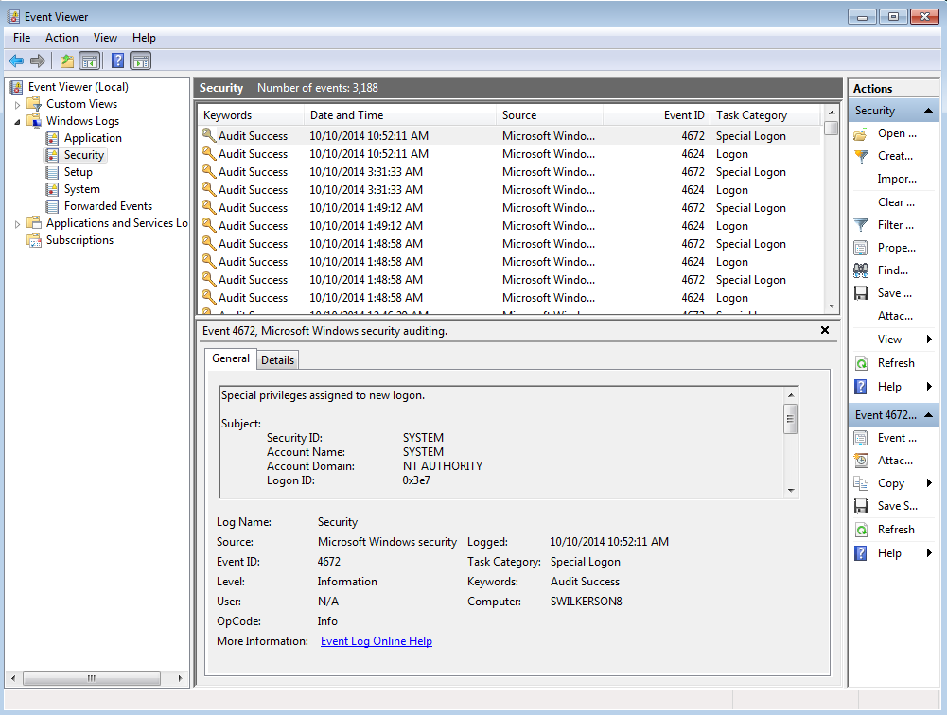
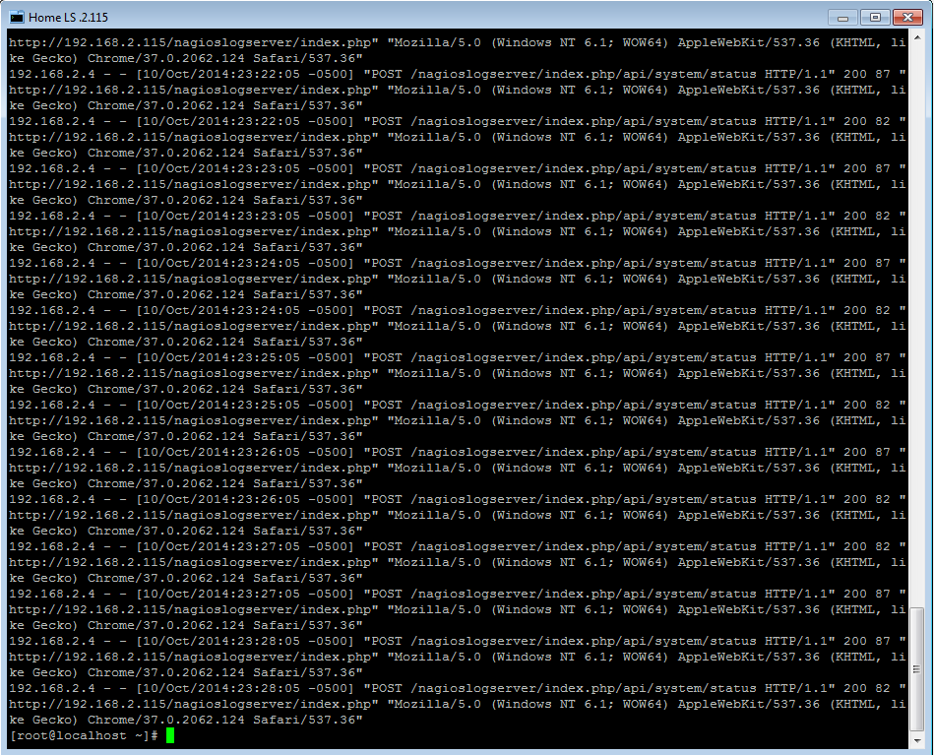
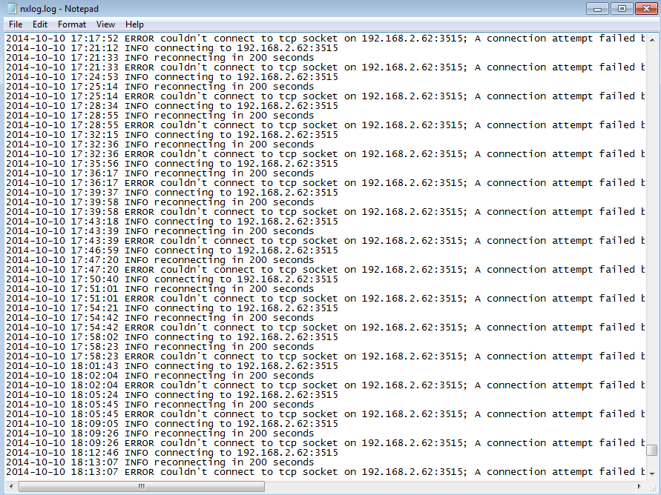
Key Features and Benefits
Accepts Any Textual Data

Slide 13
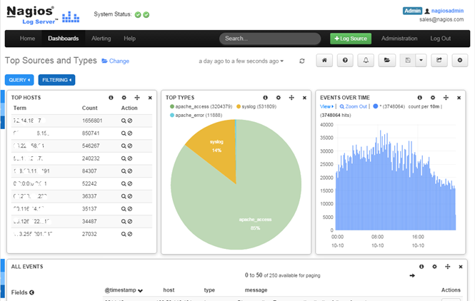
Key Features and Benefits
Accepts Any Textual Data
Infrastructure Wide Query / Analysis

Slide 14
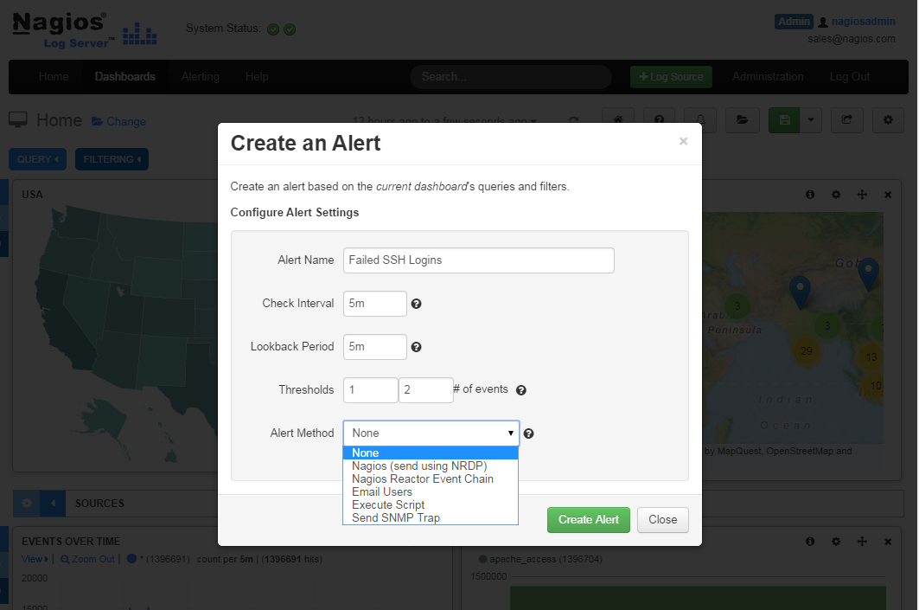
Key Features and Benefits
Accepts Any Textual Data
Infrastructure Wide Query / Analysis
Automated Alerting On Any Search Pattern

Slide 15
Key Features and Benefits
Accepts Any Textual Data
Infrastructure Wide Query / Analysis
Automated Alerting On Any Search Pattern
Automatic Archiving of Historical Logs

Slide 16
Key Features and Benefits
Accepts Any Textual Data
Infrastructure Wide Query / Analysis
Automated Alerting On Any Search Pattern
Automatic Archiving of Historical Logs
Distributed By Design

Slide 17
Key Features and Benefits
Accepts Any Textual Data
Infrastructure Wide Query / Analysis
Automated Alerting On Any Search Pattern
Automatic Archiving of Historical Logs
Distributed By Design
Scalable To Petabytes of Data

Slide 18
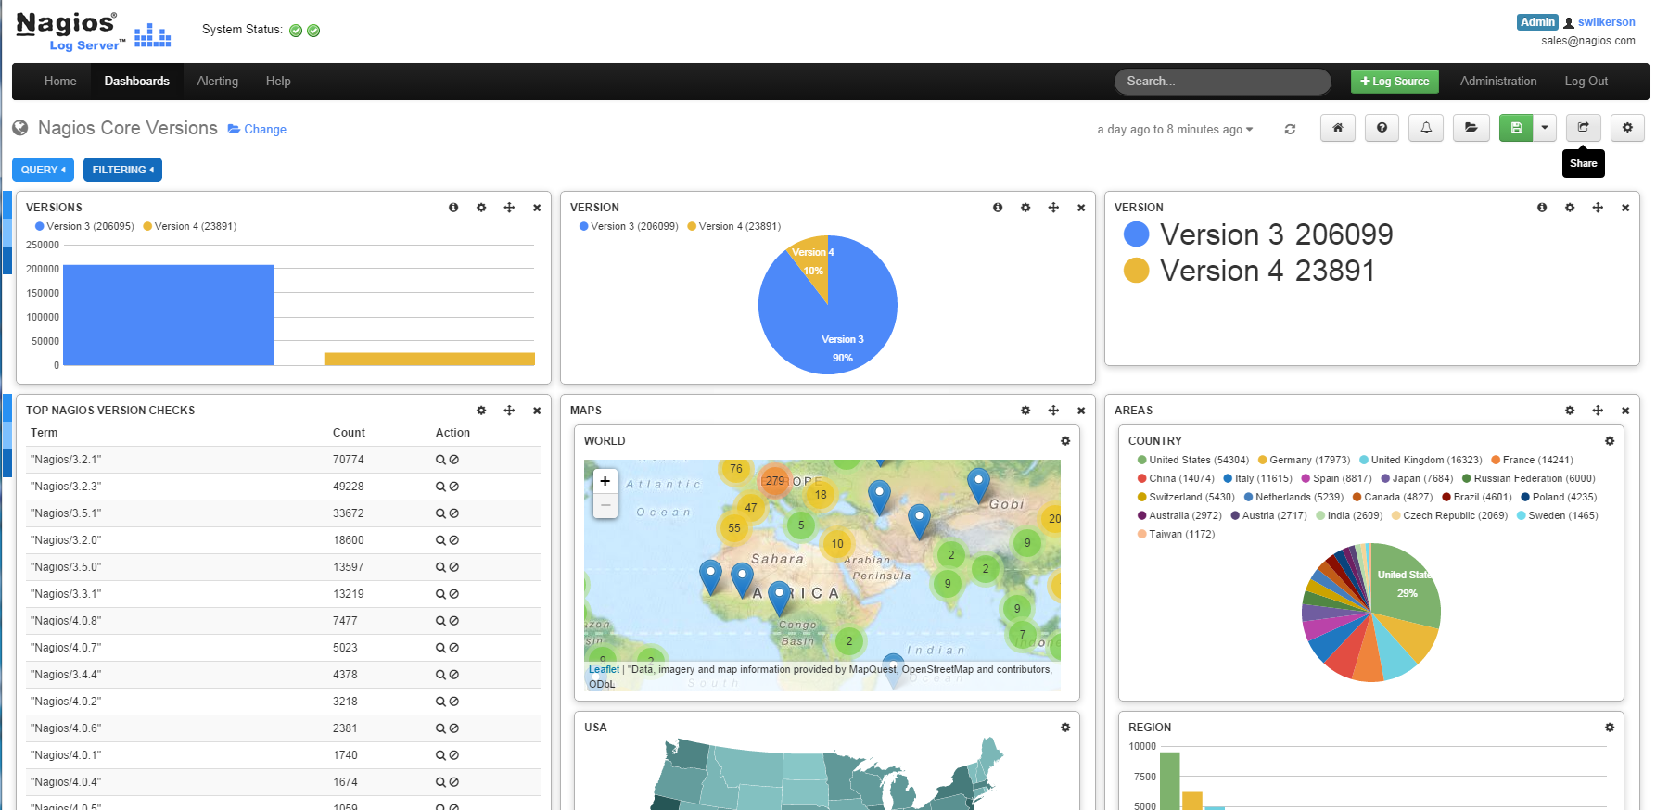
Key Features and Benefits
Easily Configure, Save & Share Dashboards

Slide 19
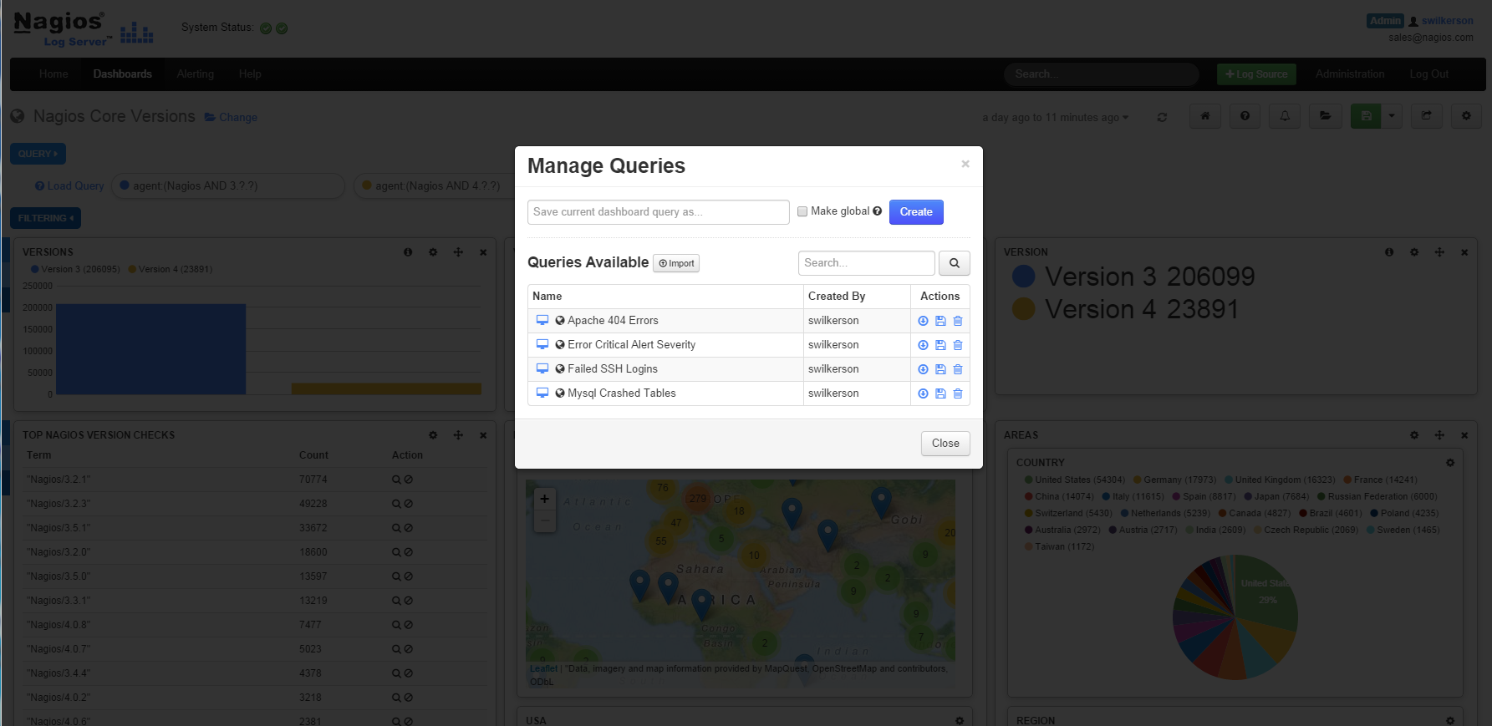
Key Features and Benefits
Easily Configure, Save & Share Dashboards
Easily Configure, Save & Share Queries

Slide 20
Key Features and Benefits
Easily Configure, Save & Share Dashboards
Easily Configure, Save & Share Queries
Data Available Near Real-time

Slide 21
Key Features and Benefits
Easily Configure, Save & Share Dashboards
Easily Configure, Save & Share Queries
Data Available Near Real-time
It’s Fast

Slide 22
Key Features and Benefits
Easily Configure, Save & Share Dashboards
Easily Configure, Save & Share Queries
Data Available Near Real-time
It’s Fast
It’s Really Fast

Slide 23
Key Features and Benefits
Easily Configure, Save & Share Dashboards
Easily Configure, Save & Share Queries
Data Available Near Real-time
It’s Fast
It’s Really Fast
Really, Really Fast

Slide 24
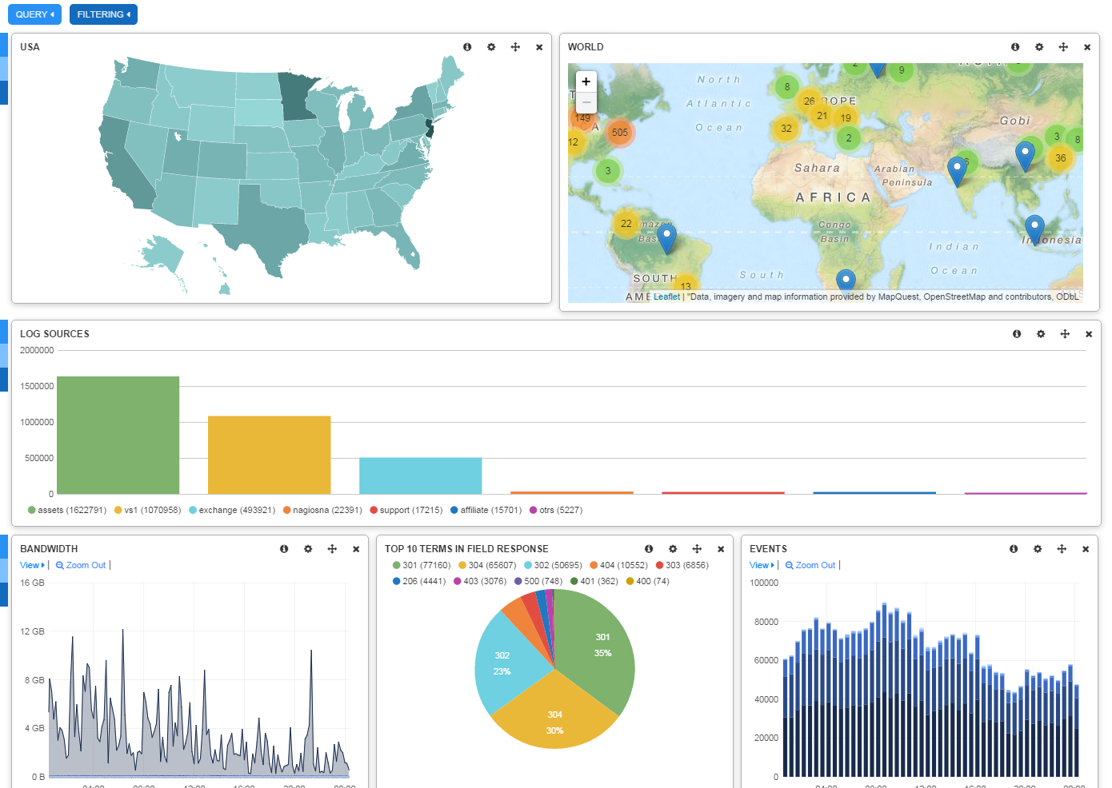
5 Minute Dashboard
Fresh install
Added geoip Filter
Send Apache Logs
if [program] == 'apache_access' {
geoip {
source => 'clientip'
}
}

Slide 25
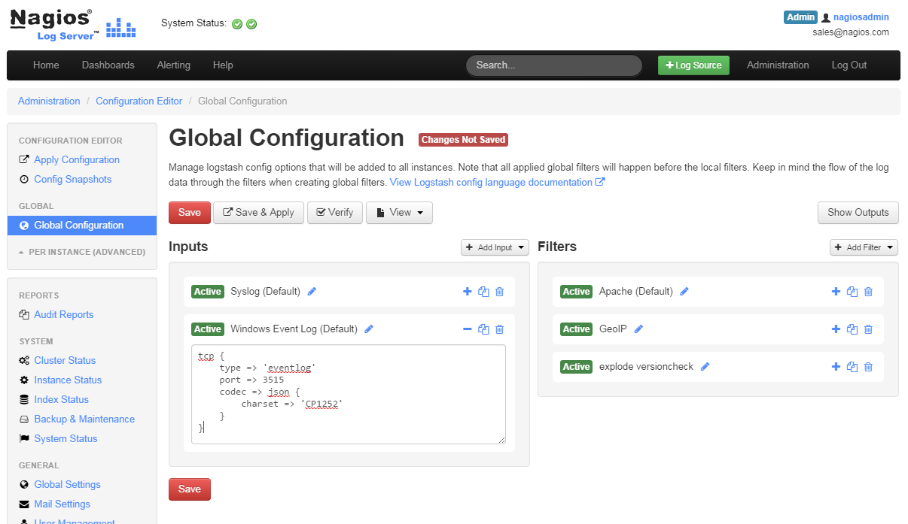
Easy Administration
GUI Based
Configuration

Slide 26
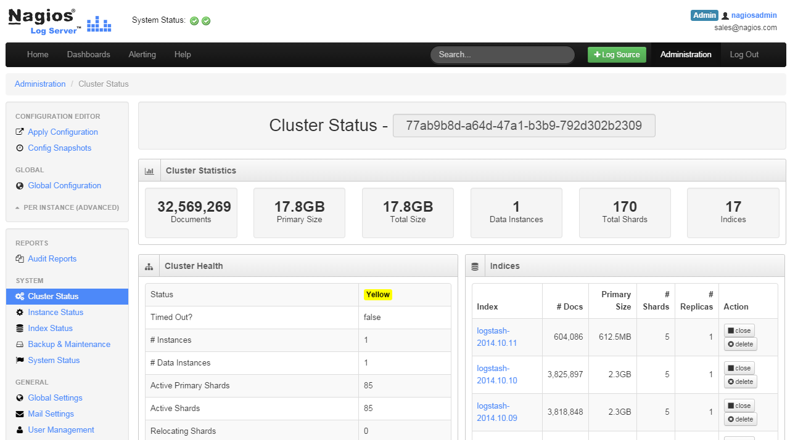
Easy Administration
GUI Based
Configuration
Cluster Management

Slide 27
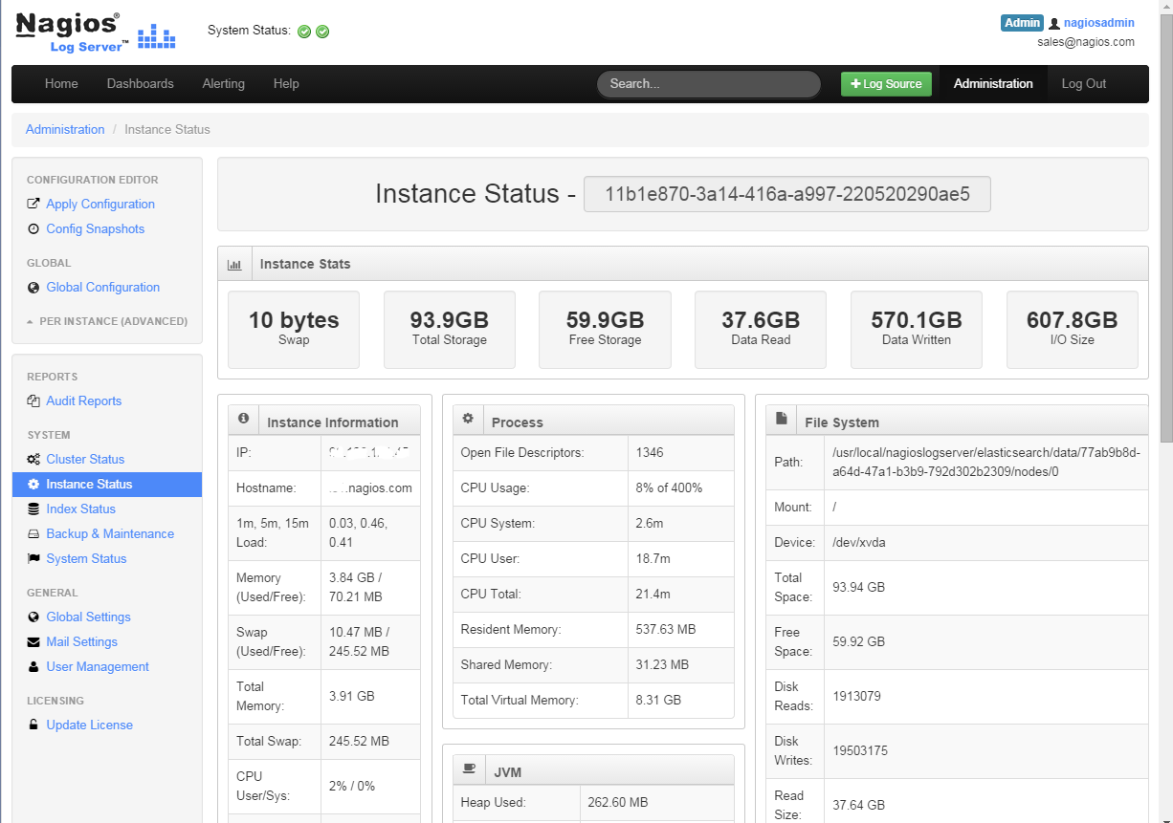
Easy Administration
GUI Based
Configuration
Cluster Management
Instance Management

Slide 28
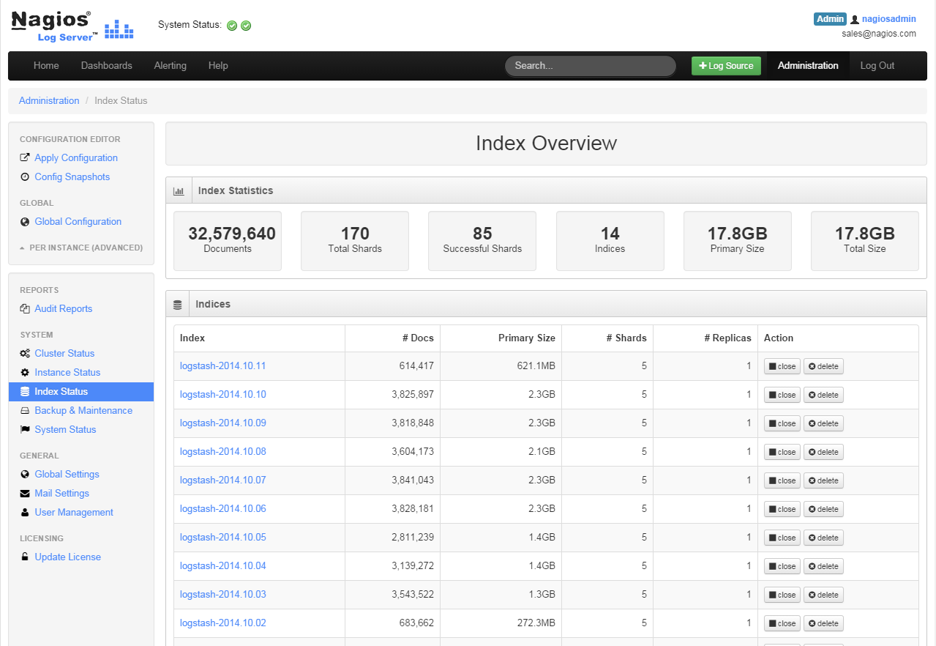
Easy Administration
GUI Based
Configuration
Cluster Management
Instance Management
Index Management

Slide 29
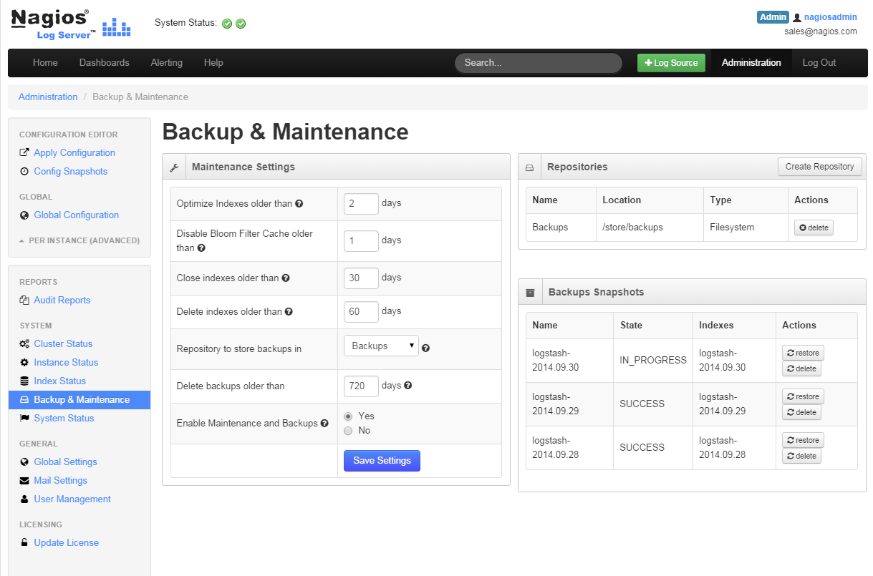
Easy Administration
GUI Based
Configuration
Cluster Management
Instance Management
Index Management
Backup Management

Slide 30
Distributed & Redundant
Like Software Raid
All Instances Share Workload

Slide 31
Contest

Slide 32
Contest
Create Cool Dashboard
Upload to Nagios Exchange by 12/31/2014
Winner will receive choice of:
5 Instance Nagios Log Server License
$500 Amazon Gift Card
Details
http://www.nagios.com/products/nagios-log-server/contest

Slide 33
Resources
90 Day Unlimited Trial Period
Download
http://www.nagios.com/downloadlogserver
Get VM Copy at Demo Table
Get Log Server Earbuds @ Demo Table

Slide 34
Questions?

