Slide 1
Nagios as a PC Health Monitor
Sean Falzon
seanf@srw.com.au
@rhassing
Notes:
Lol twitter
I was posting heaps of “cool” stuff (probably crap) but I didn’t realise my tweets were private….
Rob Hassing provided me some support
Also I don’t use twitter so don’t tweet me, Tweet Rob he’s a cool guy and he uses twitter

Slide 2
Introduction
Who am I?
Notes:
IT Operations manager at Southern Rural Water which is a wholy owned government coproration that manages the licencing of groundwater and surfce water extraction in southern victoria also operate three irrigation districts and manage three major Dam’s

Slide 3
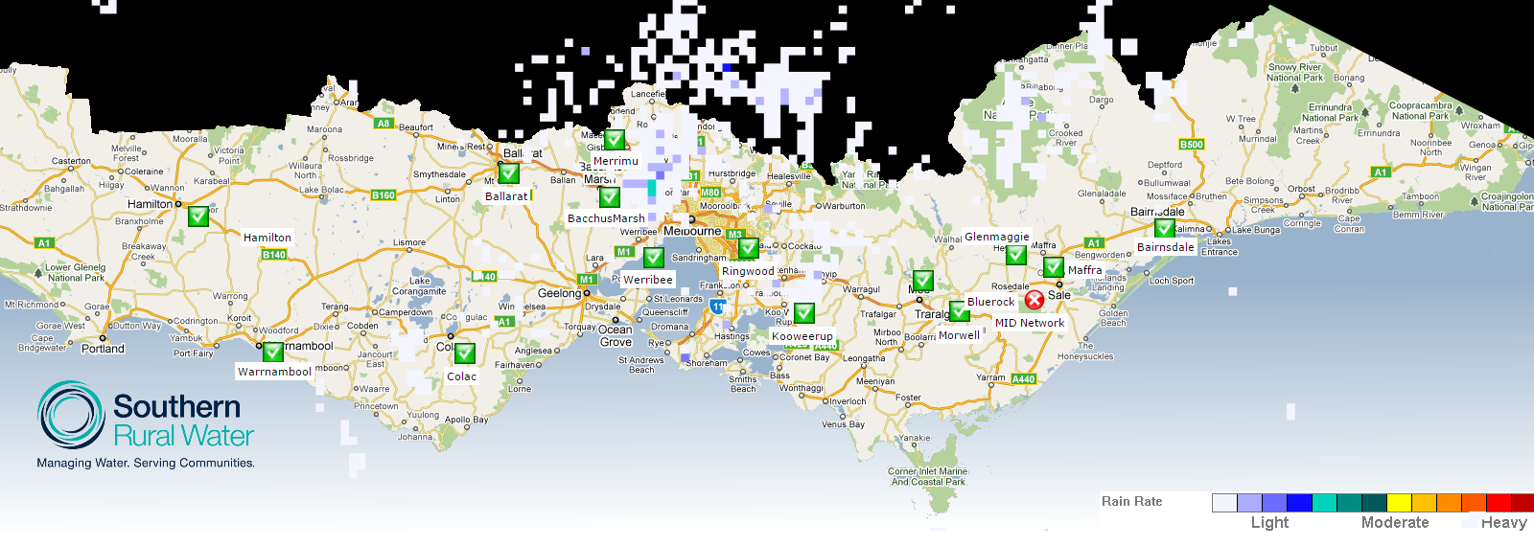
Introduction
Where am I from?
Notes:
From regional victoria about three hours from Melbourne, business covers a large area
Oh and this is from Nagvis, shows all of our office locations, their current status and the dots you can see is the current rainfall location
This is a php script that generates the images and scrapes the rainfall from the BOM website.

Slide 4
Agenda
We will be covering
The Journey
How we (IT) use nagios & how the business uses it
Why we started monitoring end user computers
How we monitor end user pc’s & lessons we learnt
What we are getting out of it now
Customer satisfaction as a driver for high performance culture

Slide 5
Introduction
How do we use Nagios?
Core Infrastructure
Office Temperature
Wireless Communications network
Asterisk Integration
Service Desk Plus integration
Notes:
Go into a bit of detail about asterisk and sdp
Going to talk a bit about the wireless network later.

Slide 6
The business knows Nagios
We give the operators of the irrigation district access to Nagvis for monitoring of the communications network
So its important to know that the business knows we have monitoring technology deployed

Slide 7
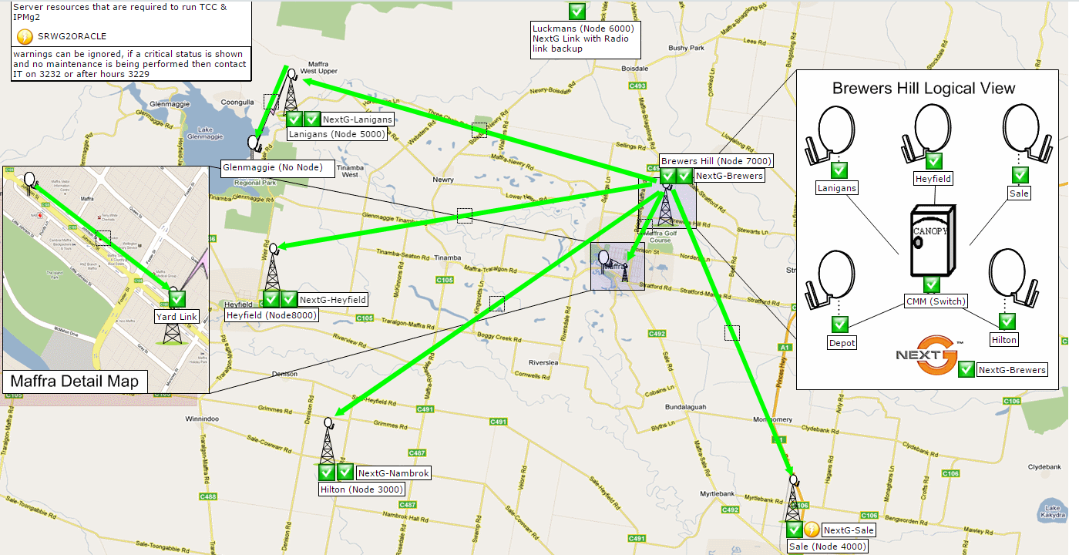
The business knows Nagios
Notes:
This is a image of the NagVis screen that the operators commonnly use, it is also useful for lower level IT staff so they can report issues to higher level IT staff.
Its important to know we also give this screen to the SCADA / Software vendor that provides the application for the irrigation district.

Slide 8
The business knows Nagios
We even use it to solve Occupational Health and Safety Issues

Slide 9
The business knows Nagios
Notes:
After many years of complaints about the office temperature I put my hand up to solve it with Nagios
This is what we provided to the office staff to show that they had issues with the temperature, the metrics are obviously also able to be graphed

Slide 10
Introduction of pc monitoring
What have we done so far in the area of PC monitoring?
Notes:
Planner PC’s
initially using Nsclient++ and active checks, exactly the same as we do servers (desktop pc’s)
Java app issues
CPU & Memory blamed however nagios monitoring showed that there was no issue with the physical memory or CPU, was limits within the java app

Slide 11
Why?
Why do we now want to monitor the entire PC fleet?
Notes:
Idea of saving money

Slide 12
How?
What approach are we now using?
Passive Checks
Notes:
Idea of saving money

Slide 13
Typical end user complaint
“My PC is slow but by the time IT support gets a chance to look at it the problem has gone away”
Notes:
We have 165 staff over 13 sites and 2 staff dedicated to resolving IT support requests.
I often hear people say things like “at 7:30 in the morning the network is very slow” which obviously is difficult to diagnose for two reasons, its very vague and I’m still in bed (or at least I’d like to be if my 3 year old would sleep in)
We have Nagios monitoring the network so we know the network links are servers are performing well. However we have no idea what is happening on their computers at that time.

Slide 14
Why monitor pc’s ?
Difficulties tracking down end user complaints about performance
Software vendors often tell business managers the issues are hardware related
Memory
CPU
Notes:
From our tests we have found that basic metrics are best for collection from the PC’s passive results
Interesting results can be obtained by monitoring log file sizes, it really provided insight into issues that were “hidden” as larger log files obviously include information that needs to be reviewed.

Slide 15
Customer Service
As a business we have a strategic goal of improving customer control and convenience
Internally our IT support team has the same goal of improving the control and convenience of the internal customers

Slide 16
Why use Nagios?
Nagios core functionality covers the required functionality of any PC fleet monitoring
Visibility
Awareness
Remediation
Reporting
Notes:
These points are from the “Nagios core overview” from the nagios website
They pretty much sum up what we wanted to achieve with PC montoring

Slide 17
Visibility
“If we can’t see the problem we can’t fix it”
Notes:
Case study – Users having slow pc around lunchtime, they end up just walking away from their PC’s turns out a scheduled tasks on the SOE was causing some slowdowns for some users.
Using nagios to monitor CPU usage on the PC fleet we would have seen the pattern much earlier
The mechanic comment is really hitting home as I’m putting finishing touches on my presentation while sitting at the local Subaru dealer getting my headlights fixed for the fifth time in six months.

Slide 18
Awareness
“Is this issue only affecting one user or is it system wide”
Notes:
Case study – Scheduled task issue was evident to be a SOE issue because it affected everyone, was a little difficult to diagnose due to the scheduled task having a variable start time but enough correlation between the high cpu events and investigations showed the same process causing the issue.

Slide 19
Remediation
“We know what the problem is, let’s fix it”
Notes:
We link Nagios to our Helpdesk software so when issues are detected it raises support requests so our IT staff can log their progress in fixing the issues
Nagios has event handlers, we haven’t used them for this yet however the theory is simple, if you have a condition you want corrected setup an event handler to deal with it.
We do this with servers, some of our printer drivers for older wide format plotters can cause the print spooler service to crash, we simply monitor the service and if its stopped we invoke the event handler to start the service.
We ma have had a large CPU issue due to a particular program having an issue, we can use nsclient++ to detect the version and log service desk jobs for the computers that have the issue

Slide 20
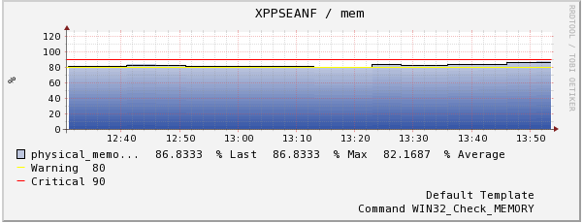
Reporting
“Reporting is key to making decisions”
When faced with budget cuts reporting on system performance is a powerful tool to identify which systems need to be replaced sooner than later.
Notes:
Using PNP4Nagios we are able to get an overview of the PC, end users are often impressed when they view the graphs because it gives them a good understanding of the amount of detail we are collecting to make sure their PC’s work well.
We see end users as customers, customers confidence in our ability to deliver is a real driver for our IT team.

Slide 21
What is required?
Two components are required
Nagios installation either XI or Core
Any compatible client on the PC
NSClient++
NCPA
others…
Notes:
Our existing deployments use NSClient++, we have always used this for active checks for windows servers however NCPA is a very attractive client, and there are others out there which have their own advantages

Slide 22
Configuration Example
Example for Nagios Core
Assume you have enabled NSCA
Configure a host template with the following “services”
cpu
disk
mem
Make sure they are configured to never be actively checked.
Notes:
This shows the CPU check command, those familure with active checks should understand how the thresholds work, CPU is very straight forward so we use it as the example here.

Slide 23
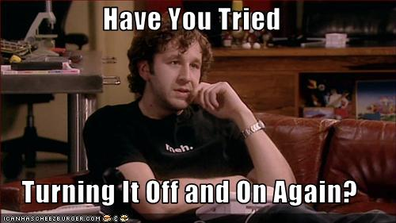
Problem solved!
Track uptime as a metric!
never have to ask this question again!

Slide 24
Distribute your client configuration
How you distribute your configuration file depends on your environment.
Options would include
System management software
GPO
Login script
Notes:
Cover each of the suggested methods, make it clear there are others but it really depends on the deployment options available to the business

Slide 25
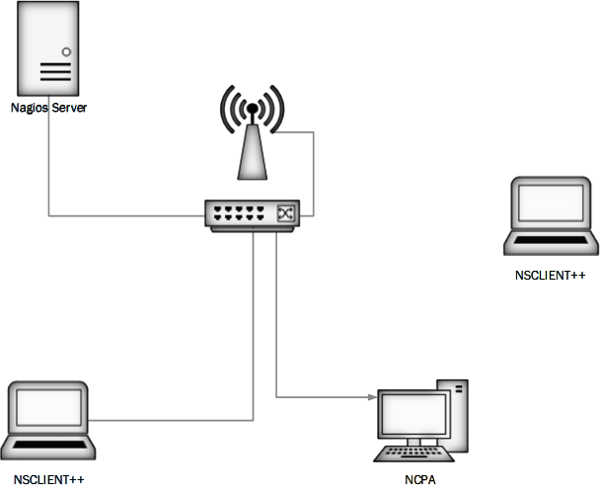
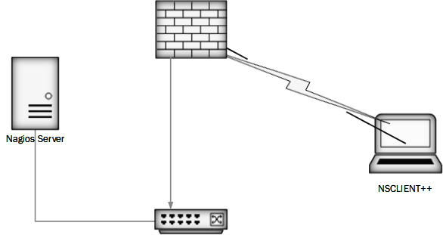
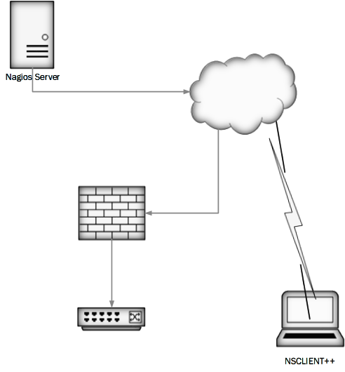
Flexible Topology
You can mix passive and active checks to achieve a solution that suits your particular environment
Notes:
You and deploy the solution much like Nagios in any manner of architecture
Our deployment has been quite basic to date, primarily because it has been in testing phases. More complex deployments such as using a cloud based solution would require additional security consideration

Slide 26
Conclusion
Nagios as a PC monitoring Solution
Flexible
Adaptive to changes – deploy a new config to track a new statistic
Powers decision making process for pc replacement
Allows for proactive fault resolution for end users
Drives high performance cultures in a business
Notes:
Its not rocket science, if you care about end user’s impressions of your IT infrastructure it doesn’t matter if you have a full SSD SAN with 10GbE backbones their main concern is the amount of time it takes to open their e-mail or print a purchase order. If you can make sure those processes are kept as healthy as your servers and core infrastructure you will find you have happy customers.

Slide 27
Questions?
Any questions?
Thanks!

Slide 28
Oh one more thing
It is easier to get a cute girl to smile for a camera than it is to monitor your fleet of PC’s

Slide 29
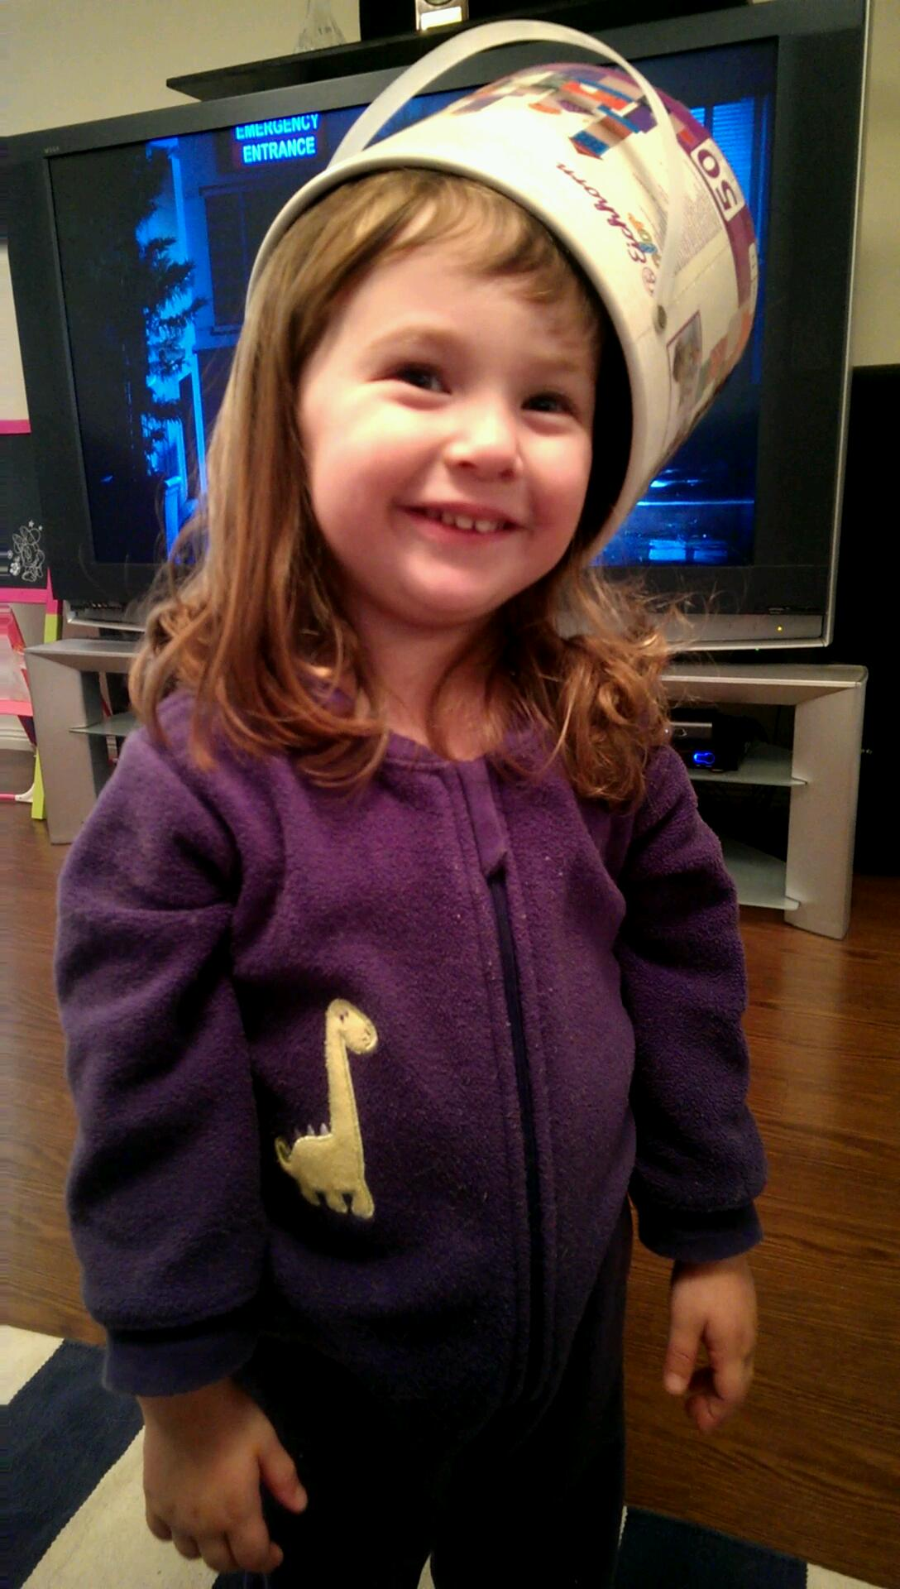
For Mila

Slide 30
The End
Sean Falzon
seanf@srw.com.au
@nozlaf_au

