Slide 1
Monitoring Maturity A 16 Year Journey and (some of) the Lessons Learned
Simon Finch
NOC Monitoring & Event Manager
sfinch@westpac.com.au
https://www.linkedin.com/pub/simon-finch/23/461/3b7

Slide 2
Westpac Stats
Australia’s first and oldest bank (1817)
World’s Ninth largest bank
Global100 world’s most sustainable company (2014)
World’s most sustainable bank 2014 (Dow Jones Sustainability Indices)
Named as one of the World's Most Ethical Companies from 2008 - 2013 by the Ethisphere Institute
Notes:
Speaker Notes:

Slide 3
Westpac Stats
12 Million Customers
570,000 Share Holders
37,000 Employee’s
1300 Australian points of representation
Offices in London, New York, Hong Kong, Singapore, India, Shanghai, Beijing, New Zealand, Pacific Islands & Indonesia

Slide 4
About This Presentation
Monitoring Landscape
NOC Dash Boards
Service Desk Integration
Mainframe Alerts via MQSI
Notes:
Speaker Notes:

Slide 5
Part 1
Monitoring Landscape
Notes:
Speaker Notes:

Slide 6
Monitoring Landscape
Westpac – multi branded
IT is both insourced & outsourced
Nagios used extensively throughout insourced brands (SGB, BSA, BoM)
Notes:
Speaker Notes:
Lots of other monitoring systems in place.
Including monitoring agents in server builds makes life so much easier.

Slide 7
Time Line
1998 - Vendor Framework Installed
2004 - First Nagios used to fill gaps
2006 - Nagios replaced proprietary monitoring framework
Notes:
Speaker Notes:
Gaps – lack of monitoring of network based services, DNS, NTP, DHCP, etc, caused apps to fail due to missing dependencies.
Vendor solution to gaps in their product was to use (and pay for) more of their product, I tried Nagios instead.
2 years after the initial Nagios instance was deployed and seeing the benefits first hand, I went out on a limb and personally made the decision to deploy Nagios monitoring throughout the enterprise.
Nagios implementation was very successful
The head of IT production support at the time, was so happy with the results that we were rapidly achieving that my KPI's for the year were all changed mid year from various monitoring projects to a single entry, "Remove vendor framework and replace with Nagios".
I was a member of the original team of three, that deployed the vendor monitoring 16 years ago in 1998
I have a unique insiders view of the entire monitoring journey and in depth knowledge of the successes and failures.
We were successful and saved the company many millions of dollars in annual licensing fees.

Slide 8
The Result ?
Paradigm shift (power to the people)
Deeper monitoring penetration
Agents part of server build
Notes:
Speaker Notes:
Paradigm shift in monitoring, Nagios so easy to use that systems admins now in charge of their own monitoring, previously not possible due to complexity.
In six months we achieved deeper monitoring penetration that in the previous 8 years
No more us and them or turf wars, sysadmins own it, so they embraced it.
App Support teams know their apps better than the monitoring team ever will, we gave them the tools to monitor what they knew was important to them.
I provide the monitoring system, they provide the app knowledge.
Including monitoring agents in server builds makes life so much easier later on, infrastructure teams built the agents into their build process because they wanted them
Internal customers are pleasantly surprised when I show up to project meeting and say “sure, I’ll have it done by next week” instead of the usual 3 months +
Occasionally I am able to attend the first meeting with a sample dashboard of their app.

Slide 9
Monitoring Today
Critical Applications
Branch Locations
Wintel, Linux, Unix
4000 hosts
37000 services
Notes:
Speaker Notes:
All supported by: 16 Nagios servers, 1 engineer and lots of support from SysAdmin colleagues.

Slide 10
Part 2
Dash Boards
Notes:
Speaker Notes:

Slide 11
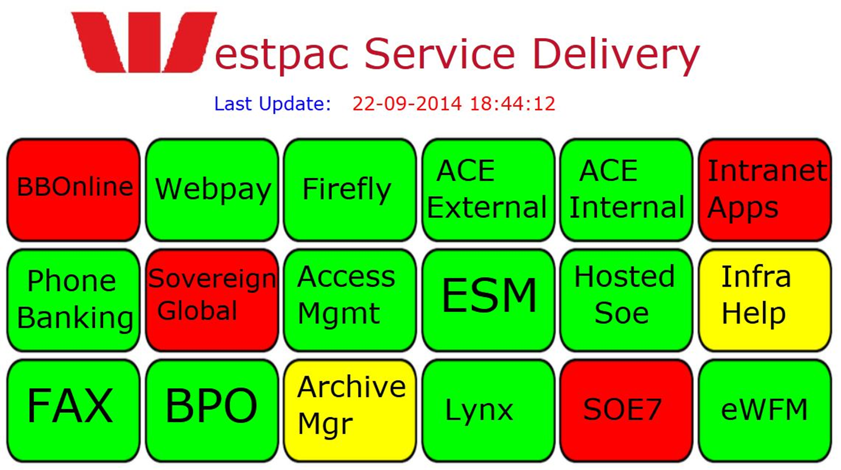
NOC Dash Boards
Notes:
Speaker Notes:

Slide 12
NOC Dash Boards
Major App status at a glance
Bright & colourful
Simple & effective
Drill down to application map
Time stamped
All done with NagVis
Notes:
Speaker Notes:
Prior to Nagios, we had no usable dash boards.
Management had no idea what was happening (neither did we)
Proprietary dash boarding software is extremely expensive.
Time Stamped as break in comms to webserver can cause browser to stop updating.

Slide 13
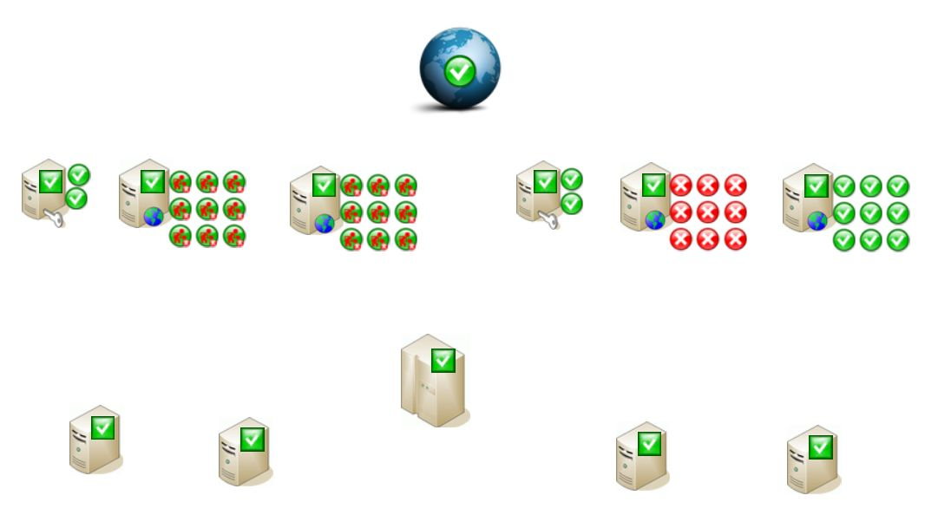
Dash Board Evolution
Early example
Notes:
Speaker Notes:
To busy, to much detail, top level status summary is usually red.

Slide 14
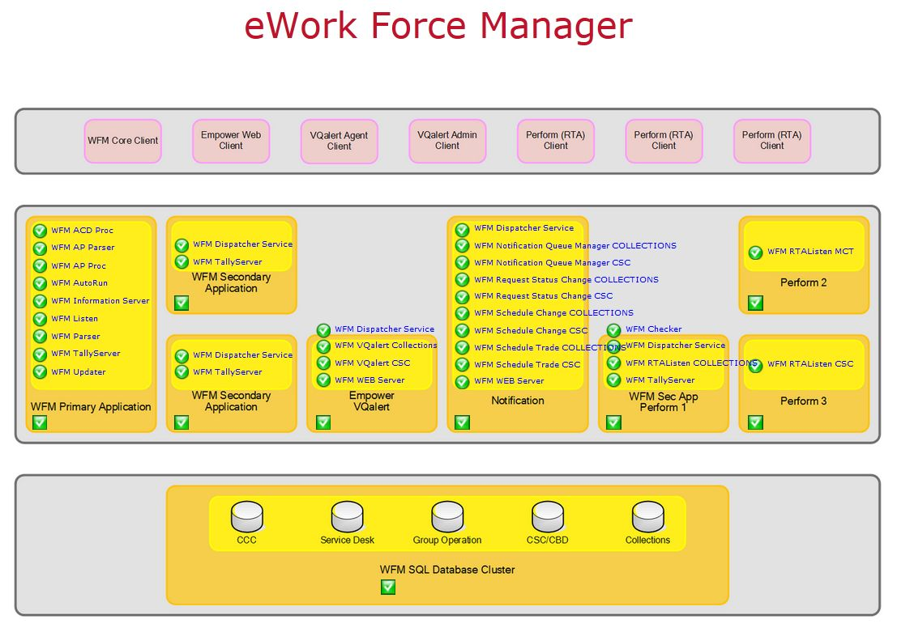
Dash Board Evolution
Then we tried
Notes:
Speaker Notes:
Not much better

Slide 15
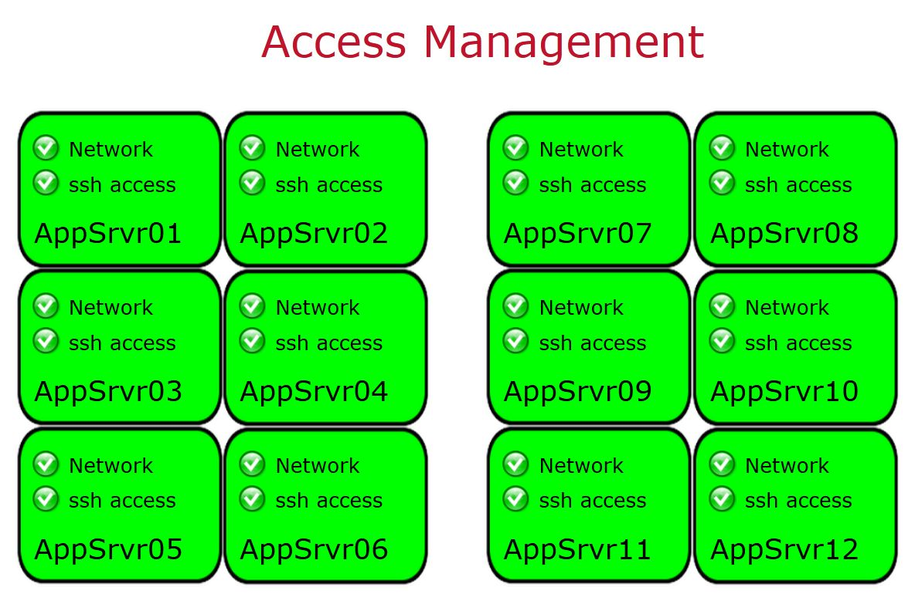
Dash Board Evolution
Today
Notes:
Speaker Notes:
Clean, simple, easy to read, application status is instant.

Slide 16
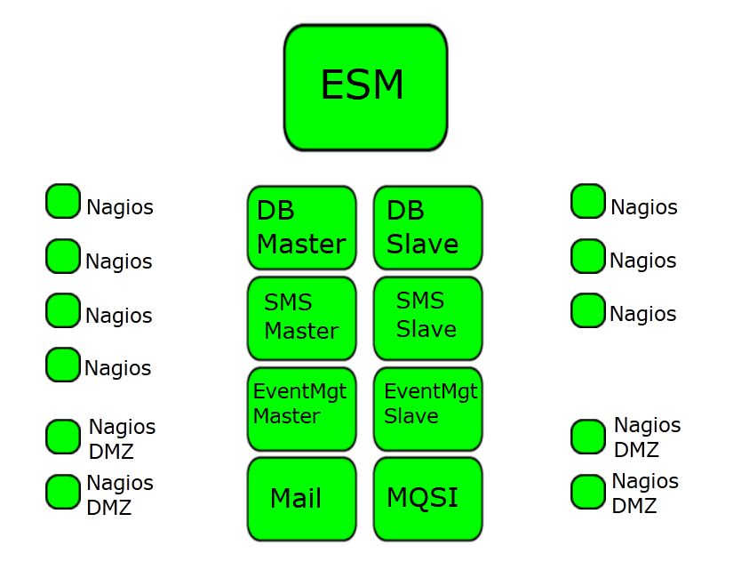
Dash Board Evolution
Notes:
Speaker Notes:
Simple information is also inferred by the position on the dash board
left hand side icons are for servers located at primary data centre, right hand side for secondary data centre.

Slide 17
VMware Dash Boards
VMware - interesting monitoring challenges
Metrics from each ESX host are monitored
Metrics are clustered to prevent false positives
> 20% Failure shown as a warning
> 40% Failure shown as critical
Notes:
Speaker Notes:
VMware clusters present some interesting monitoring challenges
Metrics from each ESX host are monitored
Metrics are clustered to prevent false positives
More than 20% failure is shown as a warning, > 40% is shown as critical

Slide 18
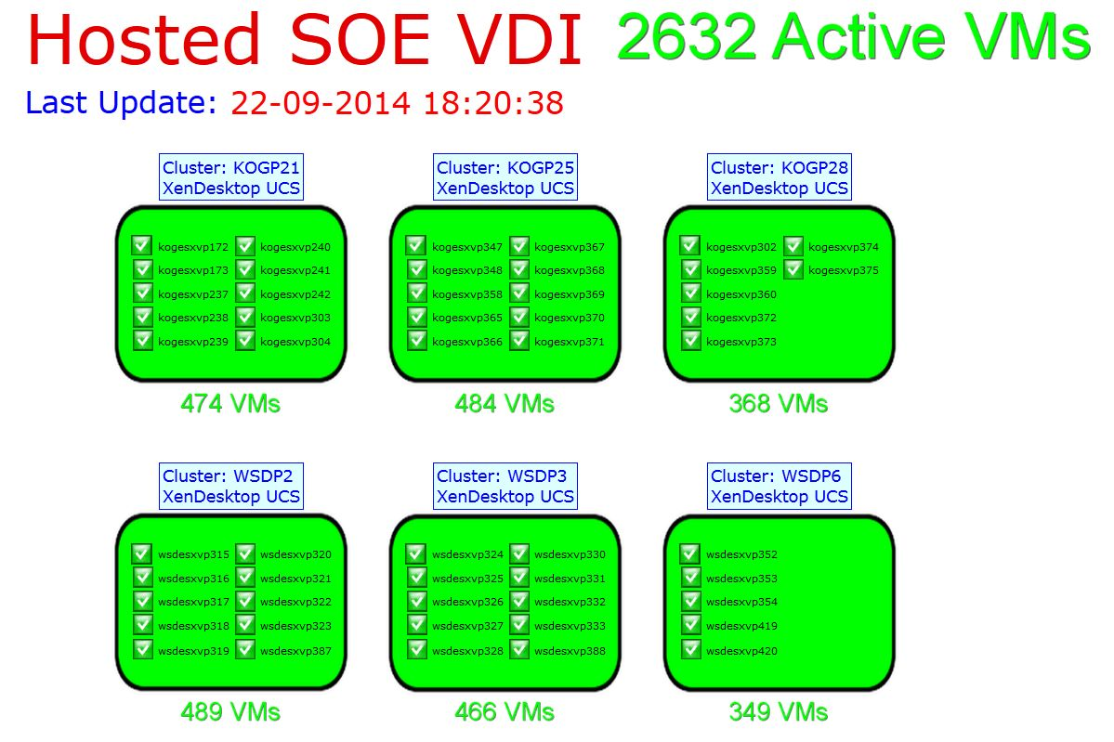
Dash Board Drill Down
Notes:
Speaker Notes:

Slide 19
VMware Dash Boards
Top level status shows nothing is wrong
VMware clusters have lots of redundancy
Hover display shows some detail
Although it looks simple, there are more than 150 metrics collected and clustered to build the status of each VMware ESX cluster.
Notes:
Speaker Notes:
There are some minor issues even though the top level show nothing is wrong.
Looks simple, there are more than 150 metrics collected and clustered to build the status of each VMware ESX cluster.
The Dashboard hides the complexity to give a simple clear indication of the application status

Slide 20
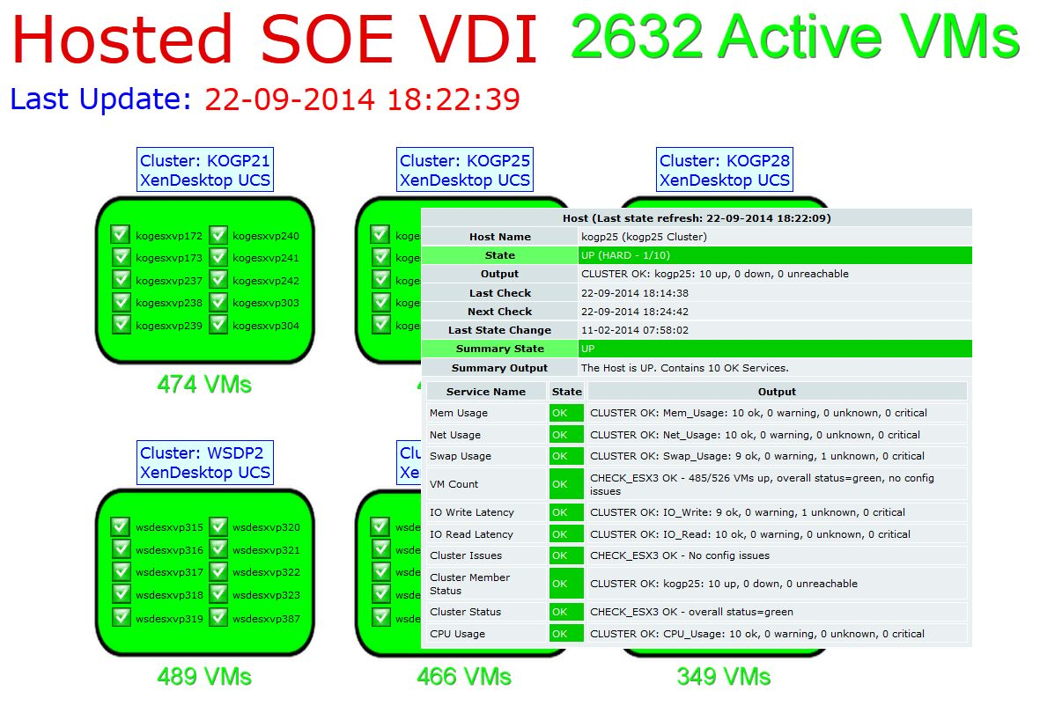
VMware Dash Boards
Notes:
Speaker Notes:
Closer inspection shows minor issues using hover

Slide 21
VMware Dash Boards
Drill down shows the details for the support teams.
Notes:
Speaker Notes:

Slide 22
VMware Dash Boards
Notes:
Speaker Notes:
Lower level dash boards show the detail for those who really need it

Slide 23
Application Support
Specific Custom Requirements
Displayed on large monitors
Used for day to day operational status
Summary rolled up to the NOC
Notes:
Speaker Notes:
Application support teams have specific requirements
Specialty dash boards are displayed on large monitors in the support team areas
These are used for day to day operational status at a detailed level
The summary is rolled up to the NOC summary dash board

Slide 24
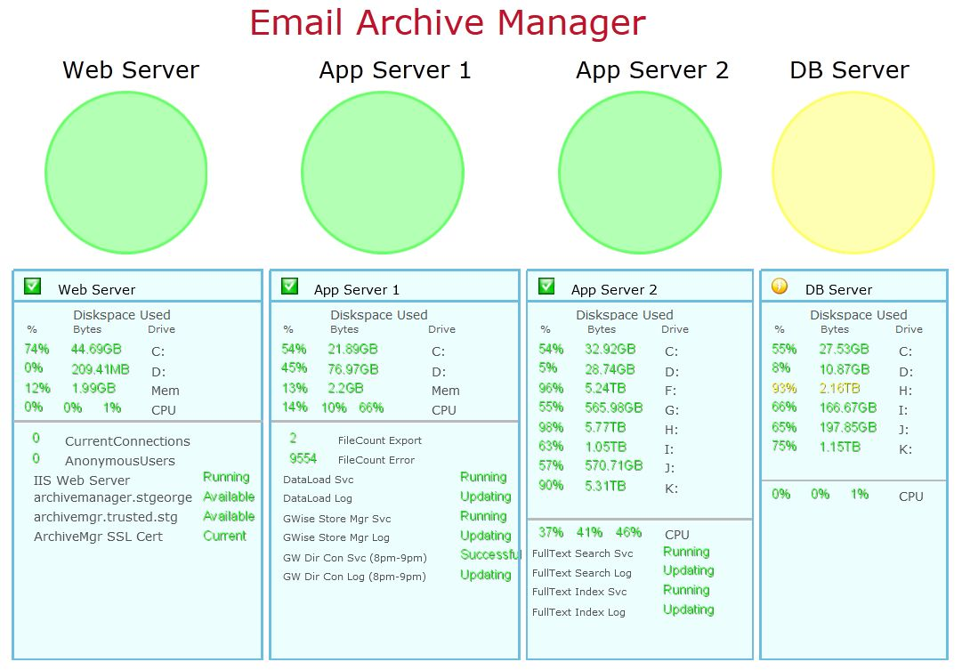
Application Support
Notes:
Speaker Notes:
These are used for day to day operational status at a detailed level
The summary is rolled up to the NOC summary dash board

Slide 25
Application Support
Notes:
Speaker Notes:
Email Archive Manager warning summary is rolled up to the summary dash board for management by the NOC

Slide 26
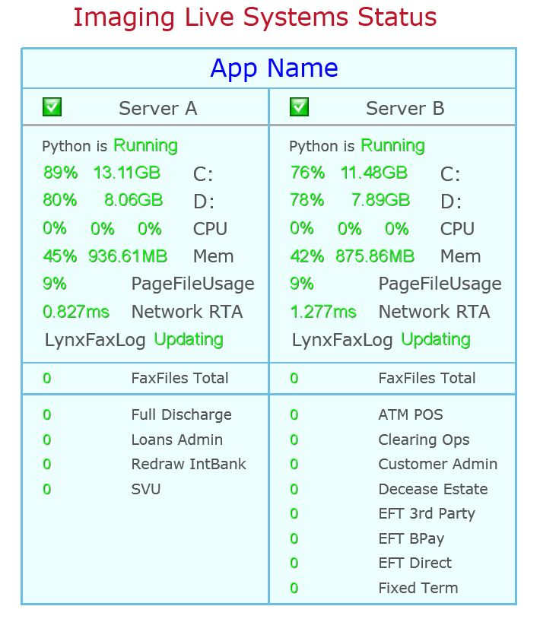
Application Support
Notes:
Speaker Notes:

Slide 27
NagVis & Livestatus
NagVis is extremely flexible
More so with Livestatus
Use simple perl script to extract data
Enhance dash boards anyway you want
Notes:
Speaker Notes:
NagVis is super configurable, anything we can dream up can be dash boarded easily.
Custom object graphics are created in graphics editor / publisher / power point and exported as png files.

Slide 28
NagVis & Livestatus
#!/usr/bin/perl -wT
use CGI qw/:standard/;
use Monitoring::Livestatus;
my $q = new CGI;
print $q->header();
$backend = $q->param( 'backend' );
$filtergrp = $q->param( 'hostGroup' );
$ml = Monitoring::Livestatus->new(
server => ‘backend hostname:port'
);
my $up = $ml->selectscalar_value("GET hosts\nFilter: host_groups >= $filtergrp\nStats: state = 0");
my $down = $ml->selectscalar_value("GET hosts\nFilter: host_groups >= $filtergrp\nStats: state = 1");
my $unknown = $ml->selectscalar_value("GET hosts\nFilter: host_groups >= $filtergrp\nStats: state = 2");
my $total = $up + $down + $unknown;
print "$down\/$total<br>";
Notes:
Speaker Notes:
Live perl code that I use to extra data from a Livestatus backend, only the hostname and port have been changed

Slide 29
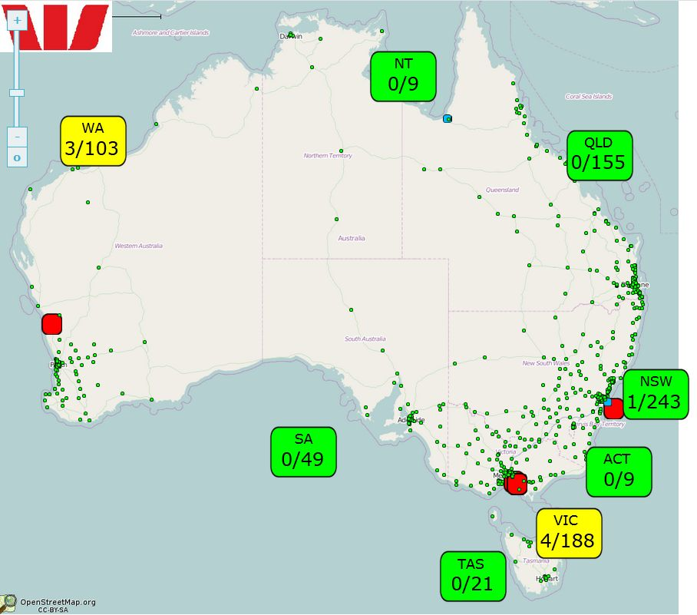
NagVis & Livestatus
Notes:
Speaker Notes:
This is a Branch Status GeoMap that has been exported as a static map
Then enhanced with a couple of lines of perl that extra data from a Livestatus backend.
The perl code from the previous slide provides the values for the status boxes.
A separate cluster monitor provides the status colour for the boxes
Branches for each geographical state belong to a hostgroup
The cluster monitor is set to !Name!2!5!$HOSTSTATEID
NOC monitoring team is in the unique position of showing all sites from all suppliers on one pane of glass, none of our service providers can do that.

Slide 30
Summary
Simple is effective
Clear status summary
Bold broad use of colour
Details only for Specialists
Notes:
Speaker Notes:

Slide 31
Part 3
Service Desk Integration
Notes:
Speaker Notes:

Slide 32
Service Desk Integration
Two tried and proven methods:
Direct to API
Event Management
Notes:
Speaker Notes:
I have done it both ways, with two different monitoring systems and two different service desks, the methods are universal
Direct to API is hard work but gives fine grain control and extremely tight coupling – lots of coding
Going via event management is very easy and is loosely coupled – very simple coding in the notification script.

Slide 33
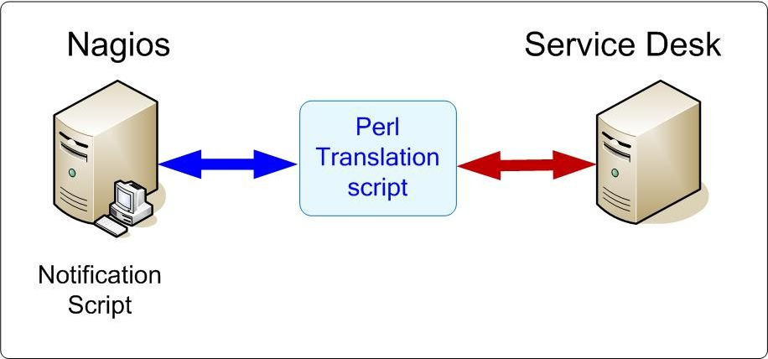
Service Desk Integration
Direct to API
Notes:
Speaker Notes:
Difficult but gives a lot more control.
A lot of code has to be written and maintained.
We did this and had very tightly coupled monitoring to SD integration, but nobody really cared, so long as the ticket gets logged
Maintained the whole thing for years.

Slide 34
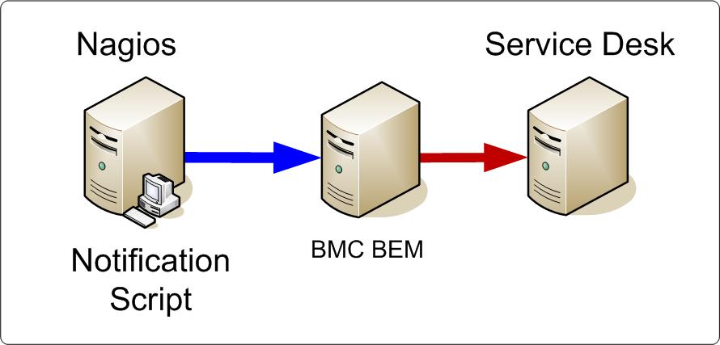
Service Desk Integration
Event Management
Notes:
Speaker Notes:
Now doing it this way.
Much easier, construct event in notification script, fire and forget.

Slide 35
Service Desk Integration
Notifications: email, sms, remedy
Custom macro in top level templates
Common script for host & Service
Custom macro sent to notify script
Email & sms easy to handle
Notes:
Speaker Notes:

Slide 36
Service Desk Integration
Service desk ticket creation handled by sending event to BMC BEM.
Same method as email & SMS.
Different handler subroutine in notify script.
Notes:
Speaker Notes:
BEM – BMC Event Management

Slide 37
Service Desk Integration
Nagios ContactGroup as ResolverGrp
Worked fine until department mergers changed ContactGroup names
Now using custom macro in top level templates
Notes:
Speaker Notes:
Custom macro contains Resolver Group for Remedy.

Slide 38
What does that give us ?
Control of notification down to individual host & service level
Ability to set notification at template level and override at service / host level
Email / sms / tickets in any combination
Complete flexibility
Notes:
Speaker Notes:

Slide 39
Summary
API – more control
API – much harder to do
EvtMgmt – not as much control
EvtMgmt – very simple to do
Notes:
Speaker Notes:

Slide 40
Part 4
Mainframe Alerts
Notes:
Speaker Notes:
Methods presented here are applicable to any legacy style system that has a logging mechanism and IP connectivity.

Slide 41
Mainframe Alerts via MQSI
Why ? (you want to do what ????)
Why bother ? (That’s what Ops are for, aren't they ?)
How ? (it’s easier than it sounds)
Notes:
Speaker Notes:

Slide 42
Mainframe Alerts - Why ?
Most of our distributed apps are back ended by mainframes
Mainframe hiccups cause apps to fail
Dash boards all stay a lovely shade of Green
MF vendor options outrageously expensive ($100k - $1M)
Notes:
Speaker Notes:
IT pundits have been predicting the death of the mainframe for years, someone forgot to tell the mainframe guys.
Instead of dying they have morphed into super web application servers.
After a recent upgrade, we kept the old MF as a OS390 WebSphere App server, these dinosaurs aren’t retiring anytime soon.

Slide 43
Mainframe Alerts - How ?
Anybody who has legacy MF Apps also has MQSI (If not, why not ?)
SysProgs already logging errors
Setup MQSI channel from MF to Intel host
Agree on simple delimited message format
field1|field2|field3|field4|field5 …fieldN
SysProgs send error messages via MQSI
Notes:
Speaker Notes:

Slide 44
Mainframe Alerts - How ?
Message arrives, MQSI auto runs custom script
Simple perl split on delimiter to recover fields.
Perl script then formats alert into any format you want and sends it to Nagios
NSCA, NDRP, SNMP, NagEventLog or what ever option you have available.
Notes:
Speaker Notes:

Slide 45
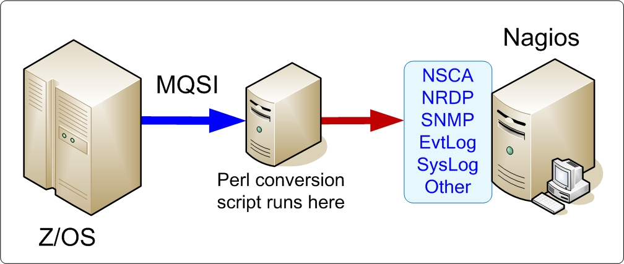
Mainframe Alerts - How ?
Notes:
Speaker Notes:
This method is flexible
Originally built to integrate into proprietary event management system.
With simple code changes to output method, now feeds into Nagios.

Slide 46
Mainframe Alerts - Result ?
MF App events now in Nagios
Map MF events to appropriate Apps
Dashboards show correct status
Happy NOC Manager
Notes:
Speaker Notes:

Slide 47
Summary
MF’s are still with us.
Process critical transactions.
Status not complete without MF app detail.
Notes:
Speaker Notes:

Slide 48
Questions?

Slide 49
Thanks for coming
Simon Finch
sfinch@westpac.com.au
https://www.linkedin.com/pub/simon-finch/23/461/3b7

