Slide 1
Nagios and Kentix System Partners - Critical Monitoring Alerts in Your Hand
Tanja Lewit
T.Lewit@Kentix.com

Slide 2
Introduction & Agenda
Nagios Core is the industry standard, Open Source IT monitoring system that enables organizations to identify and resolve IT infrastructure problems before they affect critical business processes.
Kentix is a one box “Lego Block” that adds physical environmental monitoring and security as an extension .

Slide 3

Nagios and Kentix as “Partners”
With Kentix and Nagios integration ANY monitored parameter can be established as an “alert” and can be sent via text or email to your phone.
We will cover:
>Nagios Setup for monitoring Kentix Alarm Manager-PRO with connected MultiSensors
>Setting up Nagios SMS-Alarming and Email notification via Alarm Manager

Slide 4

Why Physical Monitoring

Slide 5

One Box Innovative Security
Kentix was developed to ensure Critical Equipment protection. We feature Multi-Sensor technology which provides for all environmental sensing parameters in one.
Temp, humidity, dew point, CO2 , Pre-alarm for Fire, Motion, Access, Sabotage, Power Loss , etc .
The IT server room is a critical equipment area and beyond the network and processes, security and reliability of uptime means making sure the equipment
Is protected.

Slide 6

Multi-Sensor Technology

Slide 7

Nagios Core Overview
Comprehensive Monitoring: Provides monitoring of all mission-critical infrastructure components - including applications, services, operating systems, network protocols, system metrics, and network infrastructure.
Visibility: Provides central view of your entire IT operations network and business processes.

Slide 8
Nagios Core Benefits
Awareness: Alerts are delivered to IT staff via email and SMS. Multi-user notification escalation capabilities ensure alerts reach the attention of the right people.
Problem Remediation: Event handlers allow you to automatically restart failed applications, services, servers, and devices when problems are detected.
Reports: Ensure SLAs are being met, provides historical records of outages, notifications, and alert response for later analysis.
Extendable Architecture: Provides easy integration with in-house and third-party applications. Hundreds of community-developed add-ons extend core functionality.

Slide 9
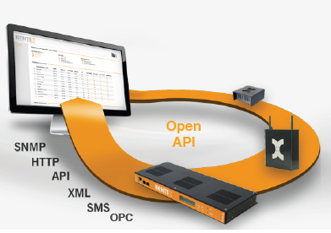
The Partners

Slide 10
Nagios Setup for monitoring Kentix Alarm Manager-PRO with connected MultiSensors
System Requirements
- Installed Nagios Core with SNMP-Plugins / Nagios-Plugins
- Installed and configured E-Mail-Server (i.e. Outlook)
The configuration is done by editing the Nagios config-files manually.
A configuration with a GUI (Graphical User Interface), i.e. NagiosQL is also possible but it has to be installed separately.
The path of the Nagios installation and its config files can vary depending on the way of installation (packages/source).
The files that require modification are always the same.
For this example -the Nagios installation was built from its source

Slide 11

Kentix-Knowledge Base
* Edit the main Nagios config file (nagios.cfg):
nano /usr/local/nagios/etc/nagios.cfg
* Locate the line „check_external_command=0“ and
* Activate: "check_external_command = 1"
* Locate the „OBJECT CONFIGURATION FILES section“
* Add the config files:
cfg_file=/usr/local/nagios/etc/objects/commands.cfg
cfg_file=/usr/local/nagios/etc/objects/hosts.cfg
cfg_file=/usr/local/nagios/etc/objects/services.cfg
cfg_file=/usr/local/nagios/etc/objects/contacts.cfg

Slide 12

Kentix Knowledge Base
* Paths can vary between distributions and installation variant (packages/built from source)
Create the defined config files if these do not already exist
touch /usr/local/nagios/etc/objects/commands.cfg
touch /usr/local/nagios/etc/objects/hosts.cfg
touch /usr/local/nagios/etc/objects/services.cfg
touch /usr/local/nagios/etc/objects/contacts.cfg

Slide 13

Kentix Knowledge Base
*Add the AlarmManager to the monitored hosts
*Edit the hosts configuration file
nano /usr/local/nagios/etc/objects/hosts.cfg
*Insert the AlarmManager as a new host to check in Nagios.
define host {
! use! ! ! ! generic-host
! host_name ! ! ! AlarmManager
! alias ! ! ! ! AlarmManager
! address ! ! ! 192.168.1.1
! check_command ! ! check-host-alive
! max_check_attempts ! 10
! notification_interval ! ! 60
! notification_period ! ! 24x7
! notification_options ! ! d,u,r
*Restart Nagios /etc/init.d/nagios restart
The AlarmManager will now appear in the hosts section of the Nagios web interface..

Slide 14

Adding an SNMP check for 1 MultiSensor value
* Download the file Kampro.mib (SNMP MIB in the software section on www.kentix.com) and open in a MIB Browser (i.e. iReasoning MIB Browser) to determine the OIDs for e.g. the temperature of MultiSensor 1.
Note Itʻs also possible to use snmpwalk to catch the needed OID.
snmpwalk -v2c -c private IP .1.3.6.1.4.1.37954
*Edit the commands configuration file nano /usr/local/nagios/etc/objects/commands.cfg
*Insert / modify the following command definition:
# 'check_snmp' command definition
define command{
command_name ! check_snmp
command_line ! ! $USER1$/check_snmp -H $HOSTADDRESS$ -c $ARG1$ -o $ARG2$ -c $ARG3$
}

Slide 15
Adding an SNMP check for 1 MultiSensor value
Description of the arguments:
$ARG1$ = SNMP Community
$ARG2$ = OID
$ARG3$ = critical warning range (also possible in 2 levels with -w (warning) and -c (critical))
Edit the services configuration file
nano /usr/local/nagios/etc/objects/services.cfg
Insert the following service definition:
define service{
! use ! ! ! generic-service
! host_name ! ! AlarmManager
! service_description ! Sensor 1 Temperature
! check_command check_snmp!IP-of-AlarmManager!public !.1.3.6.1.4.1.37954.1.2.1.2.0!100:300
}

Slide 16
Adding an SNMP check for 1 MultiSensor value
Arguments are separated with "!"
!100:300 means warn and alert below 10 degrees and above 30 degrees.
Restart Nagios
/etc/init.d/nagios restart
The Sensor will now appear in the Services section and update its value after a short time

Slide 17

Setting up Nagios E-Mail notification and SMS-Alarming via AlarmManager
ROUND TWO-
Edit the hosts configuration file
nano /usr/local/nagios/etc/objects/hosts.cfg
Add a contact or contact group to your AlarmManager-host for the alarming.
...
contacts nagiosadmin
..
Edit the contacts configuration file
nano /usr/local/nagios/etc/objects/contacts.cfg

Slide 18

Create a new contact
define contact{
contact_name nagiosadmin ! ; Short name of user
use generic-contact ! ; Inherit default values from generic-contact template
alias Administrator! ! ; Full name of user
service_notifications_enabled! 1! ;
service_notification_period ! 24x7 ;
host_notification_period ! 24x7 ;
service_notification_options ! w,u,c,r,f ;
host_notification_options ! d,u,r,f ;
service_notification_commands ! notify-service-by-email, otify-by-sms-service ;
host_notification_commands ! notify-host-by-email,notify-by-sms-host ;
pager ! ! +9736005170 ;
email mail@address.com ; <<** CHANGE THIS TO YOUR EMAIL ADDRESS **
}

Slide 19
Edit-Locate
Edit the commands configuration file
nano /usr/local/nagios/etc/objects/commands.cfg
Locate the following sections.
# 'notify-host-by-email' command definition
# 'notify-service-by-email' command definition
In the command_line of these two command definitions update the mailer behind the pipe to your used mailing-command (e.g. „/usr/bin/mail“ ).

Slide 20

Insert Command Definition
Insert the following command definition for SMS sending:
define command {
command_name notify-by-sms-host
command_line $USER1$/NagiosSendSMS.pl nagiosadmin kentix $CONTACTPAGER$ "Device:
$HOSTNAME$, Description: $HOSTSTATE$, $HOSTOUTPUT$"
}
define command {
command_name notify-by-sms-service
command_line $USER1$/NagiosSendSMS.pl nagiosadmin kentix $CONTACTPAGER$ "Device:
$HOSTNAME$, Description: $SERVICEDESC$, $SERVICEOUTPUT$"
}

Slide 21

Note:
nagiosadmin! is the user that has to exist in your AlarmManager configuration
“kentix" is the Web User Password of the AlarmManager-user
We recommend a separate user with only User name and Web User Password for SMS-Gateway
alarming.

Slide 22
Copy the Perl-Script-File „NagiosSendSMS.pl“ that comes with the SNMP MIB archive download into the folder of your Nagios Plugins (/usr/local/nagios/libexec).
Edit the Script-File:
nano /libexec/NagiosSendSMS.pl
In line #32 change the IP-address to your AlarmManager-IP.
Modify the file-owner to your nagios user (chown) and make it executable (chmod +x).
Restart Nagios
/etc/init.d/nagios restart
E-Mail and SMS-Notification will now work for the AlarmManager host and its defined services.
To test both ways of notification, set one of the values in your services configuration file (services.cfg) to a
critical level, and restart nagios again.
After 3 attempts you will receive your notification

Slide 23


Slide 24
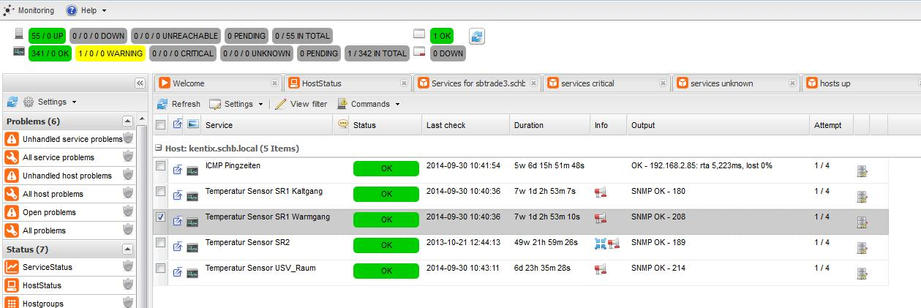
Screen Shot

Slide 25
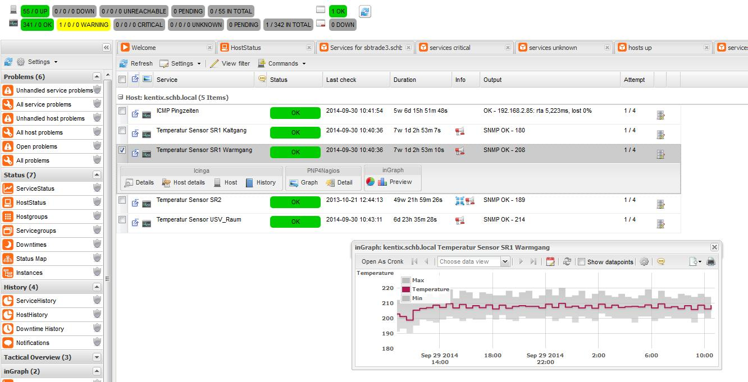
Screen Shot

Slide 26

Can you repeat that?
Have no fear!!
All information available on the web
www.Kentix.com
http://kentix.com/us/?page=service_knowledge-base
And always dedicated support
1-844-KENTIX2

Slide 27


Conclusion
Its about securing and monitoring mission critical applications and equipment.
Nagios- Is The Industry Standard In IT Infrastructure Monitoring
Plus +
the Innovative system that Detects all physical risks - instant alerting - ingeniously simple to ensure the Environment and Equipment are monitored and secure
Achieve instant awareness of IT infrastructure and the critical environment of any problems, so downtime doesn't adversely affect your business.

Slide 28




Questions?
Any questions?

Slide 29
The End
Presenter
t.lewit@kentix.com

