Slide 1
Case Study Nagios @ Nu Skin
Jeff Sly
Principal IT Architect
jsly@nuskin.com
Notes:
Isn’t Great to Be Here at the 1st Nagios World Conference, Ethan has done a great job with Nagios!

Slide 2
Who is in the Audience?
How many of you are:
Suppliers of Nagios or some value add-on for Nagios?
Customers using Nagios?
Just implementing Nagios or expanding implementation?
Using NagiosXI?
Notes:
I would like to introduce some of our Nu Skin folks here that work on Nagios.
Nate Broderick Nagios Systems Engineer
Scott McWhorter Production Support

Slide 3
Who is Nu Skin?
Notes:
Direct Selling - Lotions and Potions (or supplements), also Nourish the children

Slide 4
Our Technology Footprint
Ecommerce – Home grown
Applications – Java, EJB, ABAP, .Net
Databases – Oracle, MySQL, MSSQL
OS – HPUX, Redhat, Windows, VMWare
ERP – SAP Supply Chain, CRM, FI
Datacenters – 6 locations in 6 countries
Offices – 50 Countries

Slide 5
Monitoring Goals
Monitoring presents operations with a completely integrated global view.
Good monitoring is proactive; it helps teams prevent problems from becoming outages.
Good monitoring helps minimize outage downtime, quickly identify root cause and contacts correct people.

Slide 6
Centralized Monitoring System

Slide 7
Our Monitoring History
We tried for 10 years…
Notes:
We tried for 10 years…

Slide 8
Do it all in ‘One Tool Projects’
One Monitoring Tool to rule them all:
Mercury SiteScope
Remedy Help Desk
HP OpenView
Quest Foglight
Home grown (several)
One monitoring person
He decided to quit!

Slide 9
Could never get everything
All Failed – We always gave up! Why?
Servers and agents that were proprietary
Huge foot print inefficient performance
Steep learning curve
Very expensive
Updates costly and very time consuming
System Administrators like their own scripts, can see what they are doing

Slide 10
Resulting Monitoring Issues
Tried to make Operations clearing house for all warnings and alerts from 10+ tools
Operations was overwhelmed
Took 4 process steps and lots of software to notify of critical failures
Most Administrators setup own private monitoring to receive warnings
Many false notifications
Late notifications

Slide 11
As Is (start of project)
Our Business Customers were Unhappy

Slide 12
Old Monitoring Work Flow
Four steps to notify system administrator

Slide 13
Step 1: Everything Emails Operations
Email HelpDesk
Error
Network
HP NNM
System
Scripts
Nagios
Database
Foglight
SiteScope 8
BAC
Sitescope 6
Notes:
Everything = Critical Errors, Warnings, Information, False alerts

Slide 14
Step 2: Operations Opens Email
Email HelpDesk
Error
Network
HP NNM
System
Scripts
Nagios
Database
Foglight
SiteScope 8
BAC
Sitescope 6
Notes:
Remember there are lots of emails, critical emails buried in with the rest.

Slide 15
Step 3: Operations Checks Source
Email HelpDesk
Error
Network
HP NNM
System
Scripts
Nagios
Database
Foglight
SiteScope 8
BAC
Sitescope 6
Notes:
Decide if they think this is a critical problem, often a junior person trying to decided

Slide 16
Step 4: Operations Calls admin
Email HelpDesk
Error
Network
HP NNM
System
Scripts
Nagios
Database
Foglight
SiteScope 8
BAC
Sitescope 6

Slide 17
Inventory of Existing Checks
Regular Expression found on Web Page Monitoring
HTTP Check - Up or Down
Ping Host Up or Down
PORT monitoring
FTP checking
SMTP checking
SNMP monitoring - no trap catching yet
Radius
DNS monitoring
Disk Space monitoring
CPU and Load Average monitoring
Memory Monitoring

Slide 18
Inventory of Existing Checks
Service monitoring
Transaction monitoring - page load times – performance graph
Website click through (Webinject not working)
Log File monitor –parse for Errors
Java HEAP, Thread, Threadlock monitoring
Apache thread and worker count monitors
Ecommerce shop monitors
Email can send and receive
SQL query ODBC (catalog ODBC had bugs)
Notes:
Later I show which of these we did in Nagios and how.

Slide 19
To Be
Happy Customers

Slide 20
Key Ideas
MoM
Tool Requirements
Shared Ownership
Lowest Level
Nagios Monitor Method

Slide 21
Idea 1: MoM
Our first “break though” was the idea that even through we needed a centralized view for all monitoring that did not mean all monitoring had to be done by one monitoring tool.
We had to pick a “Manager
of the Monitors” (MoM)
to bring together the best of
breed monitoring.

Slide 22
MoM - according to Gartner

Slide 23
Idea 2: Tool Requirements
Open – not proprietary and closed
Mainstream – wanted good native support and strong community
Interface – to 3rd Party Monitoring
Flexible – adapt to many types of monitoring
Efficient – minimal foot print on production servers, not chatty on network
Notification – granular control
Reliable – good clean architecture
Usability – GUI interface, reporting

Slide 24
Idea 3: Shared Ownership
Core team
Operation of Monitoring Environment: backups, upgrades, & custom plug-ins
Monitoring Experts
Training
Monitoring leads in Development & Admin teams:
Set up own monitors
Keep own monitors current
Adjust monitors
If something is not monitored not core teams fault

Slide 25
Operations Owned Monitoring
Email HelpDesk
Error
Network
HP NNM
System
Scripts
Nagios
Database
Foglight
SiteScope 8
BAC
Sitescope 6

Slide 26
Team Leads Own Monitoring
Operations
Network
Asia
System
Scripts
Europe
Database
Web
SAP

Slide 27
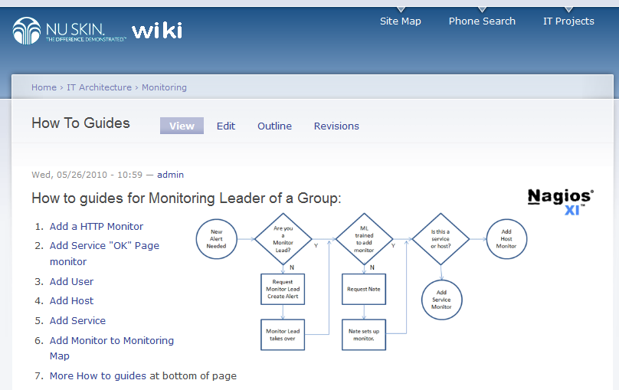
How to Guides

Slide 28
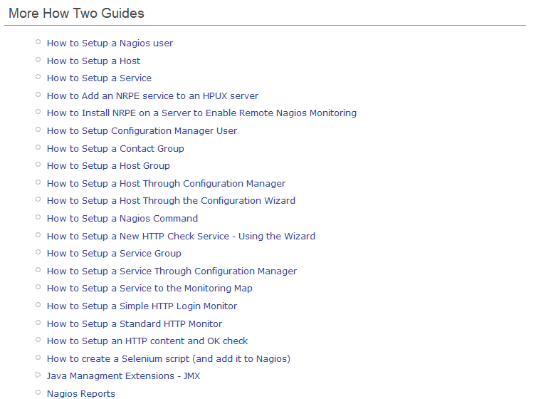

Slide 29
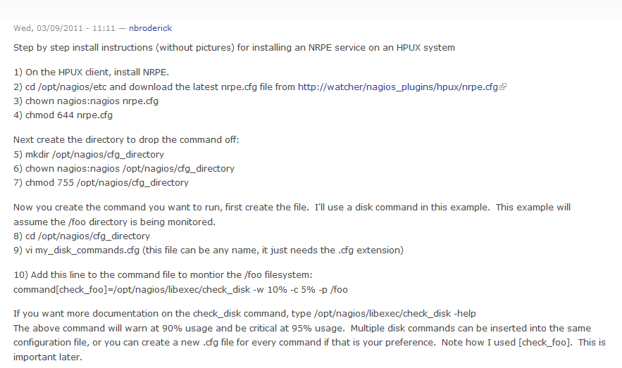
How to Setup NRPE - HPUX

Slide 30
Idea 4: Lowest Level
Handle alerts at the lowest possible level in the organization
Only forward alerts if not handled at lower levels before they become critical

Slide 31
Handle events at lowest level
Operations
Network
Asia
System
Scripts
Europe
Database
Web
SAP

Slide 32
Only forward unhandled alerts
Network
Asia
System
Scripts
Europe
Database
Web
SAP

Slide 33
Idea 5: Nagios Monitor Method
Choose the Nagios Monitoring Method
Active Check from Nagios Server (normal)
Active Check performed by remote client
NRPE, NSClient
Passive Check – Listen to 3rd party monitors
NSCA

Slide 34
Active Local Check
Web
HTTP
or
Ping
Nagios
Unix
DB
DB
Monitor
Win

Slide 35
Active Remote Check - UX
Web
Nagios
CPU, RAM
(NRPE)
Unix
DB
DB
Monitor
Win

Slide 36
Active Remote Check - Win
Web
Nagios
CPU, RAM
(NSClient)
Unix
DB
DB
Monitor
Win

Slide 37
Passive 3rd Party Alert
Web
Nagios
3rd Party
Alert NSCA
Unix
DB
DB
Monitor
Win
3rd Party Check DB

Slide 38
Bonus Idea - Tune
Tune the database
Add Ram Drive

Slide 39
Tune the Database
Modify contents of the /etc/my.cnf [mysqld] section.
tmp_table_size=524288000 max_heap_table_size=524288000 table_cache=768 set-variable=max_connections=100 wait_timeout=7800 query_cache_size = 12582912 query_cache_limit=80000 thread_cache_size = 4 join_buffer_size = 128K
http://web3us.com Info on: MySQL Tuning, Nagios Tuning

Slide 40
RAM Drive
Create a RAM disk for Nagios tempory files
I created a ramdisk by adding the following entry to the /etc/fstab file:
none /mnt/ram tmpfs size=500M 0 0
Mount the disk using the following commands
# mkdir -p /mnt/ram; mount /mnt/ram
Verify the disk was mounted and created
# df -k
Modify the /usr/local/nagios/etc/nagios.cfg file with the following tuned parameters
temp_file=/mnt/ram/nagios.tmp temp_path=/mnt/ram status_file=/mnt/ram/status.dat precached_object_file=/mnt/ram/objects.precache object_cache_file=/mnt/ram/objects.cache

Slide 41
Implementation Methodology
Site Survey
Inventory existing monitors
Proof of concept
Build new environment
Migrate monitors from each platform to Nagios, one at a time
Integrate OEM, and to send monitors to Nagios

Slide 42
Three Project Phases
Deliver something useful in each phase
Build a level at a time

Slide 43
Phase I
Set up a pilot of Nagios XI using Trial License.
Set up Foglight monitoring of JVM (Java Virtual Machine).
Purchase NagiosXI and Consulting Support
Bring in a consultant for two weeks to help set up the architecture and help us work with the system.
Documentation Web Site for Nagios learning's and “How to guides”
Define a set of standards and guidelines to follow to help aid an effective monitoring process.
Backups on Running on Production Nagios Server
Set up services which aren't being caught right now and move a few of the important services over to the new Nagios XI monitoring system.
Test Nagios plugins and server performance

Slide 44
Phase II
Migrate off of Sitescope 6 and shutdown
Migrate off of Sitescope 8 and shutdown
Decommission Foglight
Clean up the old monitoring server
Migrate the network team from old Nagios to core NagiosXI system
Set up standby NagiosXI system, cron to replicate weekly
Research missing alerts and add them to the new NagiosXI system

Slide 45
Phase III
Implement Global Monitoring
Add monitors for existing international systems
Add monitors using JMX to monitor Java servers
Nagios Remote Process Execution (NRPE) to monitor remotely
Remote Monitoring for Windows Servers (NS Client++)
Implement notification and escalation of alerts
Add monitors for critical business functions

Slide 46
Phase III continued…
Corporate Enhancements
Request recurring down time enhancement from Ethan Galstad
Automate refresh of NagiosXI standby system
Build Network Map
Retire Windows SiteScope
Add monitors for phone systems
Add monitors to data center (UPS, Temperature, Humidity)
Integrate to SAP Tidal monitoring tool

Slide 47
Phase III continued…
Business
Business review and approve SLA (using business terms)
Monitor both the Business Functions and the individual point devices that provide the Business Function
Follow the Sun with Eyes on Glass.
Training
How to setup alerts
How to receive alerts
How to report on performance graphs
Create a new Dashboard for HelpDesk and International IT Staff

Slide 48
Inventory of Monitor Checks

Slide 49
Inventory continued…

Slide 50
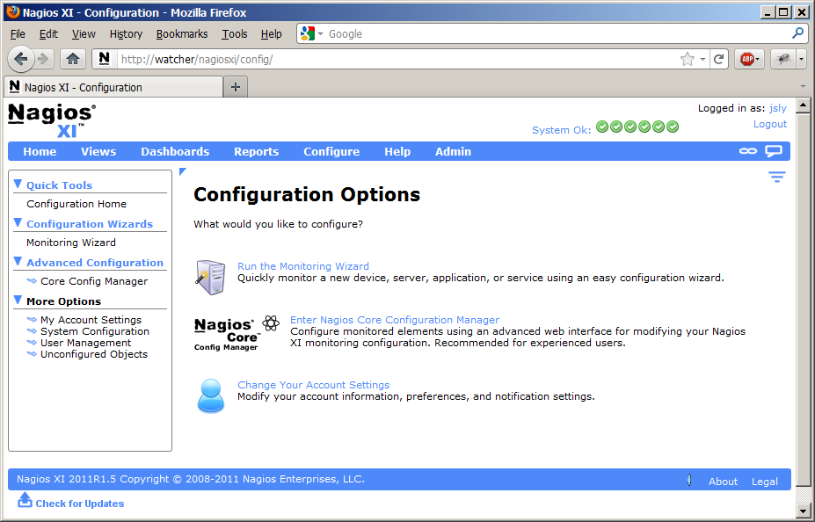
Nagios XI Interface

Slide 52
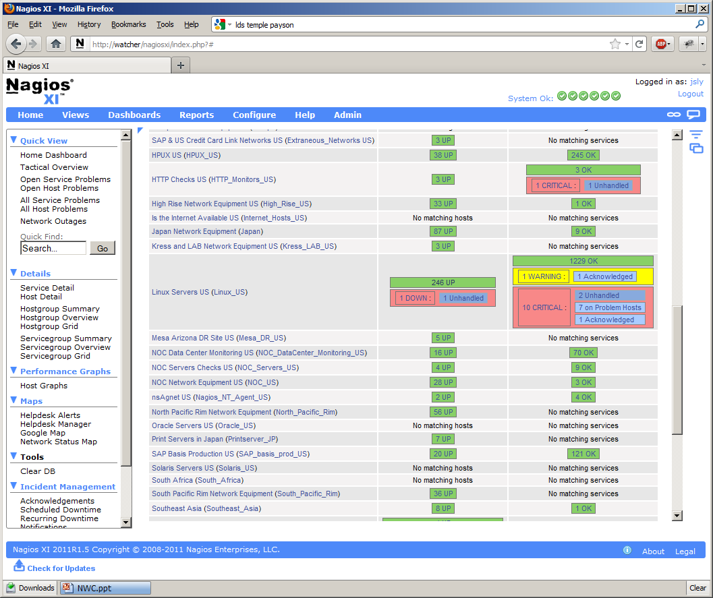

Slide 53
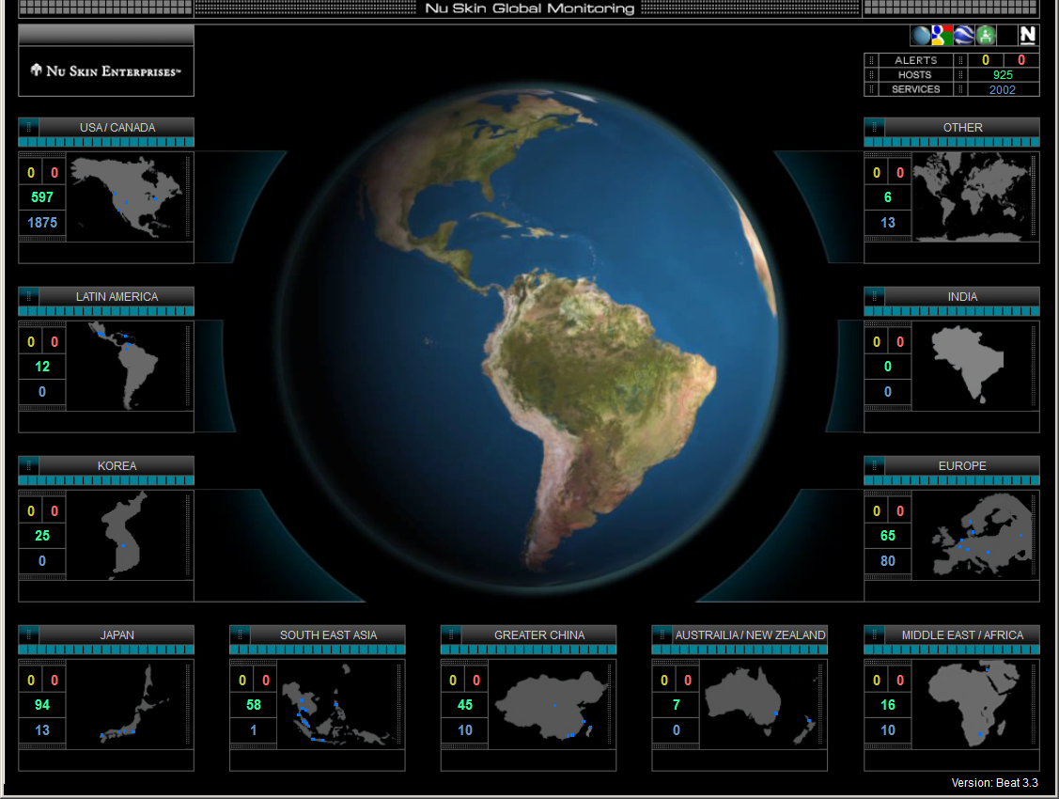
Data Centers in 7 Countries

Slide 54
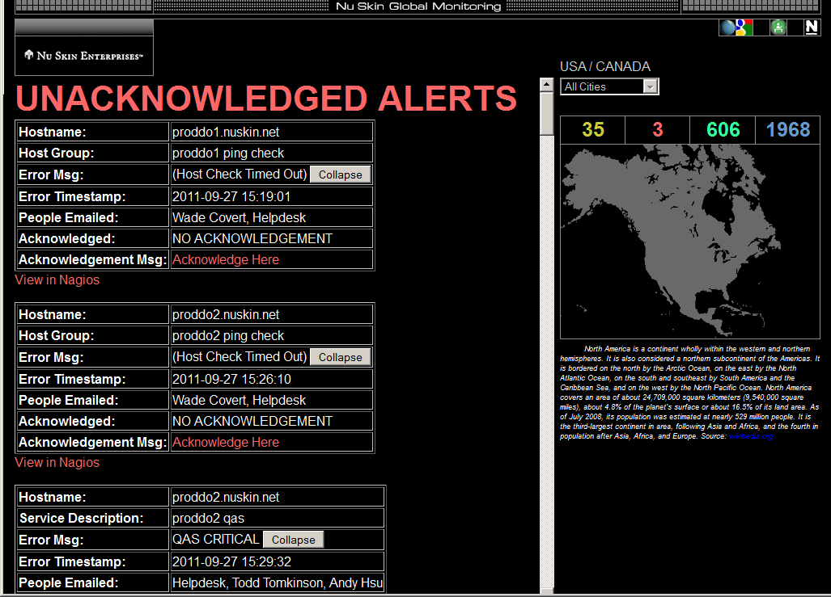

Slide 55
IT Operations
Goal | Quick Notification & Recovery from Outage
Type of Monitor | Notification of outages with details on which system is down, so we know who to contact
Solution | Migrate from Sitescope, Openview to NagiosXI

Slide 56
IT Team Managers
Goal | Prevention of outage
Type of Monitor | Warnings about conditions before outages occur, allow for corrective actions that will prevent likely outages
Solution | Migrate from Sitescope, Openview to NagiosXI, Integrate OEM SAP and Scripts with Nagios

Slide 57
Summary
MoM ~ Manager of Managers
Allow specialized tools
Tool Requirements, enough but not all
Ownership for implementation, shared
Handle alerts, lowest level in organization
Choose Nagios monitoring method

Slide 58
Tips, Tricks & Demos
Nagios XI Large Implementation
Day 3, 2:00 Track 3 (Nate Broderick)
3 Demos
Performance challenges and solutions
Integrating monitoring solutions Oracle
Migrating from BAC & Foglight
Customization
Graphing, and more.

