Slide 1
Writing Custom Nagios Plugins in Perl
Nathan Vonnahme
Nathan.Vonnahme@bannerhealth.com
To get the most out of this session, make sure you have Perl and the Nagios::Plugin module is installed.

Slide 2
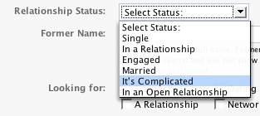
Why write Nagios plugins?
Checklists are boring.
Life is complicated.
“OK” is complicated.

Slide 3

Why in Perl?
Familiar to many sysadmins
Cross-platform
CPAN
Mature Nagios::Plugin API
Embeddable in Nagios (ePN)
Examples and documentation
“Swiss army chainsaw”

Slide 4
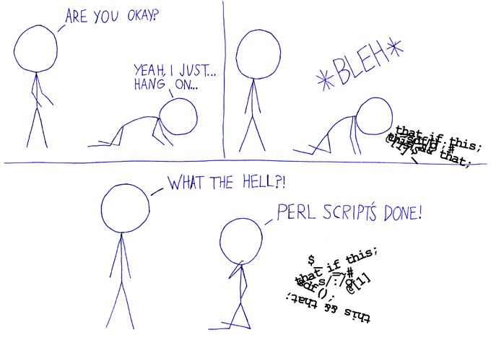
Buuuuut I don’t like Perl
Nagios plugins are very simple. Use any language you like. Eventually, imitate Nagios::Plugin.

Slide 5

got Perl?
perl.org/get.html
Linux and Mac already have it:
which perl
On Windows, I prefer
  Cygwin (N.B. make, gcc4)
  Strawberry Perl
  ActiveState Perl
Any version Perl 5 should work.
Notes:
* We may not have time to get Perl working on your Windows machine right now… feel free to just observe, or look on with someone else.
* You can also use another language now, if you prefer.

Slide 6
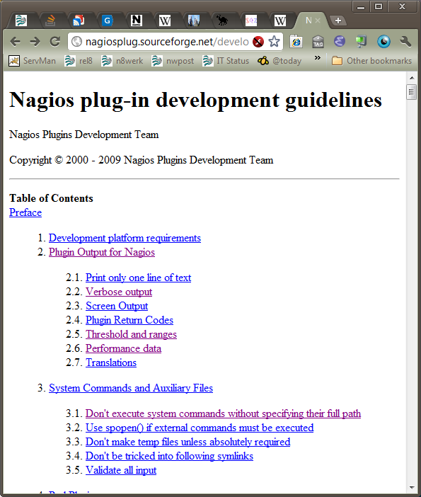

got Documentation?
http://nagiosplug.sf.net/
developer-guidelines.html
Or,
goo.gl/kJRTI
Case sensitive!
Save for later with your phone?

Slide 7

got an idea?
Check the validity of my backup file F.

Slide 8
Simplest Plugin Ever
#!/usr/bin/perl
if (-e $ARGV[0]) { # File in first arg exists.
print "OK\n";
exit(0);
}
else {
print "CRITICAL\n";
exit(2);
}

Slide 9

Simplest Plugin Ever
Save, then run with one argument:
  $ ./simple_check_backup.pl foo.tar.gz
  CRITICAL
  $ touch foo.tar.gz
  $ ./simple_check_backup.pl foo.tar.gz
  OK
But: Will it succeed tomorrow?

Slide 10
But “OK” is complicated.
Check the validity* of my backup file F.
  Existent
  Less than X hours old
  Between Y and Z MB in size
* further opportunity: check the restore process!
BTW: Gavin Carr with Open Fusion in Australia has already written a check_file plugin that could do this, but we’re learning here. Also confer 2001 check_backup plugin by Patrick Greenwell, but it’s pre-Nagios::Plugin.

Slide 11

Bells and Whistles
Argument parsing
Help/documentation
Thresholds
Performance data
These things make
up the majority of
the code in any
real plugin.

Slide 12

Bells, Whistles, and Cowbell
Nagios::Plugin
  Ton Voon rocks
  Gavin Carr too
  Used in production Nagios plugins everywhere
  Since ~ 2006

Slide 13
Bells, Whistles, and Cowbell
Install Nagios::Plugin
  sudo cpan
  Configure CPAN if necessary...
  cpan> install Nagios::Plugin
Potential solutions:
  Configure http_proxy environment variable if behind firewall
  cpan> o conf prerequisites_policy follow
  cpan> o conf commit
  cpan> install Params::Validate
Notes:
Max 5 minute wait here. Again, we may not have time to troubleshoot your CPAN configuration right now. If you can't get it to work immediately, just watch or look on with someone else, or use another language. Unix people, you may want to help or observe someone with Windows because you'll want to do it too eventually.
This worked like a dream for me with fresh Strawberry Perl, after I got the proxy configured.

Slide 14


got an example plugin template?
Use check_stuff.pl from the Nagios::Plugin distribution as your template.
  goo.gl/vpBnh
This is always a good place to
start a plugin.
We’re going to be turning
check_stuff.pl into the finished
check_backup.pl example.

Slide 15

got the finished example?
Published with Gist:
  https://gist.github.com/1218081
or
goo.gl/hXnSm
Note the “raw” hyperlink for downloading the Perl source code.
The roman numerals in the comments match the next series of slides.

Slide 16
Check your setup
  Save check_stuff.pl (goo.gl/vpBnh) as e.g. my_check_backup.pl.
  Change the first “shebang” line to point to the Perl executable on your machine.
    #!c:/strawberry/bin/perl
  Run it
    ./my_check_backup.pl
  You should get:
    MY_CHECK_BACKUP UNKNOWN - you didn't supply a threshold argument
  If yours works, help your neighbors.

Slide 17

Design: Which arguments do we need?
File name
Age in hours
Size in MB

Slide 18
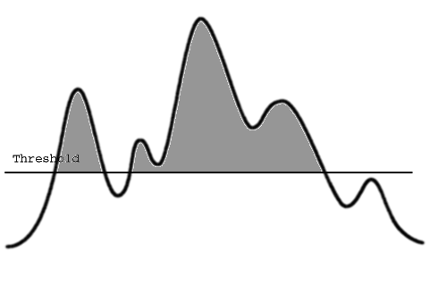
Design: Thresholds
Non-existence: CRITICAL
Age problem: CRITICAL if over age threshold
Size problem: WARNING if outside size threshold (min:max)

Slide 19
I. Prologue (working from check_stuff.pl)
use strict;
use warnings;
use Nagios::Plugin;
use File::stat;
use vars qw($VERSION $PROGNAME $verbose $timeout $result);
$VERSION = '1.0';
# get the base name of this script for use in the examples
use File::Basename;
$PROGNAME = basename($0);

Slide 20
II. Usage/Help
Changes from check_stuff.pl in bold
my $p = Nagios::Plugin->new(
usage => "Usage: %s [ -v|--verbose ] [-t <timeout>]
[ -f|--file=<path/to/backup/file> ]
[ -a|--age=<max age in hours> ]
[ -s|--size=<acceptable min:max size in MB> ]",
version => $VERSION,
blurb => "Check the specified backup file's age and size",
extra => "
Examples:
$PROGNAME -f /backups/foo.tgz -a 24 -s 1024:2048
Check that foo.tgz exists, is less than 24 hours old, and is between
1024 and 2048 MB.
“);

Slide 21
III. Command line arguments/options
Replace the 3 add_arg calls from check_stuff.pl with:
# See Getopt::Long for more
$p->add_arg(
spec => 'file|f=s',
required => 1,
help => "-f, --file=STRING
The backup file to check. REQUIRED.");
$p->add_arg(
spec => 'age|a=i',
default => 24,
help => "-a, --age=INTEGER
Maximum age in hours. Default 24.");
$p->add_arg(
spec => 'size|s=s',
help => "-s, --size=INTEGER:INTEGER
Minimum:maximum acceptable size in MB (1,000,000 bytes)");
# Parse arguments and process standard ones (e.g. usage, help, version)
$p->getopts;

Slide 22
Now it’s RTFM-enabled
If you run it with no args, it shows usage:
$ ./check_backup.pl
Usage: check_backup.pl [ -v|--verbose ] [-t <timeout>]
[ -f|--file=<path/to/backup/file> ]
[ -a|--age=<max age in hours> ]
[ -s|--size=<acceptable min:max size in MB> ]

Slide 23
Now it’s RTFM-enabled
$ ./check_backup.pl --help
check_backup.pl 1.0
This nagios plugin is free software, and comes with ABSOLUTELY NO WARRANTY.
It may be used, redistributed and/or modified under the terms of the GNU
General Public Licence (see http://www.fsf.org/licensing/licenses/gpl.txt).
Check the specified backup file's age and size
Usage: check_backup.pl [ -v|--verbose ] [-t <timeout>]
[ -f|--file=<path/to/backup/file> ]
[ -a|--age=<max age in hours> ]
[ -s|--size=<acceptable min:max size in MB> ]
-?, --usage
Print usage information
-h, --help
Print detailed help screen
-V, --version
Print version information

Slide 24
Now it’s RTFM-enabled
--extra-opts=[section][@file]
Read options from an ini file. See http://nagiosplugins.org/extra-opts
for usage and examples.
-f, --file=STRING
The backup file to check. REQUIRED.
-a, --age=INTEGER
Maximum age in hours. Default 24.
-s, --size=INTEGER:INTEGER
Minimum:maximum acceptable size in MB (1,000,000 bytes)
-t, --timeout=INTEGER
Seconds before plugin times out (default: 15)
-v, --verbose
Show details for command-line debugging (can repeat up to 3 times)
Examples:
check_backup.pl -f /backups/foo.tgz -a 24 -s 1024:2048
Check that foo.tgz exists, is less than 24 hours old, and is between
1024 and 2048 MB.

Slide 25
IV. Check arguments for sanity
Basic syntax checks already defined with add_arg, but replace the “sanity checking” with:
# Perform sanity checking on command line options.
if ( (defined $p->opts->age) && $p->opts->age < 0 ) {
$p->nagios_die( " invalid number supplied for the age option " );
}
Your next plugin may be more complex.

Slide 26
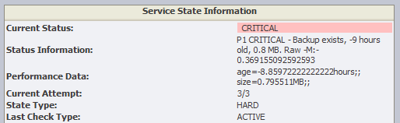
Ooops
At first I used -M, which Perl defines as “Script start time minus file modification time, in days.”
Nagios uses embedded Perl so the “script start time” may be hours or days ago.

Slide 27
V. Check the stuff
# Check the backup file.
my $f = $p->opts->file;
unless (-e $f) {
$p->nagios_exit(CRITICAL, "File $f doesn't exist");
}
my $mtime = File::stat::stat($f)->mtime;
my $age_in_hours = (time - $mtime) / 60 / 60;
my $size_in_mb = (-s $f) / 1_000_000;
my $message = sprintf
"Backup exists, %.0f hours old, %.1f MB.",
$age_in_hours, $size_in_mb;
Notes:
Again, replacing the section in check_stuff.pl

Slide 28
VI. Performance Data
# Add perfdata, enabling pretty graphs etc.
$p->add_perfdata(
label => "age",
value => $age_in_hours,
uom => "hours"
);
$p->add_perfdata(
label => "size",
value => $size_in_mb,
uom => "MB"
);
This adds Nagios-friendly output like:
| age=2.91611111111111hours;; size=0.515007MB;;
Notes:
This isn’t in check_stuff.pl

Slide 29
VII. Compare to thresholds
Add this section. check_stuff.pl combines check_threshold with nagios_exit at the very end.
# We already checked for file existence.
my $result = $p->check_threshold(
check => $age_in_hours,
warning => undef,
critical => $p->opts->age
);
if ($result == OK) {
$result = $p->check_threshold(
check => $size_in_mb,
warning => $p->opts->size,
critical => undef,
);
}

Slide 30

VIII. Exit Code
# Output the result and exit.
$p->nagios_exit(
return_code => $result,
message => $message
);

Slide 31
Testing the plugin
$ ./check_backup.pl -f foo.gz
BACKUP OK - Backup exists, 3 hours old, 0.5 MB | age=3.04916666666667hours;; size=0.515007MB;;
$ ./check_backup.pl -f foo.gz -s 100:900
BACKUP WARNING - Backup exists, 23 hours old, 0.5 MB | age=23.4275hours;; size=0.515007MB;;
$ ./check_backup.pl -f foo.gz -a 8
BACKUP CRITICAL - Backup exists, 23 hours old, 0.5 MB | age=23.4388888888889hours;; size=0.515007MB;;

Slide 32
OK?
How’s your plugin going?
Can you help your neighbor?
Subject: ** PROBLEM alert – my plugin is WARNING **

Slide 33
Telling Nagios to use your plugin
  1. misccommands.cfg*
define command{
command_name check_backup
command_line $USER1$/myplugins/check_backup.pl
-f $ARG1$ -a $ARG2$ -s $ARG3$
}
  * Lines wrapped for slide presentation

Slide 34
Telling Nagios to use your plugin
  2. services.cfg (wrapped)
  define service{
  use generic-service
  normal_check_interval 1440 # 24 hours
  host_name fai01337
  service_description MySQL backups
  check_command check_backup!/usr/local/backups
  /mysql/fai01337.mysql.dump.bz2
  !24!0.5:100
  contact_groups linux-admins
  }
  3. Reload config:
    $ sudo /usr/bin/nagios -v /etc/nagios/nagios.cfg && sudo /etc/rc.d/init.d/nagios reload

Slide 35
Remote execution
Hosts/filesystems other than the Nagios host
Requirements
  NRPE, NSClient or equivalent
  Perl with Nagios::Plugin

Slide 36
Remote Example: Windows 2008
  (This is annoyingly complex today. Anyone?)
  Install latest NC_Net MSI on Windows machine
  Let it through Windows Firewall (port 1248)
  Install Perl and Nagios::Plugin
  Put my check_backup.pl in C:\Program Files\MontiTech\Nc_net_Setup_v5\script
  Compile the NC_Net version of check_nt on the Nagios server.*
  Make wrapper C:\Program Files\MontiTech\Nc_net_Setup_v5\script check_my_backup.bat :
  @echo off
  C:\cygwin\bin\perl .\check_backup.pl -f foo.bak
Notes:
*Hint: compile nagios-plugins but replace its plugins/check_nt.c with check_nc_net.c from nc-net.sf.net

Slide 37
Profit
$ plugins/check_nt -H winhost -p 1248
-v RUNSCRIPT -l check_my_backup.bat
OK - Backup exists, 12 hours old, 35.7 MB | age=12.4527777777778hours;; size=35.74016MB;;
Notes:
☹ This is not working for me in production anymore.

Slide 38

Share
exchange.
nagios.org

Slide 39
Other tools and languages
C
TAP – Test Anything Protocol
  See check_tap.pl from my other talk
Python
Shell
Ruby? C#? VB? JavaScript?
AutoIt!

Slide 40

A horrifying/inspiring example
The worst things need the most monitoring.

Slide 41
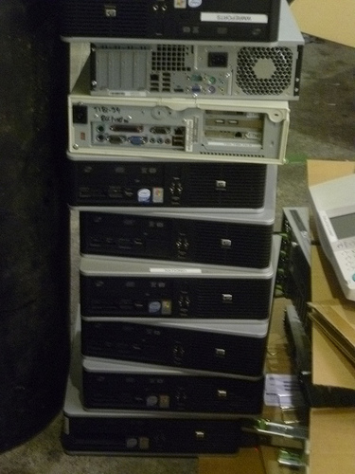
Chart “servers”
MS Word macro
Mail merge
Runs in user session
Need about a dozen

Slide 42

It gets worse.
Not a service
Not even a process
100% CPU is normal
“OK” is complicated.

Slide 43
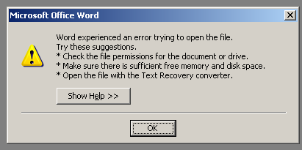
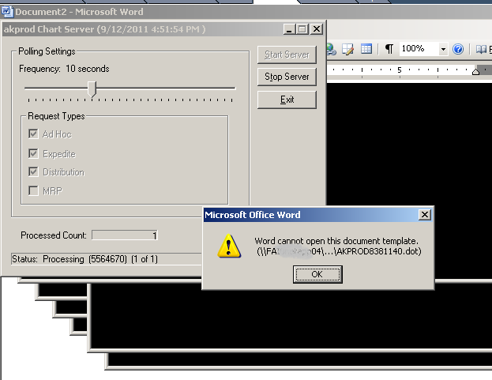
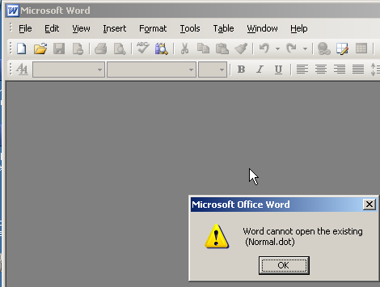
Many failure modes

Slide 44
AutoIt to the rescue
Func CompareTitles()
For $title=1 To $all_window_titles[0][0] Step 1
$state=WinGetState($all_window_titles[$title][0])
$foo=0
$do_test=0
For $foo In $valid_states
If $state=$foo Then
$do_test +=1
EndIf
Next
If $all_window_titles[$title][0] <> "" AND $do_test>0 Then
$window_is_valid=0
For $string=0 To $num_of_strings-1 Step 1
$match=StringRegExp($all_window_titles[$title][0], $valid_windows[$string])
$window_is_valid += $match
Next
if $window_is_valid=0 Then
$return=2
$detailed_status="Unexpected window *" & $all_window_titles[$title][0] & "* present" & @LF & "***" & $all_window_titles[$title][0] & "*** doesn't match anything we expect."
NagiosExit()
EndIf
If StringRegExp($all_window_titles[$title][0], $valid_windows[0])=1 Then
$expression=ControlGetText($all_window_titles[$title][0], "", 1013)
EndIf
EndIf
Next
$no_bad_windows=1
EndFunc
Func NagiosExit()
ConsoleWrite($detailed_status)
Exit($return)
EndFunc
CompareTitles()
if $no_bad_windows=1 Then
$detailed_status="No chartserver anomalies at this time -- " & $expression
$return=0
EndIf
NagiosExit()

Slide 45
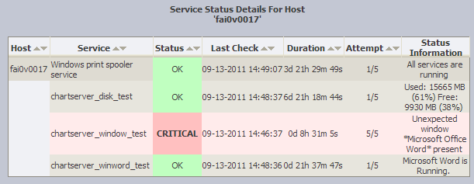
Nagios now knows when they’re broken

Slide 46
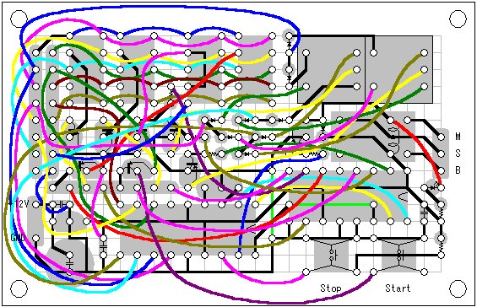
Life is complicated
“OK” is complicated.
Custom plugins make Nagios much smarter about your environment.

Slide 47
Questions?
Comments?

