Slide 1
Distributed Monitoring
for Web Apps Fernando Hönig
fernando.honig@intel.com

Slide 2
About me
From Córdoba, Argentina
System Administrator
Working last 7 years in IT Companies
Working in Intel IT since April 2011
Married with Jesica and Father of Benjamin (2)

Slide 3
Third Party Vendors / Open Source
This presentation will cover the solution achieved instead of talking about third party vendors.
All products used for this are open source.
Best Practices
With this presentation we would like to show IT@Intel processes and best practices.

Slide 4
Topics
Problem Overview
Distributed Infrastructure
Failover Solution
Webinject Architecture
API Feeds Integration
Multi Checks + NRPE
Notifications with SMS and VoIP
Q/A

Slide 5
Why do we need a Distributed Infrastructure?
More than 500 Services Checks per Customer
Apps from our Customer needs to be reached from diff GEOs
Checks every 1 or 5 minutes
Redundancy / Fast Recovery
Why do we need a Centralized Dashboard?
ACLs for different customers and groups.
Fast and simple services/commands/hosts adds/updates/removal.
MySQL stored performance data for external BI solutions.

Slide 6
Centralized Dashboard / Nagios Distribution
External
Monitoring
Provider #1
Web
Apps
Region #1
Region #2
Region #3
Region #N
External
Monitoring
Provider #2

Slide 7
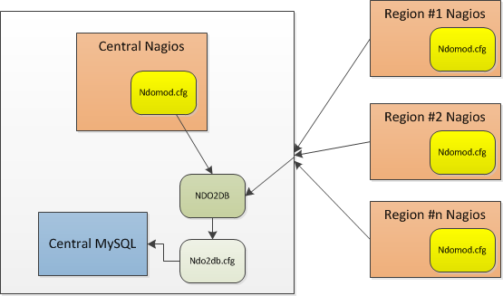
Simple Distributed Nagios with NDOUtils
Ndomod.cfg - Example
instance_name=Central
output_type=tcpsocket
output=127.0.0.1
tcp_port=5668
output_buffer_items=5000
file_rotation_interval=14400
file_rotation_timeout=60
reconnect_interval=15
reconnect_warning_interval=900
data_processing_options=-1
config_output_options=3
Ndo2db.cfg - Example
ndo2db_user=nagios
ndo2db_group=nagios
socket_type=tcp
socket_name=/var/run/ndo.sock
tcp_port=5668
db_servertype=mysql
db_host=localhost
db_name=centstatus
db_port=3306
db_prefix=nagios_
db_user=username
db_pass=password
max_timedevents_age=1440
max_systemcommands_age=1440
max_servicechecks_age=1440
max_hostchecks_age=1440
max_eventhandlers_age=1440

Slide 8
How to Enable a new distributed node?
To enable a new Nagios node you just need to:
Install a VM with the latest Nagios/NRPE/NDOMod code.
Setup ssh-without-password auth for nagios user. Add some sudo rights.
Enable that node in the centralized interface.
Create a new poller
Create a new nagios.cfg config for that poller
Create a new ndomod config for that poller
Enable the service checks that you need on that poller
All of this could be automated

Slide 9
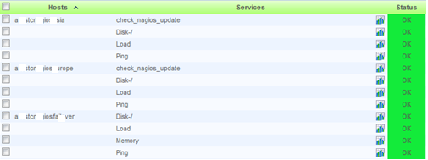
Remote Pollers Visualization
Remote Services / Checks

Slide 10
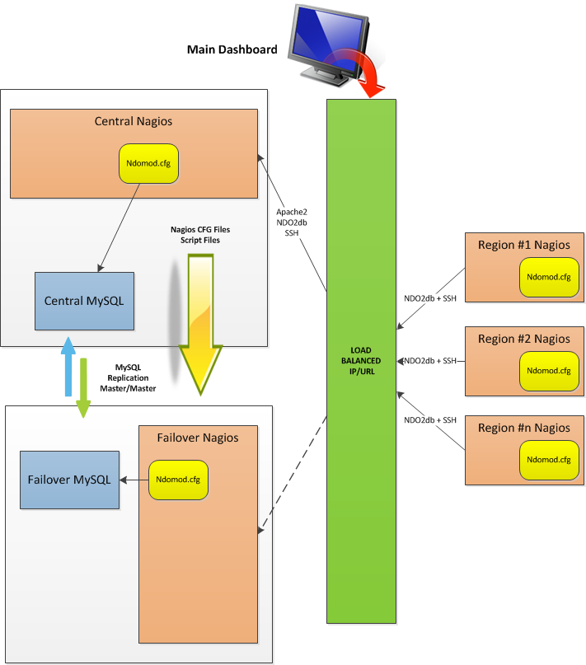
Distributed with Failover

Slide 11
Failover Infrastructure Scripts / Master Side
#!/bin/sh
apacherun=`ps ax | grep /usr/sbin/httpd | grep -v grep | cut -c1-5 | paste -s -`
nagiosrun=`ps ax | grep /usr/local/nagios/bin/nagios | grep -v grep | cut -c1-5 | paste -s -`
if [ "$nagiosrun" == "" ];
then
echo "Stopping Apache since Nagios is not running"
/etc/init.d/apache2 stop
else
echo "Nagios running"
fi
if [ "$apacherun" == "" ];
then
echo "Stopping Nagios since Apache is not running"
/etc/init.d/nagios stop
else
echo "Apache running"
fi
exit 0
NRPE Command
command[check_nagios_failover]=/usr/local/nagios/libexec/check_nagios -F /usr/local/nagios/var/status.dat -e 1 -C '/usr/local/nagios/bin/nagios -d /usr/local/nagios/etc/nagios.cfg'

Slide 12
Failover Infrastructure Scripts / Failover Side
#!/bin/sh
nagcmd=`/usr/local/nagios/libexec/check_nrpe -H 172.16.0.1 -c check_nagios_failover`
now=`date +%s`
commandfile='/usr/local/nagios/var/rw/nagios.cmd'
apacherun=`ps ax | grep /usr/sbin/httpd | grep -v grep | cut -c1-5 | paste -s -`
nagiosrun=`ps ax | grep /usr/local/nagios/bin/nagios | grep -v grep | cut -c1-5 | paste -s -`
CHECK=`echo $nagcmd | grep CRITICAL`
if [ "$CHECK" == "" ] ; then
echo "Nagios Master is OK"
if [ "$apacherun" ];
then
echo "Stopping Apache"
/etc/init.d/apache2 stop
fi
if [ "$nagiosrun" ];
then
echo "Stopping Nagios"
/etc/init.d/nagios stop
fi
else
if [ "$apacherun" == "" ];
then
echo "Starting Apache"
/etc/init.d/apache2 start
fi
if [ "$nagiosrun" == "" ];
then
echo "Starting Nagios"
/etc/init.d/nagios start
sleep 15
fi
/bin/echo "[%lu] SEND_CUSTOM_HOST_NOTIFICATION;nagiosmaster;2;nagiosfailover;Master Nagios seems to be down. Oncall Group Engaged. Nagios Failover in place.\n" $now > $commandfile
fi
exit 0

Slide 13
Web Apps Monitoring

Slide 14
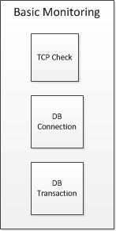
How can we monitor Web Apps?
All these white holes are the space that we’re not monitoring using these checks.

Slide 15
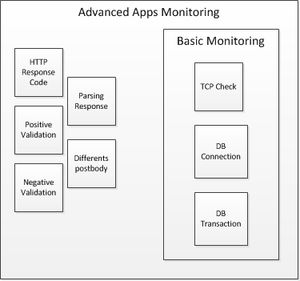
How can we monitor Web Apps?
Probably we’re not covering 100%, but white holes are not as big as before. This is a continuous improvement

Slide 16
What’s Webinject?
WebInject is a free tool for automated testing of web applications and web services. It can be used to test individual system components that have HTTP interfaces. WebInject offers real-time results display and may also be used for monitoring system response times.*
* Source: www.webinject.org
How it works?
What do you receive after a check?
Web
Apps
Config
TestCase
OK
CRITICAL

Slide 17
Webinject Installation
How to Install it?:
From Cpan Perl Library use: install Webinject
From Consol Labs: http://labs.consol.de/lang/de/nagios/check_webinject/

Slide 18
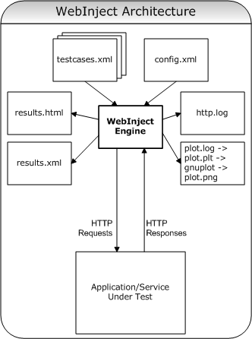
Webinject Architecture
Config File Model:
<testcasefile>test.xml</testcasefile>
<globalhttplog>no</globalhttplog>
<reporttype>nagios</reporttype>
<timeout>10</timeout>
<useragent>Mozilla/5.0</useragent>
<proxy>http://127.0.0.1:8080</proxy>

Slide 19
Webinject Architecture
Test Case File Model:
<testcases repeat="1">
<case
id=“1"
description1=“Case Description"
url="https://{BASEURL1}/id/health"
method="post"
posttype="application/x-www-form-urlencoded"
postbody="string={BASEURL2}&id=1"
parseresponse='"code":"|",“string"|'
verifypositive='"state":"{BASEURL2}"'
/>
</testcases>

Slide 20
Webinject Architecture
Test Case File Model:
<testcases repeat="1">
<case
id="1"
description1="Case Description"
url="https://{BASEURL1}/id/health"
method="post"
posttype="application/x-www-form-urlencoded"
postbody="string={BASEURL2}&id=1"
parseresponse='"method":"|"'
verifypositive='"state":"{BASEURL2}"'
/>
<case
id="2"
description1="Validation"
url="https://{BASEURL2}/v1/rollback"
method="post"
posttype="application/json"
postbody='{"usermethod":"{PARSEDRESULT}","taxes":false}'
verifypositive='"transactionMessage":"Transaction Approved"'
/>
</testcases>

Slide 21
Webinject and Nagios Integration
Command Definition:
define command {
command_name webinject
command_line /usr/local/webinject/webinject.pl $ARG1$ -c $ARG2$
}
Service Definition:
define service {
use generic-service
host_name MyApplication-server
service_description WebInject Test
is_volatile 0
check_period 24x7
max_check_attempts 3
normal_check_interval 1
retry_check_interval 1
contact_groups myapplication-admins
notification_interval 120
notification_period 24x7
notification_options w,u,c,r
check_command webinject! -s BASEURL1=url-domain.com!config_file.xml
}

Slide 22
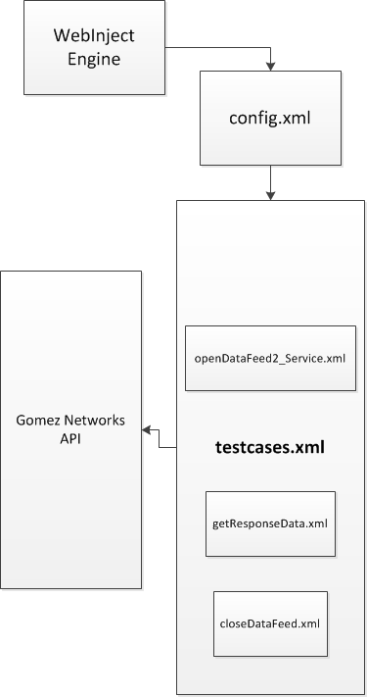
External API Integration
We use a webinject SOAP call to get the availability of a test in an external monitoring provider.
#/bin/bash
#Arguments
#1 = TestCase
# Web Inject API Call
webinject=`/path/to/webinject.pl -c path/to/config.xml $1`
if [[ "$webinject" == *CRITICAL* ]] ; then
echo “CRITICAL- $webinject"
exit 2
else
echo "$webinject"
exit 0
fi

Slide 23
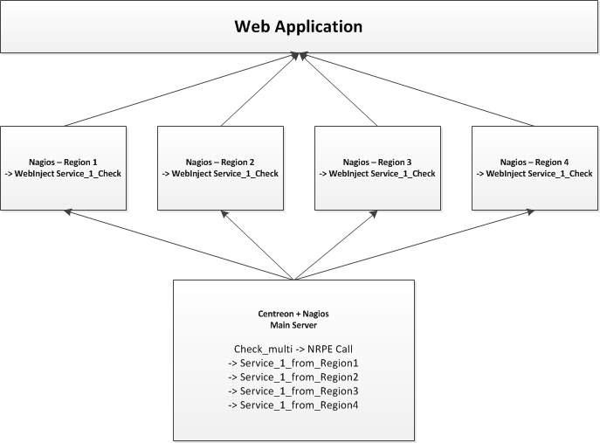
Multi Check + NRPE:
Using check_multi + nrpe we can centralize the distributed execution of
several scripts and set warning or critical threshold based on # of tests.

Slide 24
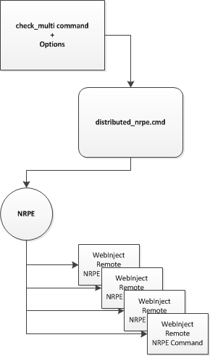
Multi Check + NRPE Architecture:
Multi Distributed Script
Bash script to call check_multi with options
cmd file to execute the tests and validate
the execution
NRPE remote command executes and get the results

Slide 25
Multi Check Bash Script
#!/bin/bash
nagiospluginpath="/usr/local/nagios/libexec"
$nagiospluginpath/check_multi –f \ $nagiospluginpath/check_multi_configs/path/webinject.cmd \
-s TEST1="$1" \
-s TEST2="$2" \
-s TEST3="$3" \
-s TEST4="$4" \
-t 60 \
-T 120

Slide 26
Multi Check Command Script
# Web Inject Calls for Multi Tests
command [ place1 ] = check_nrpe -H place1 -c external_webinject -a "$TEST1$"
command [ place2 ] = check_nrpe -H place2 -c external_webinject -a "$TEST2$"
command [ place3 ] = check_nrpe -H place3 -c external_webinject -a "$TEST3$"
command [ place4 ] = check_nrpe -H place4 -c external_webinject -a "$TEST4$"
state [ CRITICAL ] = COUNT(CRITICAL) > 3 || COUNT(WARNING)==COUNT(ALL) || COUNT(UNKNOWN)==COUNT(ALL)
state [ WARNING ] = COUNT(WARNING) > 0 || COUNT(CRITICAL) > 0 || COUNT(UNKNOWN) > 0

Slide 27
Multi Check Service Status:

Slide 28
Additional Notifications

Slide 29
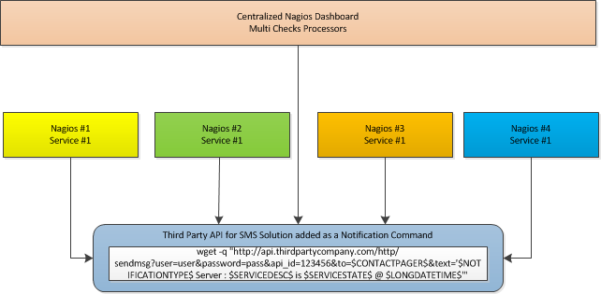
Notifications with SMS

Slide 30
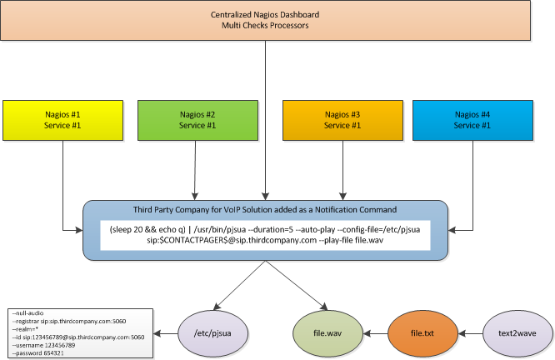
Notifications with VoIP Calls (Nagios calls you)

Slide 31
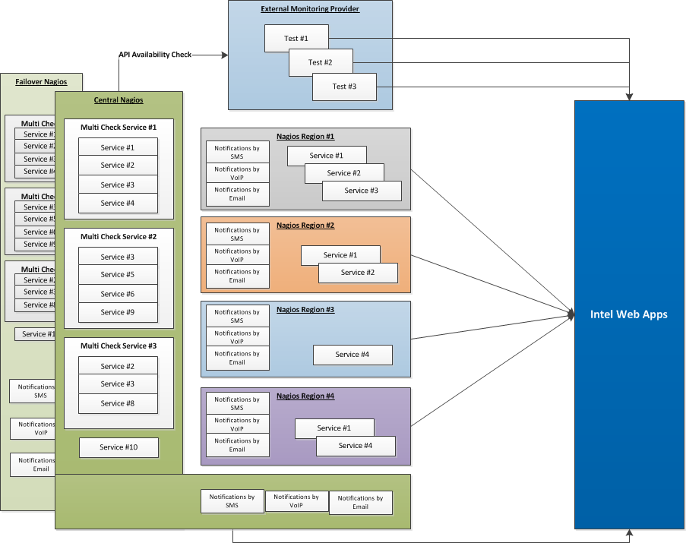
Complete Distributed Monitoring Solution

Slide 32
Q/A
Fernando Hönig
fernando.honig@intel.com
@fernandohonig
www.linkedin.com/in/fernandohonig

Slide 33
Legal Notices
This presentation is for informational purposes only. INTEL MAKES NO WARRANTIES, EXPRESS OR IMPLIED, IN THIS SUMMARY.
Intel and the Intel logo are trademarks of Intel Corporation in the U.S. and/or other countries.
* Other names and brands may be claimed as the property of others.
Copyright © 2012, Intel Corporation. All rights reserved.

