Slide 1
Nagios and Mod-Gearman In a Large-Scale Environment
Jason Cook <jcook@verisign.com>
8/28/2012

Slide 2
A Brief History of Nagios at Verisign

Slide 3
Legacy Nagios Setup
Whitepaper NSCA configuration
Typical 3-Tier setup
Remote System
Distributed Nagios Servers
Central Nagios Servers
Architecture in-place for several years
Reasonably stable, though high-maintenance
Very heterogeneous environment.
Many OS and Nagios versions
All notifications sent to an Event Management System
Offloaded graphing/trending to a custom solution.

Slide 4
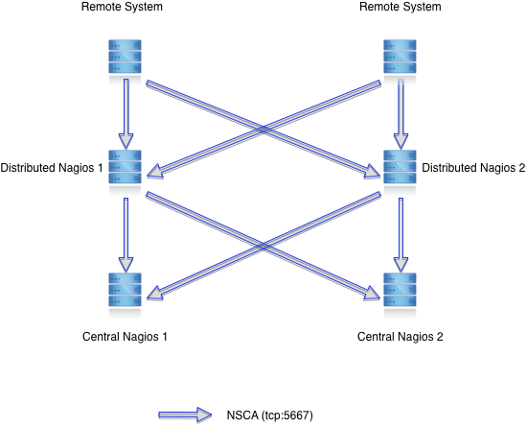
Simplified Passive Architecture Diagram

Slide 5
Challenges with our passive setup
Scaling the Nagios server layers
Requires changes to all NSCA instances using the servers
Load-Balancing solutions mostly require removing freshness checks…
Freshness checking is a challenge
More freshness checking means more Nagios forking.
More Nagios forking is more operational sadness in a large environment.
With Freshness, you end up having an active environment, even if it wasn’t your intention.
Freshness errors do not tell the whole story
Where is the problem?
Even if you know where the problem is, it can be difficult to track down what’s causing it. Nagios? Plugin? System busy? NSCA? Network? Many questions, few obvious answers.

Slide 6
Challenges with our passive setup (continued)
Lack of centralized scheduling
Adjusting schedules can be difficult for those without in-depth knowledge of Nagios and how it all works.
Inability to have a user run a check immediately without having even more in-depth knowledge about Nagios.
Lots of Nagios builds for various platforms.
Since we were using NSCA, we needed libmcrypt for encryption.
libmcrypt not a standard library for many systems, so yet another package to maintain.
All of this needed quite a bit of custom code for intelligent result queuing/sending so as to gracefully handle network outages and minimize send_nsca forking (especially on the distributed servers).

Slide 7
A Move to Active Monitoring

Slide 8
An alternative arises…
Gearman
Provides a generic application framework to farm out work to other machines or processes that are better suited to do the work.
Integrates with Nagios via the Mod-Gearman NEB module.
NRPE
Nagios Remote Plugin Executor
Merlin
Module for Effortless Redundancy and Loadbalancing In Nagios
Allows our Nagios instances to share scheduling (and therefore check results) between one another.
Great for load sharing and redundancy

Slide 9
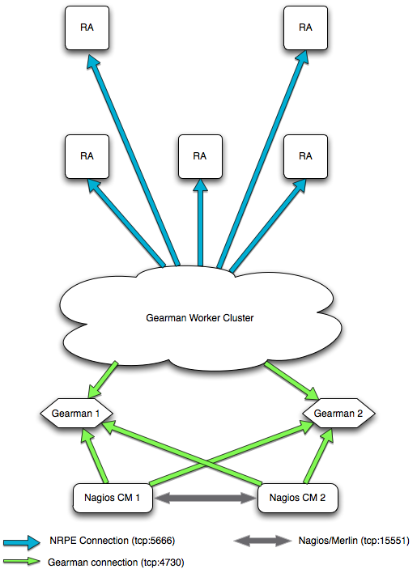
Simplified Active Architecture Diagram

Slide 10
Some details about the setup
All components run in VMs
Nagios 3.4.1 (with nanosleep)
Merlin (1.1.15)
Mod-Gearman 1.2.6
MK Livestatus (perhaps the greatest NEB module of all time)
Merlin setup is a simple peer<->peer configuration
Mod-Gearman NEB modules are configured to talk to multiple gearman servers (gearman server preference is alternated on each system, so that Gearman server failures are easily handled)
One Mod-Gearman worker process for each gearman server per worker.

Slide 11
VM Configuration & Performance
VM Configuration:
4 V-CPUs
2GB RAM
Linux 2.6.32
Performance Considerations
Very CPU Bound
RAM usage is very low
VM Usage
2 Nagios server
2 Gearman Server
2 Mod-Gearman Workers

Slide 12
Application Configurations
Nagios
100000 services @ 5 minute interval
sleep_time = 0.01
host_inter_check_delay_method=n
service_inter_check_delay_method=0.01
max_concurrent_checks=0
5 gearman collector threads
Gearman
10 I/O Threads
Mod-Gearman Workers
1000 worker processes per system
50 per second max spawn rate

Slide 13
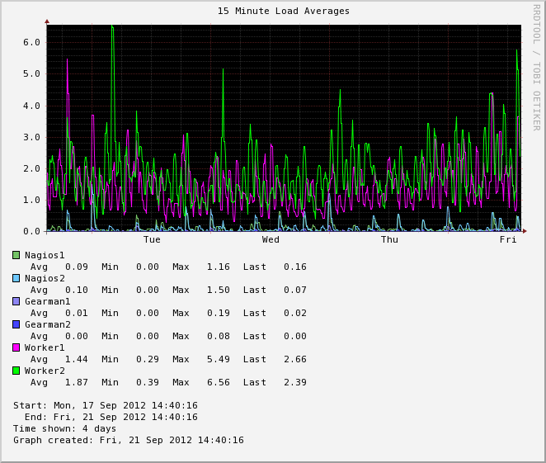
Performance Results

Slide 14
Observations
These 6 VMs can easily handle 20000 active services per minute.
Additional capacity can be had easily
Add Merlin peers
Add more workers
Scales up very well
renice of critical processes makes sure they’re getting the priority they need.
The environment can be a bit fragile.
Less fragile than before, but still has several components which all must be working correctly.

Slide 15
Benefits
Much less hardware
Centralized view and control over all monitoring
Opportunity to leverage the Gearman architecture for other services
Higher confidence in monitoring accuracy
More flexibility in scheduling logic.
Event handlers become very useful, since there is a broader view of the infrastructure via MK Livestatus.

Slide 16
Final Thoughts
Tested several methodologies before arriving at the Nagios+Gearman conclusion.
Multisite
DNX
NRDP
The current design is still a work in progress, but will be easier to change and grow (Nagios 4?).
Move anything possible off of Nagios and to external processes.

Slide 17
Credits
Verisign System Administrators for helping me test
Gearman (http://www.gearman.org)
ConSol Labs (http://labs.consol.de)
Thruk
Mod-Gearman
Mathias Kettner (http://mathias-kettner.de)
MK Livestatus
op5 (http://www.op5.org)
Merlin
Nagios (http://nagios.org)
Nagios Core
NRPE

