Slide 1
Distributed Monitoring and Cloud Scaling for Web Apps Fernando Hönig
fernando.honig@intel.com

Slide 2
About me
From Córdoba, Argentina
System Administrator
Working last 8 years in IT Companies
Working in Intel IT since April 2011

Slide 3
Third Party Vendors / Open Source
This presentation will cover the solution achieved instead of talking about third party vendors.
All products used for this are open source.
Best Practices
With this presentation I would like to show
IT@Intel processes and best practices.

Slide 4
Topics
Problem Overview
External Distributed Infrastructure
Monitoring Architecture
Cloud Scaling and Automatic monitoring
Hostgroups and services association
Nagios Event Brokers
Dashboards
Live Demo
Q/A

Slide 5
Purpose / Executive Summary
Provide agility and rapid cycle time of development
Infrastructure alignment with services demand
Zero human interaction related to infrastructure setup and application deployments cycles.
Business Objective
Reduce 50% operative costs for current infrastructure
Enable multi-geo applications
Ensure 99,99% of availability for services hosted under this architecture

Slide 6
Why do we need a Distributed Infrastructure?
More than 500 Services Checks per Customer
Apps from our Customer needs to be reached from diff GEOs
Checks every 1 or 5 minutes
Redundancy / Fast Recovery
Why do we need a Centralized Dashboard?
Automatic Reporting for SLA metrics
Fast and simple services/commands/hosts view.
One single view for several regions / hostgroups

Slide 7
Start Automation!

Slide 8
Infrastructure Capabilities
Solid Network Architecture
VPN multi-geo secure connection
Automated Monitoring
Centralized logging for app services
Infrastructure Components
Virtual Cloud Infrastructure
Firewall rules and communication flow
Public vs Private subnets
Load Balancers
DNS Failover

Slide 9
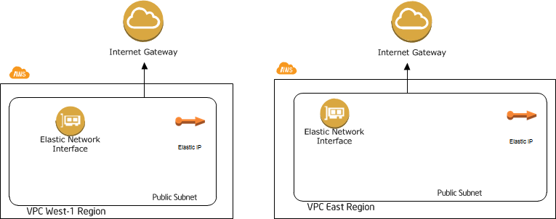
Virtual Cloud Network Infrastructure

Slide 10
Create VPN Tunnel!

Slide 11
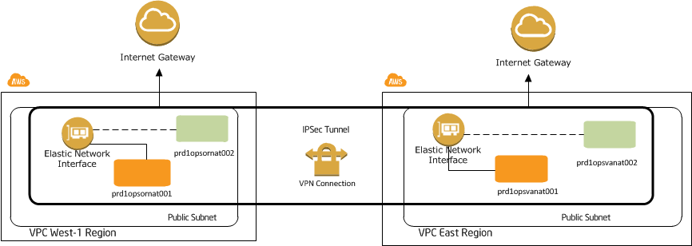
Virtual Cloud Network Infrastructure

Slide 12
Virtual Cloud VPN Multi Geo – Floating ENI
Elastic Network Interface can be attached to an instance with an specific private IP Address and a Public IP Address.
All subnets need to route traffic via that interface.
In case of instance failure:
Interface is detached from failing instance and attached to the backup one.
No changes need to be done in all routing tables
Downtime is less than 5 mins.

Slide 13
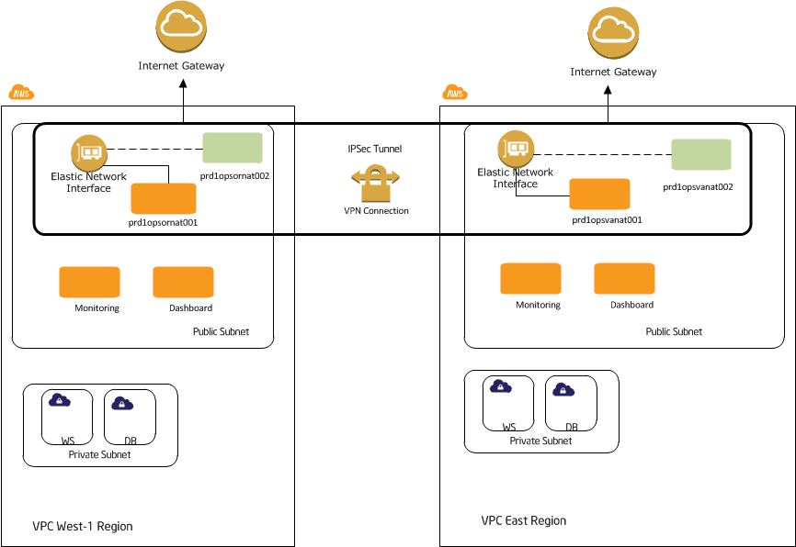
Virtual Cloud Network Infrastructure

Slide 14
How it works?

Slide 15
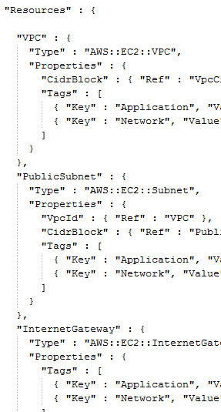
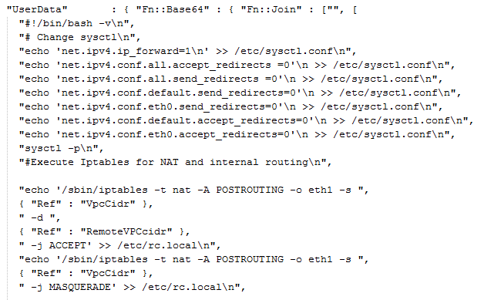
Cloud Formation + AWS cli

Slide 16
Let’s create the Monitoring!

Slide 17
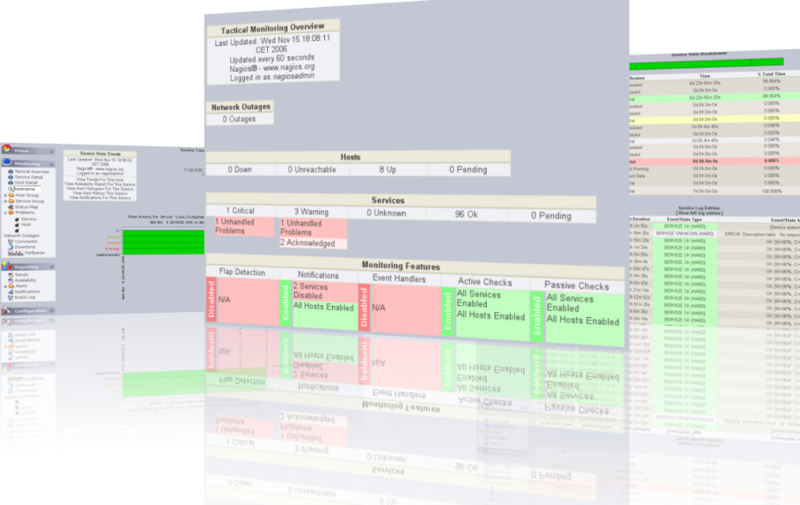
External Distributed Infrastructure

Slide 18
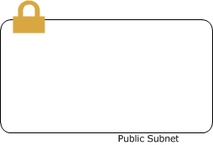
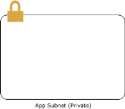
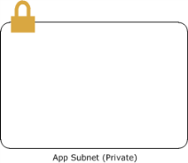
Cloud Monitoring Architecture
Hostgroups
Services
Contacts
Scripts

Slide 19
Cloud Monitoring Architecture - Tools
MK Livestatus
Opens a socket by which data can be retrieved on demand
The socket allows you to send a request for hosts, services or other pieces of data and get an immediate answer
Scales fairly well to large installations, even beyond 50.000 services
RESTlos
Is a generic Nagios API (it can be used with every core that understands the nagios configuration syntax)
Provides a RESTful api for generating any standard nagios object, modify it or delete it
Open Source code

Slide 20
Cloud Monitoring Architecture - Tools
iwatch
Written in Perl and based on inotify, a file change notification system, a kernel feature that allows applications to request the monitoring of a set of files against a list of events
Can watch directory recursively
Can execute command if an event occurs
Webinject
Is a free tool for automated testing of web applications and web services.
It can be used to test individual system components that have HTTP interfaces.
Offers real-time results display and may also be used for monitoring system response times

Slide 21
Cloud Monitoring Architecture - Integration
Mklive broker
RESTlos
Plugins
Webinject
iwatch
Mklive for output data
RESTlos for adding/removing hosts
Webinject for Apps monitoring
Iwatch for files changes

Slide 22
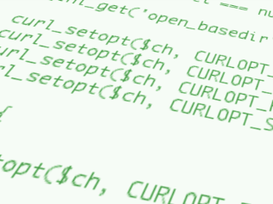
Cloud Scaling and Automatic monitoring
Create UserData for every instance based on the host-type (DB, WS, App)
[ADD] Use cURL to send a POST call to Nagios server thru RESTlos when server is starting
[DEL] Send a DELETE action with cURL when instance is shutting down
[HOST-TYPE] Use variables to define what type of server are you adding
[TOOLS] Add snmp and NRPE in your user-data info to install such software
to enable monitoring

Slide 23
Cloud Scaling and Automatic monitoring
[ADD] Use cURL to send a POST call to Nagios server thru RESTlos when server is starting. Also you must save this in a startup script like rc.local
"sed -i '$icurl -X POST -d @/etc/host-monitor -H \"content-type: application/json\" http://admin:password@" ,{ "Ref" : "MonitInstanceIP" } ,"/restlos/host?host_name=new' /etc/rc.local\n",
[
{
"host_name": "HOSTNAME",
"use": "generic-host",
"alias": "HOSTNAME",
"address": "HOSTNAME",
"hostgroups": "HOSTGROUPS",
"_SNMPCOMMUNITY": "snmpcom",
"check_command": "check_ping!100.0,20%!500.0,60%",
"max_check_attempts": "3",
"check_interval": "5",
"retry_interval": "5",
"check_period": "24x7",
"notification_interval": "60",
"first_notification_delay": "1",
"notification_period": "24x7",
"notification_options": "d,u,r"
}
]

Slide 24
Cloud Scaling and Automatic monitoring
[DEL] Send a DELETE action with cURL when instance is shutting down
You need to create a script in /etc/rc0.d/ as follow:
"echo -e '#!/bin/bash' > /etc/rc0.d/K99host-monitor\n",
"echo -e 'curl -X DELETE -H \"content-type: application/json\" http://admin:password@" ,{ "Ref" : "MonitInstanceIP" } ,"/restlos/host?host_name=HOSTNAME' >> /etc/rc0.d/K99host-monitor\n",
"chmod +x /etc/rc0.d/K99host-monitor\n",
"HOST=$(hostname); sed -i \"s/HOSTNAME/$HOST/g\" /etc/rc0.d/K99host-monitor\n"

Slide 25
Cloud Scaling and Automatic monitoring

Slide 26
iWatch Sync and Nagios files administration
For adding/removing hosts
Every time you add or remove a host, that hostfile is uploaded/removed in a central repository for backup purposes.
For new services
If you have more than 1 nagios, this is perfect to have all synced. No need to access to the linux console for edit.
For new hostgroups or servicegroups
If you have a new type of server, just add it to hostgroups.cfg and that file will be delivered across all your nagios servers.
For new contacts

Slide 27
Hostgroups
A host group definition is used to group one or more hosts together for simplifying configuration
You can put in a host configuration file as many hostgroups as you need for that particular host.

Slide 28
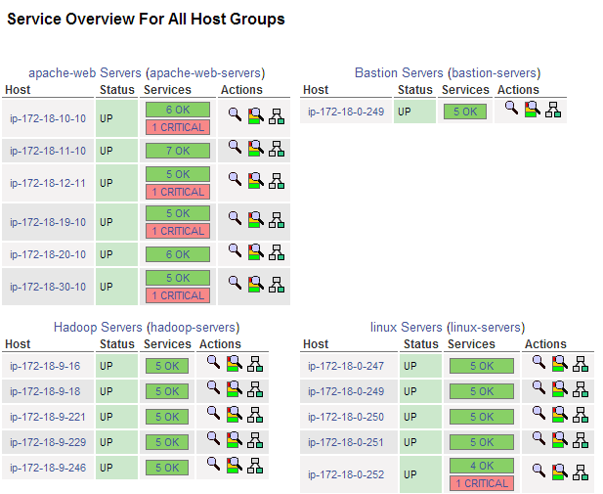
Hostgroups

Slide 29
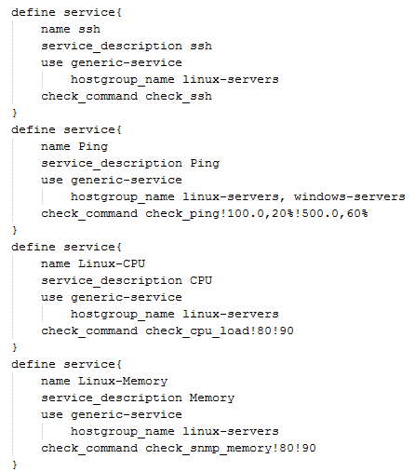
Hostgroups - Services Association

Slide 30
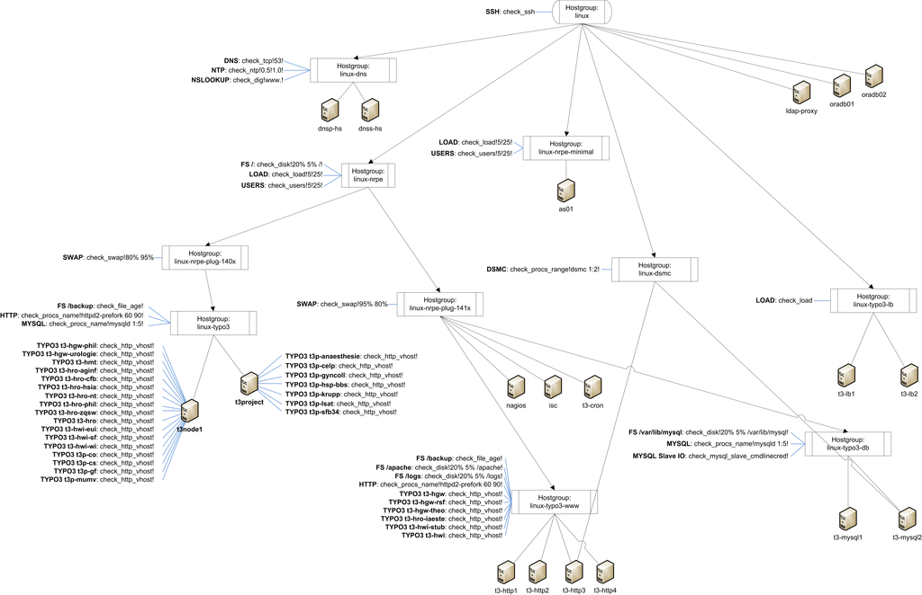
Wrap up

Slide 31
Get Nagios data from anywhere!

Slide 32
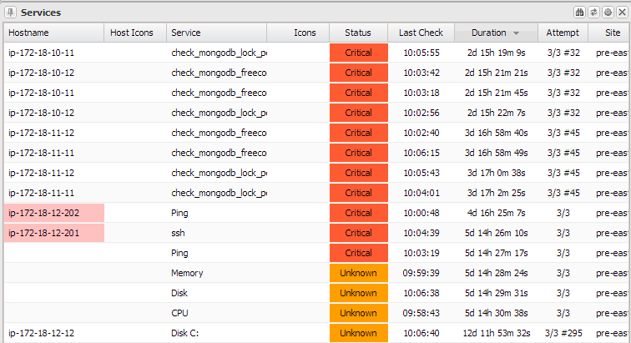
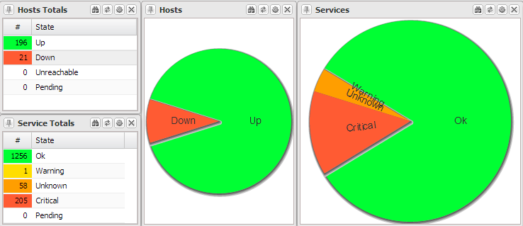
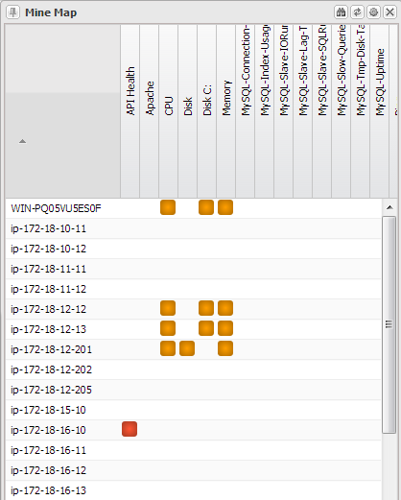
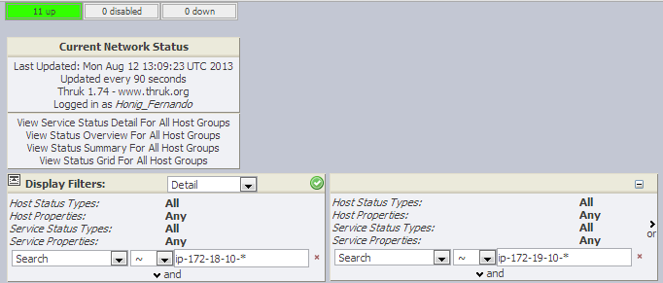
Integration Dashboards

Slide 33
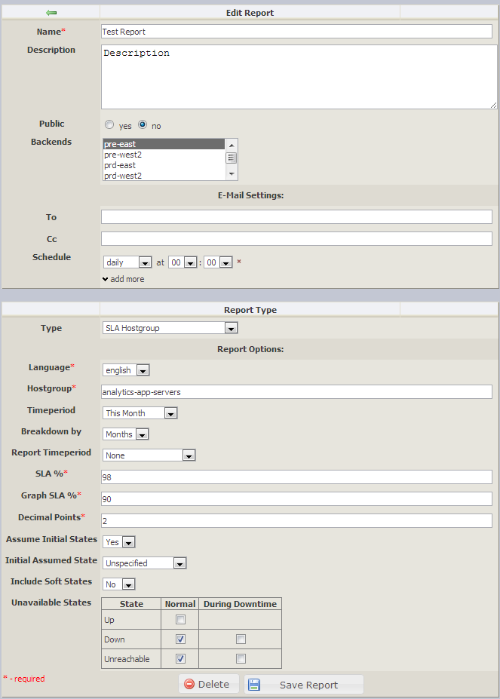
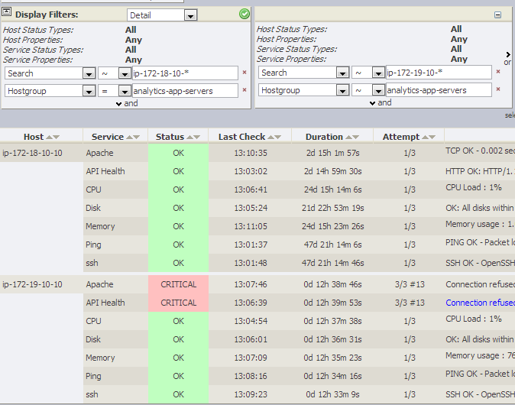
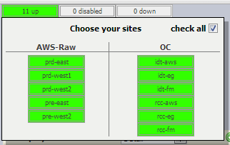
Integration Dashboards

Slide 34
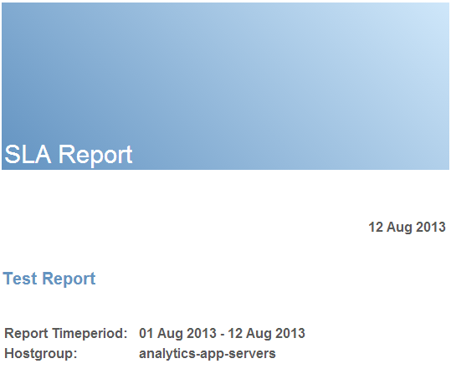
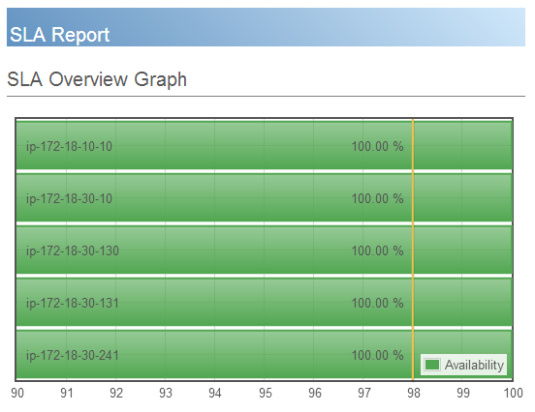
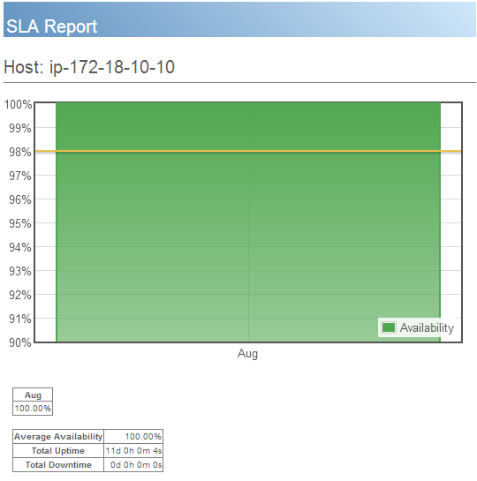
SLA Reporting

Slide 35
Stop talking, show IT!

Slide 36
Q/A
Fernando Hönig
fernando.honig@intel.com
@fernandohonig
www.linkedin.com/in/fernandohonig

Slide 37
Legal Notices
This presentation is for informational purposes only. INTEL MAKES NO WARRANTIES, EXPRESS OR IMPLIED, IN THIS SUMMARY.
Intel and the Intel logo are trademarks of Intel Corporation in the U.S. and/or other countries.
* Other names and brands may be claimed as the property of others.
Copyright © 2013, Intel Corporation. All rights reserved.

