Slide 1
Windows Monitoring
Yancy Ribbens
yribbens@nagios.com

Slide 2
Windows Monitoring

Slide 3
Active Directory 1.2
Active Directory 1.2
Authenticate users against Active Directory
Select and import users allowed to authenticate!
Active Directory Users
NagiosXI 2014
Users

Slide 4
Active Directory 1.2
Component Configuration
Admin > Manage Components > Active Directory Integration

Slide 5
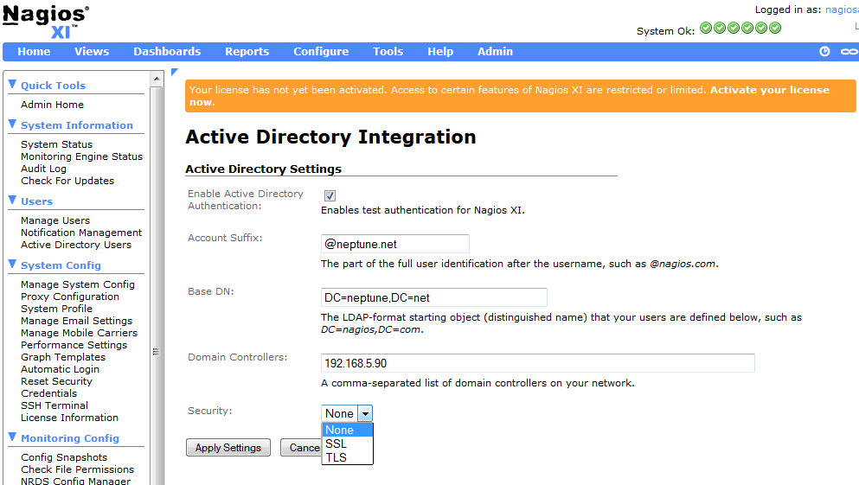
Active Directory 1.2

Slide 6
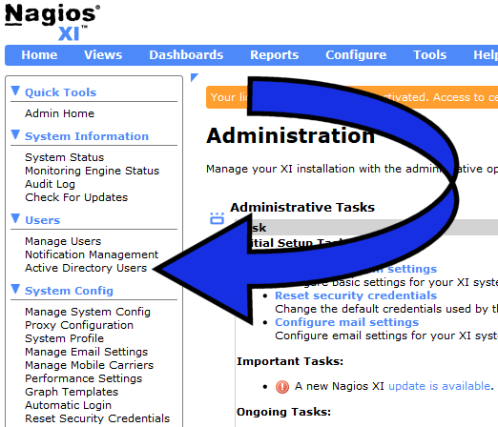
AD Import functionality
Import functionality available under
Active Directory Users

Slide 7
Active Directory 1.2
Video clip importing from OU

Slide 8
Active Directory 1.2
Video clip showing user import from AD group

Slide 9
Active Directory 1.2
Display Active Directory Computers

Slide 10
Npush
Why is Npush useful?
Advanced monitoring requires agents (pre requisite software)
Installing agents manually is slow and tedious
Automates the configuration and deployment of agent software
Concurrently install applications
Requires no client side software

Slide 11
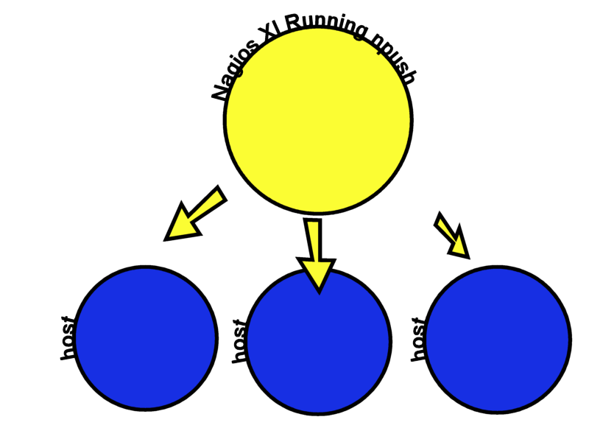
Npush
1) Npush directs clients to run instructions for downloading agent installer

Slide 12
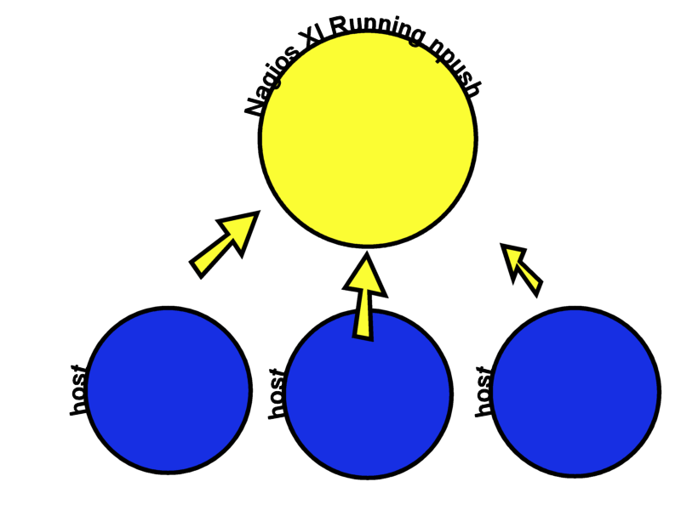
Npush
2) Once the clients have the needed instructions, they proceed with the download.
Npush can be configured to use either itself as the file source or another!

Slide 13
Npush
3) Hosts download need files and run necessary commands

Slide 14
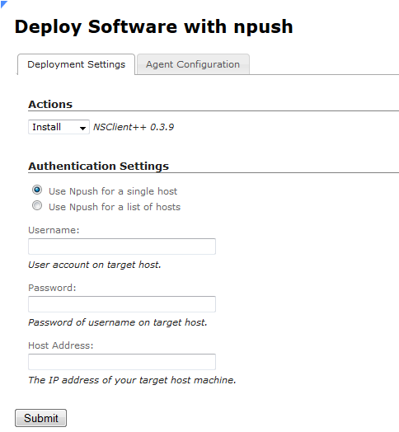
Npush
Sample Options

Slide 15
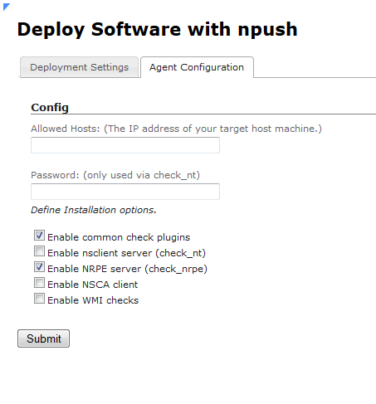
Npush
More Options..

Slide 16
Demo Video
Demo of Npush running concurrently from NagiosXI

Slide 17
Nagios Reactor
Nagios Reactor is a powerful, easy to use decision engine.
If some action in your environment happens.
Then perform some action.

Slide 18
Nagios Reactor
Full Npush Integration
Nagios Reactor
Install NSClient
Install NCPA
Install NRDS_Win

Slide 19
Nagios Reactor
Example Chain
If:
c:\program files\nsclient++ does NOT exist
Then:
Install nsclient++

Slide 20
Nagios Reactor Install NSClient Video

Slide 21
Nagios Reactor
Powerful WMI interface
If file or path exists
How many CPU cores
Test workstation DNS name
Is workstation part of a Windows Domain
System startup options
Who is the logged in user
Size of file
Reference more using class names!
WMI provider

Slide 22
Nagios Reactor
Nagios Reactor
Remote Web Address
Nagios Reactor
Host
Host
Host

Slide 23
Install Software with Nagios Reactor

Slide 24
Windows Monitoring
Question/Comments

