Slide 1
Advanced Features of Nagios XI
Sam Lansing
- slansing@nagios.com -

Slide 2
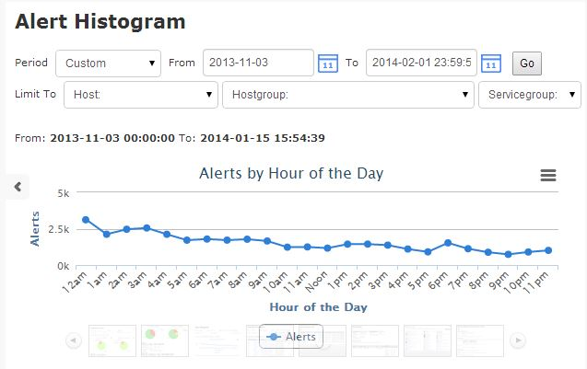
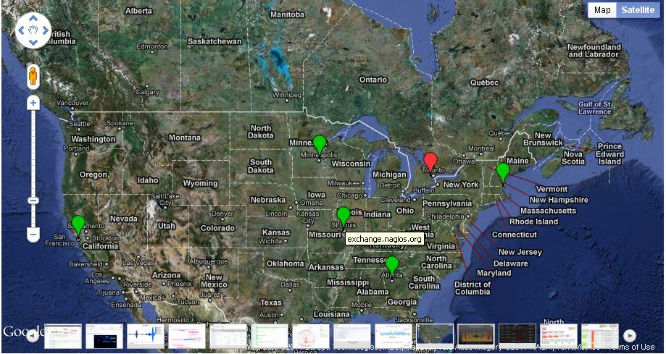
Introduction & Agenda
This presentation will cover how to use some of the more advanced and lesser known features of Nagios XI
Bulk management, tools, auto-discovery, advanced reporting
How to build a useful dashboard and deploy it to your users
Best practices for new or old XI environments

Slide 3
About Myself
Support Tech at Nagios Enterprises
- Forums, Tickets, Phone Support
- “Good Cop”
A smidge of development
- Bug fixes, small features, random things that nobody sees
2 ½ Years

Slide 4
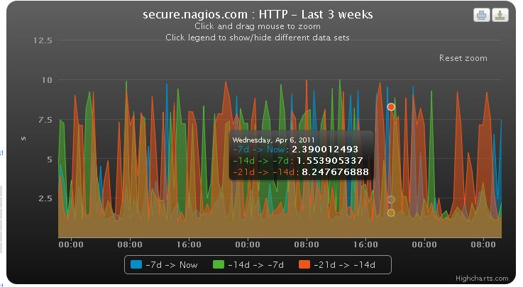
Advanced features, why should I care if everything is okay?
To increase your flexibility
Greatly cut down on time spent configuring, and get you back to the monitoring aspect.
Easy access to some specific visualizations and reports that can really help both the new and veteran XI user.

Slide 5
Host/Service Groups, and Configurations
Group alike systems to offer greater visibility and ease of configuration.
Use of parent-child relationships
Common naming scheme for quick acquisition

Slide 6
Deadpool
Auto-decommissioning, handle swaths of old configurations that will note be used again (cloud monitoring)

Slide 7
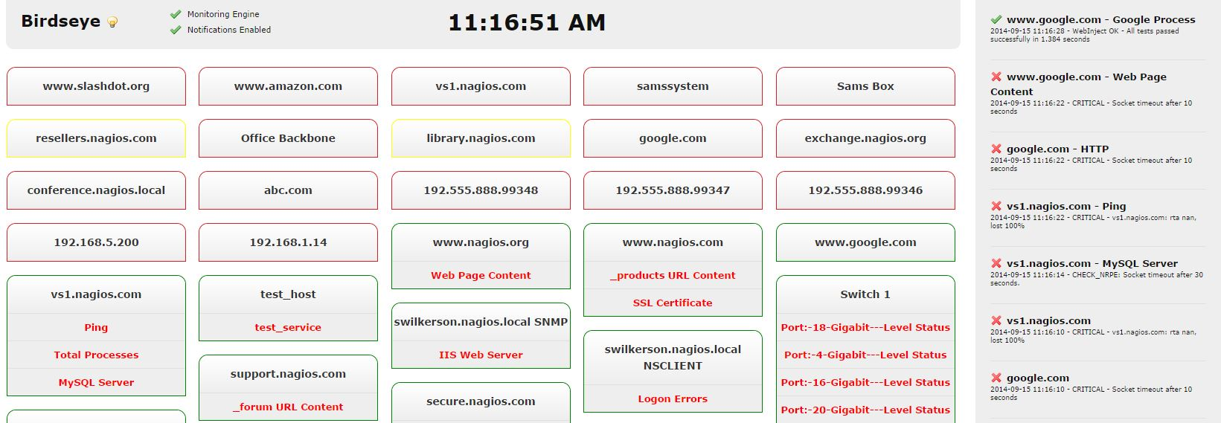
Birdseye
Streaming alerts, consistent status updates

Slide 8
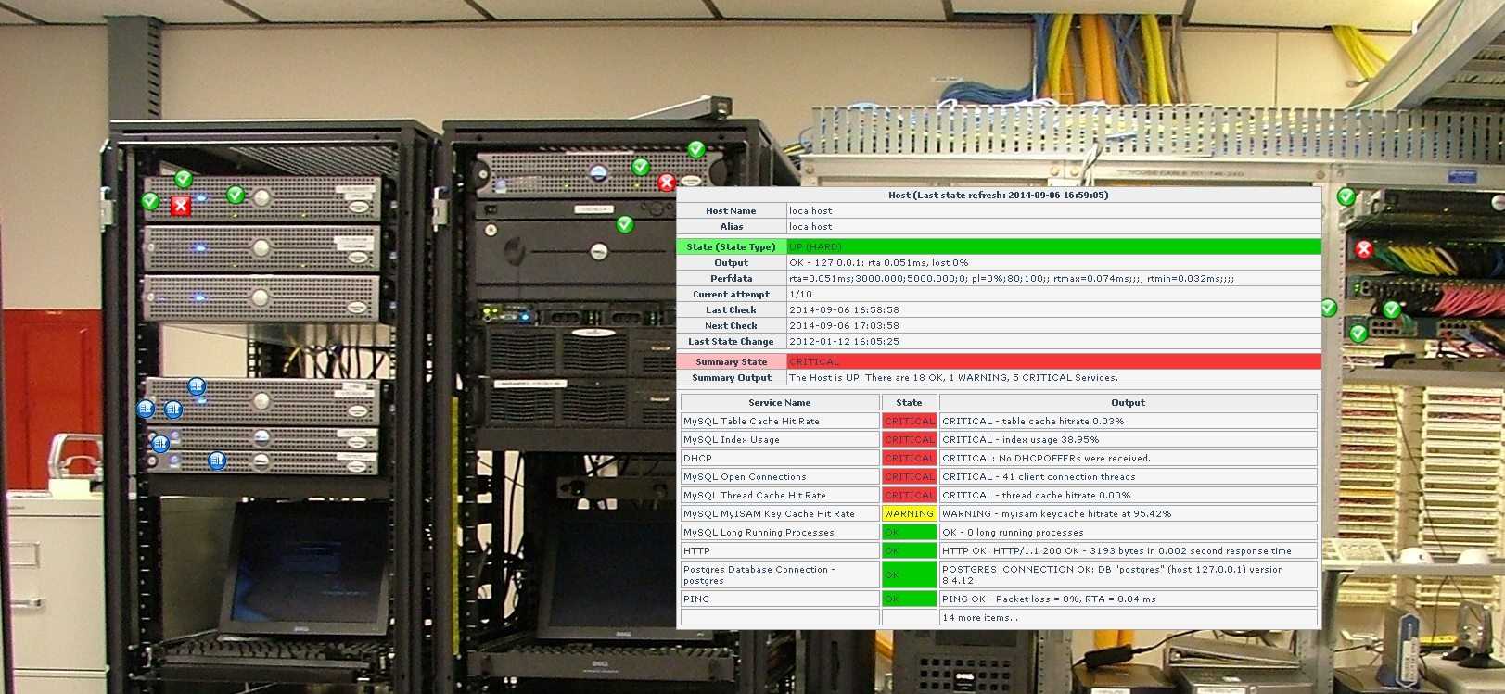
Nagvis
Visualize your environment on virtually any image, jpg, png, etc. Maintain status updates while getting a better look at the real impact.

Slide 9
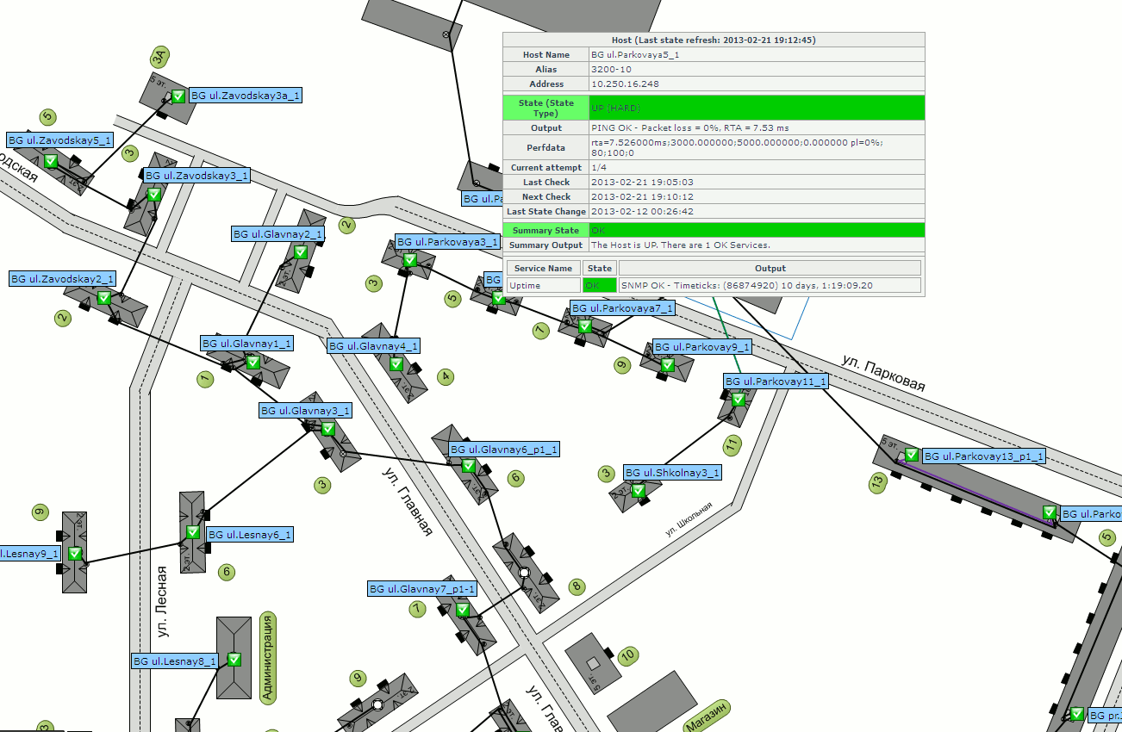
Nagvis

Slide 10
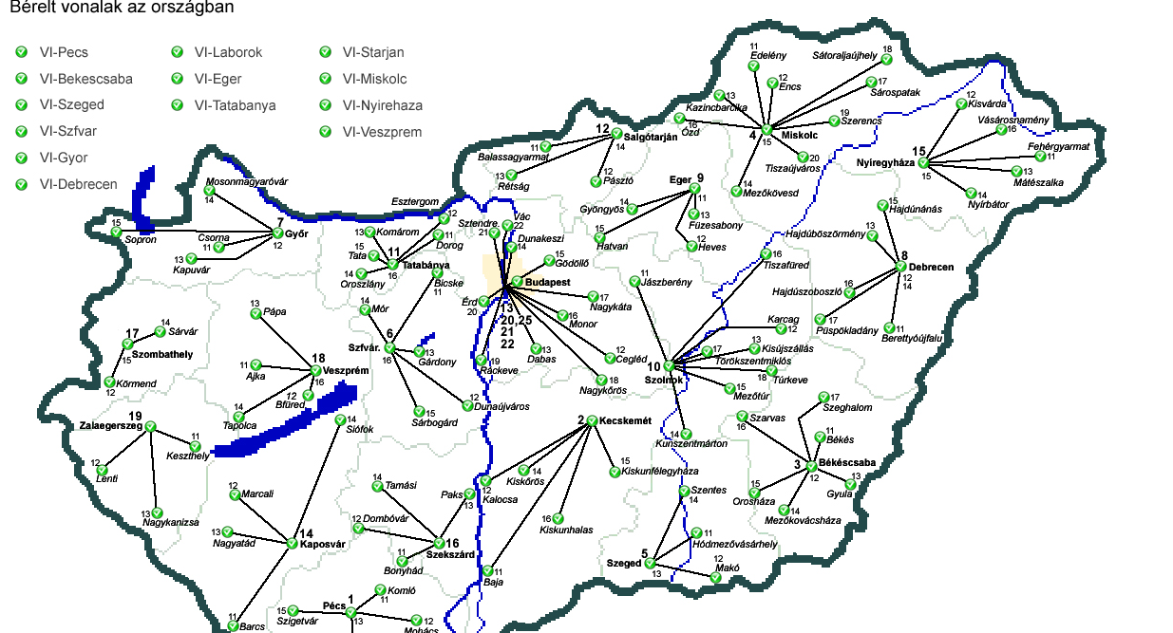
Nagvis

Slide 11
Recurring Downtime
Schedule downtime for systems that consistently require it the same time, every time. Handle both hosts and services for administrative downtime.

Slide 12
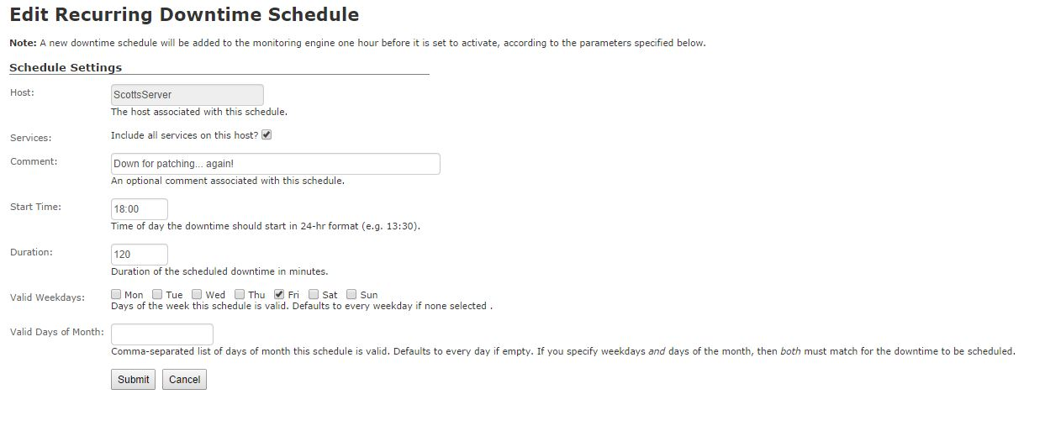
Recurring Downtime

Slide 13
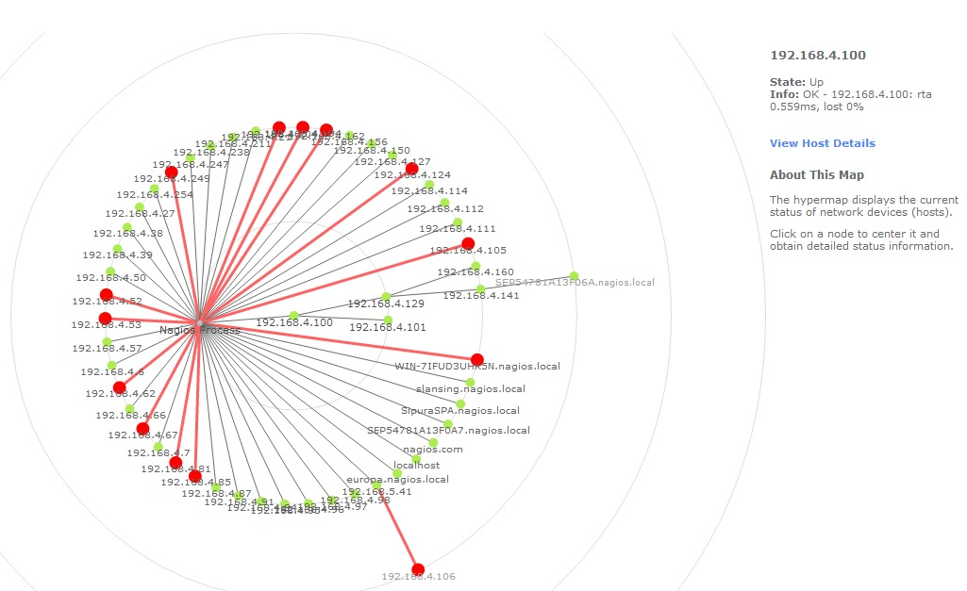
Hypermap, and Parent Child Relationships
View the impact of down hosts in your environment, see and watch the effects of systems going down as they relate to others you monitor in your environment.

Slide 14
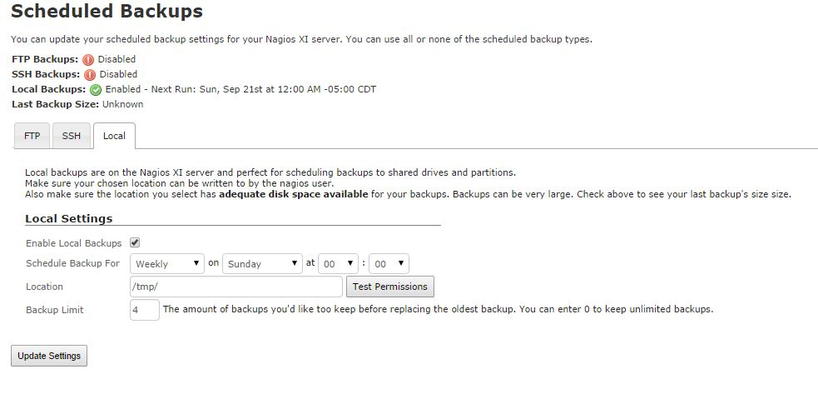
Scheduled/Local Backups
Store your XI system backups off-site, save as local, or offload as FTP/SSH.
Ensure that if your XI system goes down, you still have access to the files required to mirror it back up.

Slide 15
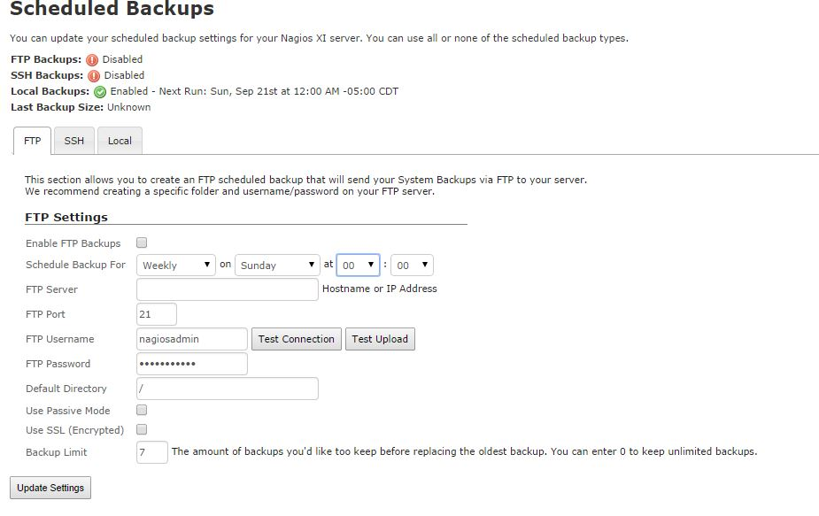
Scheduled/Local Backups

Slide 16
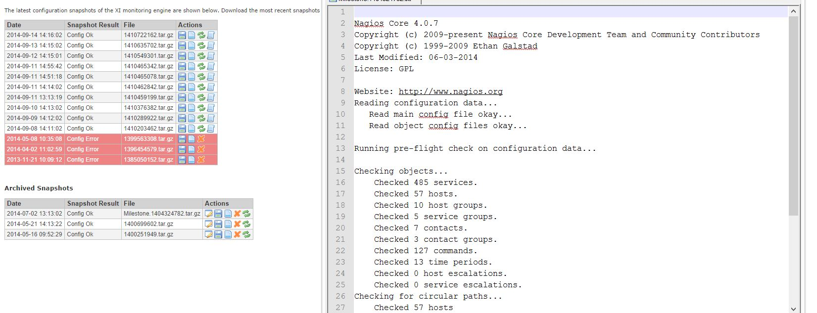
Snapshot Archive
Archive previous snapshots such as milestone configuration changes, etc. Archive, re-name, download, view output.

Slide 17
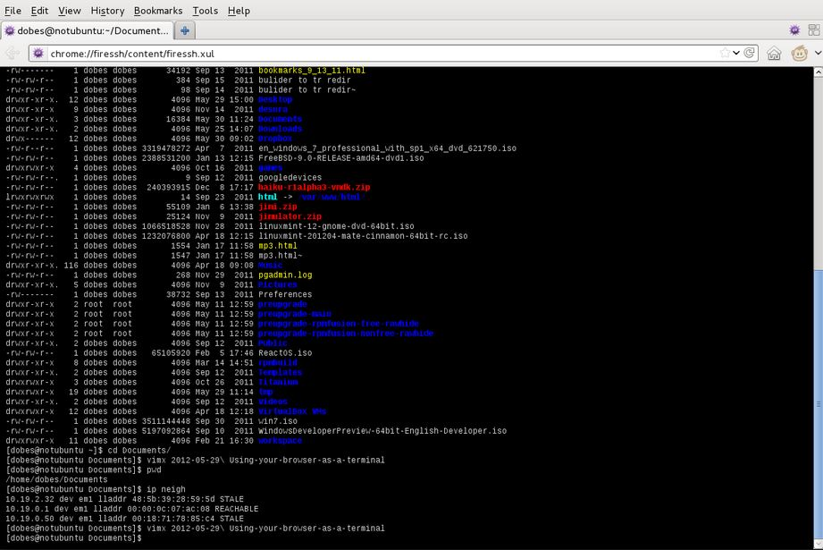
SSH Terminal
Access the XI server via SSH directly from your browser
Browser Extension, Ajaxterm package

Slide 18
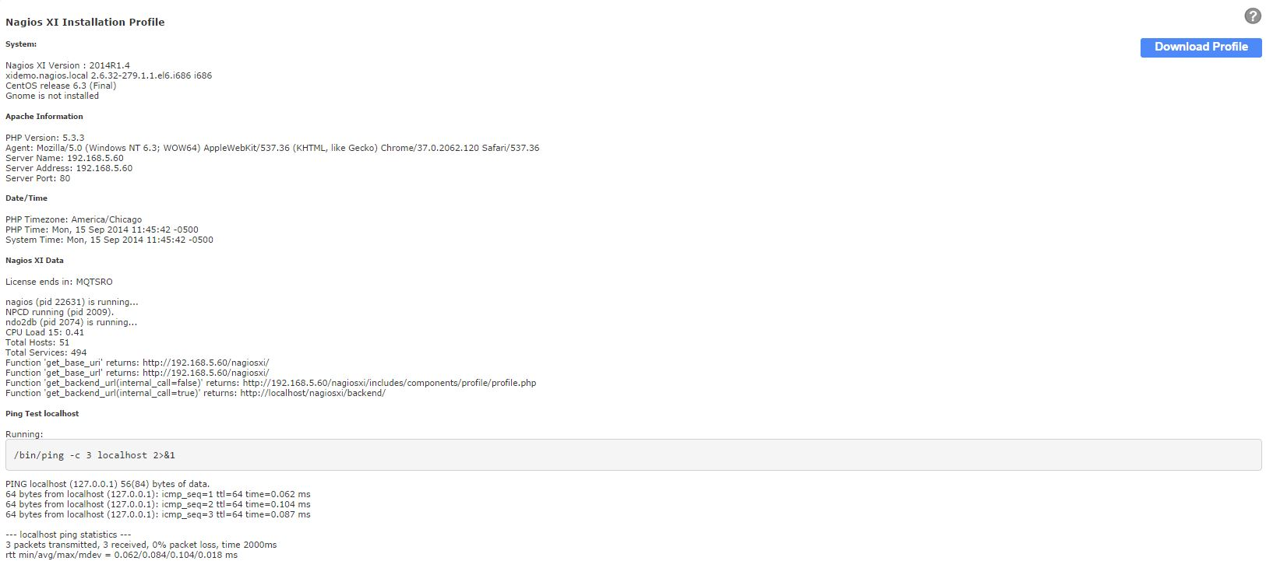
System Profile
View top logs, and metrics that the support team uses for troubleshooting daily

Slide 19
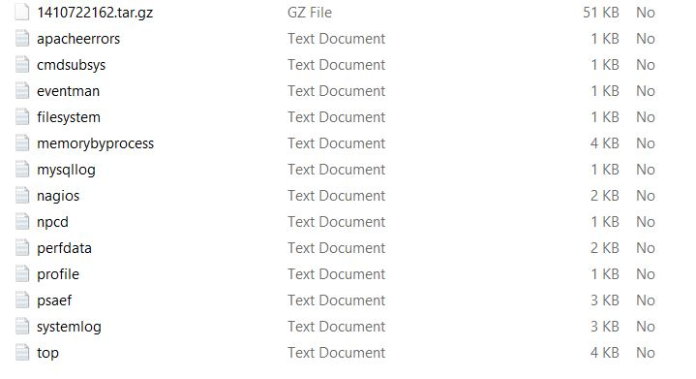
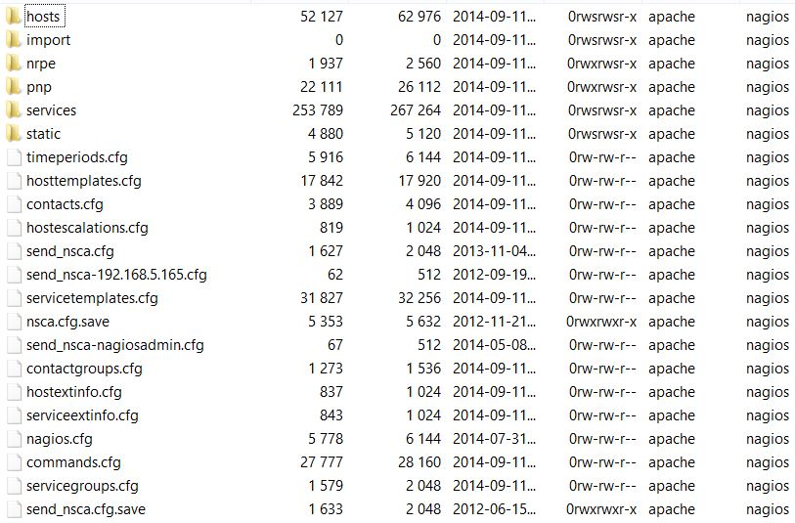
System Profile

Slide 20
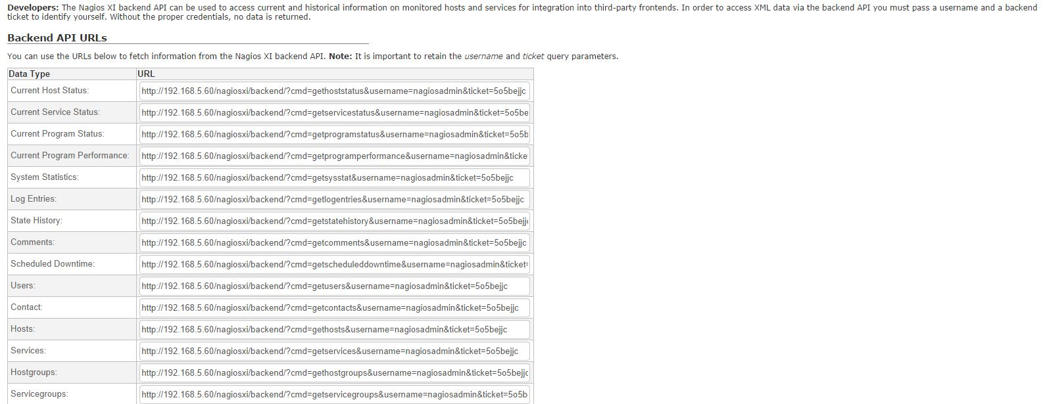
XI Backend API
Harness the XI Backend API for internal/external tools and reporting

Slide 21
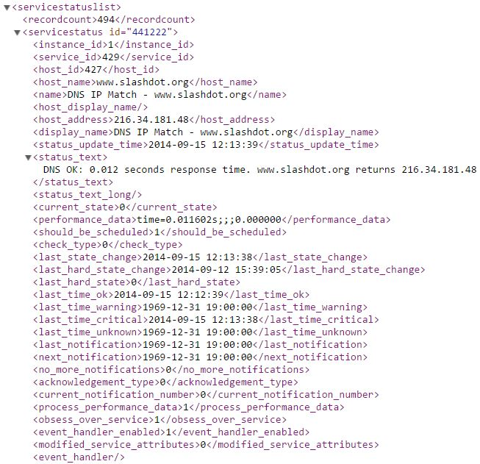
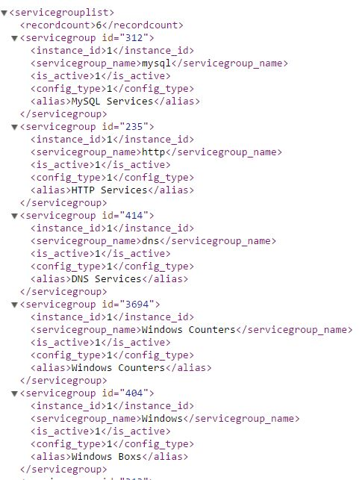
XI Backend API

Slide 22
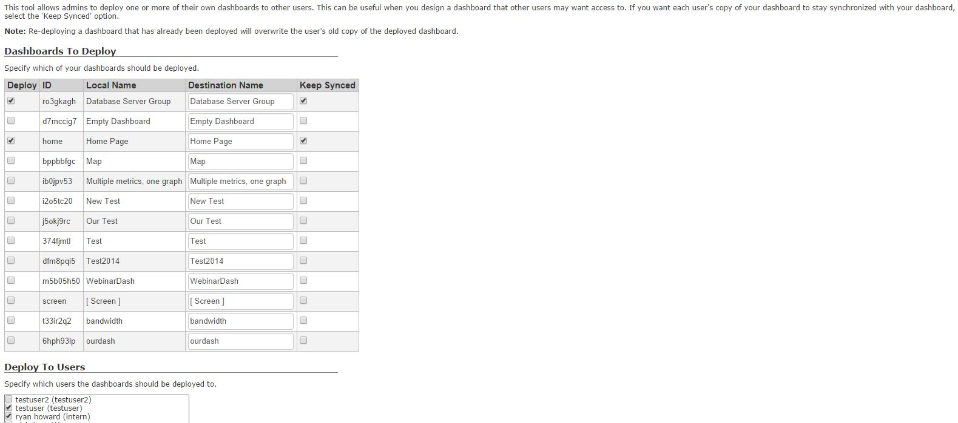
Deploy Dashboards
Create default Dashboards, sync them, then deploy them to your users

Slide 23
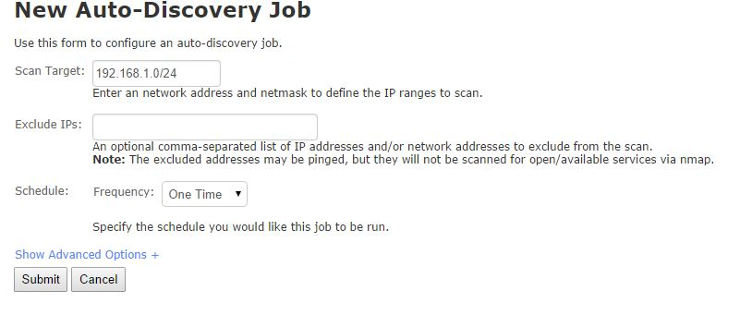
Auto-Discovery
Nmap Scan, cataloguing system, OS detection.

Slide 24
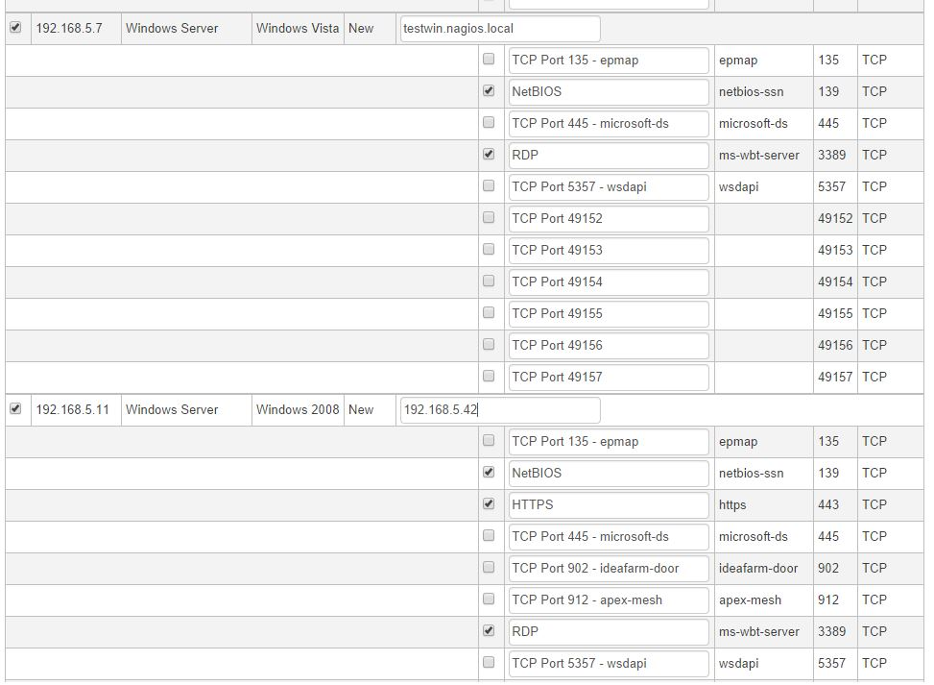
Auto-Discovery

Slide 25
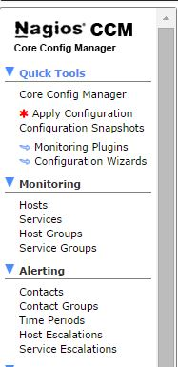
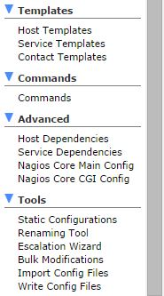
CCM Basics
Web configuration, no more flat files.
Bulk Modifications/Cloning tools

Slide 26
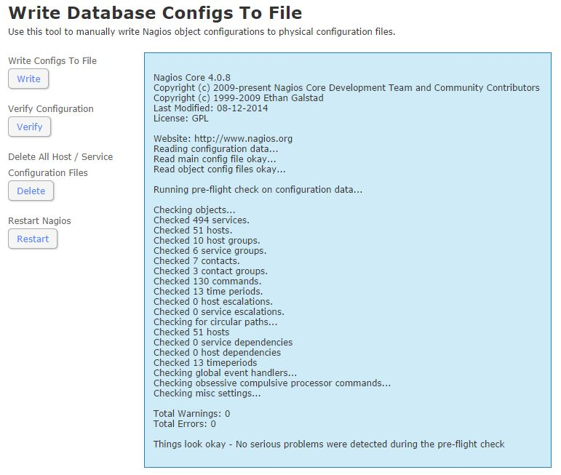
Write Config Files Tool
Write, Verify, Restart, Delete. Quick way to determine the cause of configuration errors, deletion of ghosts.

Slide 27
Write Config Files Tool

Slide 28
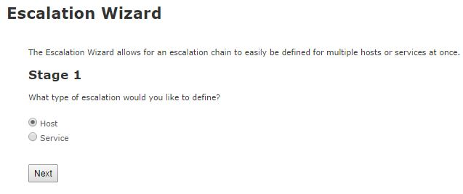
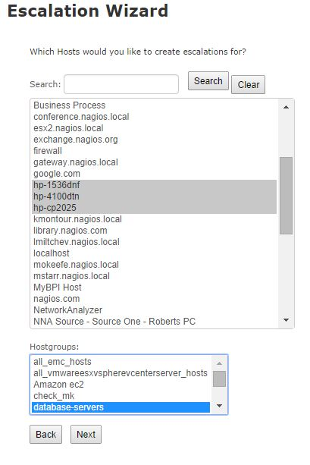
Escalations
Handle multi-tiered notification requirements, alert those who need to know, and move on to the next set.

Slide 29
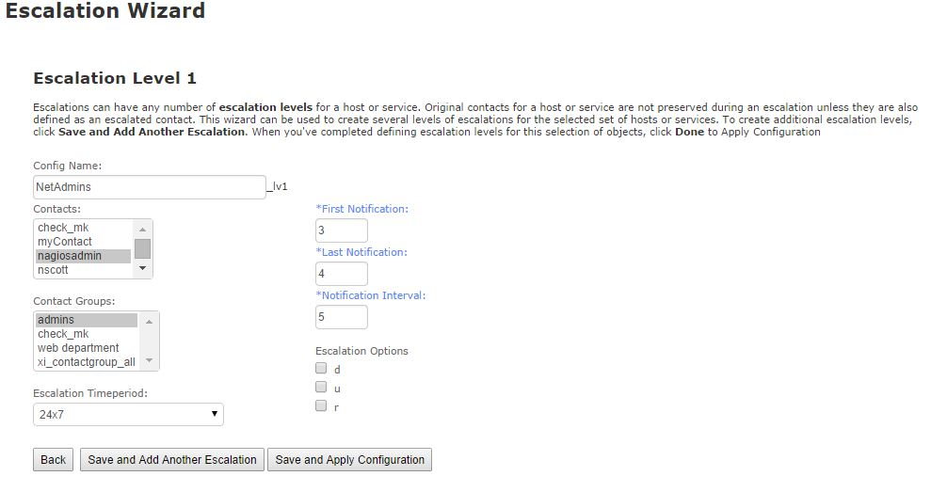
Escalations

Slide 30
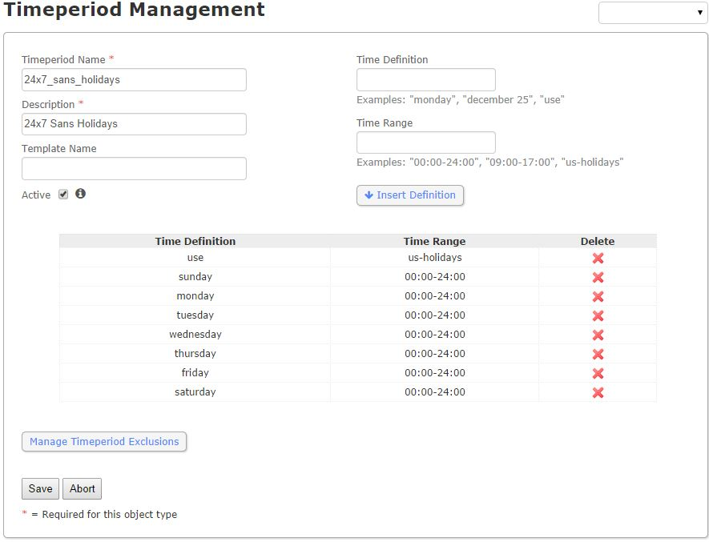
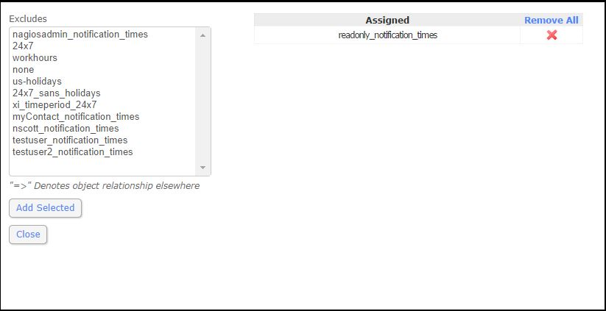
Exclusion Periods
Exclude hosts/services from notifying/checking during specific time period exclusion times.

Slide 31
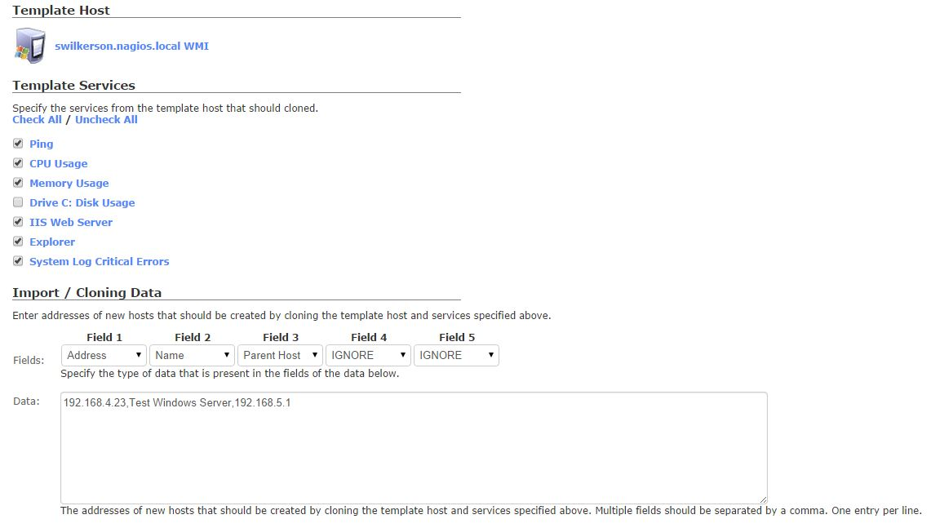
Bulk Host Clone
Clone hosts to new addresses, and names, move their services over as well.

Slide 32
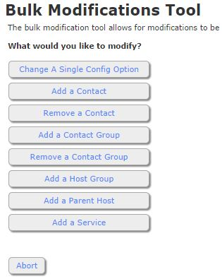
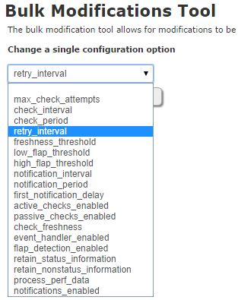
Bulk Modifications Tool
Bulk modify configuration information for multiple hosts/services at the same time.

Slide 33
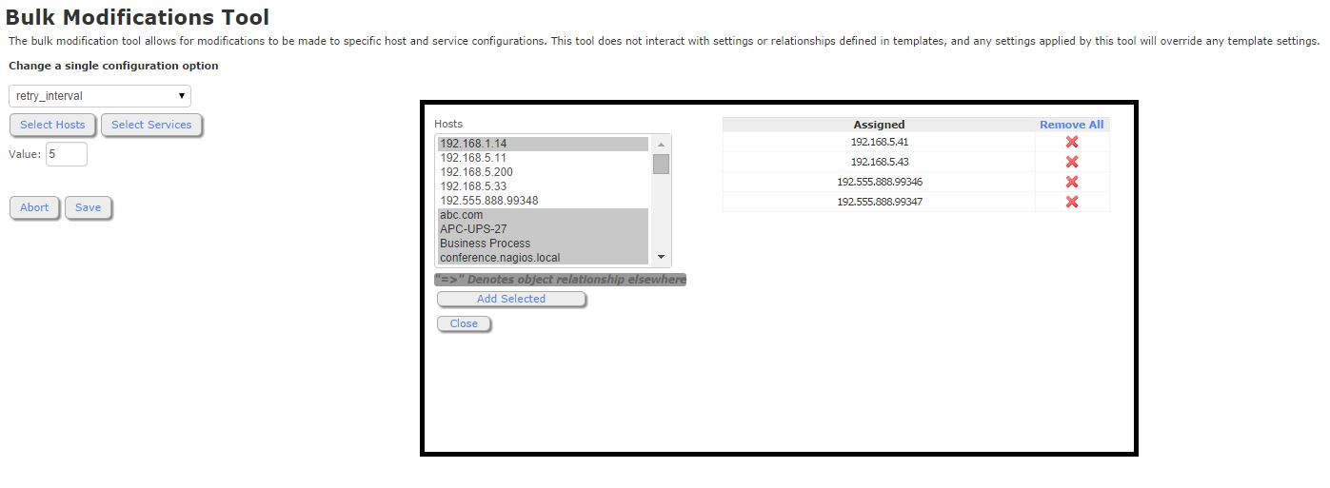
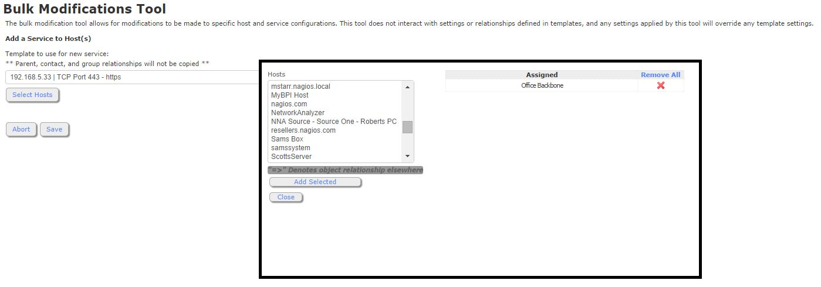
Bulk Modifications Tool

Slide 34
Config Importing
Easy way to migrate over from Core, or try XI out with your current Core Configuration setup.
Prep script alters configuration files, so make sure to back-up!
Alternative is static configuration files

Slide 35
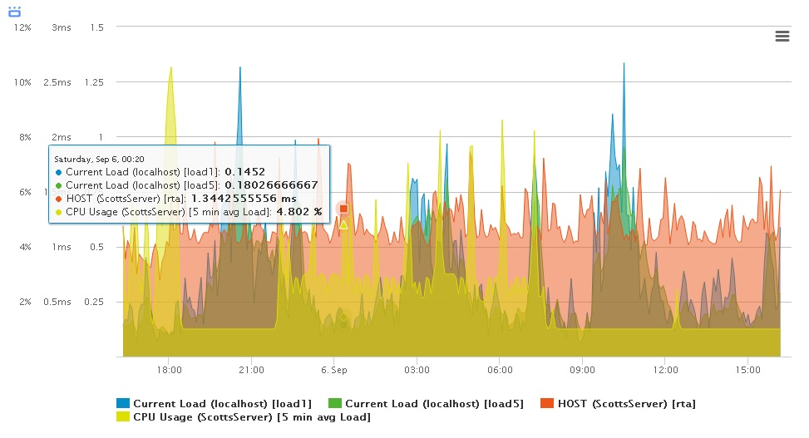
Multi-Stacked Performance Graphs
Monitor/stack multiple metrics from different hosts together against eachother, (bandwidth, drive usage, printer toner level).

Slide 36
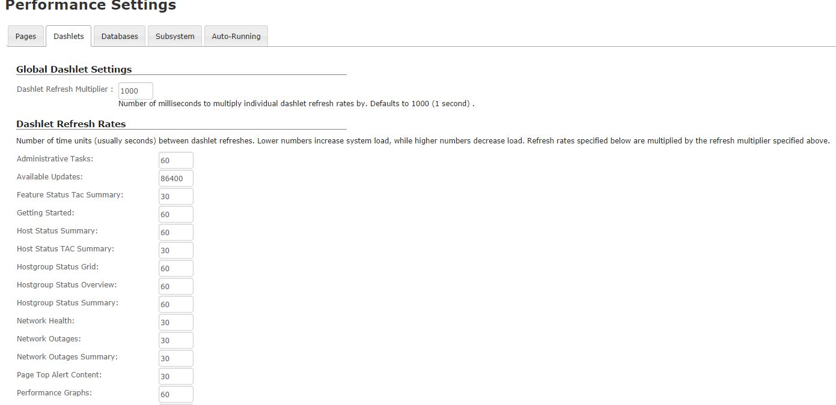
Performance Settings/Tuning
Tweak DB queires, refresh rates, ajax calls, and subsystem options for enhanced performance, or reporting.

Slide 37
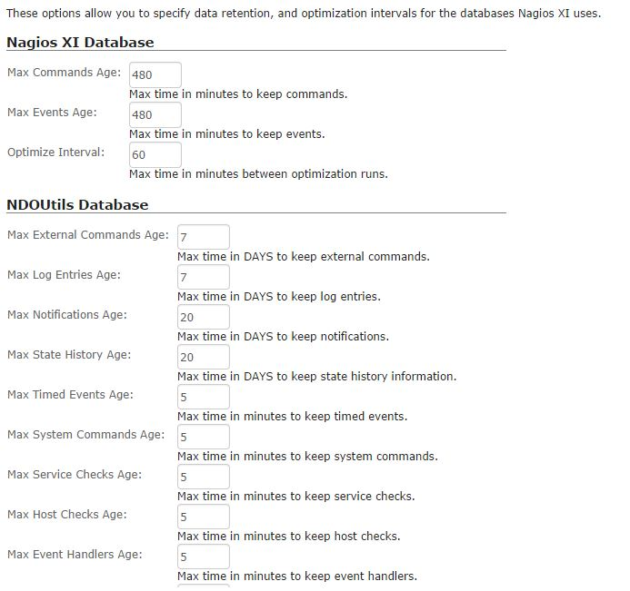
Performance Settings/Tuning

Slide 38
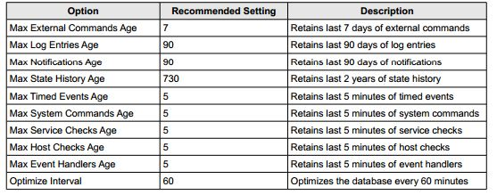
Performance Settings/Tuning
Guide to DB / Performance Tuning
http://assets.nagios.com/downloads/nagiosxi/docs/Nagios-XI-Database-Optimization.pdf
The most important settings that can affect the overall performance of your Nagios XI server relate to the NDOUtils database. This is the main database that is used to store current and historical monitoring information.Recommended values for various NDOUtils database settings are provided in the table below.

Slide 39
Business Process Intelligence
Break the chain between Host/Service/Group objects. Display and alert for your systems as they are actually set up in the real world.

Slide 40
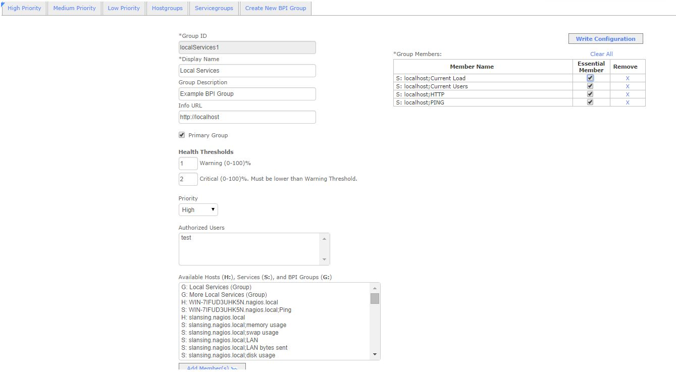
Business Process Intelligence

Slide 41
Business Process Intelligence

Slide 42
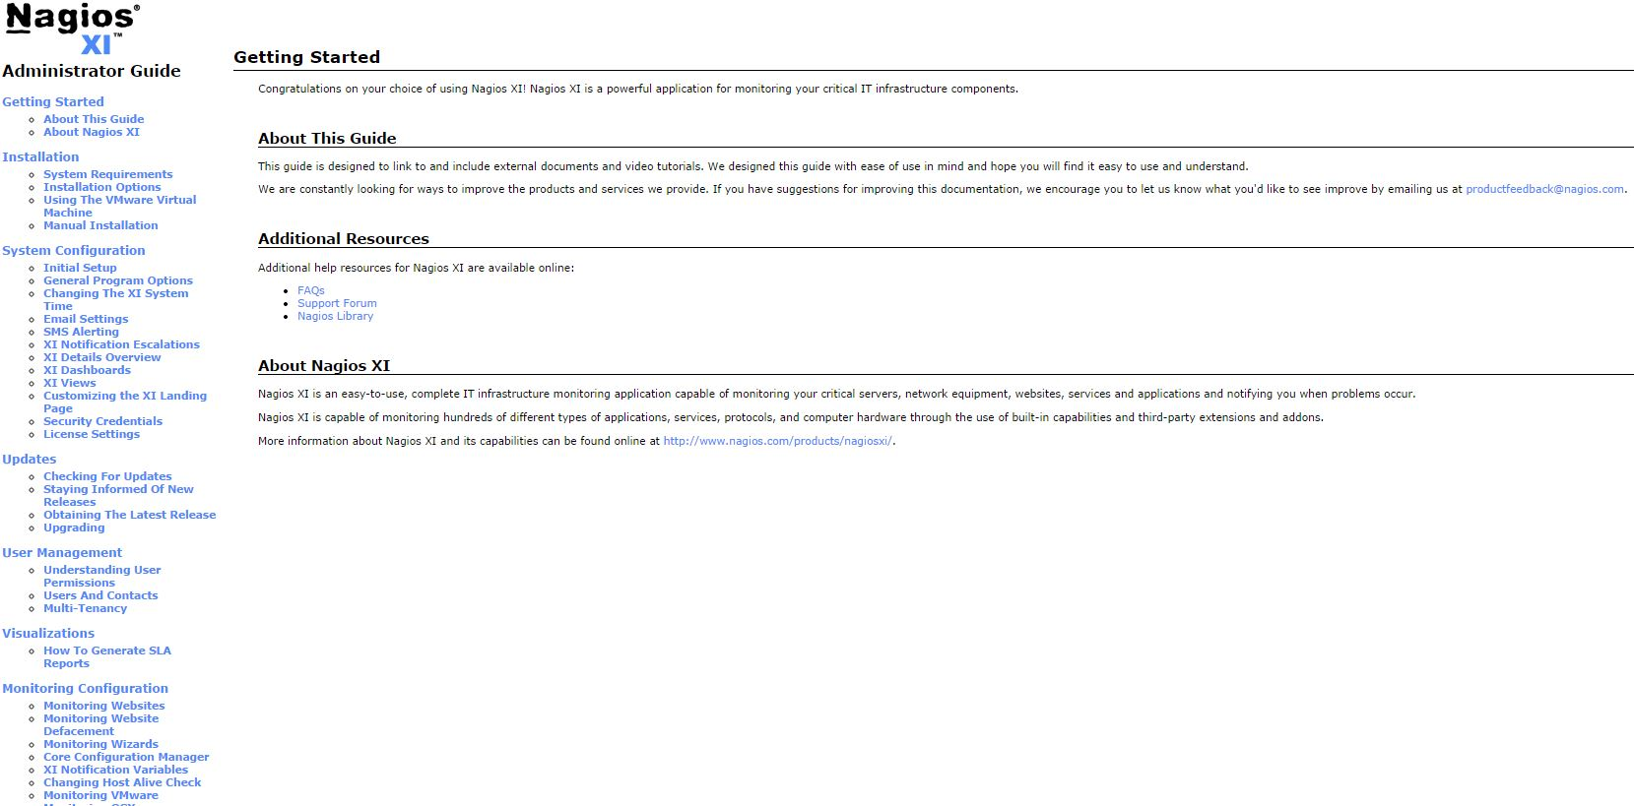
Admin & Advanced XI Guide
Highly suggested, shows examples and setups for many of the features shown today.

Slide 43
Questions
Any questions?

